Slide 1
Facilitated team feedback session
https://ilikeiwish.org

Slide 2
What?
Team feedback activity where all participants get to provide and receive both positive and constructive individual-level and team-level feedback.
https://ilikeiwish.org

Slide 3
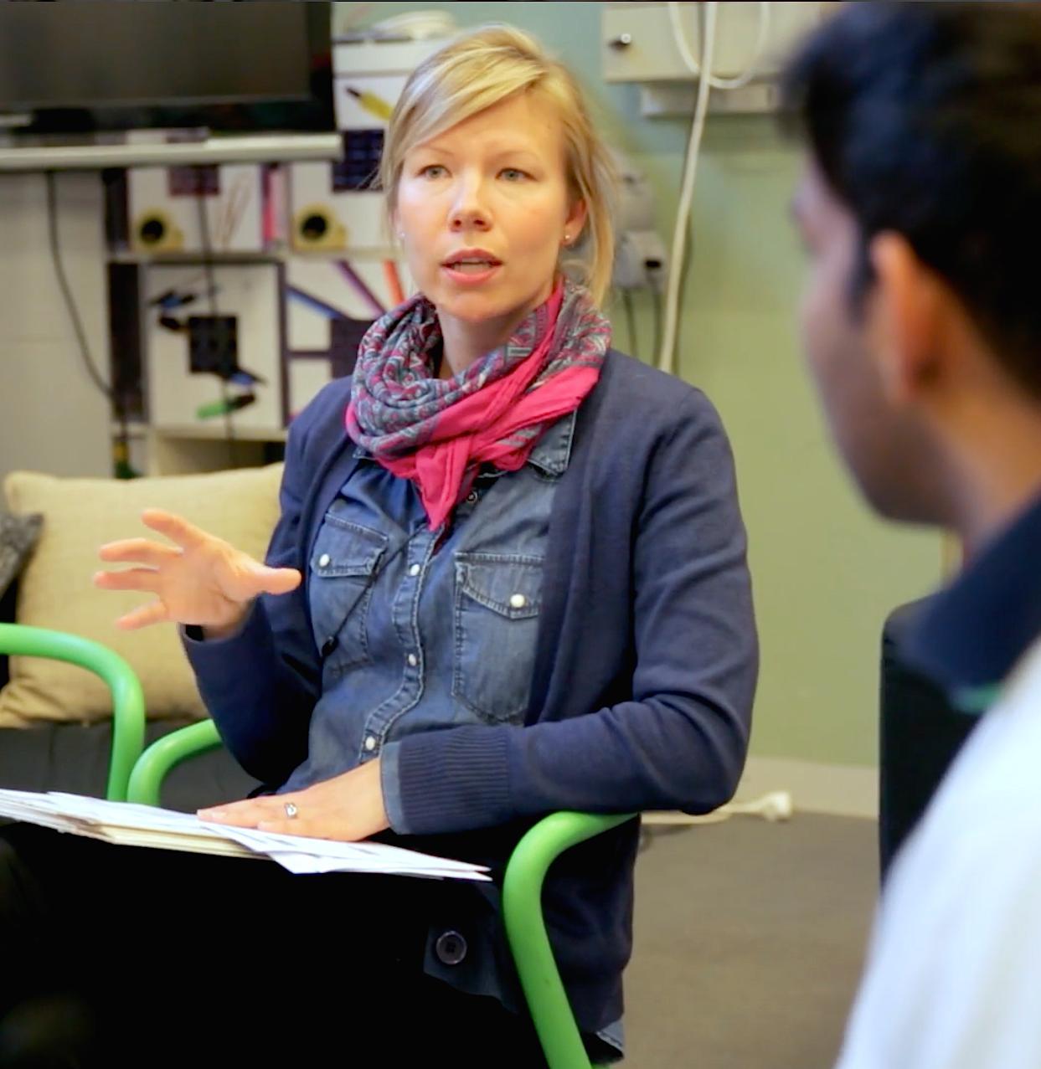
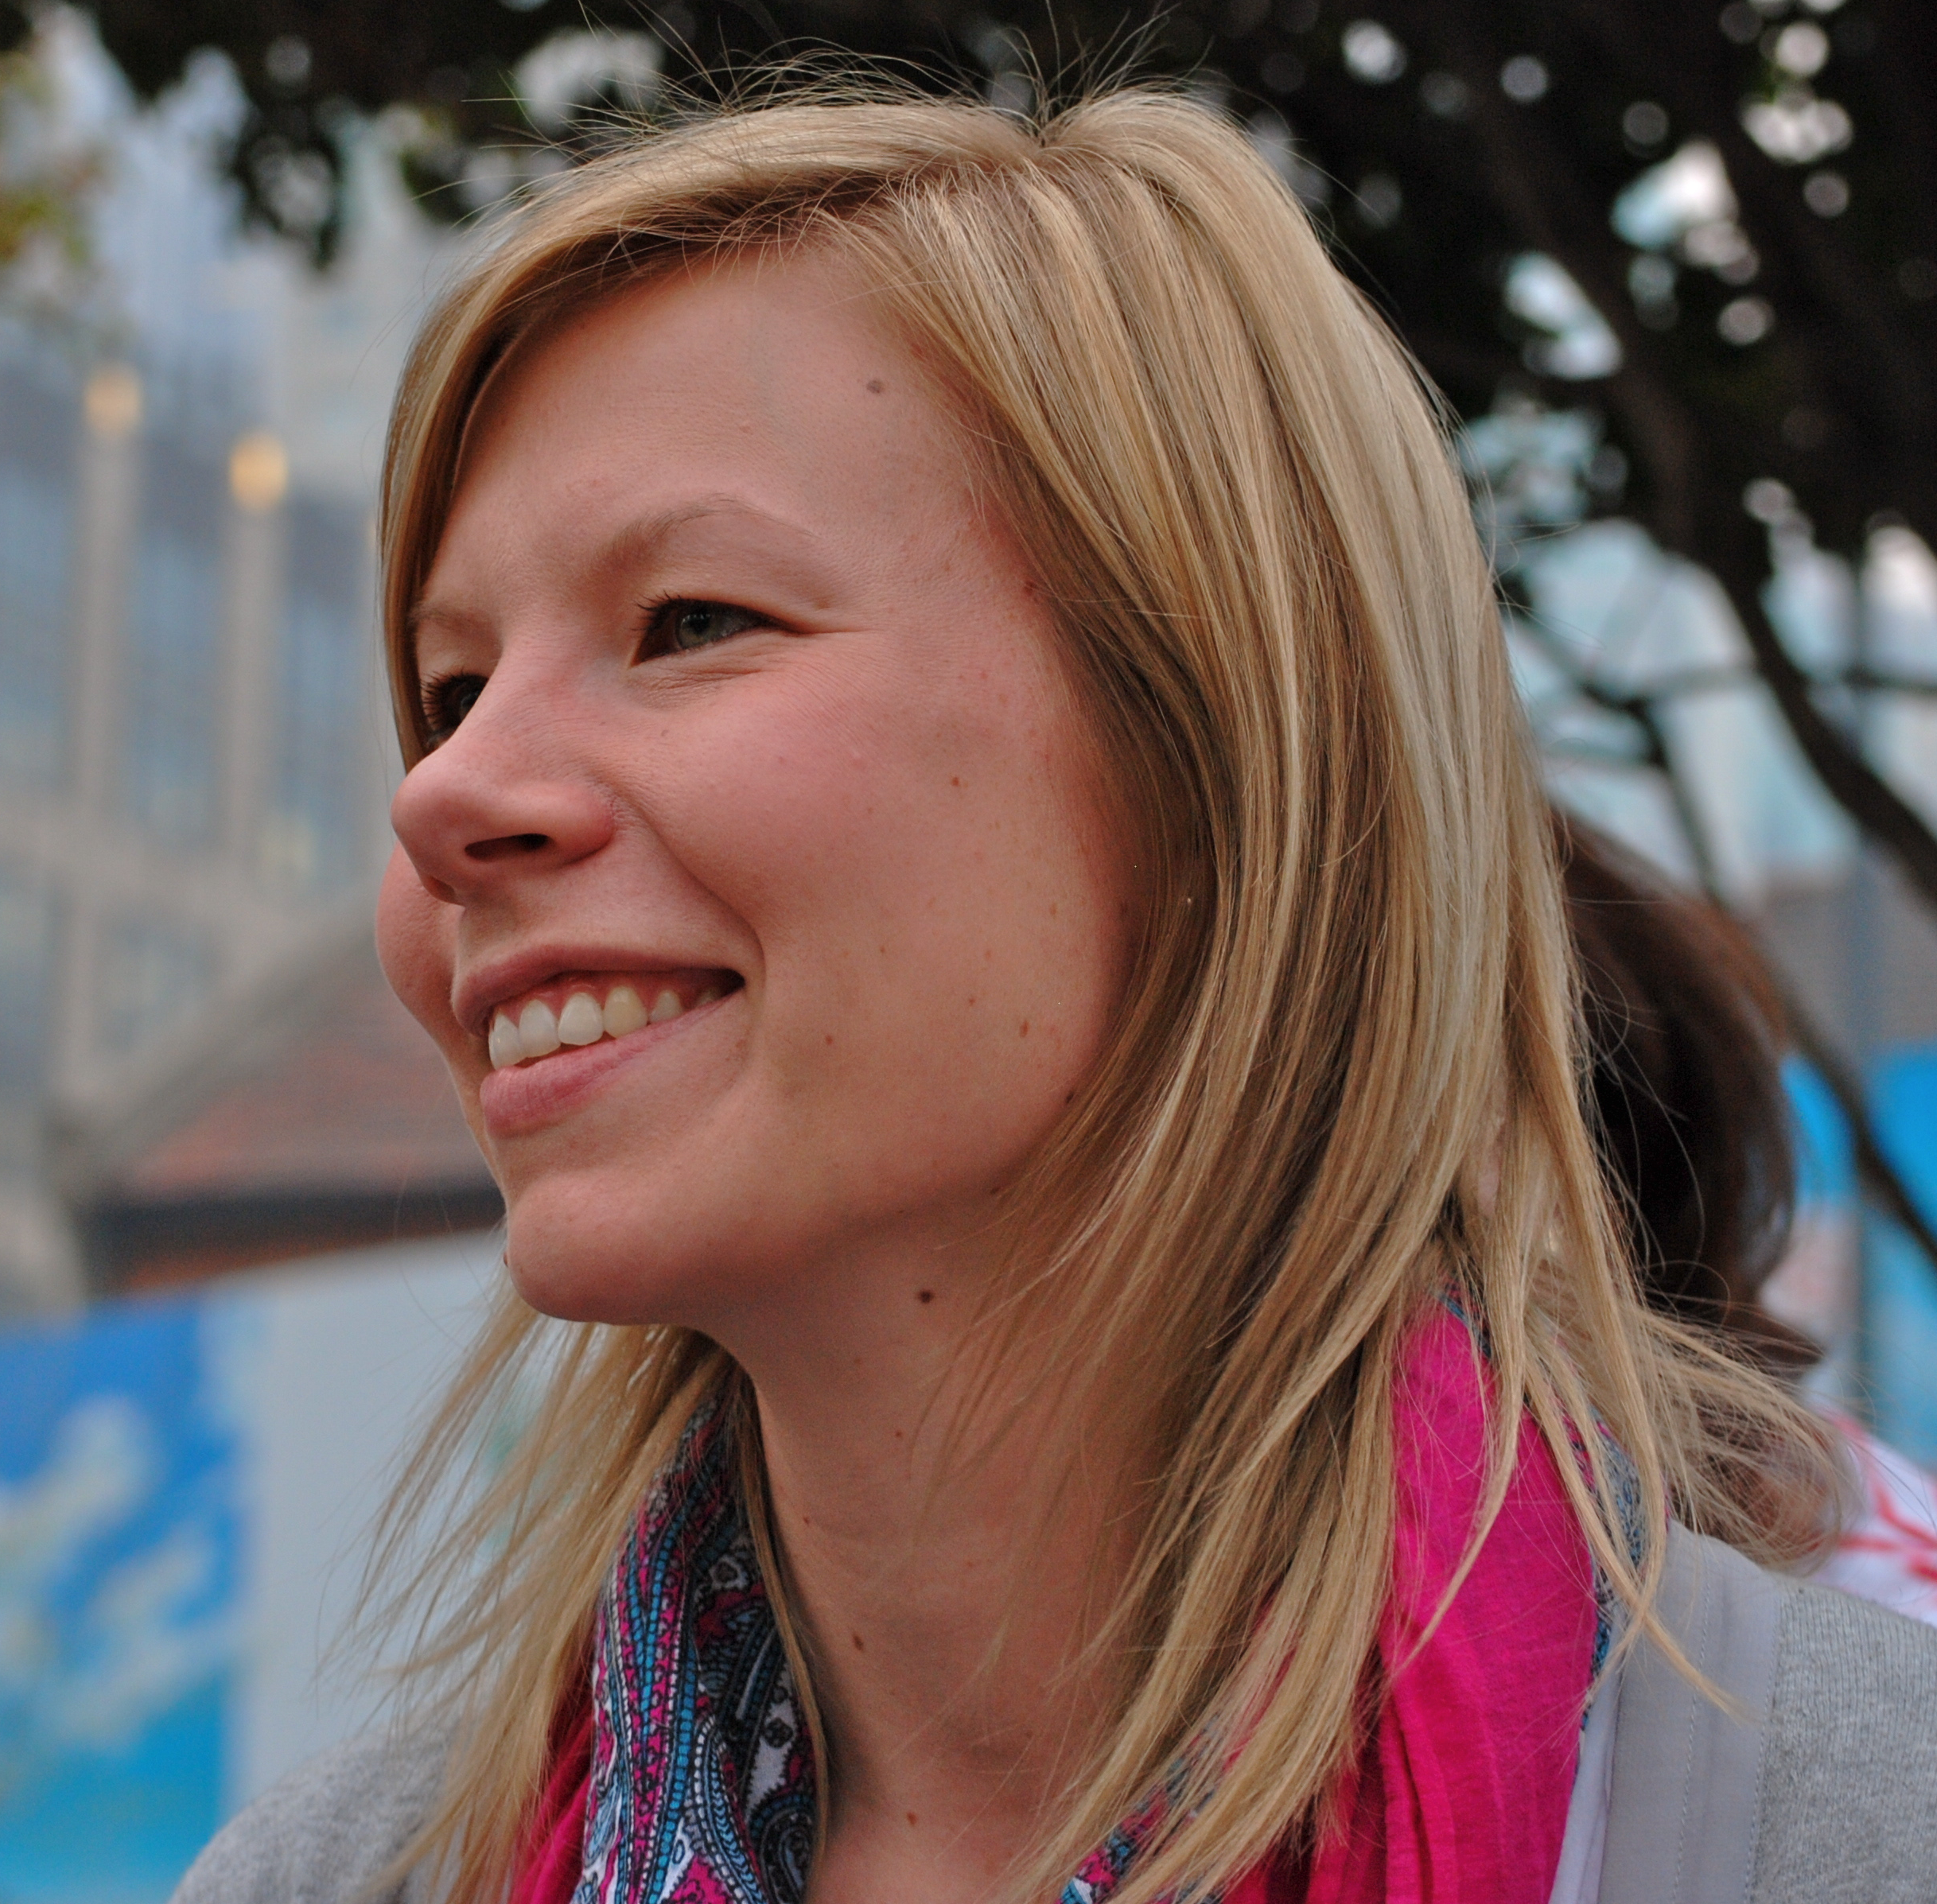

Background
The method was developed by researcher Satu Rekonen. She got the original inspiration from the d.school at Stanford University and from the student interviews collected for her PhD at the Aalto University Design Factory.
https://ilikeiwish.org

Slide 4
Why?
The level of participation in a team depends on how freely people can and are willing to share their unique information and point of views. Strengthening and constructive feedback supports open and appreciative interaction.
Without feedback behaviors may start to build on assumptions, which may be unproductive to both the team and its members.
Although recognized as important, putting aside some time and effort to systematically provide feedback among the team is easily neglected.
https://ilikeiwish.org

Slide 5
How?
Part I: Writing
Part II: Sharing
Part III: Reflection
https://ilikeiwish.org

Slide 6
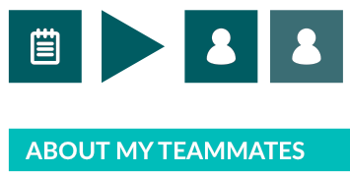

Part I: Writing
Two types of forms
https://ilikeiwish.org

Slide 7


Part I: Writing
The potential seen in a team member / team that has not yet been fully utilized.
The strengths seen in a team member / team.
“I like that you listen to everyone's point of views so carefully and take into account how others are feeling.”
“I like how enthusiastic you feel about our project.”
”I like how organized you are in your working.”
“I wish that you would share your own ideas more courageously, I’m sure we would benefit from them.”
“I wish you would bring out your own expertise more and that you would take more responsibility of the project.”
“I wish that you would build more on others’ point of views and would be interested in the diverse perspectives we have in the team.”
https://ilikeiwish.org

Slide 8

Part I: Writing
What do you see as your own strengths in the project and as a team member?
What are your potentials that have been left unutilized so far?
What are the things you recognize that you could pay more attention to?
https://ilikeiwish.org
Notes:
If time

Slide 9
Part II: Sharing
Start with the individual-level “I like” –round. Everyone’s likes for one person will be shared at a time.
After each “I like” –round, give the person who received the positive feedback an opportunity for an “I feel” moment: if desired, s/he can comment on and share his/her thoughts about the feedback received and compare it with the strengths s/he recognized in her/himself (form: notes about me).
Continue the same way with the individual-level wishes
Move on to team-level feedback but now share the wishes first and after that the likes
https://ilikeiwish.org

Slide 10
Part III: Reflection
Choose one thing from the constructive feedback (wish) received from the team members as the main target for development.
Choose one thing from the wishes shared for the whole team that you will try to affect and make an improvement to.
Reflect on the session. How did it feel? What kind of ideas and thoughts did it bring up?
https://ilikeiwish.org

Slide 11
Steps
Writing the feedback
Likes round 1 (individual –level)
Wishes round 1 (individual –level)
Wishes round 2 (team –level)
Likes round 2 (team –level)
Reflection: promises and feelings
https://ilikeiwish.org

