Slide 1
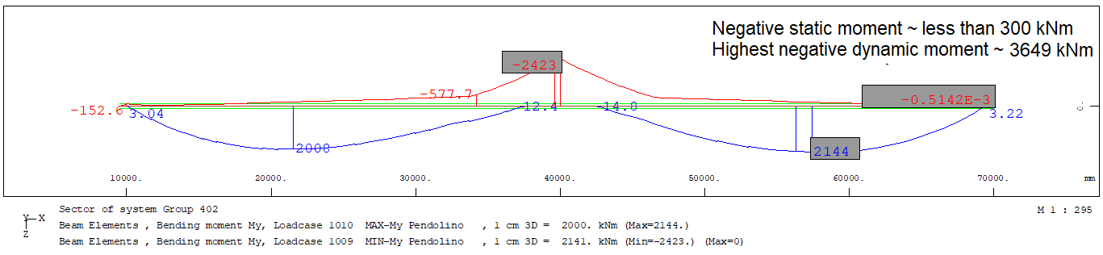
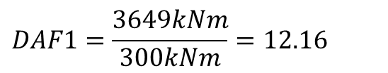
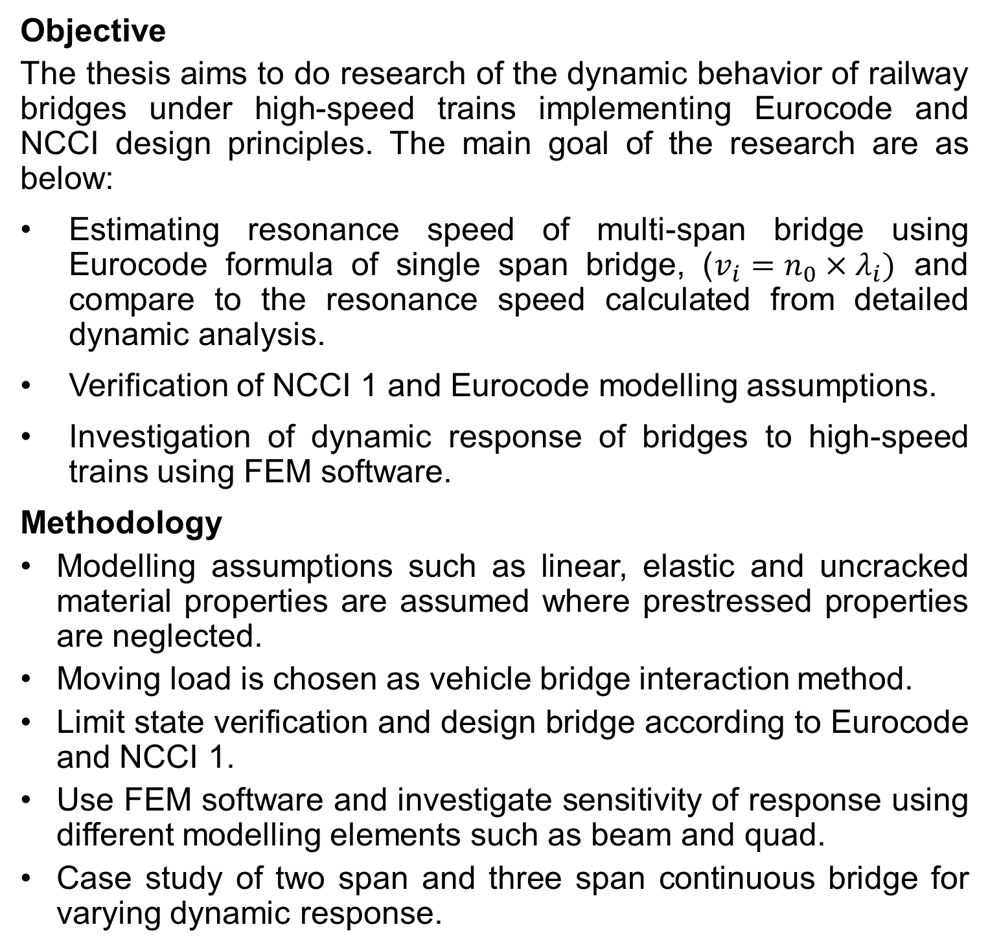
Master's Programme in Building Technology
Dynamic analysis of high-speed railway bridge
Student: Saroj, Adhikari
Supervisor: Jarkko, Niiranen, Civil Engineering
Advisor: Ristomatti, Helin, Sitowise Oy
Objective
The thesis aims to do research of the dynamic behavior of railway bridges under high-speed trains implementing Eurocode and NCCI design principles. The main goal of the research are as below:
Estimating resonance speed of multi-span bridge using Eurocode formula of single span bridge, ($v_{i}=n_{0}×λ_{i})$ and compare to the resonance speed calculated from detailed dynamic analysis.
Verification of NCCI 1 and Eurocode modelling assumptions.
Investigation of dynamic response of bridges to high-speed trains using FEM software.
Methodology
Modelling assumptions such as linear, elastic and uncracked material properties are assumed where prestressed properties are neglected.
Moving load is chosen as vehicle bridge interaction method.
Limit state verification and design bridge according to Eurocode and NCCI 1.
Use FEM software and investigate sensitivity of response using different modelling elements such as beam and quad.
Case study of two span and three span continuous bridge for varying dynamic response.
Summary of findings
The key findings of the research are:
The beam model (A) is reliable and computationally efficient method of bridge modelling with higher acceleration response.
Modelling assumptions according to NCCI yields higher values of dynamic response.
Cantilever beams in bridge oscillates with higher frequencies and results to higher acceleration even though other dynamic responses are close to zero.
All high-speed trains results resonance but, the amplitude of the acceleration can be within the maximum limit.
Realistic damping coefficient shall be used.
Lighter bridge are more susceptible to resonance.
The traditional use of static results of LM71-35 & SW/0-35 are still higher than other dynamic load train results.
The dynamic amplification factor (DAF) of negative bending moment for two-span and three span bridge is very high.
Eurocode formula approximates the resonance speed of a bridge using natural frequency but is not sufficient to explain the complete dynamic response. For instance, limit state verification can not be done.
A – Beam girders with flanges and intermediate slab
B – Beam girders without flange and quad as flanges
C – Quad model
Figure 1. Dynamic response for three different models, where model A results higher value of acceleration.
Figure 2. Resonance effect due to high-speed trains in a two-span continuous bridge and acceleration below limit of 3.5 m/s2 for the design speed of 100 m/s for lower bound estimation.
Table 1. Resonance speed for two-span continuous bridge.
Resonance speed for two span continuous bridge (m/s)
Train models | Lower bound mass |  | Upper bound mass
 | Dynamic analysis | Eurocode formula | Dynamic analysis | Eurocode formula
Pendolino | 85 | 88 | 80 | 82
HSLM-A1 | 60, 91 | 61, 91 | 56, 85 | 57, 86
HSLM-A2 | 63, 94 | 65, 97 | 59, 88 | 60, 90
HSLM-A3 | 99 | 68 | 93 | 64, 95
HSLM-A4 | 71, 103 | 71 | 66, 97 | 67, 100
HSLM-A5 | 74 | 75 | 69 | 70
HSLM-A6 | 77 | 78 | 72 | 73
HSLM-A7 | 80 | 82 | 75 | 76
HSLM-A8 | 83 | 85 | 78 | 80
HSLM-A9 | 86 | 88 | 80 | 83
HSLM-A10 | 89 | 92 | 83 | 86
$$DAF1=\frac{3649kNm}{300kNm}=12.16$$
Figure 3. DAF of negative bending moment at mid-span for two-span and three-span bridge for load model Pendolino.

