Slide 1
Welcome to Aalto University

Slide 2
Why did I choose Aalto
PUT YOUR PHOTO AND INFORMATION HERE
Who am I and what am I studying?
How did I end up choosing Aalto and the programme and field I am now in?
What is it like to study at Aalto?
What are my plans for the future?
Name
Programme/major
School
Notes:
Presenter:
Talk about your experiences here:
how and why you chose Aalto University.
Talk about your studies at Aalto
your future plans
Think about your answers to the below questions beforehand and use this list of questions as a guideline when you reply. You can pick the most relevant topics, you don’t have to go through all the questions.
What field interested you? What was your favourite subject in high school?
How did you hear about Aalto?
What made you choose Aalto? Why was Aalto the right choice for you?
How did you apply to Aalto University? (certificate-based admission, entrance examination, preparing for entrance examination/advance assignments)
Where are you from? How have you integrated into the Aalto student community?
What is the best part about studying? What have been the highlights for you personally so far? What do you still want to achieve in your studies?
Do you work alongside studies?
What are your plans for the future?
Is there anything else you would like to share about studying at Aalto?

Slide 3
My timetable at Aalto
Monday | Tuesday | Wednesday | Thursday | Friday
20E00220 Corporate Responsibility, Lecture from 9 am to 11 am | Guest lecture from 9 am to 11:30 am | Lecture, new assignment | Project idea presentation at 10 | Exam from 9 am to 12 noon
Study for the exam |  | Work on the project assignment | PHYS-A3121 Thermodynamiikka, harjoitus
Meeting with AaltoES in Otaniemi at 14-16 | Lunch meeting | Group assignment | Critique | To library ->
 |  | Read for the exam | FSHS dentist
 | UniSport at 6 pm |  | UniSport at 6 pm
PUT YOUR OWN TIMETABLE HERE
Notes:
Presenter:
Empty this sample timetable and fill in your own timetable. You can fill in your calendar for this week or a typical study week. Include lectures, exercises, preparation time for examinations, student organisation activities, work (if any), gym classes, appointments with FSHS etc. Also mention the campus you are studying on (Otaniemi, Mikkeli) and the university spaces you are using (student hub, Learning Centre, library, group workspaces, cafeterias). The point is to give the audience a realistic idea of how students use time and show that studying and student life is about more than just attending lectures.
Talk about your experiences here:
What are you studying? (What study modules have you already completed and what are you going to complete?)
How are you studying: does your everyday involve lectures, exercises, exams, etc.?
What types of projects have you been involved in?
When discussing the timetable in the field of arts, you should mention:
very few exams, more practical work, projects evaluated through critiques
Most courses require class attendance.
Especially during bachelor's degree studies, it is typical to have an entire day (from 9 to 5 pm) of classes for the same course.

Slide 4
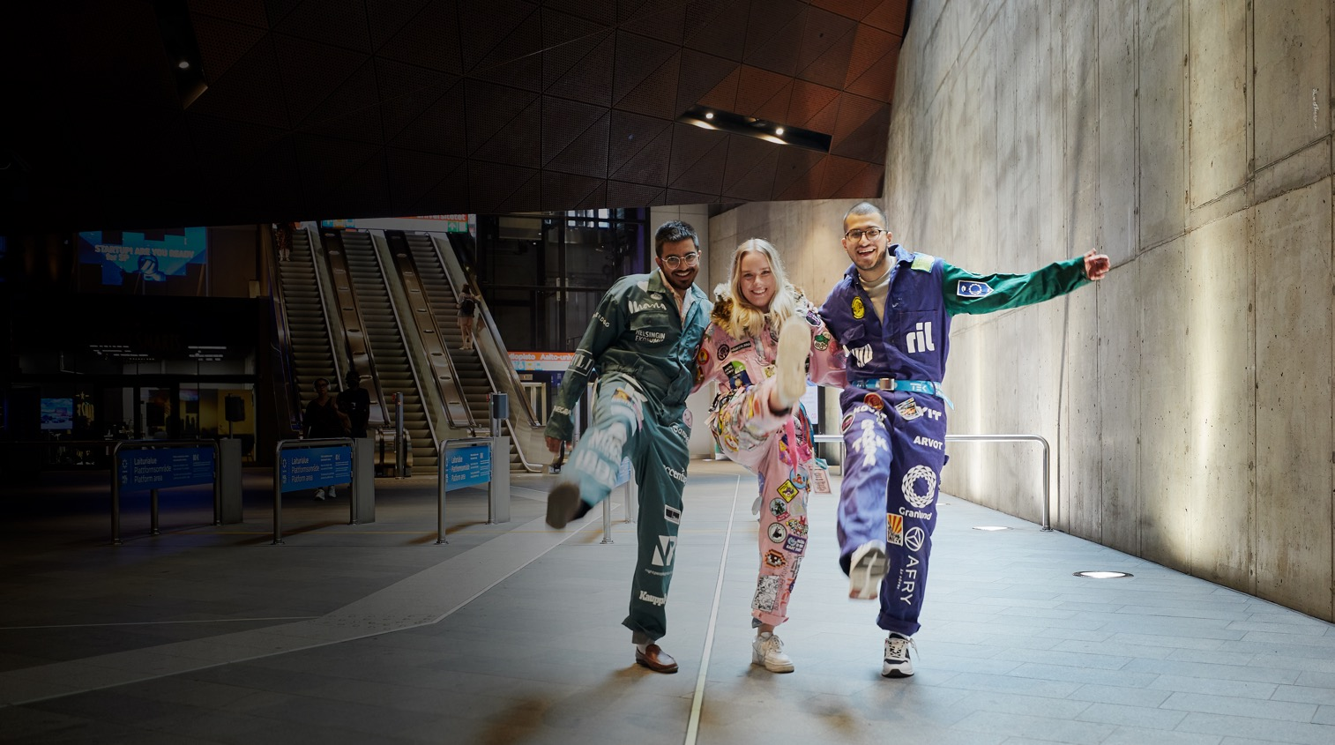
At Aalto University, science and art meet technology and business.
School of Arts, Design and Architecture
School of Business
School of Chemical Engineering
School of Electrical Engineering
School of Engineering
School of Science
Notes:
Aalto University is a community of bold thinkers; it is where technology and business meet art and design. We aim to be one of the top universities in the world.
Aalto’s three fields of education are art and design, business and economics, and science, technology and engineering.
Six schools: School of Arts, Design and Architecture, School of Business, and four schools of technology: School of Chemical Engineering, School of Electrical Engineering, School of Engineering and School of Science.
Most of the teaching is given on the Otaniemi campus (apart from the English-medium Bachelor’s Programme in International Business, which is located in Mikkeli).

Slide 5
Business and economics

Slide 6
School of Business
We are the most prestigious business school in Finland.​
You can study management, marketing, finance, economics, and business law, among other things, and if you want, also incorporate studies of technology, and art and design into your degree.​
We value high-quality teaching and research and want to advance sustainable business.​
Our degrees open up a wide variety of opportunities for developing society from a business perspective. ​
We offer an inspiring student community where everyone is taken into consideration.​
Follow us on Instagram to see what’s going on in our student life: @aaltobiz
Notes:
Our social media channels offer interesting contents and inspiring stories about studying, student life and alumni.​
You can follow student life especially on the BIZ Instagram account, which is often features takeovers by students of different programmes who post about the current affairs of the school.
https://www.instagram.com/aaltobiz/ https://www.facebook.com/aaltobiz https://twitter.com/AaltoBIZ

Slide 7
Programme video
Notes:
For videos of the various Aalto University Bachelor’s programmes, go to https://www.youtube.com/playlist?list=PLJJ2tnFVQ9wRGOoUVS7orIYQK9r1VUbgO

Slide 8
Studying business and economics is...
Built around a common core curriculum in the first year. After that, you get to focus on different specialisation areas and deepen your knowledge of the major of your choice.​
Independent and flexible. The courses consist of lectures, group work and in some cases, math exercise clinics and final exams. Everyone can study in their own way.​
Solution-oriented and international. The courses deal with and solve real-life global challenges of the corporate world and society. Nearly 160 exchange partner universities around the world give our students incredible opportunities for exchange studies.
Community-building. The strong team spirit and a sense of pulling together among our students is evident also in leisure time activities. The student association for the Aalto students of business, KY, advocates for students and organises a wide range of leisure activities.
Multidisciplinary. You can combine business, art, and technology in your degree to make it best meet your needs.
Expertise-building. Our students develop into valued experts, innovative entrepreneurs and responsible leaders of the future. A degree from the School of Business is a highly valued asset in the job market, and our graduates find employment in their field of study easily.

Slide 9
Bachelor’s programmes in business and economics
Kauppatieteiden kandidaattiohjelma taught in Finnish, which has the following majors:
Johtaminen
Laskentatoimi
Tieto- ja palvelujohtaminen
Markkinointi
Rahoitus
Taloustiede
Yritysjuridiikka
Bachelor’s programmes taught in English:
Economics
International Business, Mikkeli unit
Notes:
Major: Selected at the end of the first year

Slide 10
Art and design

Slide 11
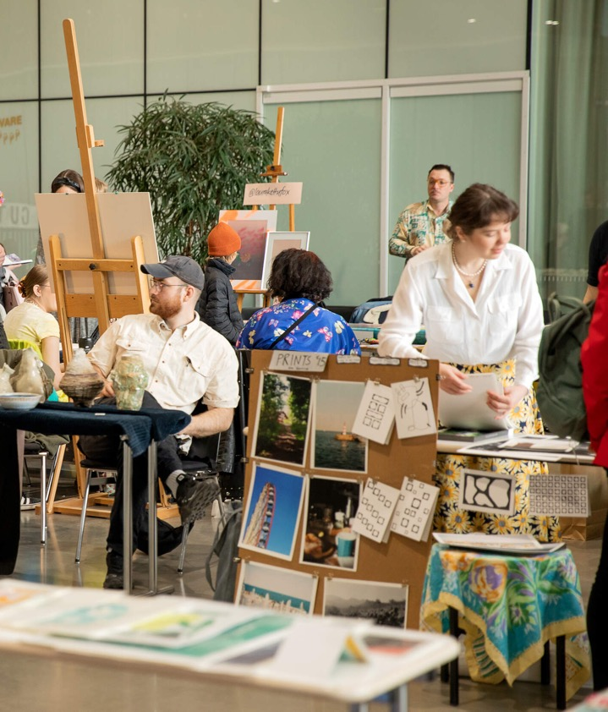
School of Arts, Design and Architecture
The leading school in design, fashion, games, digital media, architecture, film, art education, and art in Finland and in the Nordic countries.
The school was ranked sixth in the QS World University Rankings 2022 (in the field of art and design).
We train our students to be world citizens who create imaginative, collaborative and unusual approaches to the complex challenges of the world and provide solutions for sustainability.
We have cutting-edge workshop spaces and equipment.
See what’s going on in our student life by following our Instagram account: @aaltoarts
Notes:
96% of our graduates are employed or working as entrepreneurs five years after their graduation.*
* Percentage taken from the results of the career development survey conducted with Aarresaari among our 2016 graduates (2021).
Learn more about the student life and stories of arts students on our Instagram account @aaltoarts

Slide 12
Programme video
Replace this with the video of your programme on YouTube or remove this slide
Notes:
For videos of the various Aalto University Bachelor’s programmes, go to https://www.youtube.com/playlist?list=PLJJ2tnFVQ9wRGOoUVS7orIYQK9r1VUbgO

Slide 13
Studying art and design is...
Community-driven.
Small group sizes give room for team spirit, peer learning and receiving personal feedback. Instead of examinations, evaluation is done through critiques, which are shared feedback sessions.
Practice-oriented.
Projects are hands-on exercises and require class attendance. Work spaces vary from classrooms to workshops and studios.
Based on applied studies and methods.
During the studies, our students collaborate actively with actors and companies in the field.
Multidisciplinary.
You can combine business, art and technology into your degree to make it best meet your needs.

Slide 14
Bachelor’s programmes in art and design
Study options taught in Finnish:
Dokumentaarinen elokuva
Elokuva- ja tv-käsikirjoitus
Elokuva- ja tv-lavastus
Elokuva- ja tv-tuotanto
Elokuvaleikkaus
Elokuvaohjaus
Elokuvaus
Elokuvaäänitys ja -äänisuunnittelu
Kuvataidekasvatus
Muoti
Muotoilu
Pukusuunnittelu
Sisustusarkkitehtuuri
Visuaalisen viestinnän muotoilu
Bachelor’s programme taught in English :
Bachelor’s Programme in Design
Notes:
For the study options of Architecture and Landscape Architecture, applicants take part in the DIA joint admissions for engineering and architecture.

Slide 15
Science, technology and engineering

Slide 16
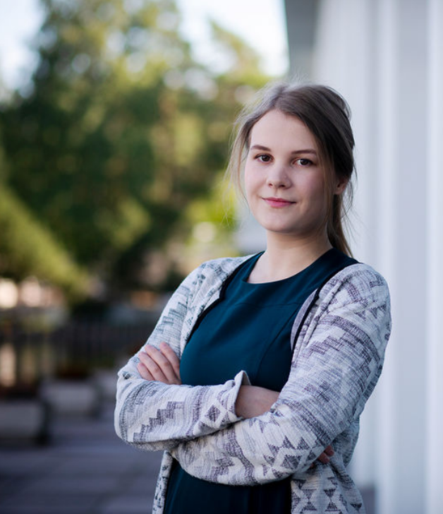
Field of technology
Do you want to help create a more sustainable future by developing solutions to the world’s greatest challenges? A common characteristic for those wishing to earn a Master of Science (Technology) is the will to make society better functioning, more ethical and sustainable.
Studying technology gives opportunities for a variety of jobs in the future. You can develop solutions to battle climate change, promote wellbeing through technology and design more sustainable cities, environments and devices.
Studies in technology gives you a broad-based knowledge in topical and emerging fields such as machine learning, robotics, industrial automation, wellbeing technology, bioproducts, environmental and energy technology as well as mobile technology.
Aalto University gives you the widest range of study options in technology in Finland.
Notes:
Employment in the field of technology
Students who graduate with a degree in technology from Aalto University have no difficulty finding a job in their field of study. Many students gain relevant work experience during their studies. The field of technology offers a wide spectrum of diverse job opportunities in industries that create solutions for the future. Our graduates work for instance as rocket scientists, acoustic designers, game developers, production engineers, product development engineers, development managers, sales managers, technology managers, environmental auditors, service designers and chief information security officers.
More information:
https://www.aalto.fi/en/study-at-aalto/get-a-degree-in-engineering-technology-or-science
https://www.aalto.fi/fi/opiskelu-aallossa/miksi-tekniikan-ala
https://www.aalto.fi/fi/opiskelu-aallossa/opiskele-tekniikkaa-aalto-yliopistossa

Slide 17
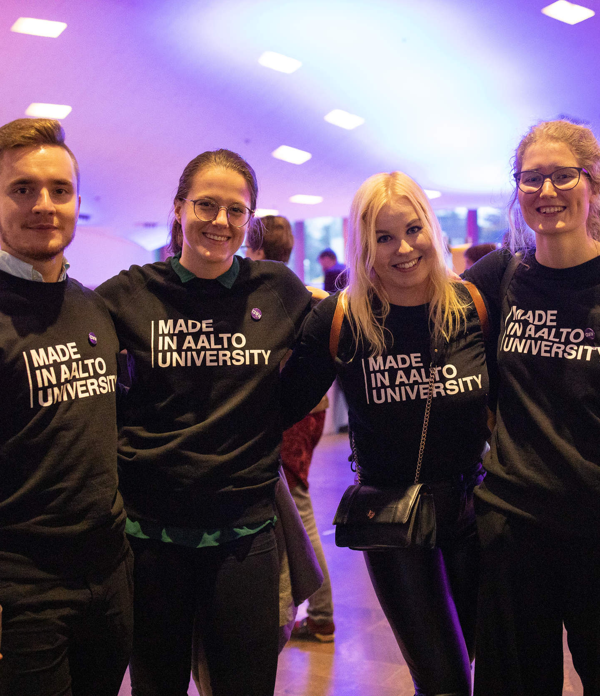
Schools of technology
School of Engineering Get to know the school’s student life and stories on Instagram: @aalto.eng
School of Chemical Engineering Get to know the school’s student life and stories on Instagram:@aaltochem
School of Science Get to know the stories of our students and alumni https://www.aalto.fi/en/study-at-aalto/get-to-know-the-school-of-science
School of Electrical Engineering Get to know the school’s student life and stories on Instagram:@aaltoelec
Notes:
Here you can talk more about your own school.

Slide 18
Schools of technology 1/2
School of Engineering
Sustainable future requires solutions in the fields of mechanical engineering, civil engineering and the built environment. Our MSc graduates find work in expert positions in many key sectors of society such as in arctic technology, sustainable built environments, mechanics and materials, multidisciplinary energy technologies and systems design and production.
School of Chemical Engineering
Chemical engineering plays a key role in solving global challenges, such as climate change, the adequacy of natural resources, new biomaterials, sustainable development or the promotion of circular economy. Our MSc graduates have versatile job profiles, ranging from the metal, electronics and wood industries to the chemical and pharmaceutical industries to biotechnology and the food industry.

Slide 19
Schools of technology 2/2
School of Science
We help create a better tomorrow by innovating new technology. Our courses focus on computer science and artificial intelligence, material physics, advanced energy solutions, health technology, industrial engineering and management, neuroscience and software engineering.
School of Electrical Engineering
As our student, you get to seek solutions to questions of sustainable development and wellbeing, among many other things. Our MSc graduates work with automation, software engineering, health technology, administration, space technology and energy solutions.
School of Arts, Design and Architecture (architecture)
We are the leading Nordic school in design, fashion, games, media, architecture, film, art education, and art. As an architect or landscape architect, you get to design and create sustainable environments for the future.
Notes:
The study options of architecture offered at the School of Arts, Design and Architecture are part of the field of technology at Aalto.

Slide 20
Programme video
Replace this with the video of your programme on Youtube or remove this slide
Notes:
For videos of the various Aalto University Bachelor’s programmes, go to https://www.youtube.com/playlist?list=PLJJ2tnFVQ9wRGOoUVS7orIYQK9r1VUbgO

Slide 21
Studying science, technology and engineering is...
Built around a common core curriculum in the first year.
After that, you get to focus on different specialisation areas and deepen your knowledge of the major of your choice.
Versatile in its teaching methods.
The methods used on the courses vary from independently studied lectures and math exercise clinics to more collaborative laboratory exercises and group work.
Expertise-building.
Our education gives you the tools to work in demanding expert and managerial duties in industry, research and as an entrepreneur.
Multidisciplinary.
You can combine business, art and technology into your degree to make it best meet your needs.

Slide 22
Bachelor’s programmes in science, technology and engineering
Study options taught in Finnish:
Automaatio ja robotiikka
Bioinformaatioteknologia
Elektroniikka ja sähkötekniikka
Energia- ja konetekniikka
Informaatioteknologia
Informaatioverkostot
Kemian tekniikka
Kestävät yhdyskunnat
Kiinteistötalous ja geoinformatiikka
Rakennustekniikka
Teknillinen fysiikka ja matematiikka
Teknillinen psykologia
Tietotekniikka
Tuotantotalous
Arkkitehtuuri
Maisema-arkkitehtuuri
Study options taught in English:
Chemical Engineering
Computational Engineering
Data Science
Digital Systems and Design
Quantum Technology

Slide 23
Studying at Aalto

Slide 24
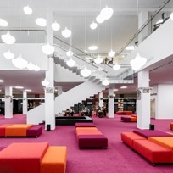
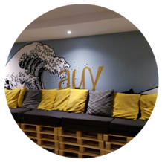
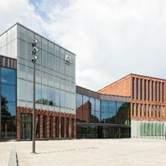
Aalto campus
Three fields of study on the same campus
Our multidisciplinary student community gives you a chance to meet people from different fields and educational backgrounds.
Learning spaces
The campus has an airy library, student hubs for independent work, laboratories, studios and workshops.
Student union spaces for students
Affordable student housing, guild rooms, formal venues, sports facilities, saunas and much more!
Good services
A shopping centre, restaurants, cafés, gyms, a shop for office supplies, grocery shops, a metro station and extensive bus connections. A tram line on the way in 2024!
A combination of city life and nature
Our green campus is located right next to a nature preserve. The vibrant campus and its fast connections to the Helsinki city centre give you an opportunity to enjoy fast-paced city life, too.
Notes:
Campus Teaching takes place mostly in Otaniemi, where the School of Arts, Design and Architecture and the School of Business have new buildings. One programme is taught in Mikkeli.
The Aalto community: The greatest asset of Aalto are its people. Studying here gives you valuable contacts and networks.
Infrastructure: The Aalto University infrastructure gives you great conditions for cutting-edge research and learning.

Slide 25
International opportunities
Exchange studies
Exchange studies are a great way to gain international experience and improve your language skills.
Exchange studies last for 3–6 months. The studies you complete during the exchange will count towards your Aalto degree.
We have ca. 130 partner universities around the world, in, e.g. Australia, Brazil, Canada, Chile, France, Germany, Hongkong, Italy, Ireland, Japan, Mexico, Singapore, Switzerland and the USA.
International double degrees
There are several master’s programmes organised in collaboration with international partners, which allow you to earn a degree from both Aalto and another European top university.
International work placements and projects
Notes:
Internationality: Aalto University is very international. It has a large network of international partners, and it collaborates with more than 400 universities. Aalto offers you a variety of international opportunities, which can take the form of a student exchange or work placement, as well as project work. In 2014, MIT placed Aalto University among the five rising stars in its ranking that included 200 universities around the world.
Exchange studies: Here you can talk about your own experiences:
Have you been on or are you considering going on a student exchange? Where were you placed as an exchange student and what was exchange study like?
Double degrees:
In double degree programmes, you study the first year in one university and the second year in another.
This means you get two degree certificates in one package for the equivalent work of a single degree, as well as international experience and possibly extra financial support.

Slide 26
Career opportunities
Bright career prospects
An Aalto degree gives you the best possible conditions to find work that fits your skills and allows you to create products, services and innovations for the future.
You have a chance to make great changes in society and solve global challenges.
Collaboration with industry
You get to be a part of interesting hands-on projects that involve representatives from the business world. Summer jobs, work placements, industry visits and thesis projects are a good way to build networks.
Aalto community
During your student years, you make contacts and form networks that will help you along in your career long after your graduation.
Start-up culture
You get to be a part of real student-led start up activities. Around 70 to 100 companies are established at Aalto University each year.
Recruitment events and career services
Aalto Talent Expo and Summer Job Day bring together the students and employers in the fields of business, art and design, and technology each year.
The Career Design Lab offers services and tools for your career needs both during your studies and after them.
Notes:
Here you can talk about your own experiences and plans for the future:
What are your plans for the future? What would you like to do after your time at Aalto?
What kind of job would you like to have? What type of career would you like to have?
Do you want to work in Finland or maybe elsewhere?
How does studying at Aalto help you in achieving these goals? (studies, networks, multidisciplinarity)
Aalto University graduates have a very high employment rate: 95–99% are employed within five years of their graduation.*
* Percentage taken from the results of the career development survey conducted with Aarresaari among our 2016 graduates (2021).
For more information on employment rates per school see:
- https://www.aalto.fi/en/school-of-business/school-of-business-graduates-in-working-life
- https://www.aalto.fi/en/school-of-arts-design-and-architecture/school-of-arts-design-and-architecture-graduates-in-working-life
- https://www.aalto.fi/en/school-of-science/school-of-science-graduates-in-working-life
- https://www.aalto.fi/en/school-of-chemical-engineering/aalto-chem-graduates-in-working-life
- https://www.aalto.fi/en/school-of-electrical-engineering/school-of-electrical-engineering-graduates-in-working-life
- https://www.aalto.fi/en/school-of-engineering/school-of-engineering-graduates-in-working-life
Work placements:
Work experience gathered in Finland or abroad is a key part of your studies.
Work experience improves your chances of finding employment after graduation.
The majority of programmes offer you a chance to incorporate a work placement (practical training, internship) into the degree.
Aalto supports work placements both with financial aid and grants.
Start-up culture:
Aalto is the origin of, for instance Startup Sauna, Aalto Entrepreneur Society (AaltoES), as well as the internationally recognised events Slush and Summer of Startups.
Aalto University career services (Career Design Lab)
Career services helps students in gaining skills for working life, offers channels for job searching and organises job fairs.

Slide 27
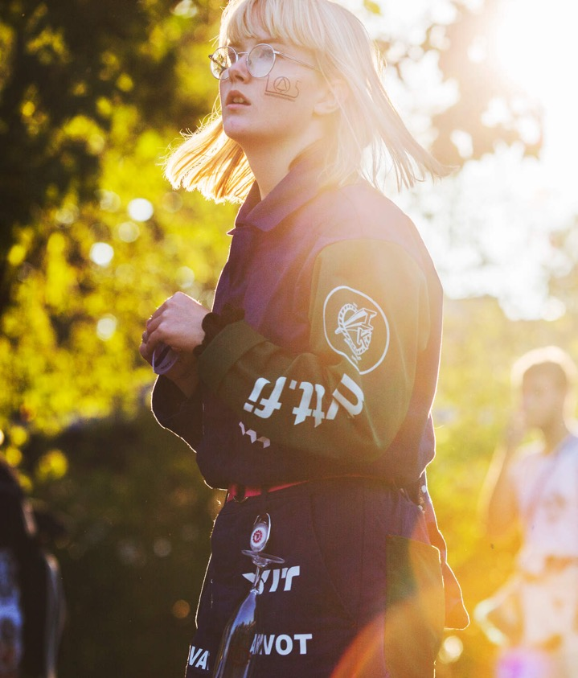
Student life
Aalto University Student Union AYY
Offers, e.g. student advocacy services, events, student housing for its members, and the right to use the Finnish Student Health Service (FSHS) and UniSport services.
More than 200 student associations
Get involved in the various student associations of AYY and you’ll have an event for every day of the year! For more information see: https://www.ayy.fi/en
Hobbies and activities for everyone
Sports, music, theatre, dance, food, games.
Opportunities for networking and developing skills for the world of work
Positions of responsibility in associations and visits to companies
Events and parties for students
Notes:
AYY represents about 14 000 Aalto students of arts, business and technology.
Student organisations by field of study: KY = Aalto University Business Students TOKYO, Students of Art, Design and Architecture in Aalto University, and the Teekkari Section.
Subject associations and guilds by major: there is a subject association for each major. Through the association, you get to meet others studying the same major also in your leisure time.
Services and discounts for students:
Student advocacy: The Aalto University student union AYY advocates for student rights in matters related to education and student life (wellbeing, health, housing, and sports).
Housing: AYY has about 2 500 apartments that are rented out to the members of the student union at affordable prices. Most of them are located in Otaniemi. Read more: https://www.aalto.fi/en/services/housing-for-students
Health care: The Finnish Student Health Service (FSHS) offers general health, mental health, and oral health services to university students. One of their service points is in Otaniemi.
Sports services: UniSport has sports centres on six campuses in Espoo and Helsinki. One of them is in Otaniemi. It offers a wide range of sports as well as facilities for many types of individual and group sports. If you like to do sports, it pays to purchase the UniSport training card, which is very affordable for students. Read more: https://www.unisport.fi/en
Student discounts: You get discounts at cafeterias, in public transport, gyms, shops, museums and much more.
Here you can share your experiences of student organisations and student life outside lectures.
What activities have you been involved in? (student union/student associations/guilds)
What have been the highlights for you?
How does involvement in student organisations support your social life?
How does involvement in student organisations benefit you professionally: have you gained related work experience or taken part in a company visit?

Slide 28
Applying to Aalto

Slide 29
Studies towards bachelor’s and master’s degrees
Bachelor’s degree
Bachelor of Science (Technology), Bachelor of Science (Economics and Business Administration) or Bachelor of Arts (Art and Design)
Bachelor’s degree, 180 ECTS (3 years)
Aalto University offers about 40 different bachelor’s-level study options. (https://www.aalto.fi/en/admission-services/applying-to-bachelors-programmes)
Master’s degree
Master of Science (Architecture), Master of Science (Technology), Master of Science (Economics and Business Administration), Master of Science (Landscape Architecture), Master of Arts (Art and Design)
Master’s degree, 120 ECTS (2 years)
Studies for the bachelor’s and master’s degree combined, 300 ECTS (5 years)
Aalto University has about 100 master’s-level study options (https://www.aalto.fi/en/study-options)
Doctoral degree
The doctoral programmes of the six Aalto University schools
Full-time doctoral studies (4 years), part-time doctoral studies (4-8 years)
Notes:
Studies towards the bachelor’s degree
The bachelor’s degree includes a minor: you can choose a minor offered at Aalto or at another university.
Note: 1 ECTS credit corresponds to a workload of approximately 27 hours.
Studies towards the master’s degree
Once you have completed your bachelor's degree studies at Aalto, you have the right to continue to a certain master’s programme or certain programmes defined by the school.
There is also an admissions process for master’s programmes to those who wish to apply to another study option instead of the one they have a right to continue without application based on their bachelor’s degree.
Master’s programmes are open for application also to those with a bachelor’s degree from another university or a Finnish university of applied sciences (AMK).
Students with a bachelor’s degree from Aalto can apply to a variety of master’s programmes.
Depending on the programme, admission criteria may include prior academic performance, motivation letter, portfolio and interviews. No entrance examinations.

Slide 30
Admission routes to Aalto
Business and economics:
Admission organised as part of the joint admissions for the field of business and economics. For more information, see: kauppatieteet.fi. (Page only in Finnish and Swedish)
Certificate-based admission (only for first-time applicants) or admission based on an entrance examination.
Open University route for business and economics (available in Finnish only).
Bachelor’s programmes taught in English: certificate-based admission or an SAT or ACT test.
Art and design:
Entrance examinations for all study options. The study options of Kuvataidekasvatus, Muotoilu, and Visuaalisen viestinnän muotoilu have either an entrance examination or use the combined score of an entrance examination and the school-leaving certificate as a basis for admission.
All study options require preliminary assignments. Depending on the study option, the entrance examinations take 3 to 5 days.
Note: You can only apply to one study option in art and design at Aalto University in the spring joint application procedures.
The bachelor’s programme taught in English: preliminary assignments, entrance examinations done independently and remote interviews.
Science, technology and engineering:
Admissions organised through the joint admissions for engineering and architecture (DIA). For more information in Finnish or Swedish, see dia.fi
Study options towards a Master of Science (Technology): Certificate-based admission or entrance examination
Open University route for technology (available in Finnish/Swedish only).
Architecture: Certificate-based admission or combined-score admissions. Preliminary assignments and entrance examinations for all applicants.
Information Networks (not part of the DIA joint admissions): Certificate-based admission or entrance examination
The bachelor’s programme taught in English: certificate-based admission or an SAT or ACT test.
Notes:
Applying to bachelor’s programmes:
https://www.aalto.fi/en/admission-services/applying-to-bachelors-programmes
This page lists all the Aalto bachelor’s-level study options and contains links to the descriptions, admissions criteria, as well as application instructions for all the study options.
First-time applicants:
Students who have not accepted an offer of admission after the year 2014 and have not completed a university degree.
A fixed number of available student places is reserved for first-time applicants.
Open university routes:
Students who have completed Open University studies may be admitted to pursue bachelor’s and master’s degrees at Aalto University in separately defined study options without an entrance examination and regardless of educational background, provided they meet the requirements set for the given Open University route.
For more information on the Open University route for business students, see: https://www.aalto.fi/en/aalto-university-open-university/open-university-route-to-a-degree-in-economics-and-business (The option is only available in Finnish)
For more information on the Open University route for technology students, see: https://www.aalto.fi/fi/aalto-yliopiston-avoin-yliopisto/avoimen-vaylan-opinnoilla-tekniikan-tutkinto-opiskelijaksi (The option is only available in Finnish or Swedish)
Separate smaller admission groups (for the fields of business and economics as well as science, technology and engineering):
Admission based on competitive performance: see the Studyinfo service, where you can find this information under the relevant admission criteria, for instance under performance in MAOL or Talousguru competitions.
In the field of economics and business administration, you can also apply on the basis of your SAT or ACT score or special merits.
Demonstrating language proficiency:
Applicants to the Aalto University study options in technology and art and design taught in Finnish or Swedish are required to have sufficient proficiency in either of the two languages. Studies in the field of business and economics require sufficient proficiency in Finnish.
For more information on demonstrating Finnish or Swedish proficiency: https://www.aalto.fi/en/study-at-aalto/language-requirements-finnish-and-swedish
Applicants to the English-language bachelor’s programme in art and design must demonstrate sufficient English proficiency.

Slide 31
Upper secondary school (high school) studies and admissions
The score of your Finnish matriculation examination is important, particularly in the fields of business and economics as well as science, technology and engineering.
In the certificate-based admission for the field of business and economics, points are given for the grades in mother tongue, mathematics (basic or advanced syllabus), and the top-scoring language and the two top-scoring subjects thereafter.
In the certificate-based admission for the field of technology, points are given for the grades in mother tongue, advanced mathematics, and chemistry or physics.
In architecture, points are given for the grades in mother tongue and mathematics as well as the three top-scoring subjects thereafter.
In the field of art and design, the preliminary assignments and entrance examinations play a bigger role.
Studying and practising arts train you in the skills that are evaluated in the preliminary assignments and entrance examinations.
Also in architecture, the preliminary assignments and the drawing and design test play a key role.
Notes:
Business and economics:
The minimum requirement for certificate-based admission is a passed matriculation examination test in mathematics at the basic or advanced level. Advanced mathematics may be useful, but it is not necessary.
The applicant can get points for five subjects: mother tongue, mathematics (basic or advanced , with the advanced syllabus giving more points), the top-scoring language and the two other top-scoring subjects thereafter.
Science, technology and engineering:
- Study options leading to a Master of Science (Technology): Certificate-based admissions take into account the applicant’s grade in three subjects: mother tongue (if Finnish or Swedish), advanced mathematics and EITHER physics OR chemistry, depending on which one has the better score. The minimum requirement for certificate-based admission is a passed matriculation examination test in mathematics at the advanced level. In addition, a minimum grade requirement is set for the matriculation examination grade in one of the following: advanced mathematics, physics or chemistry (for more information, see dia.fi).
- Arkkitehtuuri and maisema-arkkitehtuuri: In the combined-score admissions, points are given for mother tongue and mathematics (basic or advanced syllabus) as well as the three top-scoring subjects thereafter. Final admission decisions are based either on the combined score of the entrance examination and final secondary education grades or on the entrance examination score only. (see more at dia.fi)
- Informaatioverkostot: In certificate-based admission, five subjects are considered: mother tongue, mathematics, a foreign language at the advanced level, and the two other top-scoring subjects. The minimum requirement in certificate-based admission is a passed matriculation examination test in mathematics at the advanced level. In addition a minimum grade requirement is set for the matriculation examination grade in advanced mathematics and mother tongue (for more information, see https://opintopolku.fi/konfo/en/).
Art and design:
Most of the study options do not give points for final secondary education grades. The study options of Kuvataidekasvatus, Muotoilu, and Visuaalisen viestinnän muotoilu do give points for the final secondary education grades.
Their final admission decisions are based either on the combined score of the entrance examination and final secondary education grades or on the entrance examination score only. (see more at https://opintopolku.fi/konfo/en/)
Kuvataidekasvatus: Points are given for the mother tongue grade for all applicants who have completed either the Finnish matriculation examination or the IB, EB, RP/DIA (Deutsches Internationales Abitur). Those with a Finnish upper-secondary-level diploma for fine arts or media may be rewarded extra points.
Muotoilu: Points are given for the mother tongue and mathematics grades and the two top-scoring subjects for all applicants who have completed either the Finnish matriculation examination or the IB, EB, RP/DIA (Deutsches Internationales Abitur).
Visuaalisen viestinnän muotoilu: Points are given for the mother tongue and the advanced foreign language grade for all applicants who have completed either the Finnish matriculation examination or the IB, EB, or RP/DIA (Deutsches Internationales Abitur). In addition, points are given for the two top-scoring subjects. One of these may be a Finnish upper-secondary-level diploma in media or fine arts.

Slide 32
How to apply
Have a look at our study options at https://www.aalto.fi/en/study-at-aalto#/ To search our selection of study options, go to: https://www.aalto.fi/en/study-options
Read through the admissions criteria and instructions for applicants. Applying to bachelor’s programmes: https://www.aalto.fi/en/admission-services/applying-to-bachelors-programmes
Application periods: Bachelor’s programmes taught in English: 3–17 January 2024 (first joint application procedure of the spring) Bachelor’s programmes taught in Finnish and Swedish: 13–27 March 2024 (second joint application procedure of the spring)
Register as a user of the Studyinfo service and fill in and submit the online application. Submit the required appendices and any preliminary assignments by the deadline specified.
Check whether you are eligible for certificate-based admission (in the fields of business and economics as well as science, technology and engineering).
Prepare for and take part in the entrance exams.
Check if you have gained admission once the results are in.
Accept the offer of admission by the deadline as instructed in detail in the acceptance letter. Remember to also enrol as an attending student at the university.
Notes:
First joint application procedure of the spring:
The results will be published no later than 31 May 2024.
Second joint application procedure of the spring:
Results of the certificate-based admission will be published no later than 27 May 2024.
Other admission results will be published no later than 4 July 2024.

Slide 33
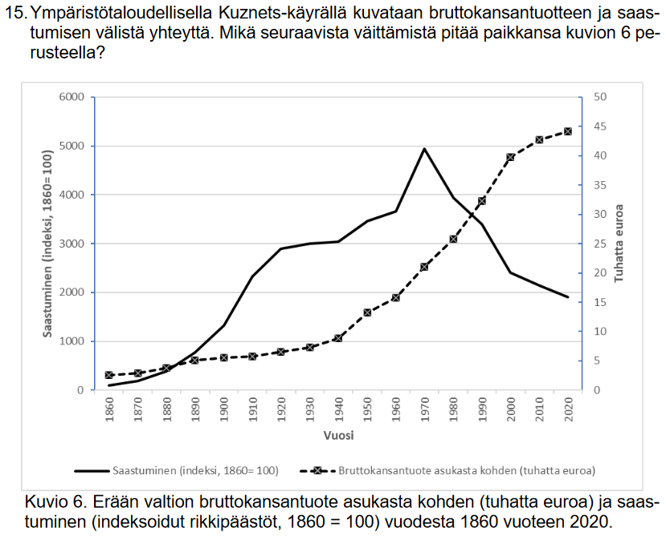
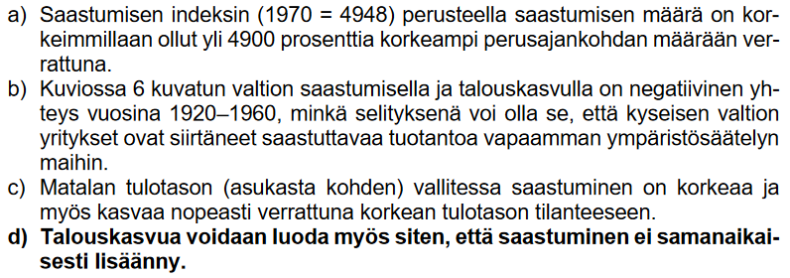
Examples of the entrance examination for business and economics
Notes:
The entrance examination for the joint admissions procedure for the field of business and economics will be held on 4 June 2024 from 12.00 noon to 15.00.
Based on:
Any material distributed at the exam and
Upper secondary school courses:
Taloustieto (YH2)
Ihminen, ympäristö ja historia (HI1)
Talousmatematiikka (MAA9, pitkä matematiikka tai MAB7, lyhyt matematiikka). Either the basic or advanced mathematics syllabus of the Finnish matriculation examination is sufficient for the entrance examination.
Includes:
Multiple-choice as well as right/wrong questions.
For additional information and previous entrance examinations, see kauppatieteet.fi

Slide 34
Examples of preliminary assignments and entrance examinations for art and design
Muoti
Suunnittele viiden asukokonaisuuden naistenvaatemallisto asusteineen käyttämällä ympyrän, neliön ja kolmion muotoisia kappaleita. Kuvaa mallistosi ihmisen päällä edestä ja takaa A2 paperiarkille.
Toteutustapa
Väritehtävä, väline vapaa, koko A2
Arviointiperusteet
Mallistokokonaisuuden hahmottaminen, visuaalisuus, värien käyttö, idearikkaus
Visuaalisen viestinnän muotoilu
Suunnittele ja toteuta julkaisu aiheista, jotka sinua kiinnostavat kuvallisessa viestinnässä. Nimeä julkaisusi. Muotoile lehteen erillinen liite, jossa kuvaat jotain harrastustasi infografiikan keinoin.
Toteutustapa
8–12 sivua käsittävä kokonaisuus, tulostettu tai käsin tehty, sivukoko korkeintaan A3.
Arviointiperusteet
Sisällölliset ratkaisut, visualisointitaidot, informatiivisuus, sommittelukyky, kerronnallisuus ja kokonaisuuden hallinta.
Notes:
You should pay special attention the assessment criteria of each assignment.
Previous preliminary assignments and entrance examination assignments:
https://www.aalto.fi/fi/opiskelu-aallossa/aiempien-vuosien-ennakko-ja-valintakoetehtavia
For additional information on the entrance examinations for the field of art and design: See Studyinfo and the admissions criteria under each study option. Links to the study option pages: https://www.aalto.fi/fi/node/54501

Slide 35
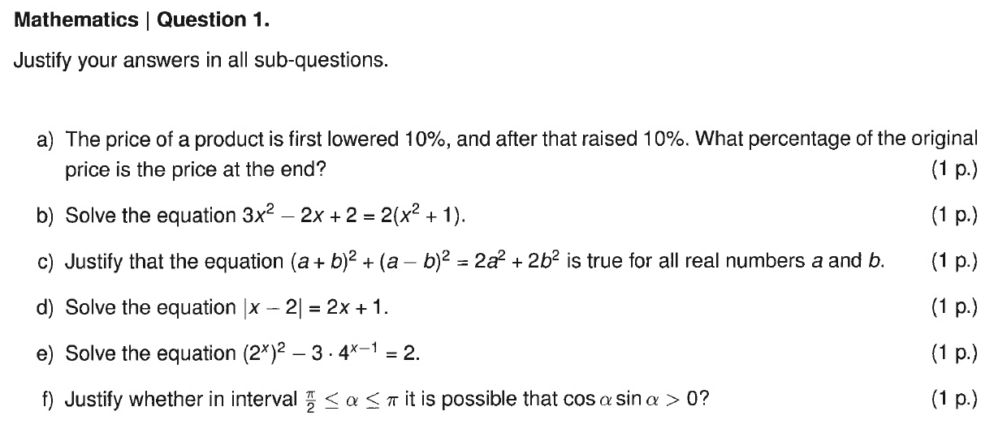
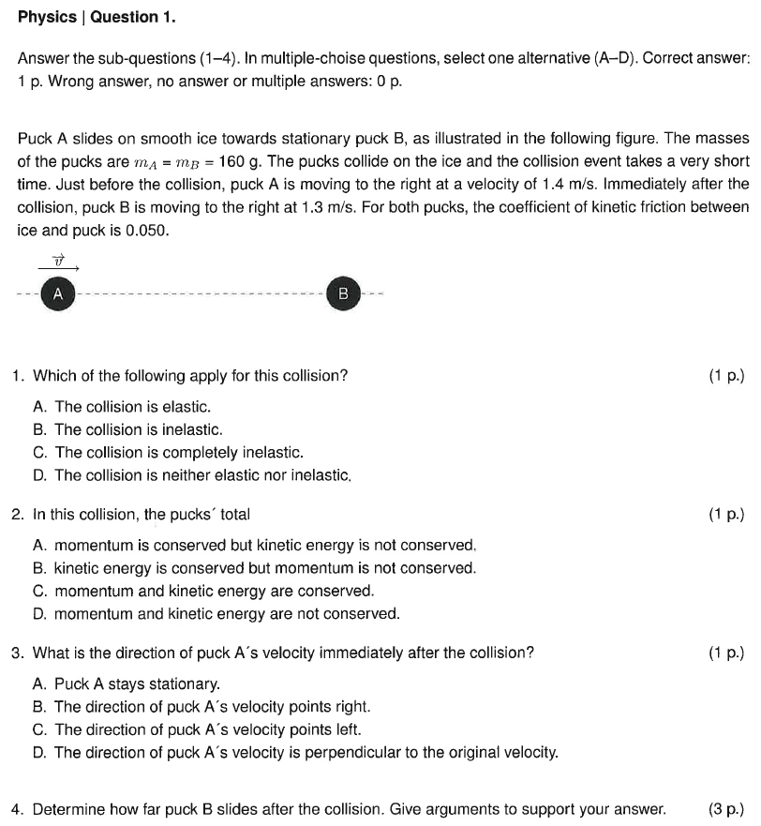
Examples of the entrance examination for science, technology and engineering
Notes:
Entrance examination for study options in technology on 28 May 2024 at 10–14
Compulsory maths section: everyone must respond to all three (3) questions Section with alternatives: everyone must respond to a total of three (3) questions out of the following: -Physics: 2 questions -Chemistry: 2 questions -Creative problem-solving skills in the field of technology: 2 questions
NOTE: In the study option of Informaatioverkostot, everyone must respond to the questions in the mathematics section and the creative problem-solving skills section.
For additional information and previous examinations, see dia.fi
For examples of entrance examinations in architecture: dia.fi>Haluan arkkitehdiksi (in Finnish)

Slide 36
Ask us anything
You can ask questions online: https://www.aalto.fi/en/study-at-aalto/chat-with-aalto-students

Slide 37
See you soon!
Notes:
Follow Aalto on social media:
@aaltouniversity

