Slide 1
Working life in Finland Kick-start for career after Master’s studies
Arttu Piri
Academic Engineers and Architects in Finland TEK

Slide 2
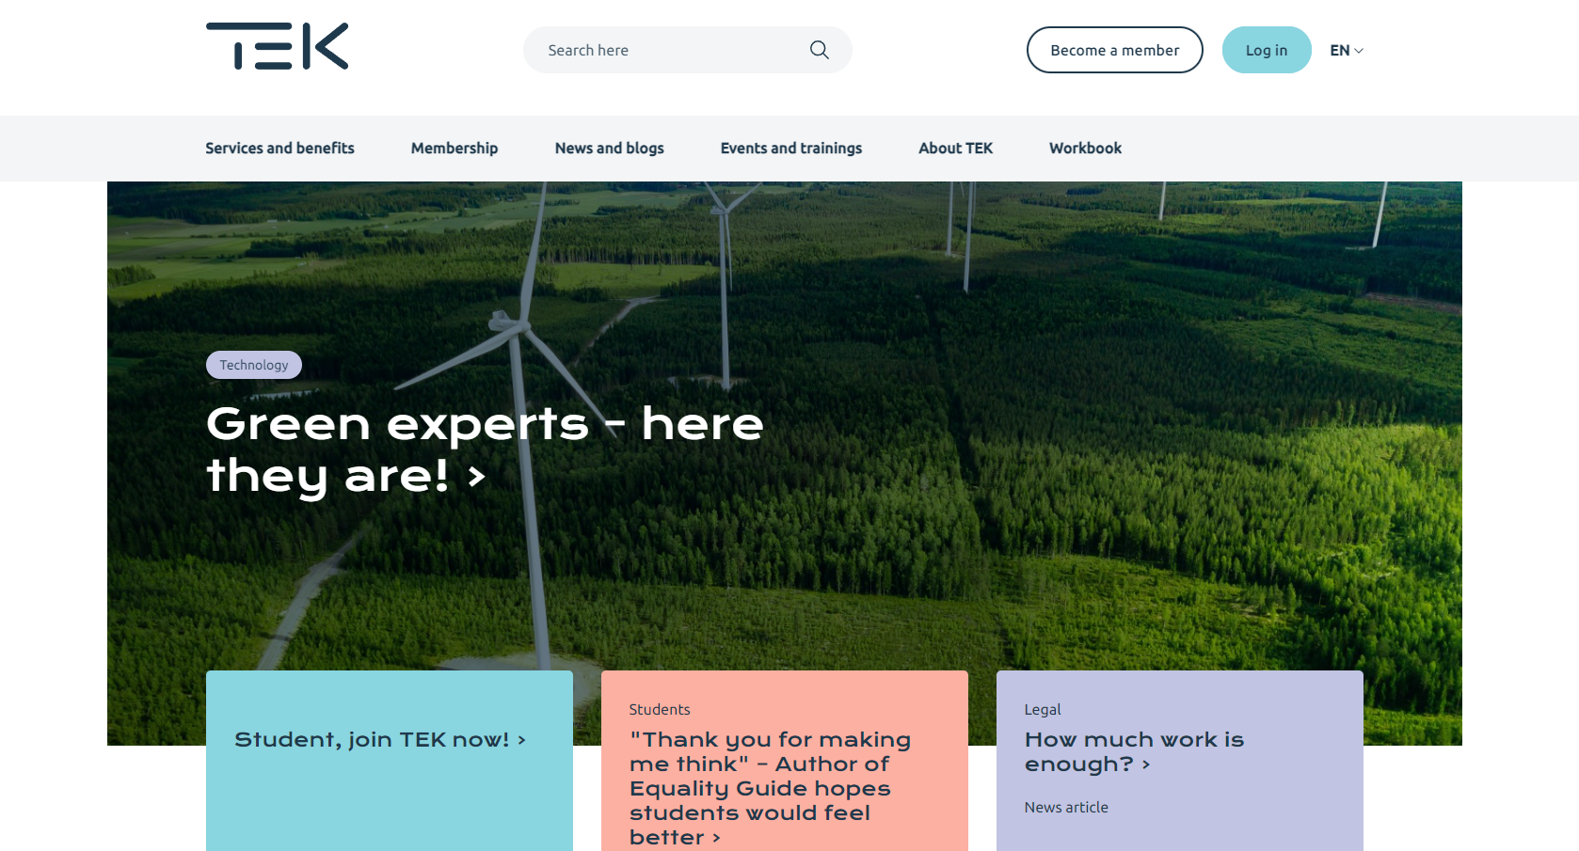
About TEK
Labor union and professional organization for Academic Engineers and Architects in Finland
About 80 000 members, over 20 000 student members
Engineers, Architects, Natural scientists
A majority of working age population in Finland are members of trade unions
Collective agreement negotiation
Helping our members on their professional careers
Earnings-related allowance for unemployment
In Finland, trade unions work closely with the employers’ organisations to ensure that the Finnish market is open, fair and competitive.
https://www.tek.fi/en

Slide 3
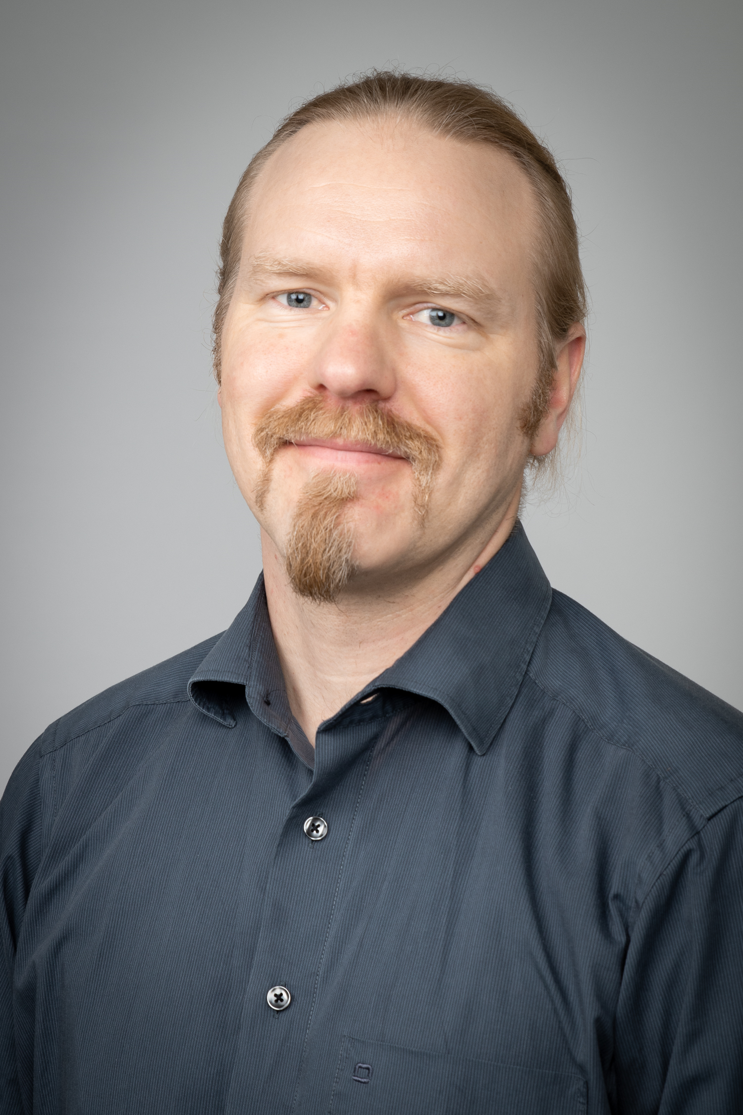
About me
Analyst / Survey Reseacher at TEK
M. Soc. Sc. in Social Psychology
Project Researcher at Aalto 2008-2012 (software development)
TEK Graduate Survey
Student feedback after graduating for M. Sc. (Tech) degree in Finland
Work markets & employment of M. Sc. (Tech) graduates in finland

Slide 5
Employment situation of academic engineers in finland

Slide 6
There is a high demand for skilled experts in engineering and technology in Finland
Technology Industries of Finland: ”Within next 10 years Finland need 130 000 new experts to drive the growth of technology industry in Finland.”
60 % of them need to have university education
74 % of the need locates to technology and ICT industry
”There is a yearly demand for hundreds of more university educated ICT & Tech experts in the work market, than what universities in Finland currently produce.”
- Unemployment rate among M.Sc. (Tech) grduates is at the moment 3 – 3,5 %.
Notes:
The prospects for getting employed are good
There is a high need

Slide 7
Key drivers for growth: green transition, digitalization, Finnish demographics
Notes:
Nostan vielä tähän alkuun murroksen kiihtyvää vauhtia konkretisoivat kuvat Elinkeinoelämän keskusliiton vihreiden investointien dataikkunasta. Mitattiin sitten euroissa tai työvoimassa tai hankkeiden määrässä, ympäri Suomen tapahtuu valtavan paljon. Elinkeinoelämän järjestöjen viesti on ollut jo hetken aikaa, että suurin kasvun este on osaavan työvoiman puute. Se viesti tulee todennäköisesti vahvistumaan entisestään.
Vihreä siirtymä nähdään myös keskeisimpänä Suomen kasvun avaimena, josta ollaan työmarkkinajärjestöjen kesken varsin yksimielisiä. Viesti työmarkkinaosapuolilta hallitusohjelmaneuvotteluihin on ollut vaatimus pitää kiinni hiilineutraaliustavoitteesta 2035 ja luontokadon pysäyttämisestä.

Slide 8
M.Sc. (Tech) careers in Finland
Employment type
Position
Fixed term 5 %
Senior professional
Executive professional
Upper middle management
Professional
Management
Lower middle management
Top management
Other
Officer
Permanent employment 95 %
Main tasks
Employment sector
Data, programming, ICT
Municipality 5 %
University 4 %
Product development
Research and development
Government 6 %
Industry 43 %
Project operations
Planning (architecture, construction etc)
Strategic planning or management
Consulting and planning 14 %
Sales or marketing
Production, manufacture or maintenance
Consulting
Other
Quality or auditing
Finance or governance
Procurement or logistics
Teaching or training
Other private sector 28 %
Notes:
- What is also remarkable is that Finns are very happy with their jobs and life in general.

Slide 9
Towards employment as an International Master’s student

Slide 10
Employability of internationals in Finland
GOOD NEWS: Currently high demand for skilled technology professionals in Finland
Industry: “78 000 experts needed”
Unemployment rate only ~3 % for all M.Sc (Tech)
GOOD NEWS: You probably have some assets that typical Finnish graduate doesn’t have
Knowledge related to your origin, e.g.
language
culture
business infrastructure and markets
THE CHALLENGE: How to get on par with the Finnish peers during the Master’s Program?
References & Work experience & Portfolio of your expertise
Contacts & Networks & Potential
THE SOLUTION: Work hard in building your networks and to showcase your potential
Network with Finnish students
Use all the help available at Aalto University
Aim for thesis collaboration with firms

Slide 11
Aim for a thesis collaboration with a private sector company!
For international students, the expectation of having good quality employment in private sector already at time of graduation is 4-times higher for those, who have done their theses in collaboration with private sector companies.
https://www.tek.fi/en/news-blogs/masters-thesis-for-a-company-helps-foreign-professionals-secure-jobs

Slide 12
Working culture, norms and expectations towards employees in Finland

Slide 13
Work culture norms
PUNCTUALITY – Be on time, deliver on time.
EQUALITY – Gender, age, religion, race. Engineering is all that counts.
LOW HIERARCHIES – The CEO is only few steps up the ladder.
SELF-INITIATIVENESS – If you can do it, do it. Communicate and respect the roles of your colleagues.
COMMUNICATE – Especially in the case of problems. Silence = Everything is running smoothly.
INFORMALITY – No Sir’s and Madam’s needed.
TRUST - Trust on your colleagues. They trust on you.

Slide 14
Work culture norms
RELIABILITY – Deliver what is agreed. It is OK to exceed the minimal requirements.
SELF-DIRECTION – Your closest supervisor? You.
TAKING RESPONSIBILITY – Try to keep the quality, that makes you feel proud. Set the bar, and go over it.
EXPECTATION OF EXPERTICE AND COMPETENCE – You are hired, because the employer believes in Your competence and abilities to grow.
SOCAL ORIENTATION AT WORK: Professional. Business. Getting things done.
ORIENTATION AT FREE TIME: Free

Slide 15
Arttu Piri
arttu.piri@tek.fi
050-3002242

Slide 16
Landing a job
Landing a job is tough work, especially if you don’t speak the language
People mostly find jobs through networks, so it’s very important to build networks during studies – only around 20 % of positions are filled through openly listed job postings
Having an up-to-date LinkedIn profile is highly recommended
Job applications and CVs have strong norms (https://www.tek.fi/en/workbook)

Slide 17
Job hunt in Finland
Where to look for openly listed jobs?
See TEK workbook list of job portals: https://www.tek.fi/en/workbook/02-job-search#7415
How to find the hidden jobs?
Make a list of minimum 20-30 interesting employers
Fastest growing startups in Finland: https://startup100.net/
Great place to work –competition: https://greatplacetowork.fi/
Kauppalehti menestyjät ranking: https://www.kauppalehti.fi/yritykset/menestyjat

Slide 18
Summary: Working in Finland
Most of the jobs are not publicly listed, so it’s important to build networks to people working in the sector you wish to be employed in
It’s tougher for non-Finnish people to land a job, but persistence pays off and when employed, the non-Finnish tend to land a job that match their educational field very well
Notes:
Three questions:
Do you wish to have a career in Finland? (yes/no/maybe)
What makes Finland an attractive country to build a career? (avoin)
What makes Finland an unattractive country to build a career? (avoin)

