Slide 1
Study- and Team-work Skills
28.8.2023, ENG masters
Study psychologist Sanni Saarimäki, sanni.saarimaki@aalto.fi
Materials by Aalto Psychologists Team

Slide 2
What kind of change would you like to make
in the world?
in yourself?
What do you think are the most important elements for successful learning?
Notes:
Why are you here? The meaning of studies, motivation

Slide 3
Which factors are most important?
Students prior / grounding knowledge and self-efficacy
Motivation to be or become successfull
Emotion regulation skills
Skills to regulate/modify learning technique
Time management and skills being productive (not to procrastinate)
Richardson et al. 2012 Psychological Correlates of University Students’ Academic Performance: Meta-analysis

Slide 4
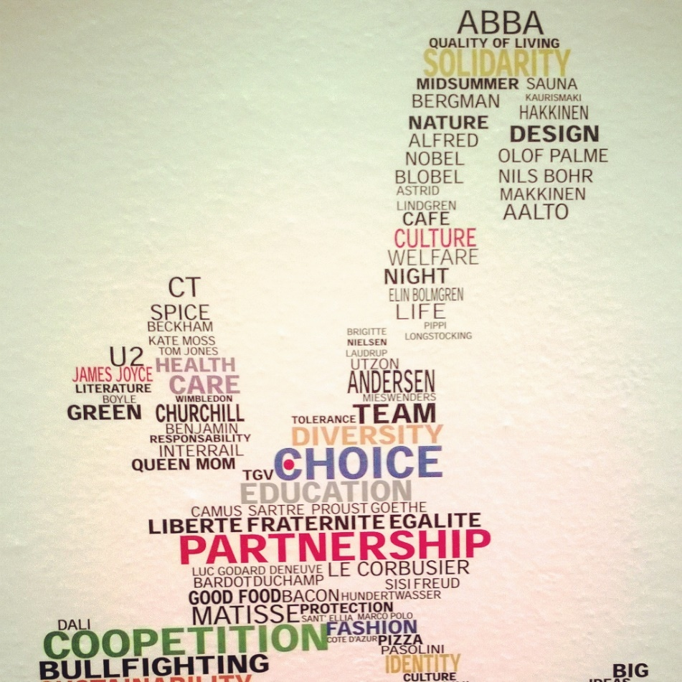
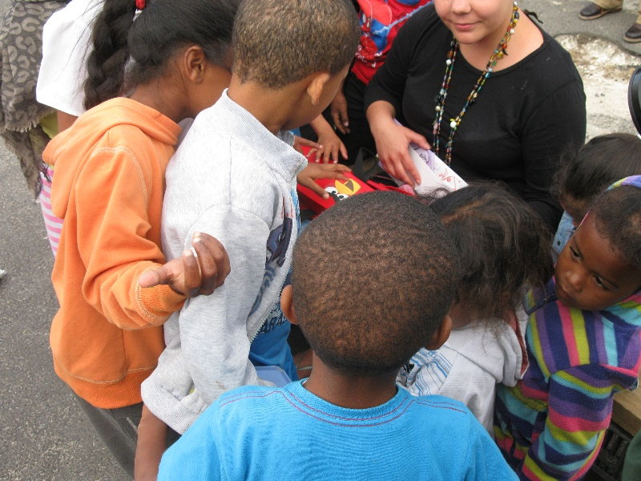
Curiosity
Deep approach to learning: understanding the meaning of the knowledge

Slide 5
What is your approach to learning?
Deep approach
  Looking for deeper understanding
  Relating new ideas to previous knowledge
  Surface approach
  Memorizing and repeating information
  Often motivated by fear of failure
  Systematic approach
  Awareness of criteria
  Planning, time management
Notes:
Viitekehys, kokonaisuus

Slide 6
Deep Approach to Learning
Really understanding instead of memorizing
Ask questions: How do we know it? Why is it that way? What does the knowledge mean? How can I use this knowledge?
Combine the new knowledge to your prior knowledge, look for deeper understanding
+ Systematic approach: awareness of criteria, planning, time management

Slide 7
The most effective study techniques
  Practice testing
  Distributed practice
  Elaborative interrogation
  Self-explanation
  How to use it?
  Make short exams for yourself and answer them!
  Don’t study a long period at once, distribute it between several days/weeks so that the amount you study in one day stays reasonable
  Ask why / how questions and make explanations!
  Write or talk about what new have you learned!
SEE: Dunlosky et al. (2013) Improving Students’ Learning With Effective Learning Techniques

Slide 8
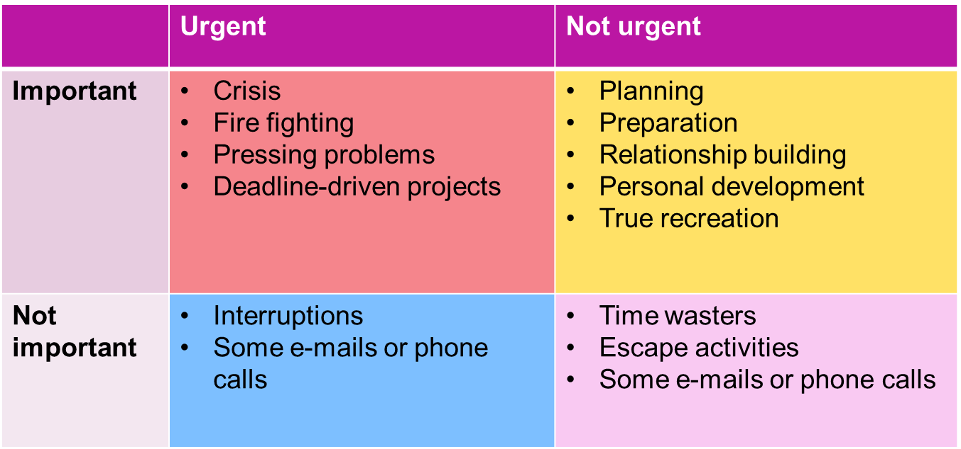
Time Management

Slide 9
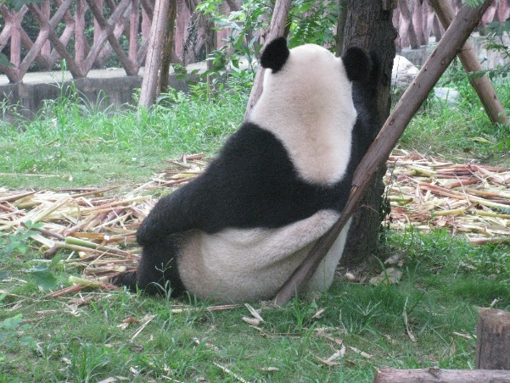
Emotions in Learning
Curiosity, interest, proud, joy -> resources for learning
Fear of failure, shame, embarrassment -> can prevent/hinder learning
Understanding that failures are part of learning
  Kindness to yourself instead of hard self-criticism
    Learn more: http://self-compassion.org/
  Share your feelings

Slide 10
Learning Together
Building knowledge is a shared process
  Being part of the academic community
  Group-work skills
Teaching others is an effective way to learn
Social support is related to success in studies

Slide 11
2. Study skills: How to maintain study habits and daily rhythm?
Create a daily study schedule with enough breaks
Sometimes plans fail -try to accept it and try again
Set small and clear goals that keep you motivated
Focus on one thing at a time – be mindful and avoid interruptions. For example, try putting your phone in an airplay mode when you study
Make your study-space as cozy as possible
1. Personal resources: How to foster joy and wellbeing?
Focus on things that are meaningful to you and bring you joy
Take the time to exercise and rest the way that suits you best – remember both, your body and mind
Try to get enough sleep and nutrition
Most of all, try to be kind to yourself
4. Study environment: How to maintain contact with peers?
Schedule (face to face or video) study groups with your peers
Set shared goals with your peers and set rewards for work completed
Remember also social time with your peers, not just studying
In addition to being kind towards yourself, be kind and non-judgmental towards others
3. Teaching
Attend study groups and tutoring and when possible, come to campus!
Remember that you can always reach out, ask for advice, feedback and guidance from your teacher, academic advisor and Learning services

Slide 12
Memorize the best team/ group work experience you have ever had
What made it so good/ successful?
What kind of stages were there? How did that group/team evolve during the process?

Slide 13
An Effective Team
Shared and accepted goals
Roles and tasks clearly defined
Interaction, Communication
Resources, Schedule
Notes:
2min (7)
An effective team requires several succeeding aspects/components
Voidaan peilata tätä tulevaan ryhmätehtävään

Slide 14
Stages of a Group
Forming
Storming
Norming
Performing
Adjourning
Notes:
3 min (10) sano jotain adjourning

Slide 15
Forming
Finding the roles
Unsecurity: do I belong to the group?
Finding the goals and tasks of the group
Often positive, enthusiastic feelings
In unclear or undefined situations we try to find familiar roles
When we feel more secure in the group we can take more flexible roles
Notes:
Timo 2 min (12)

Slide 16
Storming
Individuals try to stand out, different opinions
There might be resistance to the tasks or goals
Dissatisfaction with the group is possible
People form pairs or sub-groups
Notes:
2 min (14)

Slide 17
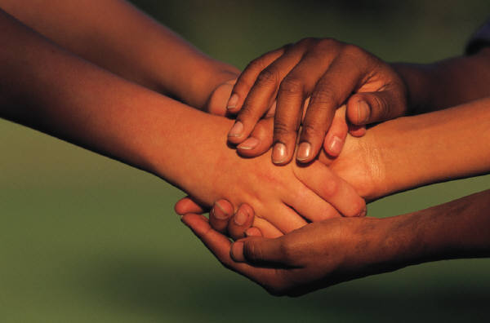
Norming
Team spirit, sense of being part of the group
Clear rules and norms
Avoiding conflicts -> the group might be less creative or effective
Group thinking: people might change their opinions towards the ”average opinion”
Notes:
2 min (16)

Slide 18

Performing
Everybody is working towards the goals
Roles are flexible, people can make most of their strenghts
Everybody takes responsibility for the work
Good spirit in the team, openess, flexibility
Notes:
2 min (18)

Slide 19
Communication in a Group
Task-oriented Skills:
Communicating thoughts clearly
Defining and analyzing problems
Asking for specifications and reasons
Finding and evaluating options
People-oriented Skills:
Listening
Showing empathy and support
Creating good team spirit
Encouraging others
Solving conflicts
Notes:
3 min (21)

Slide 20
Some Guidelines for Good Interaction
Respectful Engagement – ALSO ONLINE!
  Conveying presence
  Being genuine
  Communicating affirmation, expressing recognition
  Effective listening
  Supportive communication: specific and descriptive communication, requests rather than demands
Task Enabling
  Teaching & helping others
  Altering the process, timing or substance
Notes:
3 min (24), monikulttuurisuus

Slide 21
Some Guidelines for Good Interaction
Trusting
  Sharing information
  Giving away control
  Inclusive language
Solving conflicts
  Looking at the problem from different angles may be useful
  Talk about facts, avoid blaming anyone
  Figure out everyone’s needs and goals
  Look for a win-win situation
Notes:
Minna 3 min (27)

Slide 22
References
Dutton Jane (2003): Energize Your Workplace – How to Create and Sustain High-Quality Connections at Work. Jossey-Bass, San Francisco.
Kopakkala Aku (2005): Porukka, jengi, tiimi – Ryhmädynamiikka ja siihen vaikuttaminen. Edita, Helsinki.
Kielijelppi: www.kielijelppi.fi
Belbin website www.belbin.com

Slide 23

Starting Point of Wellbeing 2023
WHAT WE DO?
Starting Point of Wellbeing offers students advice and guidance on services related to wellbeing and study skills
No appointment needed; drop-in service currently available online & on campus in Finnish & in English
In addition to drop-in advising, SPW offers co-studying sessions, other events and groups and workshops
WHO WE ARE?
Aalto study and career planning psychologists
Guidance counsellors
Finnish Student Health Service (FSHS)
Aalto chaplains
UniSport
In cooperation with
Student union AYY
Nyyti ry Mental Wellbeing for Students / MielenTEKoja
HelsinkiMissio
WHERE TO FIND US?
Starting Point of Wellbeing | Aalto University

Slide 24
Support for learning, wellbeing and study-skills
Where to get guidance and support? | Aalto University
Starting Point of Wellbeing | Aalto University
Individual study arrangements | Aalto University

