Slide 1
ENG Master’s programme orientation
Why “intercultural communication” is important to engineering students?
Yoonjoo Cho, PhD (Language Centre)
Notes:
ID: yoonjoo.cho@aalto.fi

Slide 2
Today’s Talk
Why “intercultural communication” is relevant & important to you as an engineering student?
Where and how can we can learn this?
My name is Yoonjoo!
I teach Intercultural Communication courses at Aalto Language Centre…

Slide 3
Intercultural Communication Courses
LC-0610 Intercultural Communication (3 cr)
LC-0611 Teamwork & Leadership in the 21st Century (3 cr)
LC-0614 Developing Global Competence: Working in an International Virtual Team (2 cr)

Slide 4
A Quick Question:
https://www.menti.com/al1g2vn9wm1n
What is the most important learning area/aspect to you as an engineering student?
Knowledge and Understanding
Engineering Analysis
Engineering Design
Investigations
Engineering practice
Making Judgements
Communication and Team-working
Notes:
https://www.mentimeter.com/app/presentation/al3xgkqxrf94emvxs1742rx9vn9tv5qh/tws9fquo9at2/edit
Programme Outcomes Framework
(a) Programme Outcomes describe the knowledge, understanding, skills and abilities which an accredited engineering degree programme must enable a graduate to demonstrate. The Programme Outcomes specified below apply to accredited programmes which are to be awarded a EUR-ACE® label by an authorised agency. In this document, the term learning outcome is used only to describe the knowledge, understanding, skills and abilities which apply to individual course units/modules.
b) The Programme Outcomes specified in this document are intended to be applicable to the full range of Bachelor and Master Degree programmes in engineering offered in European HEI’s. They have to be considered as the ‘minimum threshold’ defined by the ENAEE community and to be fulfilled in order to assure the quality of engineering programmes.
(c) The Programme Outcomes can be used in both the design (by engineering academics) and the evaluation (by accreditation agencies) of programmes in all branches of engineering and for different profiles.
(d) The standards describe the Programme Outcomes that accredited programmes must meet, but do not prescribe how they are realised. Consequently, no restriction is implied or intended by the EAFSG in the design of programmes to meet the specified Programme Outcomes. HEI’s retain the freedom to formulate programmes with an individual emphasis and character, including new and innovative programmes, and to prescribe conditions for entry into each programme.
(e) The Programme Outcomes are described here separately for both Bachelor and Master Degree programmes with reference to the following eight learning areas:
1. Knowledge and understanding;
2. Engineering Analysis;
3. Engineering Design;
4. Investigations;
5. Engineering Practice;
6. Making Judgements;
7. Communication and Team-working;
8. Lifelong Learning

Slide 5
ENAEE (https://www.enaee.eu/)
Notes:
ENAEE is a not-for-profit organisation whose mission is to serve the public and society through the promotion and advancement of engineering education in Europe and abroad.
The European Network for Accreditation of Engineering Education (ENAEE) was established in 2006 as an organization to promote quality in engineering education across Europe and beyond. It is rooted in the Bologna process which aims to build the European Higher Education Area.
Membership of ENAEE is open to all bodies concerned with educational and professional standards in engineering. Such bodies may include accreditation and quality assurance agencies, professional organisations, associations of higher education institutions, employers’ associations, and engineering student bodies and their associations.
EUR-ACE® Framework Standards and Guidelines

Slide 6
Intended Learning Outcomes
WHY?
Of course, who would say communication is not important? ☺
As an engineer
Interculturality
Notes:
https://sdgs.un.org/2030agenda

Slide 7
Now
Near Future
Notes:
When you are doing your degrees.
When you have finished your studies and start working in the real world.

Slide 8
During your MSc
Notes:
When you are doing your degrees
When you have finished your studies and start working in the real world (your relevant field)

Slide 9
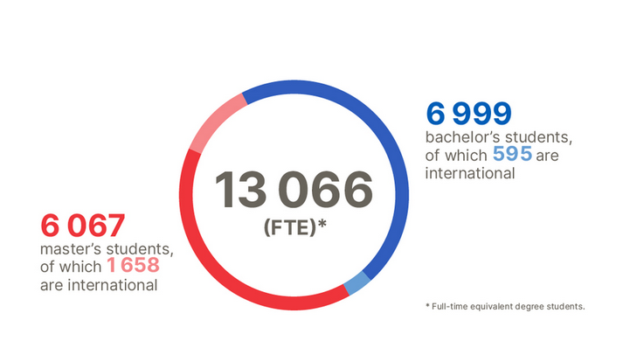
WHY is it important?
Master’s programmes have a more diverse student demographics
Around 10%
Around 25%
It is not just a mere presence!
https://www.aalto.fi/en/aalto-university/key-figures-of-2022-and-annual-reports
Notes:
https://www.aalto.fi/en/aalto-university/key-figures-of-2022-and-annual-reports
160 out of 230 students are international students in the school of ENG
Overall, universities themselves are one of the most diverse and international places in the country
But it is not just a mere presence

Slide 10
WHY is it important?
Team-based learning (e.g. team project) is one of the common elements in completing MSc courses
At some point, you are going to interact with other students having different backgrounds as teamwork is part of the courses
Explaining, Questioning and Answering, Cooperating, Negotiating, Persuading…
Notes:
A range of social interactions would be relevant
You interlocutors are likely to have a different linguistic, ethnic and educational backgrounds
discussing, persuading, negotiating, cooperating, questioning, answering, brain-storming, supporting, influencing…

Slide 11
After your MSc
Notes:
When you are doing your degrees
When you have finished your studies and start working in the real world (your relevant field)

Slide 12
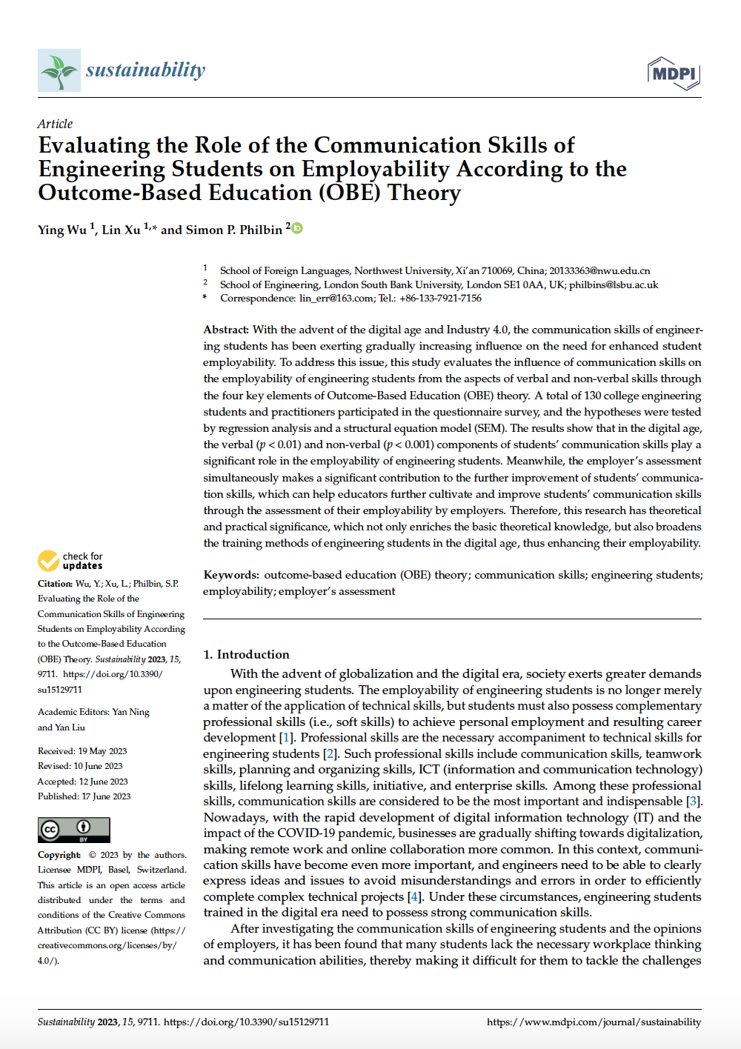
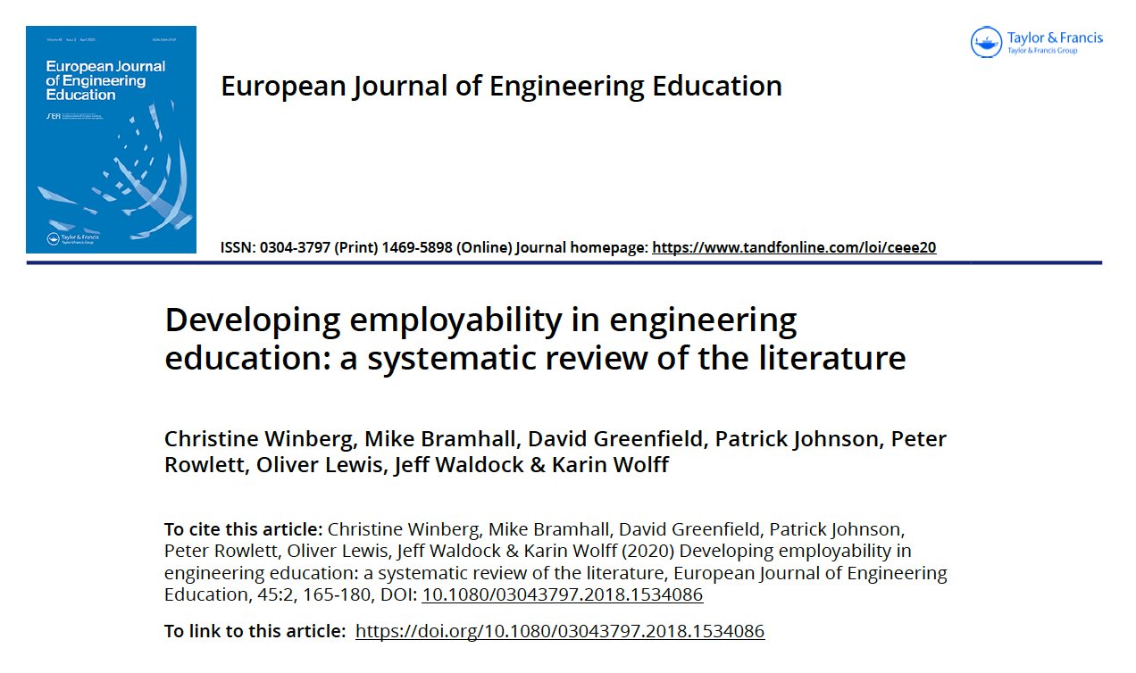
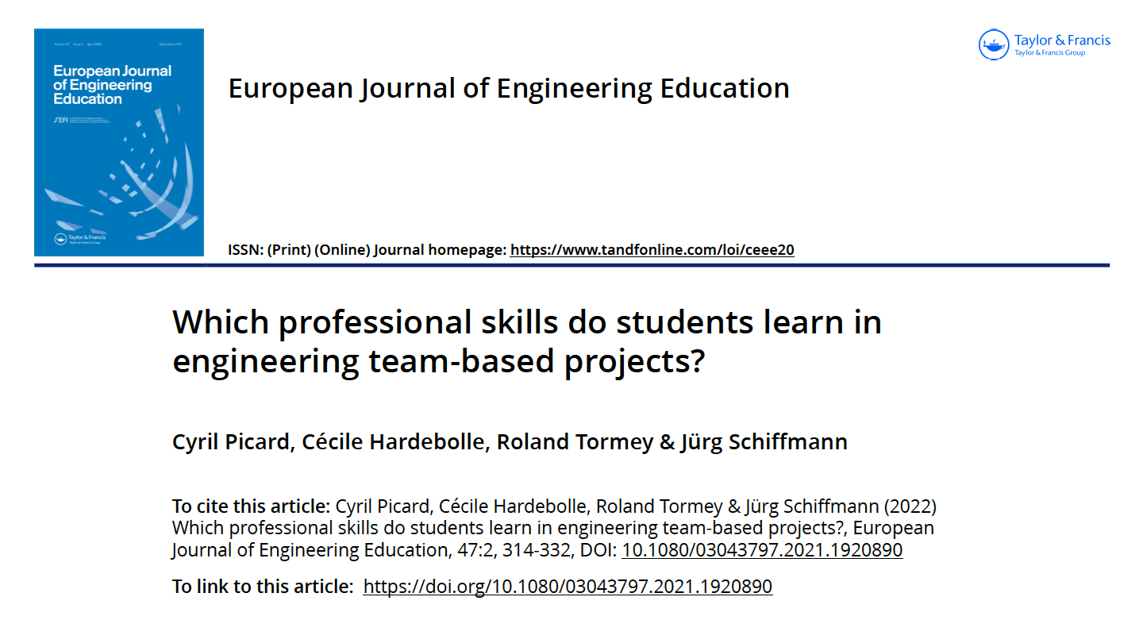
WHY is it important?
Employability
Notes:
I can add the screenshots of the relevant journal articles that I am going to introduce in the forthcoming slides
I, myself, who does not have first-hand experience of engineering education was in need of researching, “Why Intercultural communication, and professional communication skills, in general, is relevant/important/engineering?” (This has been a big question to me since I joined Aalto three years ago)
Look into leading journals in the field of engineering education (particularly, recent research papers)
Even though, it is not a mainstream discussion, but there has been a consistent voice for the last couple of decades in relation to “the importance of communication skills of engineering practitioners” – The interdependent relationship between technical knowledge & communication skills
Employability (individual level) & Sustainable Development (societal level)

Slide 13
WHY is it important?
Of course, the technical knowledge matters
Students who lack confidence in the core engineering disciplines would be unlikely to develop competence in engineering communication (Winberg et al., 2020: 170).
Notes:
An interdependent relationship between engineering knowledge and professional skills that enabled engineering graduates to attain employability
the interrelationship between scientiﬁc knowledge and social practices
Mastering engineering knowledge + the ability to work with others across contexts (professional skills)
Recent studies and reports provide compelling reasons why undergraduate engineering education is in need of change if graduates are to develop the capacities for responding to the complex challenges of the twenty-ﬁrst century (e.g. Graham 2012).
Winberg et al. 2020: Many of the studies reviewed conﬁrm the importance of Mathematics, Physics and the engineering sciences as the basis of engineering practice, but equally, point out that key professional skills, such as communication, teamwork, project management, and professional ethics – as well as broader environmental and societal issues – have been neglected in engineering programmes
what is under dispute is how much engineering science is required, how it is taught and learned, and how professional skills, particularly non-technical skills, might be built onto, or integrated into, the engineering knowledge base.

Slide 14
WHY is it important?
The employability is no longer merely a matter of the application of technical skills
Students must also possess complementary professional skills (i.e., soft skills) to achieve personal employment and career development (Wu et al., 2023).
Notes:
With the advent of globalization and the digital era, society exerts greater demands upon engineering students. The employability of engineering students is no longer merely a matter of the application of technical skills, but students must also possess complementary professional skills (i.e., soft skills) to achieve personal employment and resulting career development [1].
Professional skills are the necessary accompaniment to technical skills for engineering students [2]. Such professional skills include communication skills, teamwork skills, planning and organizing skills, ICT (information and communication technology) skills, lifelong learning skills, initiative, and enterprise skills. Among these professional skills, communication skills are considered to be the most important and indispensable [3]
Nowadays, with the rapid development of digital information technology (IT) and the impact of the COVID-19 pandemic, businesses are gradually shifting towards digitalization, making remote work and online collaboration more common. In this context, communication skills have become even more important, and engineers need to be able to clearly express ideas and issues to avoid misunderstandings and errors in order to efﬁciently complete complex technical projects [4]. Under these circumstances, engineering students trained in the digital era need to possess strong communication skills.
The higher the ability to apply the dimensions in communication skills, the more competitive the student’s employment prospects will be and the higher the employer’s assessment will be
The ﬁrst category of articles (∼25%) argues that engineering knowledge matters and that ‘a strong technical knowledge base’ (Bingham, Southee, and Page 2015, 410) is key to employability and necessary for the development of professional skills.
These studies explain that the disciplinary core is highly relevant to employability and should not be neglected because engineering students who lack conﬁdence in the core engineering disciplines would be unlikely to develop competence in engineering communication, management or professional ethics.

Slide 15
WHY is it important?
The advent of globalization and the digital era
Remote work and online collaboration are more common.
Engineers need to be able to clearly express ideas and issues to avoid misunderstandings and errors thereby efficiently completing complex technical projects. (Wu et al., 2023).
Notes:
With the advent of globalization and the digital era, society exerts greater demands upon engineering students. The employability of engineering students is no longer merely a matter of the application of technical skills, but students must also possess complementary professional skills (i.e., soft skills) to achieve personal employment and resulting career development [1].
Professional skills are the necessary accompaniment to technical skills for engineering students [2]. Such professional skills include communication skills, teamwork skills, planning and organizing skills, ICT (information and communication technology) skills, lifelong learning skills, initiative, and enterprise skills. Among these professional skills, communication skills are considered to be the most important and indispensable [3]
Nowadays, with the rapid development of digital information technology (IT) and the impact of the COVID-19 pandemic, businesses are gradually shifting towards digitalization, making remote work and online collaboration more common. In this context, communication skills have become even more important, and engineers need to be able to clearly express ideas and issues to avoid misunderstandings and errors in order to efﬁciently complete complex technical projects [4]. Under these circumstances, engineering students trained in the digital era need to possess strong communication skills.

Slide 16
WHY is it important?
Communication, teamwork, and organisational abilities are also featured prominently in sources looking at labour-market needs such as employer and alumni surveys (Picard, et al., 2022: 314)
Notes:
Although there is no clear consensus on the exact set of skills under the term ‘professional skills’ (also called ‘soft’, ‘transferable’, ‘transversal’ or even ‘21st Century’ skills), there seems to be an overall agreement that engineering education should not only address science and engineering but also social, ethical, and organisational aspects of engineers’ practices and responsibilities (Kolmos and Holgaard, 2019; Winberg et al., 2020).
As an example, the 2013 IEA ‘Graduate Attributes and Professional Competencies’ report highlights skills related to societal responsibility, ethics, teamwork, communication, and project management (IEA, 2013). Communication, teamwork, and organisational abilities are also featured prominently in sources looking at labour-market needs such as employer and alumni surveys (Carter, 2011; Itani and Srour, 2016; Craps et al., 2017) or in occupational databases such as O*NET in the US4, which provide information on the skills considered important for current engineering positions.
With growing concerns regarding the automation of jobs and the rise of outsourcing and globalisation, studies have attempted to predict the evolution of those needs. Frey and Osborne (2017) have investigated the susceptibility of jobs to computerisation and found that jobs requiring more skills related to interpersonal and interprofessional domains such as perceptiveness, negotiation, and persuasion were less likely to be aﬀected.

Slide 17
Then, what kind of communication skills
would be relevant/important?

Slide 18
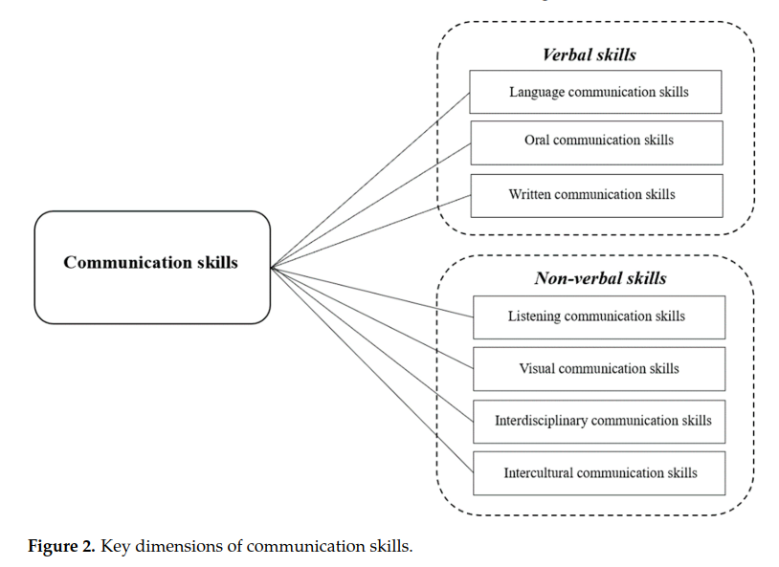
Communication Skills
Communication Skills
Employability
Employer evaluations
Notes:
Three variables and the relationship between these three (communication skills, employability and employer evaluation)
Interdisciplinary communication skills
Communication and learning between disciplines are also important aspects of communication skills that require enhancement. Interdisciplinary communication skills are increasingly recognized as essential skills for engineering graduates, especially those who intend to work internationally. Not only do engineers need to communicate and work with fellow engineers from other countries, but they are also required to master effective communication across disciplines, such as engineering and management. Interdisciplinary projects in university education can contribute to the development of students’ teamwork skills. The integration of these programs has been partly due to the industry’s need for engineers with more extensive skills. With interdisciplinary communication skills, engineers can build strong working relationships between team members, and a positive working environment can be created [40]
Non-verbal communication skills also include interdisciplinary communication skills and, in the era of Industry 4.0, embedding elements of interdisciplinary collaboration into team learning is also conducive to strengthening students’ collaboration and communication skills, thus promoting their employability [57]. To develop a fully stimulating approach to enhancing students’ employability, it makes sense to provide training in interdisciplinarity in universities [58]. For example, BIM (Building Information Modeling) as a new platform for assistance and communication links design phases that are initially separated due to different professions to enhance productivity [59]. For manufacturing, the integrated status of skills related to smart manufacturing, information technology, data analysis, and systems integration will create greater demands as the process of digitalization continues to deepen. Due to the collaborative nature of smart manufacturing production technologies, the smooth implementation of products and processes requires complex and efﬁcient coordination between various mechanical, hydraulic, electronic and software components. As a result, the industry needs more “versatile architects and versatile engineers” with comprehensive management skills such as broad and complex knowledge structures, as well as holistic competencies, creativity and the ability to learn sustainably [60].
Intercultural communication skills
The emergence of new ICT (information and communications technologies, e.g., internet, email, satellite communications), faster and cheaper international transport, migration ﬂows, and the internationalization of business have led to an increasing number of people—including engineers—engaging in cross-cultural exchanges. Moreover, the internationalization of degree courses is not only important for remaining competitive in a global economy but are also indispensable in a world where survival can only be achieved through global cooperation. A prerequisite for successful global cooperation is the development of intercultural competence. In an era of globalization, engineers need to communicate with people from home and abroad as well as from different cultural backgrounds. Research shows that intercultural communication skills enable students to adapt to different cultures and deal with different social systems.
Besides interdisciplinary communication skills, intercultural communication skills are also important for engineering students since multinational business activities have developed rapidly around the world and more and more multinational joint ventures have undertaken construction projects and operating across borders [61].
The key results
Communication skills, as one of the important soft skills, affect the employability of engineering students through verbal skills and non-verbal skills. When engineering students have good oral and visual communication skills required by the digital age, and the ability to avoid cultural conﬂicts in transnational cooperation, they can gain more discourse rights and opportunities in the workplace, which can signiﬁcantly enhance their employment competitiveness.
The employability of engineering students also affects the employer’s assessment. The change in digital times puts forward higher requirements for the employability of engineering students. Therefore, the cultivation of modern students should not only be limited to the improvement of professional skills but should be closer to the cultivation of compound talents. This training mode will further change the employer’s assessment from a single technical-level assessment to a comprehensive quality assessment that conforms to the overall development of the job market.
Employer’s assessment further promotes the improvement of communication skills of engineering students. Employers believe that, with the continuous development of science and technology, engineering students should understand the use of various media, have the communication skills necessary for the workplace, such as listening, speaking, reading, and writing, and require engineering education institutions to adopt corresponding training strategies to develop workers who meet the job market.

Slide 19
Where and how can we develop it?

Slide 20
HOW & WHERE can we develop this?
Of course, I cannot explain ‘how’ in detail now as we are running out of time! ☺
‘Social Interaction’ is the core aspect of developing communication skills!
Being exposed to an environment where you can comfortably share different perspectives with others
Notes:
Of course, the major part of your MSC studies is to establish your technical knowledge skills (Knowledge and understanding; Engineering Analysis; Engineering Design; Investigations; Engineering Practice; Making Judgements – the core engineering discipline)
There is a small space where you can add ‘communication aspects’ – it is not a mandatory part of your degree programme
The core aspect of learning communication is about ‘practice’ & ‘social interaction’ – enable you to expose to the social interactions with other students having different backgrounds!

Slide 21
Language and Communication Courses!
We, Language Centre, are here to support you! ☺
https://www.aalto.fi/en/language-and-communication-studies/teaching

Slide 22
Intercultural Communication Courses
LC-0610 Intercultural Communication (3 cr)
Period 1, 2, 3, 4 & 5
LC-0611 Teamwork & Leadership in the 21st Century (3 cr)
Period 2 & 4
LC-0614 Developing Global Competence: Working in an International Virtual Team (2 cr)
Period 5

Slide 23
If you have any Qs relating
to ICC courses, please contact me!
yoonjoo.cho@aalto.fi

Slide 24
Thanks for listening!
All the best for
your MSc journey! ☺

Slide 25
References
Picard, C. et al. (2022) Which professional skills do students learn in engineering team-based projects? European journal of engineering education. [Online] 47 (2), 314–332.
Winberg, C. et al. (2020) Developing employability in engineering education: a systematic review of the literature. European journal of engineering education. [Online] 45 (2), 165–180.
Wu, Y. et al. (2023) Evaluating the Role of the Communication Skills of Engineering Students on Employability According to the Outcome-Based Education (OBE) Theory. Sustainability (Basel, Switzerland). [Online] 15 (12), 9711–.

