Slide 1
Extensive experience with scientific writing?

Slide 2
Worried about writing a paper of 60 pages or more?

Slide 3
Scientific Writing
Aalto University Language Centre
Susan Gamache
susan.gamache@aalto.fi
28 Aug 2023

Slide 4
Writing courses – Master’s
International students are required to take 3 credits of language studies that include oral & written skills
LC-1310 Academic Communication for MSc students (o,w) (3 cr)
You will write and present on a topic from your own field (usually based on previous BSc research or ongoing MSc research)
LC-1317 Integrated Project Communication for MSc students (o,w) (3 cr)
This option is only available to students in the EMC program as it’s integrated into “Field Experience and Project in Hard Rock Mining”

Slide 5
Support when writing your Master’s thesis
LC-1322 Thesis writing for engineers (w) (3 cr)
Writing clinic
8 free one-on-one session with a Language Centre teacher to help you improve your writing. In person or via Zoom.
Book through MyCourses

Slide 6
What is ”good” Scientific Writing?

Slide 7
Do you agree?
“Good writing is mostly about using standard grammar, incorporating disciplinary vocabulary, and good mechanics.”
“Good writing is subjective. Every reader wants something different.”
“Scientific writing requires complicated sentences and long words.”
“Great writers are born, not made”
https://www.menti.com/alrhm92x9prr

Slide 8
Objectivity
Complexity: lexically and grammatically more complex
Formality
Precision with facts & figures
Explicitness: signposting / linking ideas
Accuracy: narrow specific terminology
Hedging: cautious language indicating a degree of certainty
Responsibility: support claims with evidence, use sources, critically assess sources
Gillet, 2015
Notes:
Gillet, A. (2015). “Features of Academic Writing.” Using English for Academic Purposes: A Guide for Students in Higher Education. [Website] Retrieved from: http://www.uefap.com/writing/feature/featfram.htm

Slide 9
Cultural differences in writing
Reader-responsible vs. writer-responsible writing cultures

Slide 10
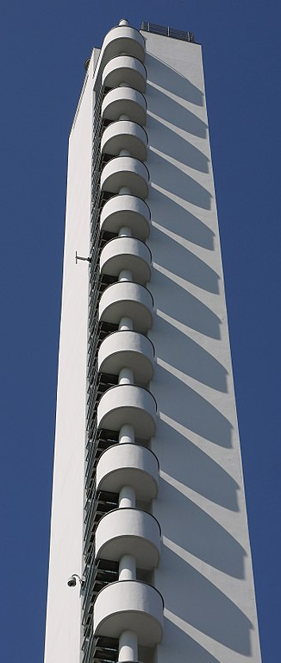
Reader-responsible culture
The responsibility is on the READER to understand
the message.
Avoid stating the obvious
Avoid repetition
Preference for complicated structures

Slide 11
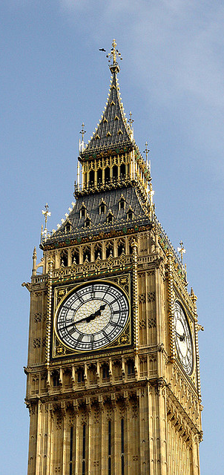
Writer-responsible culture
The responsibility is on the WRITER to make the
message understandable.
Give a lot of background information
Repetition and summaries
Language is relatively clear and simple

Slide 12
Writer-responsible writing cultures:
Australia, Canada, Great Britain, Ireland, Netherlands, New Zealand, Singapore, South Africa, United States
Reader-reponsible writing cultures:
Argentina, Brazil, China, Columbia, East Africa, Ecuador, Greece, Guatemala, Hong Kong, Jamaica, Japan, Malaysia, Malta, Morocco, Pakistan, Panama, Peru, Poland, Portugal, Romania, Russia, Salvador, Serbia, Slovakia, Slovenia, South Korea, Spain, Suriname, Turkey, Uruguay, Vietnam
Mixture:
Arab Countries, Austria, Bangladesh, Belgium, Bulgaria, Chile, Costa Rica, Croatia, Czech Republic, Denmark, Estonia, Finland, France, Germany, Indonesia, India, Iran, Italy, Luxembourg, Norway, Philippines, Sweden, Switzerland, Taiwan, Thailand, Trinidad, Venzuela
Source: McCool, M. (2009, p.123). Writing Around the World: Guide to Writing Across Cultures. Continuum International Publishing Group Ltd.
Notes:
McCool, Matthew (2009). Writing Around the World: Guide to Writing Across Cultures. Continuum International Publishing Group Ltd., 2009

Slide 13
What is plagiarism?

Slide 14
What is plagiarism?
Stealing ideas or language from another source without giving credit for it
Intentional plagiarism / unintentional plagiarism
Image: Heath Robinson, 2018, Creative Commons license
Harvard University Library, 2012
Notes:
Source: Harvard University Library. (2”Harvard Guide to Using Sources” From: https://usingsources.fas.harvard.edu/
018)

Slide 15
How do you avoid plagiarism?

Slide 16
Originality assessment tool
All theses must go through Turnitin.
Freely available for Aalto students
→ Use it to improve your citation skills & avoid plagiarism
https://wiki.aalto.fi/display/turnitin/Turnitin+for+students

Slide 17
Is this a good citation practice?
X
Additive manufacturing was originally developed to guide product design by providing a way to create prototypes directly from digital designs. This method called rapid prototyping (RP), as the name implies, consumes less time and resources than most preceding techniques. For instance, the manufacturing of an injection mold for prototyping purposes would be extremely expensive. However, the part can be created with additive manufacturing for a fraction of the cost. Moreover, rapid prototyping is cost and time effective when it can substitute handcrafting, CNC manufacturing, or silicon molding. The downside when compared to these methods is often poor surface quality and inferior dimensional accuracy. However, RP enables fast iterative testing of products with a low threshold of prototypes failing expectations. This makes it a superior tool in product development and explains why prototyping has been the leading application of AM. (Wohlers 2013)
Source: Kukko-Liedes, 2015. Used under CC license.

Slide 18
Topical progression
Chen and Liu (2004) studied the effect of aggregate size distributions and the volume fraction of aggregate on the fracture parameters of concretes with strength 50 – 89 MPa under three-point bending test. For this purpose three various maximum aggregate sizes of 10, 15 and 20 mm were employed. They also investigated the influence of coarse aggregate volume fraction on the fracture parameters of HSC. For this purpose three various volume fraction of aggregates named 40 %, 60 % and 80 % were employed. They concluded that HSC with lower brittles could be made by aggregate with greater size. The maximum fracture energy and fracture toughness were achieved at 60 % of aggregate volume.
(Rashad and Seleem, 2017)
Notes:
From: Rashad, A. and Seleem, H. (17 July 2014) “A Study of High Strength Concrete with Moderate Cement Content Incorporating Limestone Powder,” Building Research Journal. 61/1: 43-58. DOI https://doi.org/10.2478/brj-2014-0004

Slide 19
Topical progression
Chen and Liu (2004) studied the effect of aggregate size distributions and the volume fraction of aggregate on the fracture parameters of concretes with strength 50 – 89 MPa under three-point bending test. For this purpose three various maximum aggregate sizes of 10, 15 and 20 mm were employed. They also investigated the influence of coarse aggregate volume fraction on the fracture parameters of HSC. For this purpose three various volume fraction of aggregates named 40 %, 60 % and 80 % were employed. They concluded that HSC with lower brittles could be made by aggregate with greater size. The maximum fracture energy and fracture toughness were achieved at 60 % of aggregate volume.
(Rashad and Seleem, 2017)
Notes:
From: Rashad, A. and Seleem, H. (17 July 2014) “A Study of High Strength Concrete with Moderate Cement Content Incorporating Limestone Powder,” Building Research Journal. 61/1: 43-58. DOI https://doi.org/10.2478/brj-2014-0004

Slide 20
Which essential element is still missing from the previous citation example?
Your own voice!

Slide 21
Want to learn more?
Sign up for…
a Master’s Writing Course
https://shorturl.at/entuL

Slide 22
Thank you!

