Slide 1


Welcome!
New Master’s students at Aalto University School of Engineering

Slide 2
Today
10:15 AM - 10:50 AM | Dean's Welcome | Otakaari 1, Undergraduate Centre - Lecture Hall B
10:50 AM - 12:00 PM | Study Essentials, Working life in Finland
12:00 - 1:00 PM | Lunch | Otakaari 1, Undergraduate Centre - Lecture Hall B
1:00 - 2:00 PM | Scientific writing & Communication in team Susan Gamache & Yonjoo Cho, Aalto University Language Center | Otakaari 1, Undergraduate Centre - Lecture Hall B
2:00 - 2:15 PM | Break
2:15 - 3:00 PM | Study and group-work skills Sanni Saarimäki, Study Psychologist | Otakaari 1, Undergraduate Centre - Lecture Hall B
3:00 - 3:30 PM | Aalto University Student Union AYY Introduction to School of Engineering student guilds and | Otakaari 1, Undergraduate Centre - Lecture Hall B

Slide 3

At this session
Introduction to your Orientation Week
Study Essentials – a recap of the Pre-Orientation
International student matters

Slide 4

Warm-up excercise
Introduce yourself to someone you don’t know!
Your name? What do you study? Where are you from? What did you have for breakfast yesterday?

Slide 5
Orientation Week
Tuesday & Wednesday | Programme-specific meetings | Check your programme’s Student guide/During studies/Starting your studies page for details
Thursday 9 am – 10 am 10 am-4 pm 2 pm- 3 pm | Information for tuition-fee-liable students ENG, Otakaari 4, Lecture hall 216 Aalto Welcome Fair Check out the event page here. Program includes pop-up service points like DVV, HSL, Bank, Carrier Lab, Unisport etc. Better Study Life Lecture | Otakaari 4, Lecture hall 216 Otaniementie 1, Undergraduate Center Lecture in Otaniementie 1, Undergraduate Center, A-hall
Friday 9 am – 12 pm 12 pm-14 pm | LES ENG Open House at Otakaari 4 Teekkari life | Otakaari 4 Lecture in Otaniementie 1, Undergraduate Center, A-

Slide 6
Make the most out of your orientation week!
Some examples of questions you might have in your mind and where to get answers to them:
Which elective courses should I select? → Programme-specific meetings, Tue-Wed
What kind of sport facilities are available for the students? → Service Fair, Thu
Where should I go if I fall ill and need to see a doctor? → Service Fair, Thu
How and where can I activate my HSL student discount? → HSL pop-up servicedesk, 29 August to 31 August, 10 am-4.00 pm: Otakaari 1, Main entrance
I need help with course registrations and my personal study plan → book an individual appointment with your planning officer or coordinator in MyStudies or join the Open House on Friday

Slide 7

Getting started with your studies
If missing any of these, use the free hours of your orientation week to catch up!
At this point you should have
Enrolled at the University (DL 1 September)
Been in contact with your student tutor
Applied for a student card
Activated your Aalto IT account
Checked the degree structure and courses of your programme
Completed the Pre-orientation in MyCourses
Registered your residence and received a Finnish ID code (DVV-pop up service on Thursday 31 August at Aalto Welcome Fairn 10 am-4 pm)

Slide 8

Study Essentials
New Master’s students at Aalto University School of Engineering
28 August 2023 Aino Roms

Slide 9







Hi! My name is Zig and I’m from planet Phosh. I have no idea of this university-thing, could you help me?

Slide 10

Agenda
Who are we, where are we?
Recap of most important points of preorientation & introduction to further sources of information
Get to know your surroundings
Essential Tools and IT services
Quick guide to Student Guide
How to contact us
Next steps
Errm… excuse me, what is Pre-orientation, how can I access it?
https://mycourses.aalto.fi/course/view.php?id=34715

Slide 11

Thank you for introducing me to the university! Now I know what this place is, but how should I behave here? The Phoshian culture is very different from yours.

Slide 12
Code of Conduct
The foundation of our community culture: Putting our values and way of working into practice.
It is a responsibility of all of us, as members of Aalto community, to know this – and to know how to act in case we encounter violence of the code.
Complete the mandatory course for students at https://mycourses.aalto.fi/course/info.php?id=41628

Slide 13
Guidance for the use of artificial intelligence in teaching and learning at Aalto University
The use of AI-based technologies is allowed as a support for learning unless instructed otherwise by the teacher of the course. Mainly this means that AI-based tools are not allowed to use when completing study attainments (e.g. Basic programming course) but are allowed to use to support learning. Please follow the instructions:
https://www.aalto.fi/en/services/guidance-for-the-use-of-artificial-intelligence-in-teaching-and-learning-at-aalto-university
Tips for using artificial intelligence for students:
https://www.aalto.fi/en/services/tips-for-using-artificial-intelligence-for-students

Slide 14

Essential tools and IT services
In Phosh, we communicate and transfer information with ultrasound, but I heard you have something called INTERNET and many tools there for the university students. Could you brief me on them?

Slide 15
Essential tools and IT services
Student Guide
Curriculum, contact information, instructions, academic rules and regulations
students.aalto.fi → Bookmark the page of your programme!
MyCourses
Only accessible after registration to the course
mycourses.aalto.fi
Sisu
Your interface to student register
sisu.aalto.fi
PSP’s, course descriptions, registering for courses and exams, course grades, official electronic transcripts, personal schedules
Sisu instructions in Student Guide -> Support for studying -> Applications, instructions and guidelines
Your study guide
Your course work platform
Course spaces, news, materials, assignment submissions
MyStudies
Your landing page to studies
MFA required
Contact information of your personal Success Team
Appointment booking system
Notes and tasks given by Success Team
Links to key services
Instructions https://www.aalto.fi/en/teaching-and-learning/mystudies-instructions
mystudies.aalto.fi

Slide 16

Your personal information
Update your records (and keep them updated) in Sisu
You can update your contact information and selections for disclosure of information by clicking the Edit button in My Profile – Personal Information
Other records must be updated by Student Services
Check at least these:
Finnish personal ID Number (contact studies-eng@aalto.fi)
Address
Home municipality
Phone number
Excuse me, where should I enter my home planet…?

Slide 17
Aalto email
All students have an @aalto.fi e-mail address, usually firstname.lastname@aalto.fi
You can access Aalto's email either with a browser (mail.aalto.fi) or via Microsoft Outlook on your computer (or phone).
All informational emails (instructions, decisions, newsletters etc.) will be sent to your @aalto.fi email – check it daily!
If you use some other email address, redirect your @aalto.fi emails
Multifactor Authentication (MFA): Download Microsoft Authenticator app (do not sign in!) and follow instructions at https://www.aalto.fi/en/services/aalto-multifactor-authentication-on-office-365-accounts
Problems? Please contact IT Services servicedesk@aalto.fi or visit them at Welcome Fair on Thursday

Slide 18
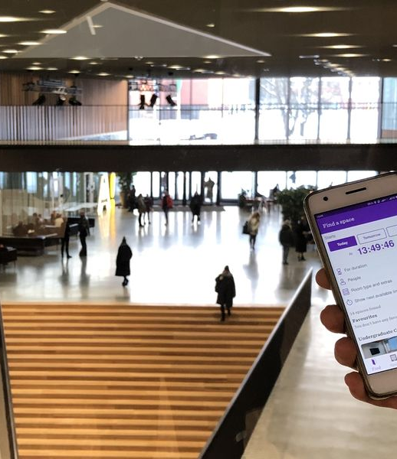
Aalto Space App
Find spaces
Navigate on campus
Reserve self-study spaces
Download in Apple App Store or Google Play, or use https://booking.aalto.fi/aaltospace/ on your browser

Slide 19
Go to students.aalto.fi → page of your programme
Quick guide to Student Guide
Ok, I’m ready, let’s get started!

Slide 20
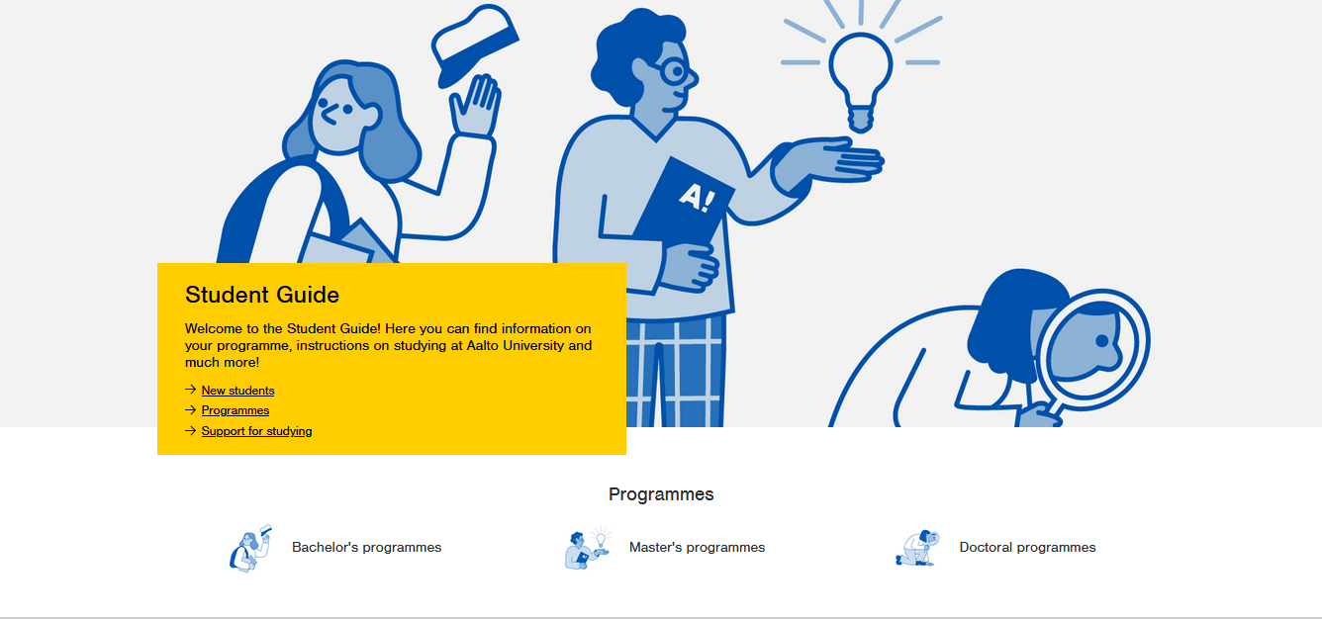
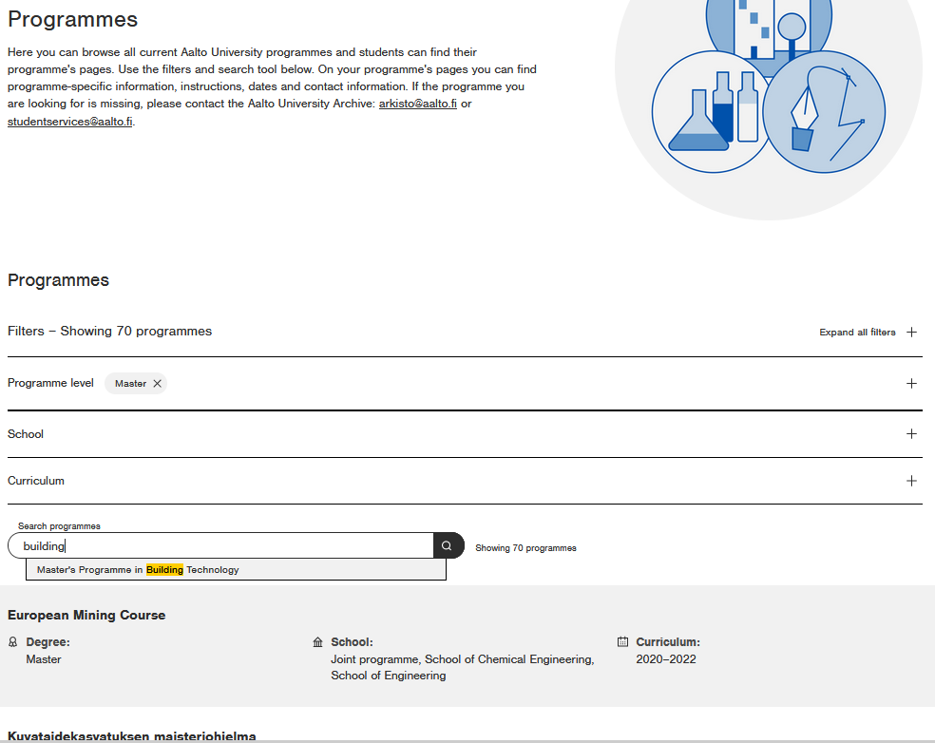
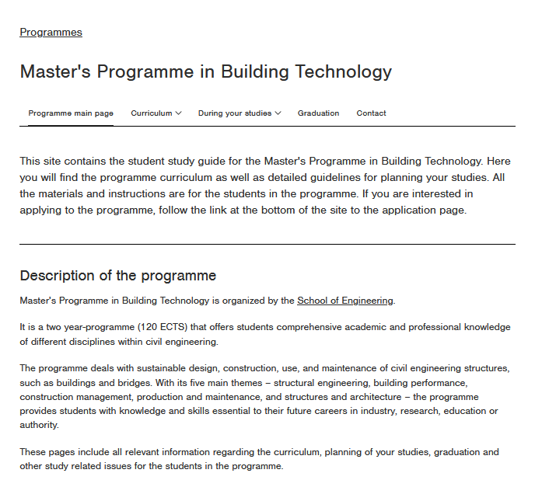
Bookmark the page of your programme!

Slide 21

Basic information on studies and courses
Check pre-orientation https://mycourses.aalto.fi/course/view.php?id=30633
Student vocabulary
Academic freedom and responsibility
Academic year
Courses and other studies
Lectures

Slide 22
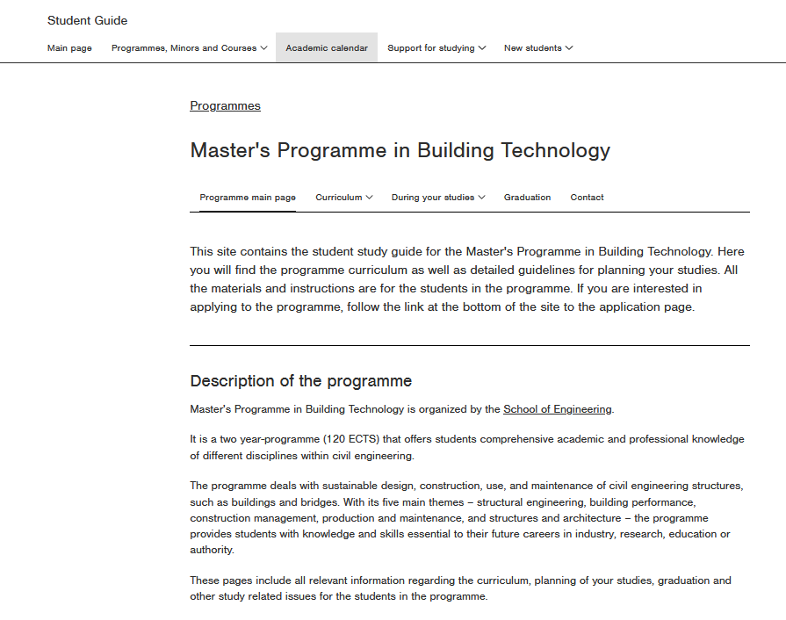
Academic year 2023-2024
(1 August 2023 – 31 July 2024)
Student Guide → Academic Calendar
Autumn term 2023 (1 August – 31 December 2023)
Teaching/evaluation period | Time | Week numbers
First evaluation period and orientation | 28 Aug – 3 Sep 2023 | 35
Period I and evaluation week | 4 Sep – 22 Oct 2023 | 36–42
Period II and evaluation week | 23 Oct – 10 Dec 2023 | 43–49
Seond evaluation period | 11 Dec – 17 Dec 2023 | 50
Notes:
Lisää screen shot Key dates

Slide 23
Academic year 2023-2024
(1 August 2023 – 31 July 2024)
Spring term 2024 (1 January – 31 July 2024)
Teaching/evaluation period | Time | Week numbers
Period III and evaluation week | 8 Jan – 25 Feb 2024 | 2–8
Period IV and evaluation week Spring break 28 Mar – 3 Apr 2024 | 26 Feb – 21 Apr 2024 | 9–16
Period V: multimodal period | 22 Apr – 9 Jun 2024 | 17–23
So… when is there a break, when can I travel or visit my family? Phosh is quite far away…

Slide 24
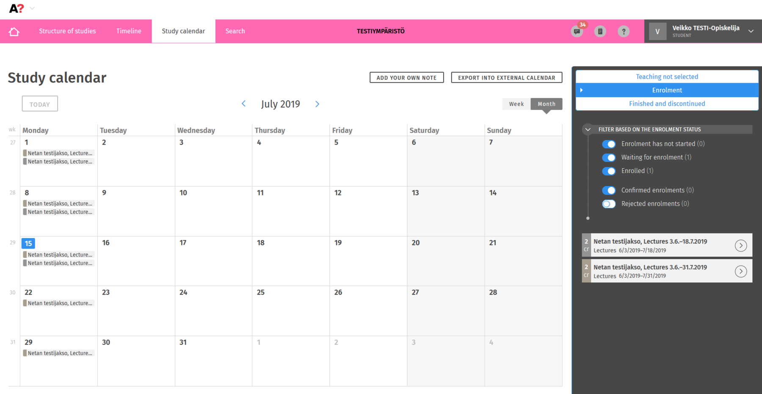
Weekly schedule
You will compose your individual schedule after making your personal study plan and registering on courses
Hey, I found this in Sisu! Looks like I have a lot of free time, right? Studying at Aalto isn’t that much of work after all, or?

Slide 25
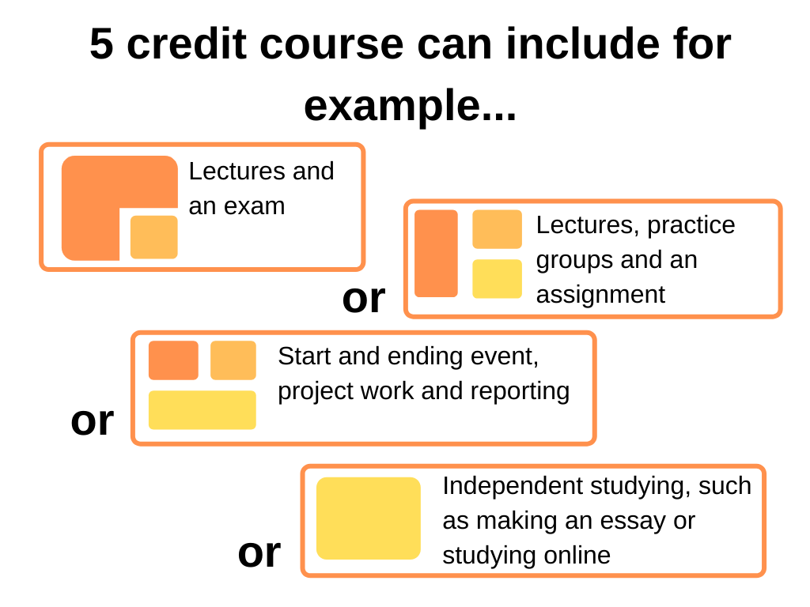
A typical course at Aalto
1 ECTS = 27h of work
A lecture is usually 90 minutes
“Academic quarter”: Lectures start usually a quarter past and finish a quarter to
NB! Exams always start at sharp hours!
A major part of the workload is individual or group work
Some courses have flexible extent (1-10 ECTS)
Not all the courses have exams

Slide 26
Planning your studies
In Phosh, I can clone myself and be present in an unlimited number of places at the same time. I’ve heard that here you have only one body but so many opportunities! How to cope with that?

Slide 27
Msc Degree structure (120 ECTS)
“Inhouse” Master’s programmes
Major studies
Elective studies
Master’s thesis (30 ECTS)
International joint Master’s programmes
Major studies (Aalto + partner university)
Master’s thesis (30 ECTS)

Slide 28
Planning your studies – why?
To stay within the normative study schedule, students at Aalto University have responsibility for:
building and updating a personal study plan in Sisu
planning a balanced, weekly schedule taking into account lectures requiring attendance, independent assignments and recovery from studies
avoiding overlaps when choosing elective courses (and/or actively look for solutions to overlaps with responsible persons of courses)
registering for courses on time in Sisu
communicating challenges related to progress of studies as early as possible.
Notes:
Photo: Aalto University material bank, Tuomas Uusheimo

Slide 29

Planning your studies – how?
Curriculum & degree structure = what you have to and can include in your degree
Programme page in Student Guide
Personal Study Plan (PSP; HOPS in Finnish) = how you plan to do this
Sisu (sisu.aalto.fi)
Registration to courses is done via PSP
“Your best plan to graduate for the time being” – can be modified at any time
Play with the PSP to plan your workload per teaching period / semester
Also a tool used to apply for graduation at a later stage
How to make your PSP, credit transfer, practical training, academic advising → programme-specific meetings Tue & Wed
Notes:
Photo: Aalto University material bank, Tuomas Uusheimo

Slide 30
Planning your international studies
Aalto supports its students to grow globally.
During your studies you have plenty of opportunities to study and work abroad as well as work actively in multicultural partnerships and projects.
You can choose to:
study abroad in an exchange programme
complete your degree in an international jointly organised master's programme
find an internship placement abroad
find other international study opportunities in our university networks
Notes:
Photo: Aleksi Poutanen

Slide 31



STUDY EXCHANGE
Apply for exchange in the best technical universities all over the world!
Students can apply for exchange during the application times in January (all placements excluding Japan), September (for spring placements only) and November (placements for Japan)
New master students need to have studied for at least 1 semester before applying, be registered as attending at Aalto at the time of applying and have a GPA of at least 2.00
Master students must have room for at least 24 credits in their study plans in order to apply
You can find the exchange destinations and application criteria on the Aalto.fi Student Guide -> Exchange studies
Information event on
7.9. at 12-13
in Otakaari 1, U135a U7 PWC
Questions? Send an email to exchanges-eng@aalto.fi!

Slide 32

Planning your language studies
If you have completed your Bachelor degree outside Finland, you must take a 3-ECTS course in a foreign language (intermediate or advanced level) or in Finnish or Swedish (any level)
Courses with (o,w) = oral and written
If you have completed your high school in Finland but BSc abroad, please contact your programme’s planning officer
Foreign language course options in Student Guide
Finnish / Swedish course options
Studying basics in Finnish is strongly recommended to all international students!

Slide 33
Course registration, exams, and grades
Erm… should I turn off my telepathic ultrasound transmission during exams?

Slide 34
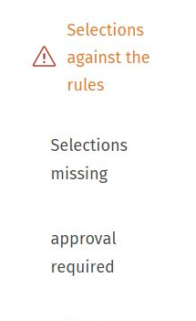
Registration for courses and exams
Course registration
Most registrations are open until the 2nd week of period I (11 September)
Project courses & courses with limited seats might closer registration earlier (e.g. 4 September) – check your PSP!
Register through your PSP n Sisu and make sure you are using the right year of PSP and registering to the course edition of the current academic year
Exam registration
When registering for the course you automatically register for the course exam(s) as well
If you want to retake an exam you have to register for it separately > first retake exams for I period courses take place after the II teaching period
You cannot attend an exam if you haven’t registered
“Error messages“ in your study plan do not prevent course registration. Your programme staff will advise you whether you need to apply for approval immediately or only later.

Slide 35
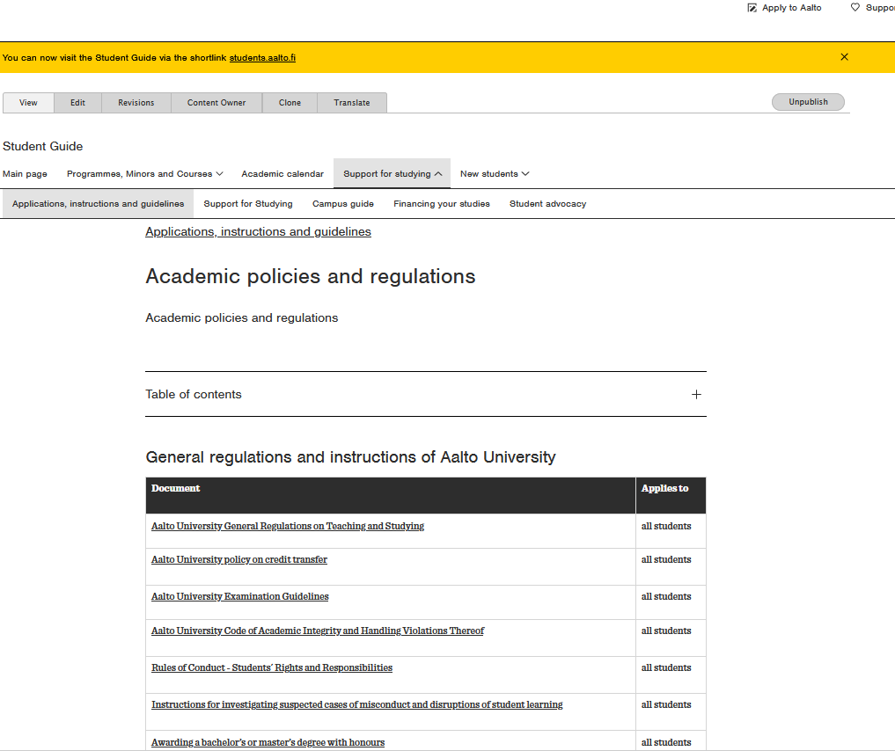
Exams
Exams take place during the evaluation week at the end of each study period; not all courses have exams
Exams last typically 3 hours
Essay questions, calculations, multiple choices etc.
Take your student card, pencil and eraser with you to the exam hall. Calculators and dictionaries → check the instructions for each exam separately.
Examination regulations in Student Guide: https://www.aalto.fi/en/applications-instructions-and-guidelines/aalto-university-examination-guidelines

Slide 36
Grading system
Grade | Meaning | ECTS grade
5 | Excellent | A
4 | Very good | B
3 | Good | C
2 | Satisfactory | D
1 | Sufficient | E
0 | Fail | F
Courses may also be assessed as pass/fail
Failed courses will not appear on the official transcript of records
The course evaluation must be given within 4 weeks from the exam
Want to raise your grade by retaking the course or participating in a make-up exam? → Discuss first with course teacher; Learning Services staff will help with possible enrolment matters
GPAmbitious? Your degree may be awarded with honours if the weighted average grade of the studies (with the thesis) included in the degree is at least 4.00 and if the thesis grade is 4 or 5.

Slide 37
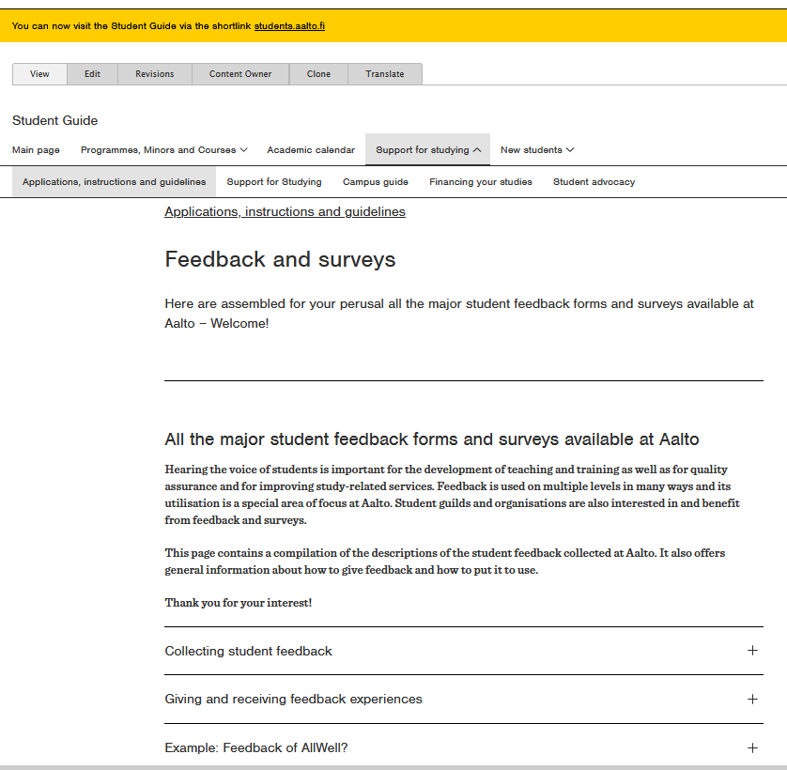
Feedback
Feedback is collected for every course
In some cases you might receive extra points for giving feedback
Time to time we also ask you to answer more general feedback questionnaires regarding the studies and also your wellbeing
It is very important that you give us feedback <3

Slide 38

International Students
Great! I guess I know how to study here now, more or less… now I only have to find out how to live here!

Slide 39
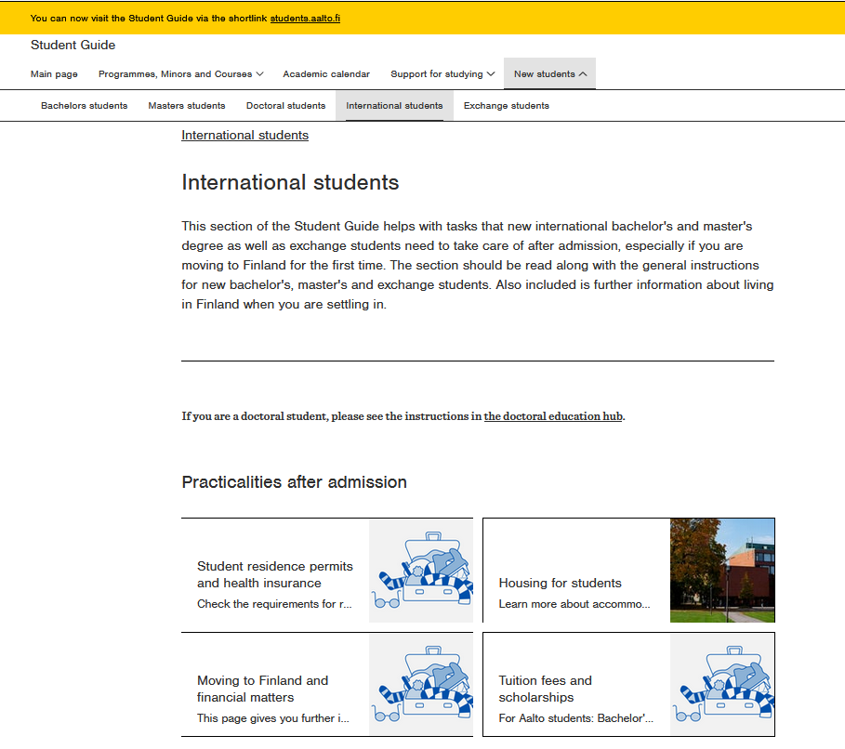
Student Guide for International Students
Practicalities after admission
Practicalities after moving to Finland
Living in Finland
Frequently asked questions

Slide 40
Residence permit & registration of residence
Non-EU/EEA students need a residence permit for studies before coming to Finland
EU/EEA students register their residence at MIGRI within 3 months after arrival → book an appointment in advance!
Nordic citizens register their personal data at DVV (Digital and Population Data Service Agency)

Slide 41
Finnish ID number
The Finnish personal identity number (i.e. social security number, ‘henkilötunnus’ in Finnish) is the main means of identification in Finland.
Inform the university of your personal ID code at masterstudies-eng@aalto.fi
The code is needed for accessing important services, such as the FSHS (healthcare services), HSL transportation seasonal tickets, working, opening a bank account or a mobile phone plan.
How to get one?
Non-EU/EEA citizens: when you are granted the student residence permit OR upon arrival by registering at the Digital and Population Data Services Agency
EU/EEA citizens: when your right of residence is registered at Migri OR upon arrival by registering at the Digital and Population Data Services Agency
Nordic citizens: when you register at the Digital and Population Data Services Agency
Note that the identity code is sensitive personal information, so please do not share it in social media or other open channels.

Slide 42
Municipality of residence
If you are staying in Finland for more than a year (regardless of your nationality), you are required to register your place of residence and your permanent municipality of residence in Finland at the Digital and Population Data Services Agency (DVV).
The registration enables you, for example, to receive the full student discount in public transportation (HSL) and to use some municipal health care services.
Pop-up desks at the Welcome Fair → see details at https://www.aalto.fi/en/events/aalto-welcome-fair
Bring your passport, residence permit card (non-EU/EEA) and certificate of student status (download in Sisu → My profile)

Slide 43

Tuition fees & scholarships
If you are a non-EU/EEA citizen, you are liable for tuition fees at Aalto University
Welcome to hear more about how tuition fee liability may (or may not) affect planning your studies on Thursday at 9 am
Useful also for those exempted from fees
Note: not for EIT students

Slide 44
Support for studies
This information has been very helpful but what if I need some additional support with my studies? I might have some physical challenges compared to most human beings.

Slide 45
Individual study arrangements
Each Aalto student has a right to reasonable individual study arrangements due to an impairment restricting his/her ability to study or other health condition.
For example: dyslexia, sensory impairment, mathematical learning difficulties, attention deficit and hyperactivity disorder, autism spectrum disorders or mental disorders
The measures for making individual study arrangements are individual solutions to course teaching, examinations and working methods.
For example: extended exam time, separate exam room, modified schedule, alternative ways of assessing learning outcomes
Please contact your Learning Services by secure email (firstname.lastname@aalto.fi.s)
Additional information and contact details https://www.aalto.fi/en/services/contact-information-for-individual-study-arrangements

Slide 46
Learning Services (LES)
One of the biggest (if not the?) service unit of Aalto University
“To let students focus on studies and faculty members focus on teaching and research” – we help with the rest
We are mostly study affairs secretaries, study coordinators and planning officers – we are not teachers or (necessarily) experts in your substance
Units and areas of learning services
Open University
Admission Services
Library Services
Student Services (at each school and at Starting Point) → often referred to as synonym to LES in student contexts
Language Centre
Teacher Services
Programme management services
Welcome to ask questions on Friday from 9 am to 12 pm in Otakaari 4 lobby!

Slide 47
Student’s Primary LES Contacts
Find our contact information & book appointments with us in MyStudies
Master’s programme | LES Contact persons
Advanced Energy Solutions (AAE) | Pauliina Liimatta / Suvi Jämsä
Building Technology (CIV) | Katri Koistinen / Harri Långstedt
Geoengineering (GEO) | Katri Koistinen / Harri Långstedt
Geoinformatics (GIS) | Päivi Kauppinen / Harri Långstedt
International Design Business Management (IDBM ENG) | Katri Koistinen
Mechanical Engineering (MEC) | Katri Koistinen / Helena Suonsilta
Real Estate Economics (REC) | Päivi Kauppinen
Spatial Planning and Transportation Engineering (SPT) | Päivi Kauppinen / Suvi Jämsä
Urban Studies and Planning in Real Estate Economics (USP) | Päivi Kauppinen
Water and Environmental Engineering (WAT) | Päivi Kauppinen
masterstudies-eng@aalto.fi
Welcome to ask questions on Friday from 9 am to 12 pm in Otakaari 4 lobby!

Slide 48
Student’s Primary LES Contacts
Joint international Master’s programmes | LES Contact person
Nordic Master programmes
Environmental Engineering | Michael Sagulin / Börje Helenius
Innovative Sustainable Energy Engineering | Michael Sagulin / Börje Helenius
Maritime Engineering | Michael Sagulin / Börje Helenius
Cold Climate Engineering | Michael Sagulin / Börje Helenius
EIT programmes
Environomical Pathways for Sustainable Energy Systems (EIT InnoEnergy) | Michael Sagulin / Börje Helenius
Energy Storage (EIT InnoEnergy) | Michael Sagulin / Aino Roms
Manufacturing (EIT Manufacturing) | Anni Vänskä / Aino Roms
Urban Mobility (EIT Urban Mobility) | Anni Vänskä / Aino Roms
European Mining Course | Anni Vänskä
jointmasters-eng@aalto.fi
Notes:
Nelli?

Slide 49
You handle most things easiest and quickest on electronic study platforms, but if needed, you can visit regarding…
Certificates of student status / attendance
Transcript of records
Annual enrolment for the academic year (primarily done online via WebOodi)
Changes of name for the student register
Questions related to study rights
Always use your Aalto.fi email when you contact us and mention your programme as well as student number
General Student Services
Starting Point Otakaari 1 (Undergraduate Centre), room Y199a Starting Point Service Desk is open Mon–Thu 12-15, closed on Fridays studentservices@aalto.fi +358 29 442 9280
Student Service Desk, School of Engineering Otakaari 4 (K1 building) room K102 Open this week Mon-Fri 10-12 & 13-15 studies-eng@aalto.fi or studentservices@aalto.fi +358 50 347 8230

Slide 50
Questions?

Slide 51

Last slide (promise) – Wrap up
Attend programme-specific events later this week
Booking one-on-one appointment with Learning Services coordinator / planning officer in MyStudies (reviewing study plans, discussing electives, questions..)
Find this material will be on your programme’s Student Guide page → Starting your studies
Lost and don't know where to be tomorrow? Stay to chat!
mystudies. aalto.fi

Slide 52

Kiitos!
Thank you, I feel super relieved and welcome now!
Notes:
Photo: Aalto University material bank, Unto Rautio

