Slide 1
Welcome to Aalto ENG!
Mirka Jalonen Manager, Academic Affairs
28.8.2023

Slide 2
Learning Services works for you!
Learning Services (LES) personnel is helping you with planning your studies from first year to graduation and you are most welcome to ask us anything regarding the beginning of your studies and during your study path.
Counselling and advising is organized via Zoom/ Teams, phone or email and face to face.
Contact details of Learning Services of ENG: https://www.aalto.fi/en/student-guide → Support fo Studying → School of Engineering Learning Services
You can always send email to studentservices@aalto.fi

Slide 3
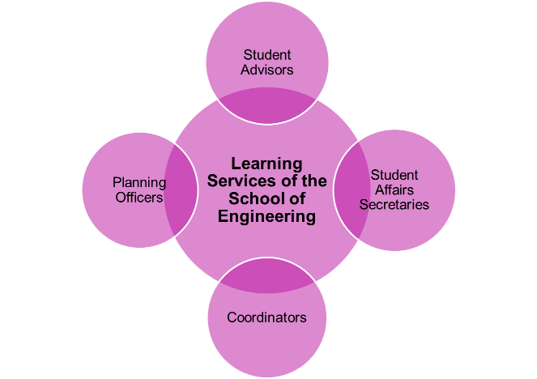
Examples of services offered from the School’s Learning Services (LES)
Help with Personal Study Plan (HOPS)
Study right related matters
Study counselling
Transcripts and certificates
Annual enrolment
Transfer of credits
Degree certificates
Exchange studies
Tuition fee related matters
Study time extensions
Timetables
Curriculum planning and coordination
Information on BSc and MSc theses practical issues
Coordination of academic advising
Updating student register SISU
Coordination of applicants’ academic evaluation
Graduation + graduation ceremonies

Slide 4
Students’ well-being services
Students’ well-being is important for Aalto and Aalto offers guidance and self-study services that supports student well-being. Below you will find more about the services available and links to useful materials.
Starting Point of Wellbeing supports your well-being
Personal Impact course offering, 2023-2024
Groups, workshops and online materials for supporting wellbeing and study ability
The Best Thing Today is a podcast series by Aalto study, career and advanced study psychologists.
You can use Finnish Student Health Service once you have registered - (yths.fi) (only for BSc and MSc degree students)
Nyyti Ry / services for students to support students’ mental health and ability to study
UniSport – Exercise and much more!

Slide 5
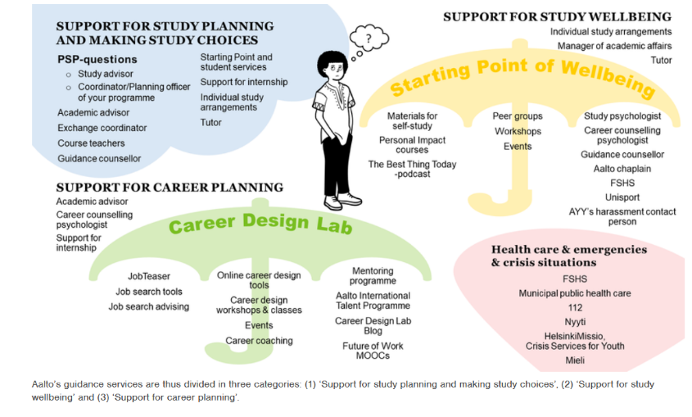
https://www.aalto.fi/en/services/guidance-and-support-for-students

Slide 6
Orientaatioviikko/ Orientation week
Insinööritieteiden kandidaattiohjelma/ Bachelor programme in Engineering: https://www.aalto.fi/fi/ohjelmat/insinooritieteiden-kandidaattiohjelma/opintojen-aloittaminen?check_logged_in=1
Master’s programmes: Student Guide → Programmes → Find your own programme → During your studies → Starting your studies
ENGin opiskelijapalvelupisteen aukioloajat orientaatioviikolla/ ENG student service desk opening hours during the orientation week 28.8.-1.9.2023
28.8. - 31.8. 10:00–12:00 and 13:00–15:00
1.9. 10:00–14:00
Tervetuloa!/ Welcome!

Slide 7
Aalto Day One
Let’s start the new academic year of Aalto University together! All members and partners of the Aalto community are welcome to celebrate on Tuesday 5 September.
Please remember to register for the event.
The link to the webcast of the opening ceremony will be provided on the event’s webpage on the day of the event: https://events.aalto.fi/en/3X3IKxA7/aalto-day-one-592023-4a3b7T8hrg/overview
Timetable
13.15–14.20 Opening ceremony of the academic year | Undergraduate Centre, U2 hall & online & screening studios
14.20–15.00 Reception | Undergraduate Centre, U wing, lobby
15.30–19.30 Aalto Party | Alvar Aalto park

Slide 8
Your feedback matters!
During the time of studies you have a possibility to give many kind of feedback. Feedback gives important information for the development of teaching as well as for quality assurance and for improving study-related services. All the feedback is much appreciated!
Some examples:
Course feedback after every course
New student questionnaire after 1st study year (Fuksikysely)
The national Finnish Bachelor's Graduate Survey (Kandipalaute)
Study Well-being questionnaire (AllWell?)
Graduates questionnaire after Master studies

Slide 9
Thank you! Have a great orientation week and even greater first academic year!

Slide 10
Learning Services School of Engineering
Manager, Academic Affairs, Mirka Jalonen, mirka.jalonen(a)aalto.fi
Management of Learning Services, School of Engineering
Presenting officer, study related decisions (i.a. admissions, degrees, study right extensions, requests for an administrative review)
Violations of Aalto University Code of Academic Integrity (plagiarism, cheating on exam, inappropriate conduct)
Preparer and presenting officer, School Academic Committee
Manager, International Relations, Saara Sokolnicki,
saara.sokolnicki(a)aalto.fi
International partnerships, incl. student exchange (agreements)
International education projects (agreements)
Specialist Heidy Tiits-Tikkanen, heidy.tiits-tikkanen(a)aalto.fi
Pedagogical specialist, Teaching Competence Assessment Committee (TCAC)
Teaching development
Coordinator Reetta Mannola, reetta.mannola(a)aalto.fi
ENG doctoral programme
Selection process, doctoral programme
Preparation and execution of the decisions delegated to head of doctoral programme
Graduation
Planning Officer Ritva Viero, ritva.viero(a)aalto.fi
ENG doctoral programme
Selection process, preliminary examination process, doctoral programme
Preparation and execution of the decisions made by the Doctoral Programme Committee and the dean
Learning Services provides support for teachers, students and applicants.Three teams work in cooperation with Aalto’s Learning Services and other Aalto staff. This prochure includes the main tasks of each employee. More information and the contact info can be found from the websites Student Guide and people.aalto.fi
Student Service Desk room 102a, Otakaari 4, Otaniemi, ESPOO open on Tuesdays 12–14 and on Thursdays 13–15 PL 14100, 00076 AALTO p. +358 50 347 8230 studies-eng(a)aalto.fi
Student advisors advisors-eng(a)aalto.fi

Slide 11
Student Services (SUP-team)
Coordinator Helena Suonsilta,
team leader helena.suonsilta(a)aalto.fi
Master’s programmes MEC
Personal study plans, graduation
Timetables
Secretary, Degree Programme Committee
Secretary and member, TCAC
Coordinator Elias Forsman, elias.forsman(a)aalto.fi
Bachelor’s programme, majors KEY, KIG and RYM
Support for bachelor’s programme
Personal study plans, graduation
Secretary, Bachelor’s Programme Steering Group
Advising Swedish speaking bachelor’s students
Coordinator Elisa Murto, elisa.murto(a)aalto.fi
Student Service Desk
Registerations
Non-degree studies and contract studies
Graduation ceremonies
Coordinator Pauliina Latvakoski, pauliina.latvakoski(a)aalto.fi
ENG Bachelor’s thesis seminars
ENG common evening exams
Coordinator Marlene Parman, marlene.parman(a)aalto.fi
Bachelor’s programme, majors EKO and KJR
Support for bachelor’s programme
Personal study plans, graduation
Timetables
Study Secretary Tiia Pelkonen, tiia.pelkonen(a)aalto.fi
Student Service Desk
Degree certificate, archiving
Study credit registerations
Coordinator Virpi Riissanen, virpi.riissanen(a)aalto.fi
Supervisor of student advisors
Contact person, Metropolitan Sports Academy Urhea
Orientation and orientation course, bachelor’s programme students
Coordinator Erika Ruohonen, erika.ruohonen(a)aalto.fi
Bachelor’s programme, majors RAK and ENY
Support for bachelor’s programme
Personal study plans, graduation
Responsible for timetables

Slide 12
International Study Services (ISE-team)
Planning Officer Aino Roms, aino.roms(a)aalto.fi, team leader
Joint master’s programmes ES, UM, MANUF
Curriculum planning, admissions
Academic advising, master students
Planning Officer Börje Helenius, borje.helenius(a)aalto.fi
Joint master’s programmes NMCC, NMEE, ISEE, NMME ja SELECT
Orientation, master’s programme students
Degree descriptions, curriculum planning, admissions
Coordinator Vilma Jokinen, vilma.1.jokinen(a)aalto.fi
Outgoing exchange students, selection process, advise, grants
Unite: outgoing and incoming students
Coordinator Jaana Kauppi, jaana.kauppi(a)aalto.fi
Aalto coordinator, housing for international students
Degree descriptions and admissions, master’s programmes
Secretary, Engineering Academic Committee
Coodinator Michael Sagulin,
International joint degree programmes, NMCC, NMEE, ISEE, NMME, SELECT, ES
Student selection, advising and marketing
Graduation
Planning officer Melina Nummi, melina.numi(a)aalto.fi
Student exchange (outgoing) and international internhips selection process, orientation, advising, marketing
Unite, Joint Mobility Centre and Mobility for All Projects
Coordinator Hannele Pietola, hannele.pietola(a)aalto.fi
Student exchange (incoming), selection process, orientation, advising, marketing
Coordinator Anni-Elina Vänskä
International joint degree programmes, EMC, UM, MANUF
Student selection, advising and marketing
Graduation

Slide 13
Support Services for Teachers and Programme Directors (TED-team)
Planning officer Minna Marin, team leader minna.marin@aalto.fi
Substitute for Saara Kanerva
Bachelor’s programme
Curriculum planning, admissions
Support for programme director
Planning officer Päivi Kauppinen, paivi.kauppinen(a)aalto.fi
Master’s programmes GIS, REC, SPT, WAT, CS, USP
Curriculum planning, admissions
Support for programme director
Planning Officer Katri Koistinen, katri.koistinen(a)aalto.fi
Master’s programmes MEC, CIV, GEO, IDBM
Curriculum planning, admissions
Support for programme director
Contact person, accessibilities
Coordinator Suvi Jämsä, suvi.jamsa(a)aalto.fi
Master’s programmes GIS, CS, REC, SPT, USP
Personal study plans, graduation, timetables
Coordinator, national grants
Secretary, AAE Degree Programme Committee
Secretary and member, TCAC
Planning Officer Sanni Valkeapää,
On family leave
Coordinator Harri Långstedt, harri.langstedt(a)aalto.fi
Master’s programmes GEO, CIV, WAT, EMMEP, NMEE
Personal study plans, graduation
Timetables
Coordinator, Study Counsellor Mari Martinmaa, mari.martinmaa(a)aalto.fi
Study councelling (bachelor students)
Student feedback surveys
Academic advising
Secretary and member, TCAC
Planning Officer Pauliina Liimatta, pauliina.liimatta(a)aalto.fi
Substitute for Sanni Valkeapää
Aalto joint master’s programme AAE
Curriculum planning, admissions
Support for programme director
Personal study plans, graduation
Planning officer Saara Kanerva.
On family leave

Slide 14
ENGin koulutusohjelmat/ Programmes at ENG

Slide 15
Degree Programmes, School of Engineering (ENG)
Bachelor’s Programme in Engineering/ Insinööritieteiden kandidaattiohjelma
Majors until 31 July 2025/ Vanhat pääaineet, mahdollisuus valmistua 31.7.2025 asti ENY Energia- ja ympäristötekniikka/ Energy and Environmental Engineering
KJR Kone- ja rakennustekniikka/ Mechanical and Civil Engineering
RYM Rakennettu ympäristö/ Build Environment
New majors, starting from 1 August 2022/ uudet pääaineet 1.8.2022 alkaen
EKO Energia- ja konetekniikka/
Energy and Mechanical Engineering
KEY Kestävät yhdyskunnat/ Sustainable Communities
KIG Kiinteistötalois ja geoinformatiikka/
Real Estate Economics and Geoinformatics
RAK Rakennustekniikka/ Civil Engineering
Aalto Bachelor’s Programme in Science and Technology
ENG major
COE Computational Engineering
In house Master’s Programmes
CIV Building Technology
GEO Geoengineering
GIS Geoinformatics
MEC Mechanical Engineering
REC Real Estate Economics
SPT Spatial Planning and Transportation Engineering
WAT Water and Environmental Engineering
Joint Master’s Programmes with other Aalto Schools
AAE Advanced Energy Solutions (ENG majors: Sustainable Energy in Buildings and Built Environment ja Sustainable Energy Conversion Processes)
IDBM International Design Business Management
USP Urban Studies and Planning (ENG: Urban Studies and Planning in Real Estate Economics)
Joint International Master’s Programmes
NMCC Cold Climate Engineering (Nordic Master)
NMEE Environmental Engineering (Nordic Master)
ISEE Innovative Sustainable Energy Engineering (Nordic Master) NMME Maritime Engineering (Nordic Master) EMC European Mining Course
ES Energy Storage (EIT InnoEnergy)
SELECT Environomical Pathways for Sustainable Energy Systems (EIT InnoEnergy)
MANUF Manufacturing (EIT Manufacturing)
UM Urban Mobility (EIT Urban Mobility)
Doctoral Programme in Engineering

