Slide 1
Welcome to Aalto ENG!
Jani Romanoff
Vice Dean of Education, School of Engineering
28 August 2023

Slide 2
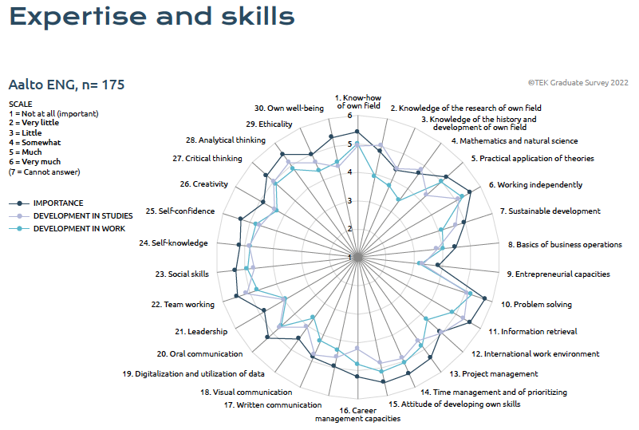
Learning through Well-being
The aim is that everyone find their own meaningful study path
We learn and we teach the best we can – we are in this journey together
Society needs you to solve the grand-challenges with creativity and entrepreneurial mindset – we are known for our capability to innovate
Work-life balance is essential for our success, see related course Mind and Study (3cp)
https://www.aalto.fi/fi/uutiset/uusi-3n-opn-kurssi-mind-study-hyvinvoivan-opiskelijan-tyokalupakki-tulossa-2-periodissa
https://sisu.aalto.fi/student/courseunit/otm-01b019fd-4d00-4e90-a49a-cc30444a4415/completion-methods

Slide 3
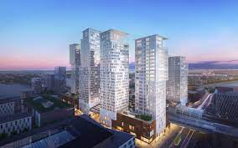
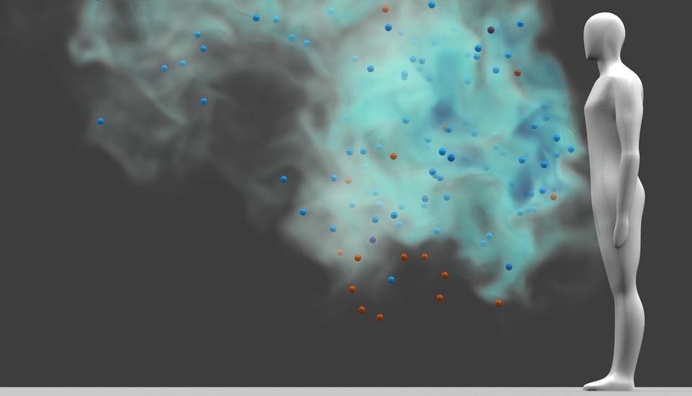
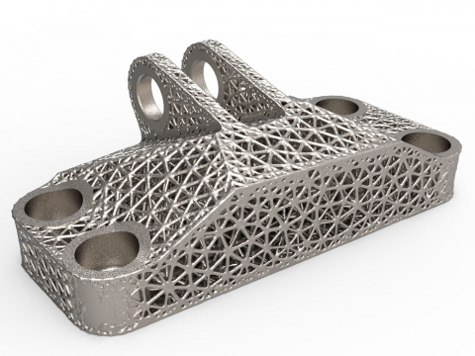
Changes to Bachelor Programme in Engineering
Current majors/application targets
Energy and Environmental Technology (ENY)
Mechanical and Structural Engineering (KJR)
Built Environment (RYM)
Computational Engineering (COE)
New Majors/application targets starting from autumn 2022
Energy and Mechanical Engineering (EKO)
Civil Engineering (RAK)
Sustainable Communities (KEY)
Real Estate Economics and Geoinformatics (KIG)
Computational Engineering (COE)

Slide 4
New B.Sc. Programme with intakes aligned with Master's Programmes
4 Finnish + 1 English language intakes/majors
B.Sc. Clusters
on common studies
20-25ECTS
Extended Major
Electives
45-50ECTS
B.Sc. Minors + Electives
(ENG & other schools)
Energy and Mechanical Engineering
Common Studies (65-70ECTS)
Energy Engineering
Mechanical Engineering (School Internal)
Aalto Internal M.Sc. Programs: Mechanical Engineering (several paths); Building Technology (several paths, FISE); Advanced Energy Solutions; Geoengineering; Geoinformatics; Water and Environmental Engineering; Real Estate Economics; Spatial Planning and Transportation Engineering
Mechanics
Common Studies
Mechanical Engineering
Civil Engineering
Structural Engineering
…
Geo Engineering
Intelligent systems
(Joint between Schools)
International Co-operation M.Sc. Programs: Environmental Engineering; Innovative Sustainable Energy Engineering; Maritime Engineering; Cold Climate Engineering; European Mining Course; Env. Pathways for Sust. Energy Systems; Energy Storage; Urban Mobility; Manufacturing
Sustainable Communities
Spatial planning and transportation engineering
…
Build Environment
Common Studies
Water and environmental engineering
Real Estate Economics and Geoinformatics
Real estate economics
Industrial Economics
(Other Schools)
Geoinformatics
National Co-operation M.Sc. Programs: Urban studies and planning (in real estate economics); FITech, Bilateral agreements (UTU)
Computational Engineering
Computational Engineering
* The B.Sc. studies in Technology / Engineering contain:
Common studies 65-70 ECTS (inc. 5 ECTS on communication and languages)
Cluster and Major studies 60-75 ECTS
Minor studies 20-25 ECTS
Electives 15-30 ECTS
Technical Schools: Math 20, Natural Sciences 10, Computer Sciences 10

Slide 7
