Slide 1
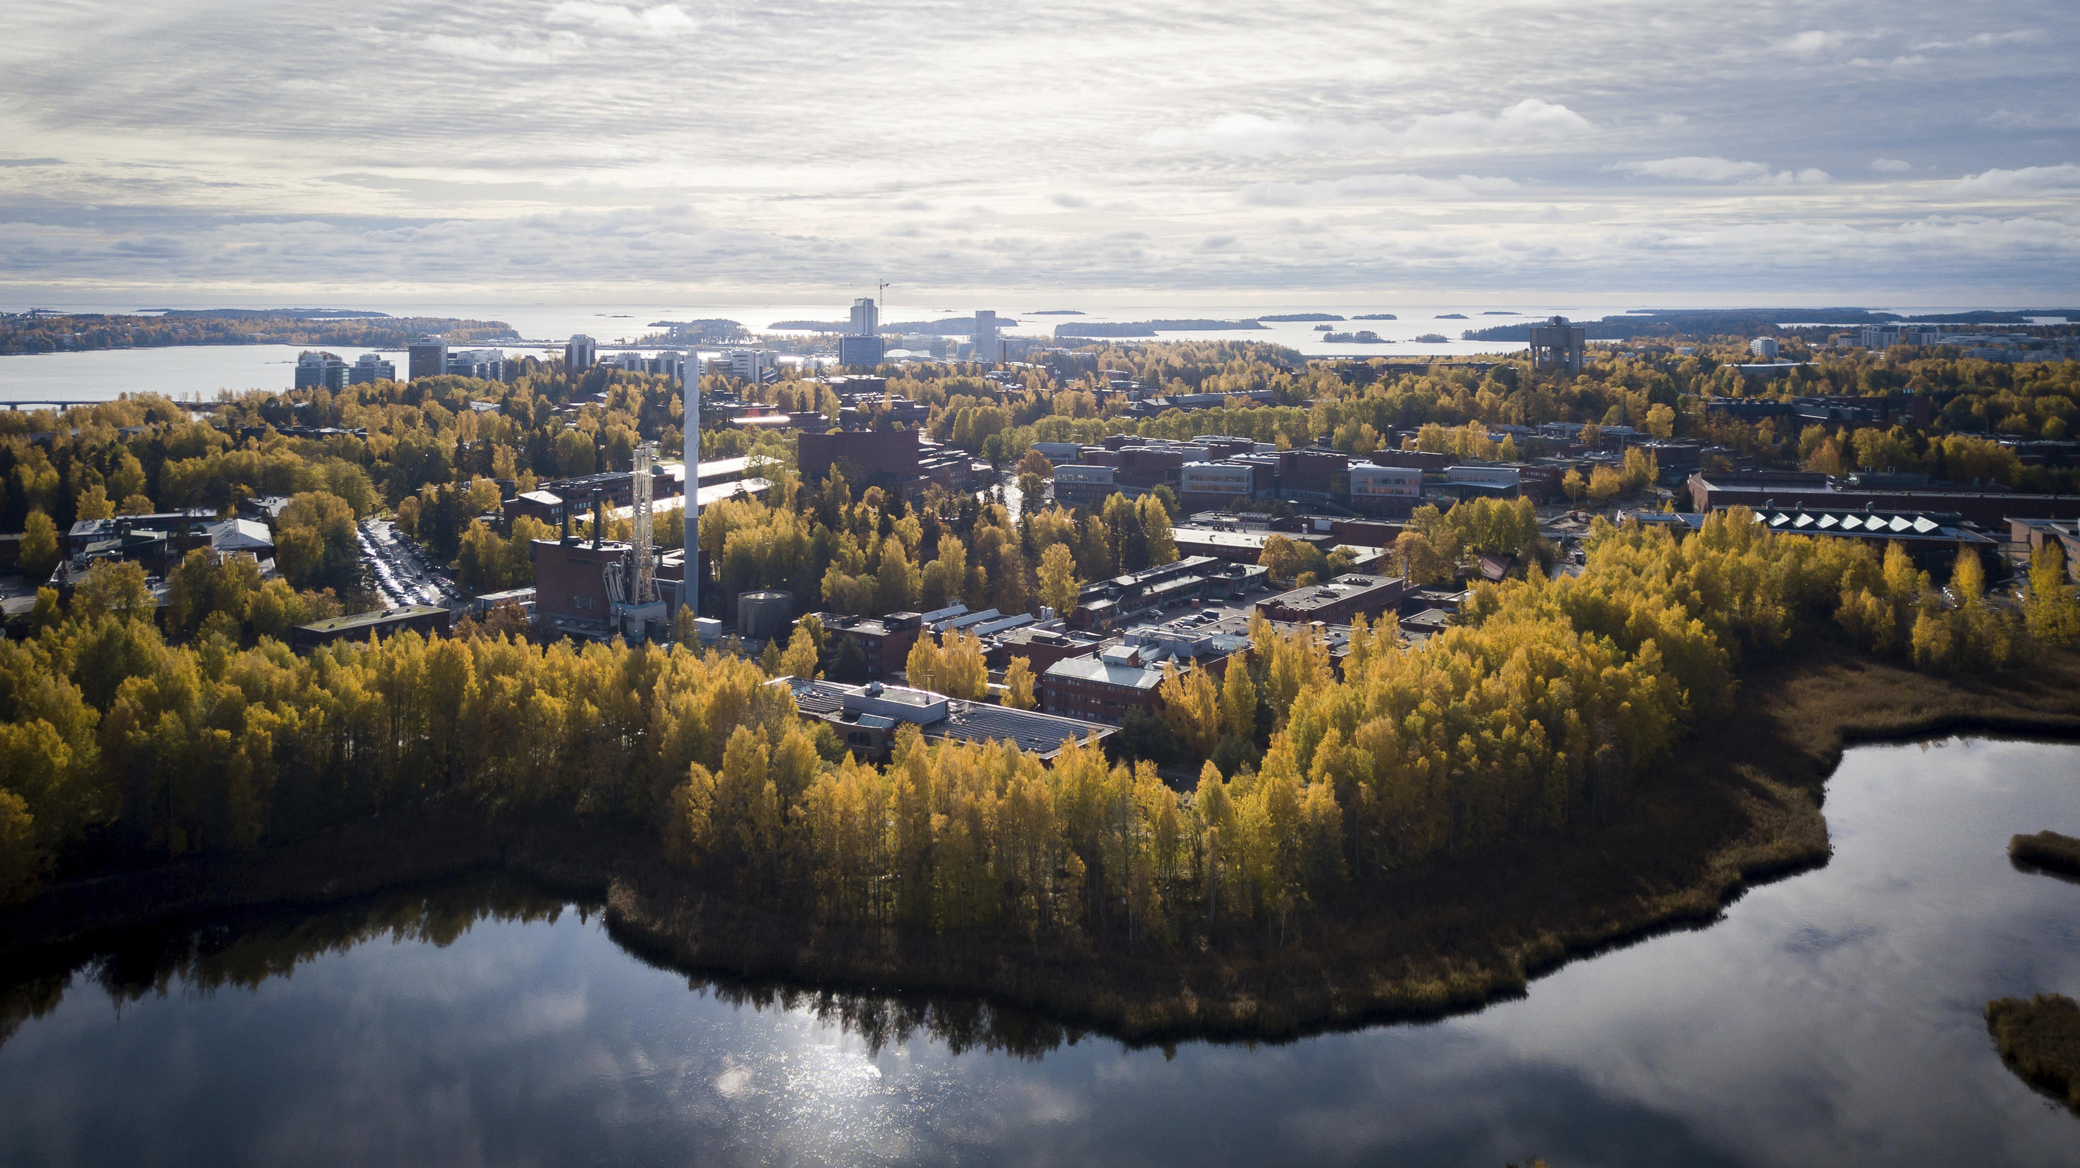

Aalto University
FINEEC AUDIT
Site visit 25.-26.1.2023
4.1.2023 / KEK

Slide 2

Purpose of the quality audit
Ensure
Monitor
Use
Support
Promote
Enhance
The main focus is on how the Aalto University improves and enhances its activities
The functionality and effectiveness of the quality systems of HEIs is assessed.
  With respect to FINEEC criteria
  With respect to Aalto strategy
The focus of the audit is on the procedures used by the Aalto University to maintain and enhance the quality of its activities.

Slide 3

FINEEC audit model 2019–2024
I University creates competence
▪ The planning of education
▪ The implementation of education
▪ The enhancement of education
▪ Example(s) of successful development activities
II University promotes impact and renewal
▪ Managing societal engagement and impact
▪ Research, development and innovation activities and artistic activities with impact
▪ Promoting renewal through the organisational culture
▪ Example(s) of successful development activities
III University enhances quality and well-being
▪ Using the quality system in strategic management
▪ Supporting the competence development and well-being of the staff
▪ Functionality and development of the quality system
▪ Example(s) of successful development activities
IV University as a learning organisation (Benchlearning case)
▪ Equality, Diversity and Inclusion (EDI)
AUDIT MANUAL FOR HIGHER EDUCATION INSTUTUTIONS 2019-2024
Evaluation scales: Excellent, Good, Insufficient.
In order for the HEI to pass the audit, the evaluation areas
I–III should reach at least the level Good.

Slide 4
Area I) Aalto creates competence – main aspects
Competence-based education (defined learning outcomes)
Working-life relevance
Research-based education
Inter-nationalisation
Student-centred approach
Support services
Continuous/ lifewide learning
Systematic development of education

Slide 5
Area II) Aalto promotes impact and renewal – main aspects
Managing and enhancing societal engagement and impact
Societal impact of RDI and artistic activities
Operational culture encourages innovation and experimental activities

Slide 6
Area III) Aalto enhances quality and well-being –
main aspects
Using the quality system
in strategic management
Supporting the
competence development
and well-being of the staff
Functionality and development of the quality system

Slide 7
Quality system audit preparations in a nutshell
Self-evaluation of Aalto processes and quality management system
Self-evaluation report submitted 2.11.2022
Schools, services and joint areas conducted the audit self-evaluation as part of our annual University Review
Benchlearning exercise with EPFL – case Equality, Diversity and Inclusion
Site visit of the audit 25.-26.1.2023
Site visit of the audit carried out by an international audit team appointed by Finnish Education Evaluation
Centre (FINEEC)

Slide 8
The programme of the site visit on 25–26 January
Wednesday 25 January
Interview with the Rectorate and Provost
Interview with Deans of Schools
Thematic interview: Education
Student workshops
Thematic interview :Research, art and innovation activities
Thematic interview: Societal engagement and impact
Interview with Board of the Aalto University
Interview with External stakeholders
Thursday 26 January
Thematic interview: Quality management
Staff workshops: Development of research-based teaching and learning, lifewide learning and learning support services
Thematic interview: Student union and student representatives
Thematic interview: Doctoral students
Thematic interview: Support services
Thematic interview: Staff competence development and well-being
Thematic interview: Equality, Diversity and Inclusion (staff and students separately)
Final interview with the top management
Preliminary feedback to the Aalto University

Slide 9

Purpose of the audit site visit
To get an overall picture of Aalto and how the quality of education, research and regional development is maintained and developed
To verify and supplement the observations made based on the Aalto’s audit material
An interactive event that supports the development of the operations of the Aalto

Slide 10
Audit team of Aalto
Antoinette Perry (chair), Vice Principal, Associate Professor, University College Dublin, Ireland
Professor Geir Øien (vice chair), Norwegian University of Science and Technology (NTNU), Norway
Student Mia Brzakovic, University of Belgrade and Trinity College Dublin, Serbia
CEO Mika Konu, Technology Centre Merinova, Finland
Sirpa Moitus, Counsellor of Evaluation, FINEEC
Kirsi Mustonen, Senior Advisor, FINEEC

Slide 11
Auditors
have been trained for their role
see us through written materials
may have decided internal roles
have a priori understanding on us
may have pre-prepared drafts for their reports
The purpose of audit visit is to verify and supplement the observations
made on the basis of the audit material

Slide 12
Auditor perspective
The auditors need to make sure they understand how the Quality System works – As a whole / At all levels / At all units
They need to find evidence for and examples of the claims made in the self-evaluation report and other written materials. - Identification of strengths and best practices – but also development needs and gaps.
The audit team will typically ask
  how are things done and processes developed
  how do we know that something works/doesn’t work
  for examples
  In other words, they aim to find out about the quality assurance mechanisms and the level of systematisation.

Slide 13

How to prepare for the interviews and workshops?
The audit team is interested in daily activities of the university and its quality management and development.
  The interviews are confidential.
  Interviews and workshops are not exams or testing sessions.
  There are no wrong answers.
  There is no need to memorise documents related to the quality system and development.
  There is no need to bring material to the interviews.
In interviews and workshops
  If anything is unclear in the interview, please ask for clarification.
  In interviews, you may answer in your own style and from the perspective of your own position.
  The interview sessions have tight schedule, and you are advised to keep your answers short and to the point.

Slide 14
Example questions: management practices of the department / school / university)
How do you set the goals for the education / research / impact / services ? Planning of actions.
How do you follow the execution of the (strategic) plans, and review the KPI’s?
How do you evaluate / review education / research / impact activities, services supporting it, and management/leadership within the department/school/university?
How do you develop different activities / operations within the department / school / university? Utilisation of evaluation results and feedback from students, staff, stakeholders.
How is multidisciplinarity embedded in Aalto's education / research / impact activities ?
How are different personnel groups, students and external stakeholders participating in the development of the activities ?
How do you keep all actors appropriately informed?

Slide 15
Materials submitted to FINEEC
Self-evaluation report
͘Overall strategy of the university
͘Quality manual - Aalto Handbook
An organisation chart
The curricula of degree programmes
RPL instructions
Equality, Diversity and Inclusion plan 2022-2024

Slide 16
Finally
When possible, try to contextualise your answer in terms of
  The PDCA cycle
  The annual planning/management cycle
This should, however, sound natural …
Remember, this is an enhancement-led exercise.
  The auditors are not trying to find out whether the interviewees know the right answers.
  The auditors try to find out how things are done in order to help Aalto University to develop the quality system further.
  (Also) the auditors are nervous.
  The auditors are desperate to find evidence and examples and will be very grateful for any help.

Slide 17
Interview practicalities
Audit visit takes place 25.-26.1. – all interviews at Dipoli
The interview group get together 10 minutes before the audit discussion – Dipoli, first floor
After interview a short feedback/debriefing session in café room
In case of force majeure (e.g. sickness), please send text message to Iina (0504420722) or Kirsi (0503841707)
Audit result public after FINEEC meeting in April

Slide 18
Background
information

Slide 19
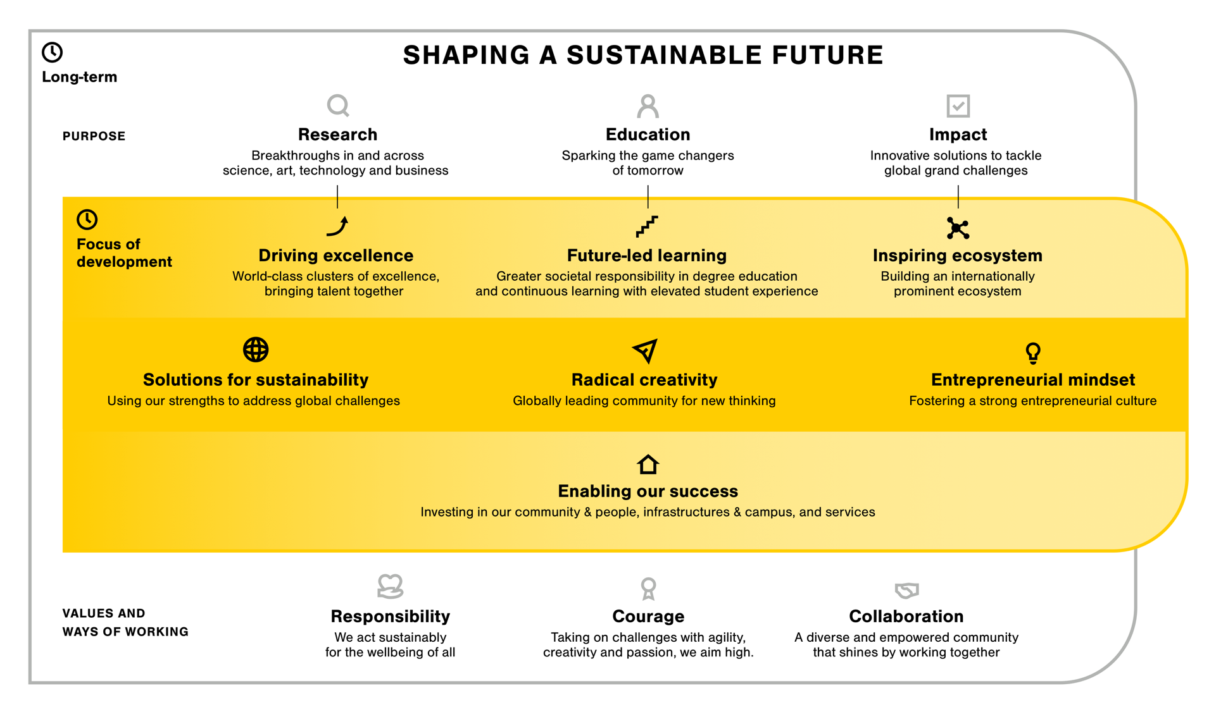
Notes:
Aalto University’s living strategy

Slide 20






Quality system in our daily activities
WHAT
WHO
WHY
Organisation
& processes
(roles, responsibilities, reporting)
Continuously improving
Strategy and
Our plan
Feedback & follow-up
(KPI’s, feedback surveys, development actions, milestones)
Long term evaluation
programme
(RAI, TEE, S(A)AB, AUDIT)
WHEN
HOW
Annual clock
(meetings, annual processes)
Information & documentation
(Aalto handbook, aalto.fi, code of conduct)
Personal development
and career advancement
(Career systems, MyDialogues)
aalto.fi
Notes:
CONTINUOUSLY
IMPROVING

Slide 21
Aalto quality system
Aalto strategy
School’s / Department’s strategic plans, action plans
Bylaws, regulations, instructions
Research activities
Artistic activities
Education and learning
Societal interaction
Services and leadership
Adjustment to strategy
Improvement actions and development projects
Renewal of objectives
Key performance indicators
Internal and external evaluations
Feedback

Slide 22
Annual management processes
UNIVERSITY
REVIEW N-1
UNIVERSITY DIALOGUE N+1 and N+2 - 4
Board long term plan
UNIVERSITY PREVIEW
Strategy implementation follow-up by AMT
Strategy implementation
target setting
OUR PLAN
Reviewing assumptions of the operating environment
1 + 3 year university target agreement
Schools
Schools
MEC steering process
Joint strategic areas
Services
Joint strategic areas
Services
SEPTEMBER - NOVEMBER
FEBRUARY- MARCH
APRIL-MAY
JUNE

Slide 23
Aalto University Evaluation Programme
-Employee wellbeing survey
-Human Resources Strategy for Researchers (HRS4R)
-Physical & digital campus evaluation
-Scientific (and Artistic) Advisory Boards (S(A)AB) reviews
-Research, Art & Impact assessment (RAI)
-Employee
wellbeing survey
-Human Resources Strategy for Researchers (HRS4R)
EXTERNAL
2021
2022
2023
2024
2025
2026
2027
Employee
wellbeing survey
Scientific (and Artistic) Advisory Boards (S(A)AB) reviews
Employee
wellbeing survey
Scientific (and Artistic) Advisory Boards (S(A)AB) reviews (tbc)
Quality system audit
Ministry of Education & Culture negotiations
Teaching & learning Evaluation Exercise (TEE)
INTERNAL
University Review*
+ Internationali-sation review
University Review*
+ EQU 2019-21 review incl. language guidelines
University Review*
+ Values and Aalto way of working review
University Review*
+ Internationali-sation review
University Review*
+ EDI 2022-24 review incl. language guidelines
+ Quality management interim review
University Review*
+ strategy interim review
University Review*
+ Internationali-sation review
*University Review includes:
Quality management system, incl. long term evaluation programme, Aalto Handbook and Indicator Handbook
Core activities; research & art, impact & innovation incl. infra, education incl. programmes (every second year)
Cross cutting approaches: sustainability, radical creativity, entrepreneurship
Enablers (community & people incl. diversity & inclusiveness, services & resources, infra & campus)
Risk assessment
When relevant special themes as planned
Notes:
Aalto University Evaluation Programme 2021-2027

Slide 24
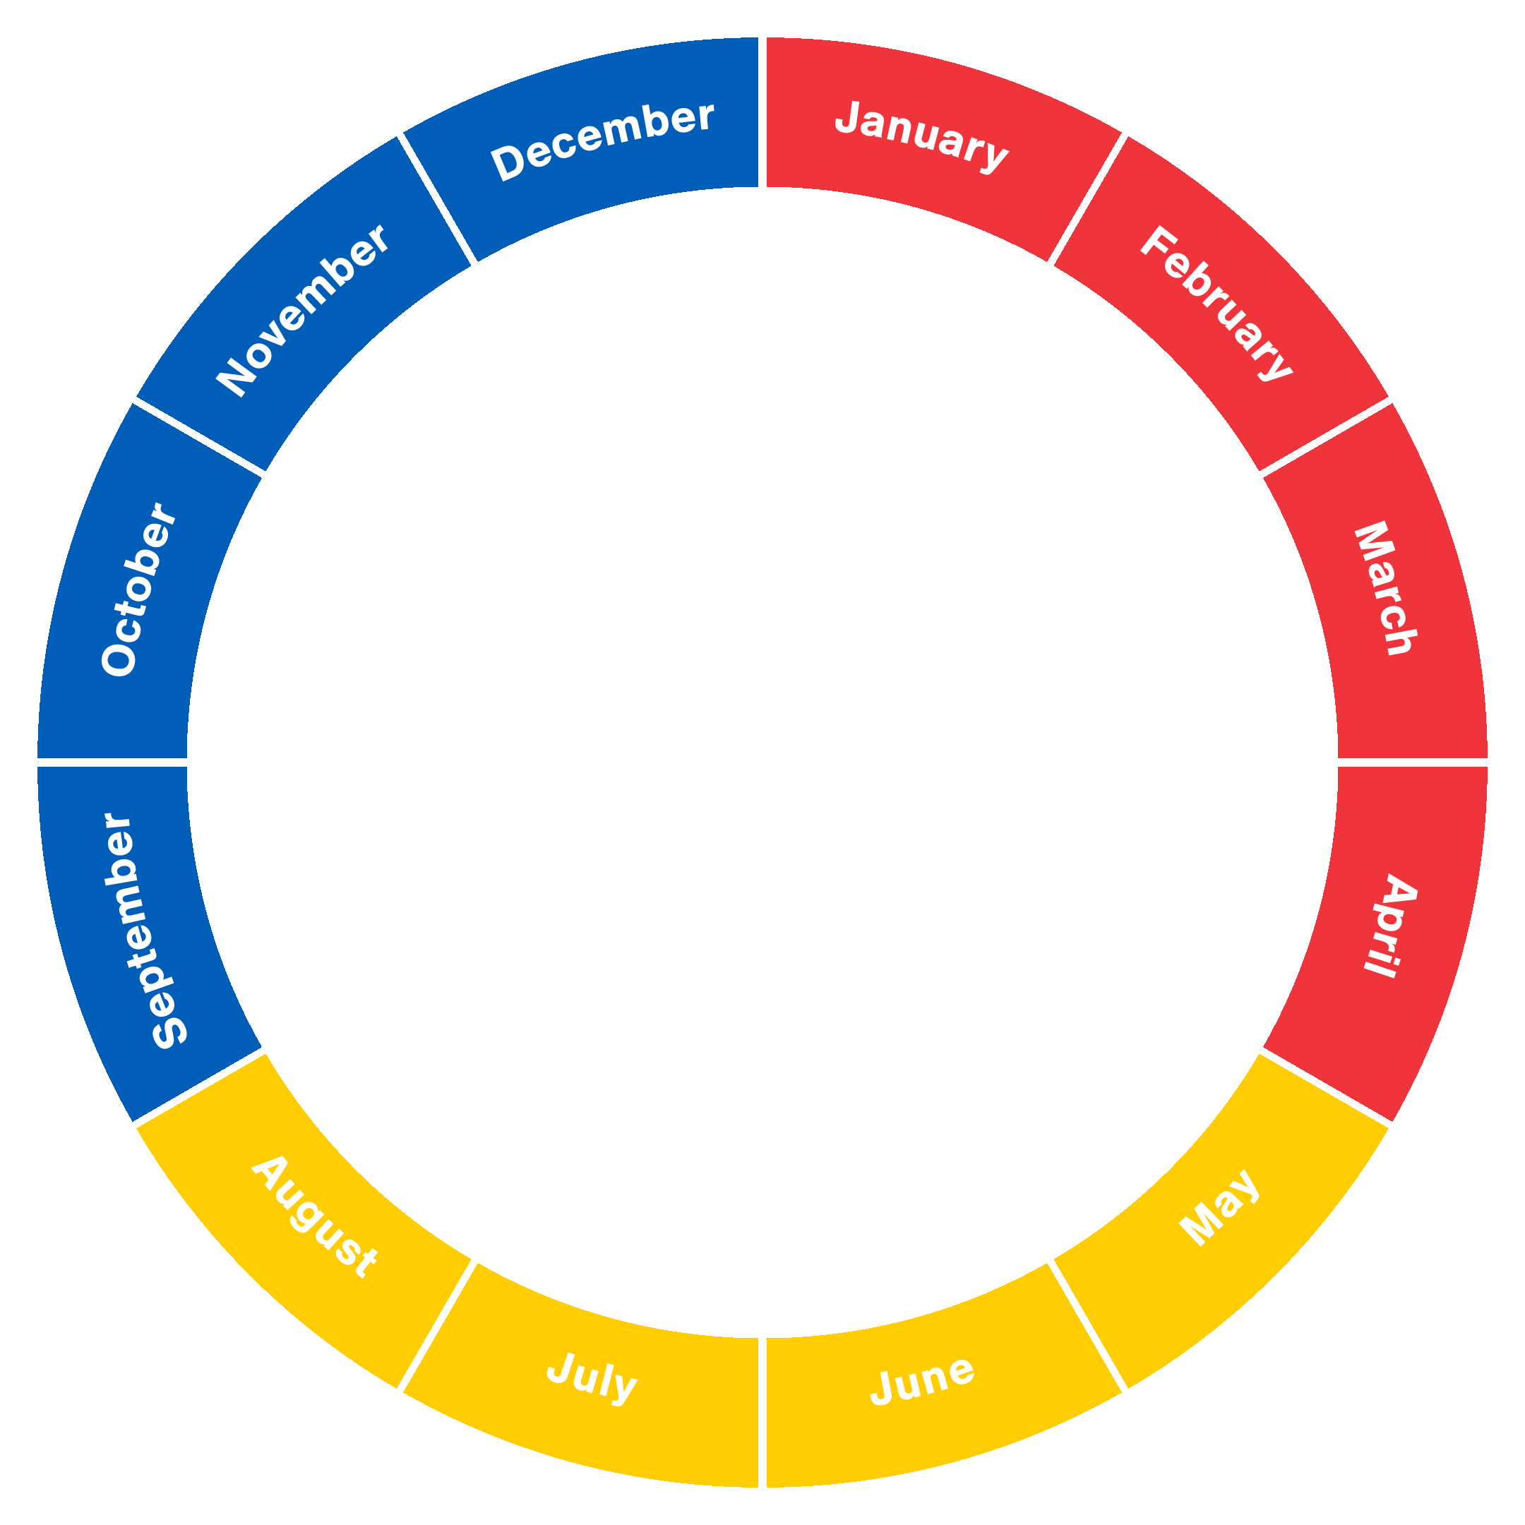
Annual Clock 2023
Aalto Management Actions
PMT 25.8.2022
January
10 Jan instructions to review preparations
12 Jan PMT (PMT spring agendas)
17 Jan Aalto TTC
26 Jan PMT (SCI and ENG Deans topical)
Annual statistics incl. MEC and other authorities
Objective discussions
December
5 Dec Aalto TTC
7 Dec PMT (BIZ, ARTS Deans topical)
13 Dec AUFB – Group LTP approval, Endowment strategy
21 Dec PMT (CHEM Deans topical)
12 Dec Aalto TTC
February
1-2 Feb PMT Development Days
7 Feb AAC
8 Feb Aalto TTC
16 Feb PMT (RESG and LESG chair topical)
Preparations for University Reviews (Schools, Services dl 10.2., SGs dl 28.2.)
November
1- 2 Nov PMT Development days
8 Nov Aalto TTC
9 Nov PMT (ISG, ESG chairs topical, T2 review)
21 Nov AAC
23 Nov PMT (ELEC Deans topical)
30 Nov AMT, University Preview
(Forethought of operating environment)
March
2 Mar AMT, University Review (Strategy implementation follow-up)
8 Mar Aalto TTC
9 Mar PMT (ELEC and CHEM Deans topical)
15 Mar AUFB - Annual report and indicator and funding model guidelines
16 Mar PMT (Funding model 2024, AUFB brief)
17 Mar instructions for University Dialogue (Schools, Services dl 24.4., SGs dl 3.5.)
29 Mar Aalto TTC
30 Mar PMT (ISG and ESG chairs topical)
October
4 Oct Aalto TTC
12 Oct PMT (ENG Deans topical)
26 Oct PMT (CCA topical)
Financial forecast (T2)
2023
September
1 Sep AMT
7 Sep PMT (SCI Deans topical)
12 Sep Aalto TTC
13 Sep AUFB - strategic risk register, internal audit plan
28 Sep PMT (RESG, LESG chair topical)
April
4 Apr AAC
13 Apr PMT (BIZ Deans topical)
27 Apr PMT (CCA topical)
May
3 May Aalto TTC
9 -10 May University Dialogue (Targets and plans)
11 May PMT (ARTS Deans topical)
15 May dl for updated dialogue materials
17 May PMT (Resources, Summary of University Dialogue,)
23 May AAC
25 May AMT, AAC
31 May TTC
Financial forecast (T1)
August
15 Aug Aalto TTC
16 -17 Aug PMT development days
17 Aug PMT (PMT autumn agendas, annual process feedback)
23 Aug TTC
31 Aug AMT )
June
1 Jun PMT (Aalto priorities, PMT overseeing responsibilities)
7- 8 Jun AUFB - targets 2024 and joint plans 2025-27 and financial and personnel plans for 2024​ approval
14 Jun Aalto TTC
15 Jun PMT (Approval of Our Plan 2023-2026, T1 review)
AUFB, Aalto University Foundation Board
AAC, Aalto Academic Committee
Aalto TTC, Aalto Tenure Track Committee
AMT, Aalto Management Team
PMT, President’s Management Team

Slide 25
Key recommendations from FINEEC audit 2016
Establish clear aims and core requirements for academic advising and doctoral supervision and scheduling opportunities for students to formally receive feedback and to discuss their plans and their performance. Integrate a formal process in the Annual Clock cycle for doctoral students to provide feedback on their wider learning experience beyond coursework..
Promote multidisciplinarity in research and teaching and enhancing societal impact are two strategic goals of the University. Develop indicators to monitor these two areas.

Slide 26
Key quality system developments and evaluations after FINEEC audit 2016
All strategic and resource plans combined into one document (Our plan).
University Preview, an operative environment analysis, integrated to the annual clock.
KPIs revised according to the new strategy and living strategy dashboard open for all.
Updated governance structure for joint activities and community engagement to support the new strategy.
Strategy preparation and launching
Living strategy
Aalto Handbook
launched as online version in aalto.fi
Strategic and resource planning joined in University Dialogue with a timespan for 1+3 years.
Feedback collection from annual processes started to ensure continuous development and feasible workload.
2016
2017
2018
2019
2020
2021
2022
FINEEC Audit
Scientific and artistic advisory board S(A)AB meetings
Research, art and impact evaluation (RAI), recommendations taken further in strategic planning.
Mid-term review of audit 2016 recommendations
Education evaluation (TEE), recommendations taken into account in educational programme portfolio renewal.
Scientific and artistic advisory board S(A)AB meetings. Focus on school and department strategic plans and RAI 2018 recommendations.
Preparation for FINEEC audit 2022 integrated to annual processes 2022.

