Slide 1

Professor in AI-Health

Slide 2
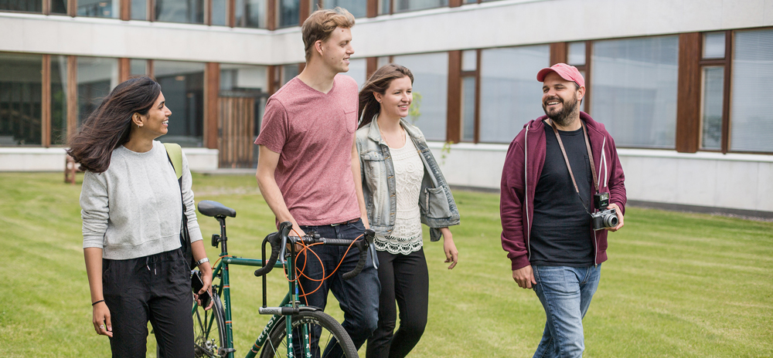
Aalto University
Aalto University is a multidisciplinary community of bold thinkers where science and art meet technology and business.
Aalto University is a university where research, art and education are promoted hand in hand. We are committed to identifying and solving grand societal challenges and building an innovative future.
With high-quality research we aim at creating significant impact on the international scientific community, industry and business, as well as the society at large. Disciplinary excellence is combined with multidisciplinary activities, engaging both students and the local innovation ecosystem.
Aalto has with nearly 11 000 students and more then six schools an 400 professors. We are an international community: more than 40% of our academic personnel have an international background.
Aalto University was founded in 2010 as three leading Finnish universities, Helsinki University of Technology, the Helsinki School of Economics and the University of Art and Design Helsinki, were merged. Our campuses are located in Espoo and Helsinki, Finland.
The University campus in Espoo is developing into a unique, open innovation hub and a center of collaboration that attracts partners from all around the world. It encourages sharing of ideas, inter-disciplinary encounters, creativity, growth and entrepreneurship. The core of the campus will be a vibrant city with versatile services and attractive places to meet.
More info at
aalto.fi

Slide 3

School of Business
We work for better society through better business.
Aalto University School of Business is the leading business school in Finland and one of the top schools in Europe.
We educate the influential leaders of tomorrow with over 100 years of experience - building on our proud history as Helsinki School of Economics and on our recent achievements as part of Aalto University.
There are six departments in the school:’
Management
Marketing
Accounting
Information and Service Management
Finance
Economics
Two additional units: Center for Markets in Transition, CEMAT, and Center for Knowledge and Innovation Research, CKIR.
Aalto School of Business is the first business school in the Nordic countries to have received all three labels of excellence from the world’s leading business school accreditation bodies: AACSB, AMBA and EQUIS. This Triple Crown status is an honor held by only few business schools worldwide.
The School of Business is an innovative and lively community of about 2,700 students and over 400 faculty and staff. Our campuses are in Helsinki, Otaniemi (Espoo), and Mikkeli, Finland.
More info at
biz.aalto.fi

Slide 4
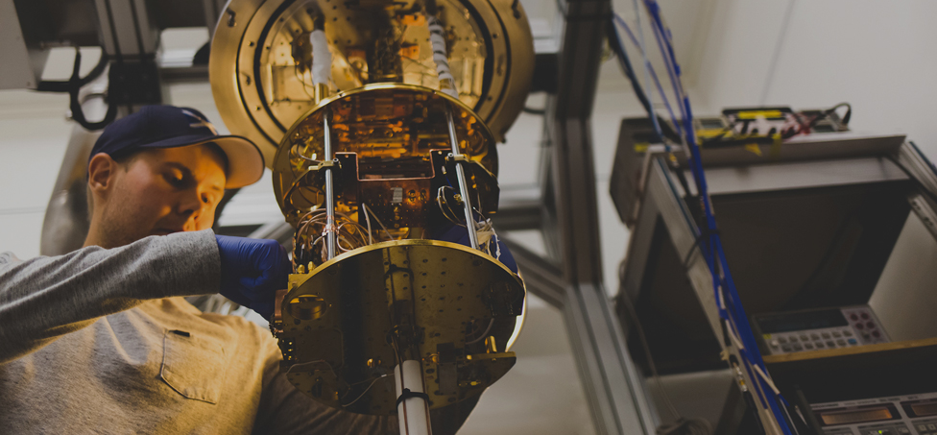
School of Science
Changing the world for the better through high-level research, making a significant impact on society.
At the school, the research carried out meets the highest of international scientific standards in our focus areas and scientific and technological applications on the basis of research findings are developed. The school is an important research partner and has strong connections with many international networks.
Moreover, the school is committed to having an active role in society and promoting the societal effectiveness of research findings at both a national and international level. During the last twenty years, the school has generated approximately 100 patents and tens of research-based enterprises.
The School has five departments:
Applied Physics, Computer Science, Industrial Engineering and Management, Mathematics and Systems Analysis and Neuroscience and Biomedical Engineering
Around 3 500 students are taught by the School of Science. Over 250 master's degree students and 90 doctoral candidates graduate from the school every year. In total, there are 1 500 members of academic staff at the school, of which 110 are professors, 400 are doctoral candidates, and other research and teaching personnel 600.
More info at
sci.aalto.fi

Slide 5
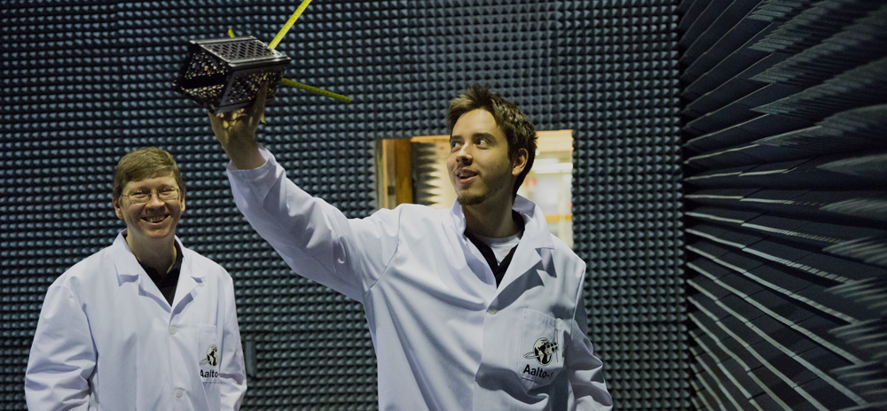
School of
Electrical Engineering
At the School of Electrical Engineering, science and engineering meet society.
Our portfolio covers fields from natural sciences to engineering and information sciences. In parallel with basic research, we develop ideas and technologies further into innovations and services. We are experts in systems science: we develop integrated solutions from care of the elderly to space robotics.
Our school has about 2000 students, approximately 50 doctor’s and about 250 master's degrees are completed annually. There are 600 members of academic staff at the School, of which 60 are professors.
The School's five departments cover the fields of electronics, communications and automation. Special fields include automation and systems technology, electronics and information technology, power engineering, communications engineering and bioinformation technology.
The novel research results and systems solutions require committed researchers, hard-working students, modern research infrastructure, and an excellent support organization. Our international and close-knit community is one of our strengths.
More info at
elec.aalto.fi

Slide 6
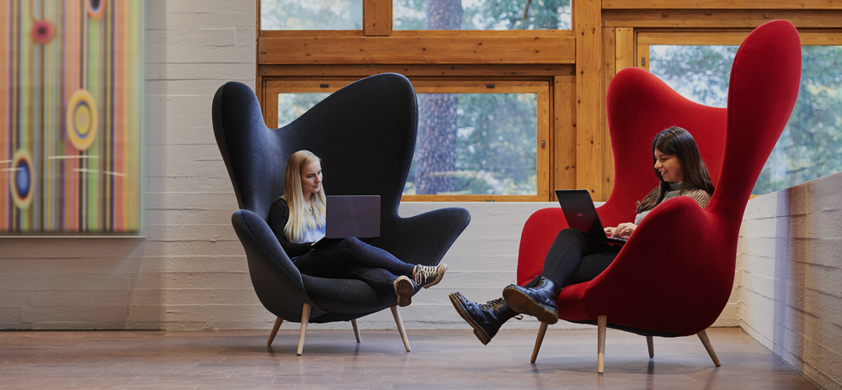
Department of Economics
The Department of Economics is the leading research-oriented economics unit in Finland. We are committed to outstanding research and research-based education at all levels. We are particularly strong in theoretical and empirical microeconomics with applications in labor and personnel economics, energy and environmental economics, urban economics, competition and innovation policy, education, and development.
We offer Bachelor's, Master's and PhD degrees in Economics. The study programmes are structured to ensure internationally recognized qualifications and a lifelong human capital.
The Department of Economics is part of the Helsinki Graduate School of Economics initiative, which brings together the economics faculty from three Finnish universities – Aalto University, Hanken School of Economics, and University of Helsinki. Our mission is to produce outstanding research with maximum academic and social impact, to educate the next generation of world-class economists, and to offer excellent training across disciplinary borders. (Helsinki GSE, http://www.helsinkigse.fi) Helsinki GSE collaborates closely with VATT Institute for Economic Research (http://www.vatt.fi/en/).
For more information about the Department, please visit: http://economics.aalto.fi/en/”
More info at
dept.aalto.fi

Slide 7
Department of Electrical Engineering and Automation
Research and teaching
The Department of Electrical Engineering and Automation (EEA) of the Aalto University School of Electrical Engineering is an ecosystem where scientists and engineers from different fields interact and work together by crossing over traditional boundaries to solve the most challenging scientific and technological problems, to provide excellent education and to produce wellbeing for the society.
EEA is an academic community of approximately 160 employees and 23 professors. Talented scholars can conduct their own independent research on topics related to our areas of inquiry. The department has over60 students pursuing Doctor of Science in Technology and 39senior research and teaching staff members
Research
Research in EEA is organized in four focus areas, Power systems and conversion; Control, robotics and autonomous systems; Well-being and smart living environment; Industrial electronics and informatics. Because of the interdisciplinary nature, the department partner network covers a large share of Finnish and international industries from the energy sector to manufacturing industries, including many machinery production companies, medical sector, cities and public organizations, and service providers. There have been several spin-off companies utilizing the research results.
Teaching
The Department conducts research and provides education in bachelor, master‘s and doctoral programmes. The programs relevant for this professor positions is especially
Master’s program in Automation and Electrical Engineering including three majors
Control, robotics and autonomous systems
Translational Engineering
Electrical Power and Energy Engineering
In all of these expertise in embedded electronics is needed and especially in the first one on autonomous systems too.
More info at
http://ele.aalto.fi/en/

Slide 8
Department of Computer Science
The Department of Computer Science provides world-class research and education in modern computer science to foster future science, engineering and society. The work combines fundamental research with innovative applications.
Computer Science is the largest department at Aalto University and the largest CS unit in Finland with 44 professors and more than 400 employees. It is routinely ranked among the top 10 CS departments in Europe and in the top 100 globally.
Education
The Department offers three undergraduate degree programmes:
Computer Science and Engineering
Data Science
Information Networks
The Department also offers five Master’s programmes taught entirely in English:
Computer, Communication and Information Sciences (CCIS)
Life Science Technologies
Information Networks
Double degree programme ICT Innovation (EIT Digital Master School)
Security and Cloud Computing (Erasmus Mundus)
Research
The Department has strong groups in a range of areas including Algorithms, Data Science, Machine Learning and AI, Mobile and Distributed Systems, Security and Privacy, Software Engineering, and Visual Computing and HCI. The current faculty’s strength is evidenced in part by the high volume of extremely competitive funding from the Academy of Finland (equivalent to the National Science Foundation) and the European Research Council (ERC). The Department consistently attracts many high-achieving international students entering its MSc and PhD programmes.
Doctoral studies
Doctoral studies are organised through the Aalto Doctoral Programme in Science. The Department has also integrated a doctoral track into a number of its MSc majors, for supporting and expediting the progress of top students who aim for the doctoral degree directly from the Bachelor’s level.
The Helsinki Doctoral Education Network in Information and Communications Technology (HICT) is a collaborative doctoral education network hosted jointly by Aalto University and the University of Helsinki, the two leading universities within this area in Finland. The network serves as a collaboration platform for doctoral education combining all the relevant subfields of computer science and information technology at Aalto University and the University of Helsinki. At present, it involves 65 professors and almost 300 doctoral students, and the participating units graduate altogether more than 40 new doctors each year.
More info at cs.aalto.fi

Slide 9
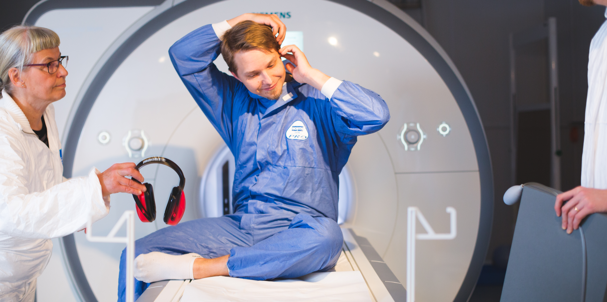
Department of Neuroscience and Biomedical Engineering
The Department of Neuroscience and Biomedical Engineering (NBE), formed in 2015, combines the former Department of Biomedical Engineering and Computational Science and the Brain Research Unit of the O.V. Lounasmaa Laboratory.
The Department aims at understanding of system-level dynamic functions of the human brain, mind and body. The research, enabled by state-of-the-art technology and computational methods, leads to discoveries and technological breakthroughs that contribute to health and wellbeing.
NBE brings together systems and cognitive neuroscience, biophysics, and biomedical engineering. The levels of description range from molecular and cellular measures to noninvasive neuroimaging and behaviour. New generations of multidisciplinary scientists and engineers are educated by engaging them with cutting-edge science and technology.
Research
The department focuses on biomedical engineering, biophysics, and brain research. We combine experimental and computational methods and develop algorithms as well as new technologies to tackle major problems in human well-being and medical diagnostics. The grand challenges in brain research are in better understanding the function of the human brain in health and disease, as studied in well-controlled and increasingly complex experimental settings, including during social interaction.
Teaching
The Department of Neuroscience and Biomedical Engineering provides courses on Bachelor’s, Master’s and Doctoral levels. At the Bachelor’s level education, NBE contributes to the majors Engineering Physics and Bioinformation Technology. We also supervise Bachelor theses.
At the Master’s level education, NBE produces two majors for the Master’s Degree Programme in Life Science Technologies: Biomedical Engineering and Human neuroscience and –technology.
More info at
nbe.aalto.fi
Notes:
Lisätty piste viimeisen kappaleen loppuun.

Slide 10

Professor in AI-health
The position is open to talented individuals who hold a doctorate in a related field and have an excellent potential or proven track record for a productive scientific career. This position is a new cross-school initiative in artificial Intelligence by leading departments in their own fields. The goal is to build solutions for socially and economically sustainable healthcare by combining artificial intelligence with neuroscience, medical technology, and economics. Artificial intelligence (AI) is quickly changing the world and opening doors to entirely new solutions in all areas of life. Healthcare with its growing challenges is one of the major domains where AI can contribute to significant advances. New levels of efficacy for prevention, diagnosis and treatment of both individual diseases and the overall healthcare system can be reached if AI-related knowledge is combined with expertise in the health domain. Aalto is well placed for this initiative given its strength in AI research, and its ability to combine this with expertise in three special areas of healthcare that have significant future relevance—neuroscience, medical technology, and economics. Complemented with the unique availability of health records in Finland, strong existing ties to public authorities, and tight collaboration with medical partners, the AI-driven healthcare theme can provide significant contributions to research-based knowledge in the healthcare area. This program will help build socially and economically sustainable healthcare by bringing together expertise in these key research areas: Health and Wellbeing, ICT, and business.
As a tenure-track faculty member, the nominated candidate is expected to complement the expertise of the current faculty by bringing new ideas and perspectives into our community. The candidate is also expected to teach in our study programs with a typical teaching load of about two courses per year.
The nominated candidate is expected to take responsibility for education in the relevant field at Aalto University. Preference will be given to candidates who plan to integrate their research with the existing research in their field in Aalto university. We mainly search for candidates at the Assistant Professor level, but exceptional candidates at the Associate and Full Professor levels will also be considered.
Your experience
Throughout their career, those in the academic tenure track system are expected to conduct and guide scientific research, to provide related higher academic education, to follow advances in their field, to participate in service to the Aalto University community, and to take part in societal interaction and international collaboration in their field.
We seek applicants with
Expertise and research experience in AI
A doctorate in a field relevant for healthcare; for example, Computer Science, Economics, Mathematical modelling, Medical Technology, Neuroscience, Physics, or Statistics
Potential to carry out research at the highest level and to attract research funding
Potential to take responsibility for education in the relevant field
Ability to be an effective teacher in undergraduate and graduate degree programs
The applicants will be reviewed based on their merits in research, teaching, academic/technological leadership, and activities in the scientific community, including in R&D, in accordance with their career stage. A more detailed description of the tenure track system at Aalto University is available at https://www.aalto.fi/en/tenure-track
Aalto University is committed to promoting diversity, equality and non-discrimination in all its activities. Thus, we promote equal opportunities to learn, acquire knowledge, participate and to make a difference. We encourage qualified candidates from all backgrounds and especially women, who are underrepresented in this field, to apply. As an equal-opportunity employer, Aalto University recruitment decisions are based on applicants’ competencies, skills and aptitudes. Aalto’s recruitment processes are clearly defined, transparent and fair, and allow the relevant areas to be emphasized when recruiting people to positions in the various career systems and levels. Career breaks due to periods of parental leave and other obligatory absences, such as military service, will be taken into account to your benefit when considering applications.
More info at
position.aalto.fi

Slide 11
Working at
Aalto University
Why join us?
Established in 2010 as a merger of three leading Finnish Universities, we are both challenger of the old, and traditional with strong history and legacy.
Our unique combination of fields in art and design, technology and business enable multi-disciplinarity and finding clever solutions for the world’s most wicked problems in the interfaces of these fields.
We aim for societal impact, educating game changers to drive sustainability.
We enjoy working at our evolving collaborative campus close to the heart of Helsinki, with good connections, great architecture and amazing nature.
We are international and diverse: more than 40 % of our faculty comes from outside of Finland. Our working environment is multi-cultural, widely English-speaking and its easy to settle in, despite of wherever you come from.
We have strong academic standing and reputation in our key fields – Aalto University is among top 10 of New Universities in the world (QS ranking). Of the participating fields, Computer Science is a leading European department (3rd in Europe and 33rd worldwide in the U.S. News Best Global Universities subject ranking 2020), and the other fields are equally successful: Electrical Engineering, Neuroscience and Economics.
Our well-functioning and fair Tenure Track career system enables building a successfull academic career, providing support for fulfilling your professional ambitions.

Slide 12
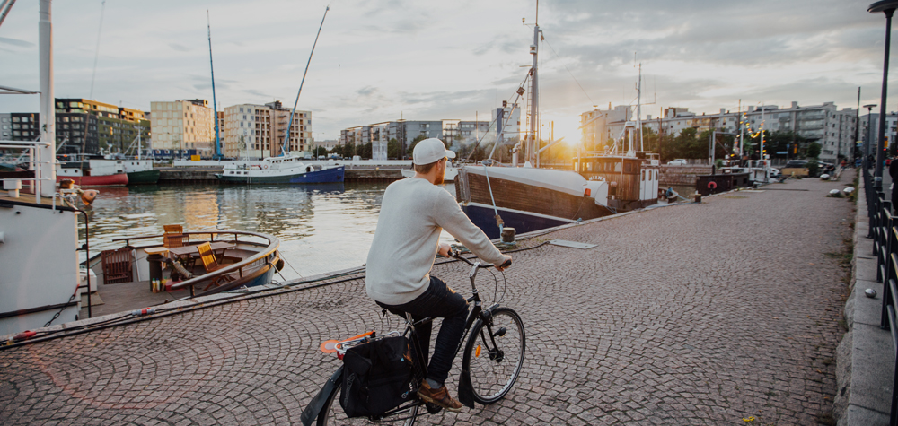
Living in Finland
Finland is among the best countries in the world according to many quality of life indicators, including being the happiest country in the world (UN study 2018).
We are humble people, but dare to say we have one of the most advanced education systems in the world.
The Nordic values of equality and co-operation are rooted deeply into our society. We are one of the world’s top countries in press freedom and consider the many voices in our society a strength.
With high investments in R&D, a strong innovation culture, open data and advanced state of digitalization, we are a nation of innovation and entrepreneurship.
Gender equality, flexibility and low hierarchy are at the core of our Nordic working environment. Professional ambitions can be combined with a fulfilling personal life.
We are one of the world’s most reliable and stable nations with low levels of corruption and high level of safety. We are proud to provide exceptionally high standards of social security and healthcare, financed by the state.
Having four distinct seasons, clean air and thousands of lakes, we are some nature-loving people and take good care of our unique environment. We enjoy our midnight sun in the summer and northern lights in the winter.
Finnish language is known to be a bit on the complicated side, but don’t worry, we Finns are fluent in English, and have an international mindset.
We have wide and reliable transport networks, with Helsinki airport serving over 100 direct destinations. The comprehensive public transport makes it easy to commute. Our campus is situated within a 10 minute metro ride from the heart of Helsinki.
Want to live in the best country in the world?
More about Helsinki
More about Espoo
More about Finland
More about working at Aalto

Slide 13
Aalto University –
a community of
game changers
aalto.fi

