Slide 1
TiO₂ nanotubes/Ti foil:
As functional supports and flexible electrodes in solar energy storage
PhD: Xuelan Hou
Prof. Peter D. Lund, Prof. Yongdan Li
Aalto University
Notes:
PAPER ID: 3590931 PAPER TITLE: TiO₂ nanotubes grown on Ti foil: As functional supports and flexible electrodes DIVISION: Division of Energy and Fuels SESSION: Electrochemistry-Enable Catalysis for Energy, Chemicals, & Materials SESSION TIME: 2:00 PM - 4:00 PM PRESENTATION FORMAT: Oral - Virtual ROOM & LOCATION: Virtual Room PRESENTATION DATE & TIME: Tuesday, 8/24/2021, 3:15 PM - 3:40 PM

Slide 2
Outline
1
2
3
Introduction
Conclusions
Our research work
Anode
Cathode
Why choose the topic?

Slide 3
1
Introduction

Slide 4
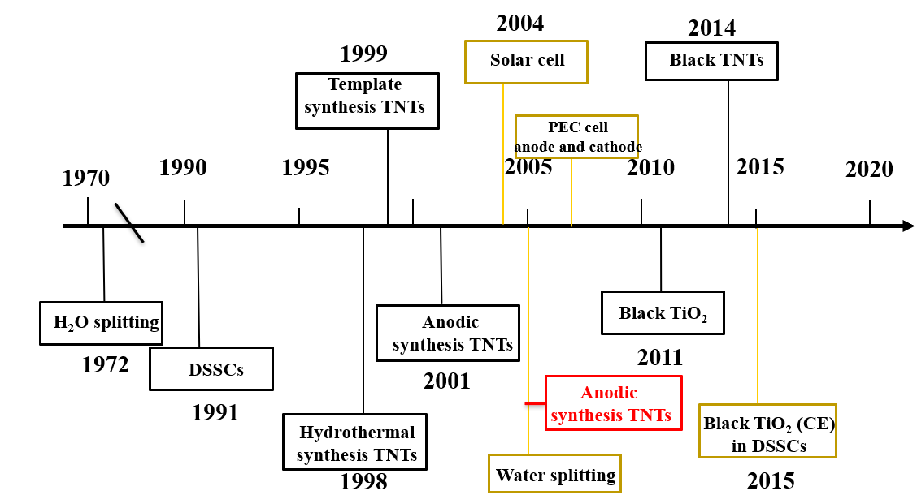
History

Slide 5
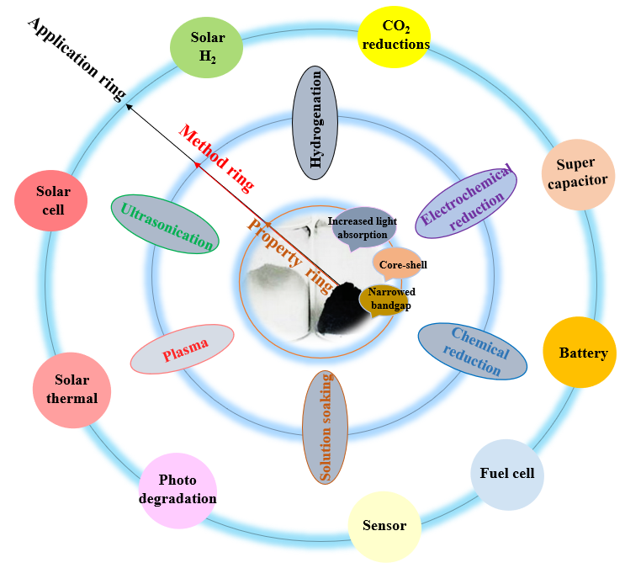
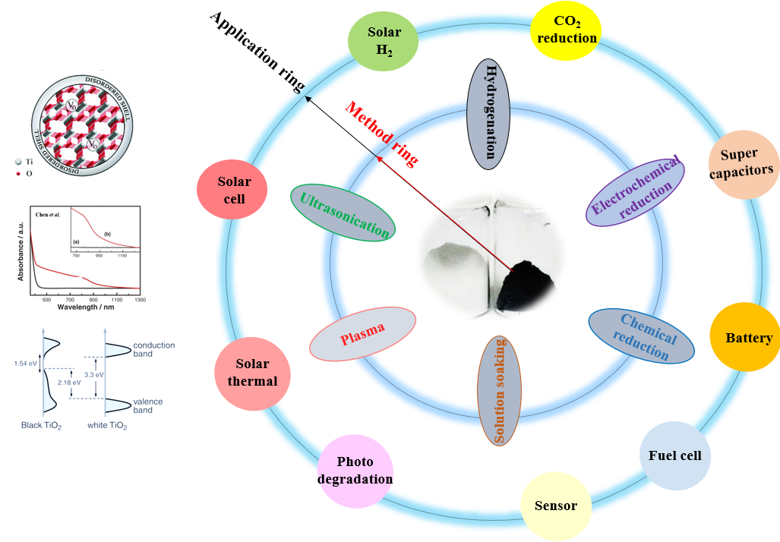
Why black titania ?
Fig. 1. A schematic diagram of the properties, preparation methods and applications of black TiO₂

Slide 6
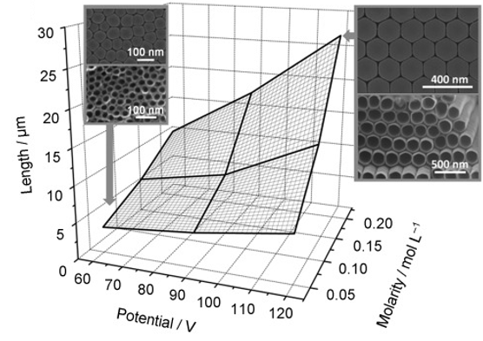
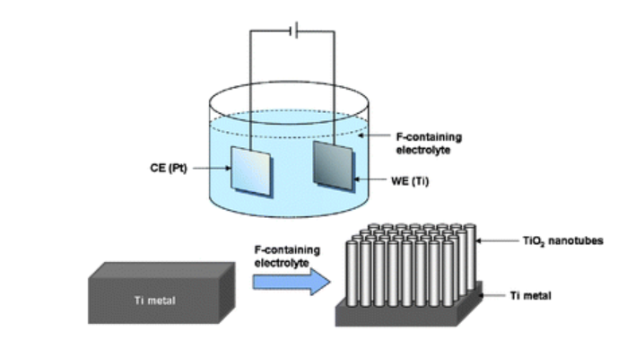
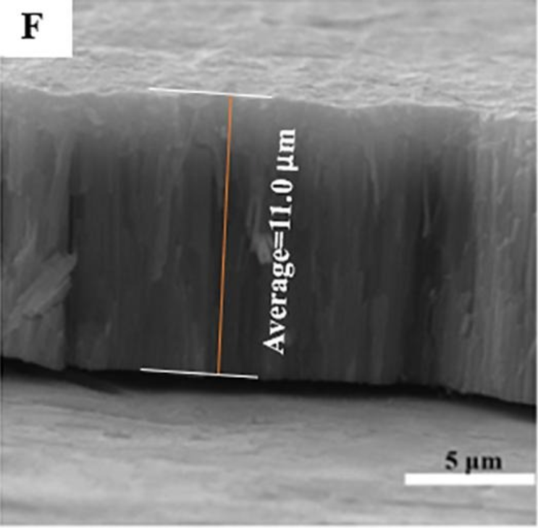
Why anodic TiO₂ nanotube?
(b)
(a)
t, C,V, T
Fig. 3. Schematic of electron pathway in TiO₂ NPs and TNT
(c)
Electron density ³⁻⁴ :
TiO₂ NPs: 7.67*10¹⁷ cm⁻³
Black TiO₂ NPs: 5.61*10¹⁹ cm⁻³
Fig. 2. (a) A schematic diagram of a electrochemical set-up and the anodic growth of TNT a Ti metal sheet .¹ (b) The parameters to tune the morphology of TNT by the anodic oxidation method.¹ (c) Cross-sectional view of SEM of anodic TNT²
TNTs : 1.24*10¹⁹ cm⁻³
B-TNTs : 5.55*10²¹ cm⁻³
1. Nanoscale. 2010;2(1):45-59.
2. Chemical Engineering Journal, 2021, 131415.
|3.Energy Environ. Sci., 2013, 6, 3007–3014
4. J. Mater. Chem. A, 2014, 2, 8612-8616

Slide 7
2
Our research work
Anode
Cathode

Slide 8
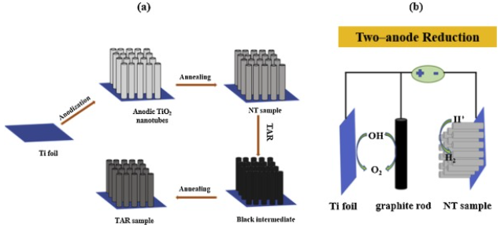
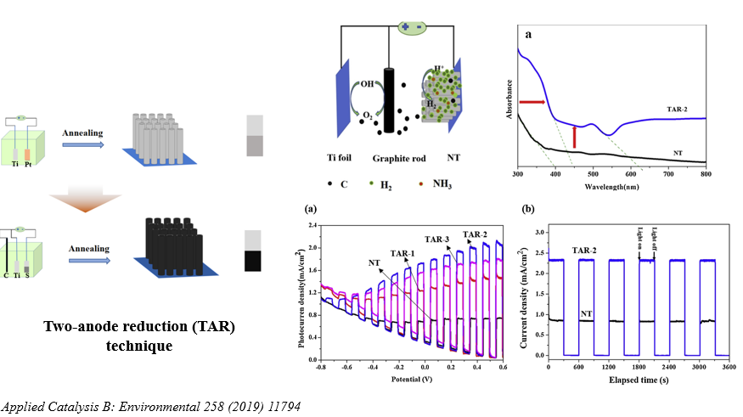
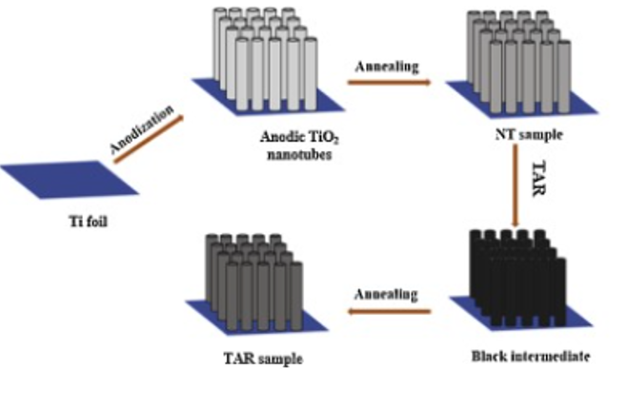
Photoanode: Part I
(b)
(c)
(a)
(d)
(e)
Applied Catalysis B: Environmental 258 (2019): 117949.
Notes:
0.71, 1.44, 2.05and 1.73 mA/cm²,

Slide 9
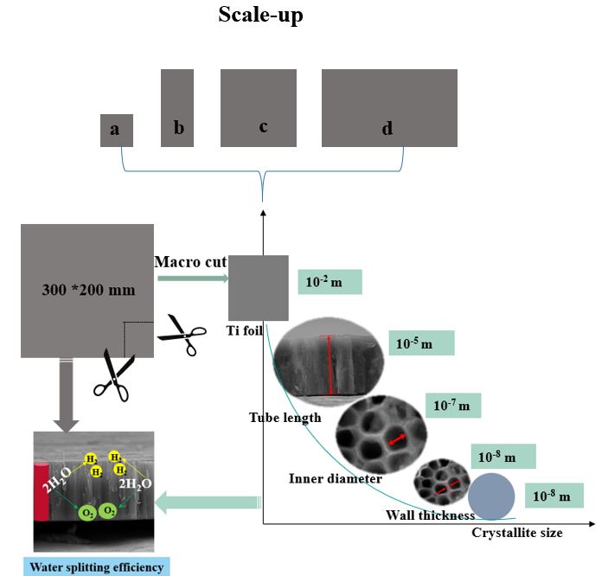
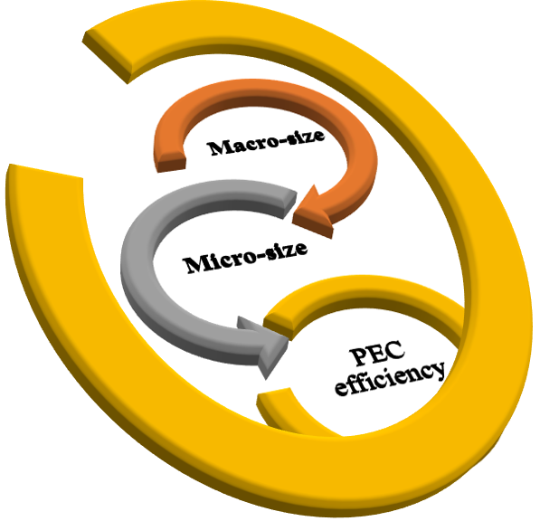
Photoanode：Part Ⅱ
Photocurrent density :
Pure TNT: 0.05 - 0.5~1.0 mA/cm² at 1.23 V_{RHE}
10~50 times
A span 6 orders magnitude length scales ranging
from 10⁻⁸ m to 10⁻² m
Multi-length scale effect on PEC efficiency:
Scale-up
1 cm² 2 cm² 4 cm² 6 cm²
Chemical Engineering Journal (2021): 131415.

Slide 10
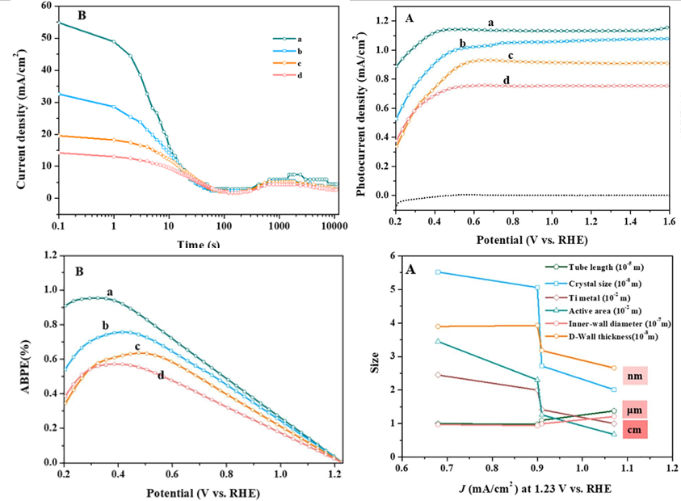
a
b
c
d
Fig. (a) Normalized transient i-log(t) curves under 60 V in 50 ml electrolyte.(b). LSV curves (c) ABPE curves (d) Effect of six size factors on the photocurrent density at 1.23 V_{RHE} under 100 mW/cm² in 1 M NaOH. The numbers of the Y-axis multiply the minus orders specified in the insets are the size values.

Slide 11
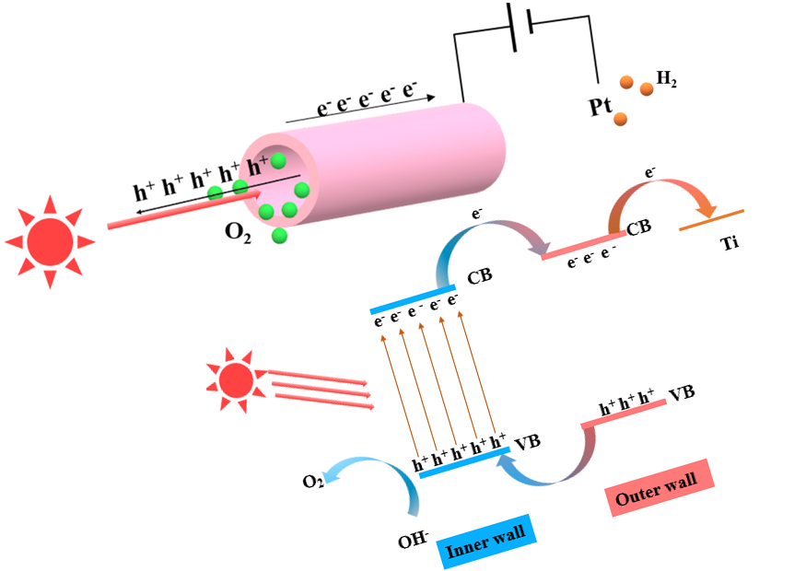
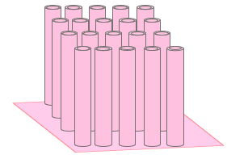
Mechanism
Scheme 1: the photon capture, charge carrier flow
and water splitting mechanism.
Chemical Engineering Journal (2021): 131415.

Slide 12
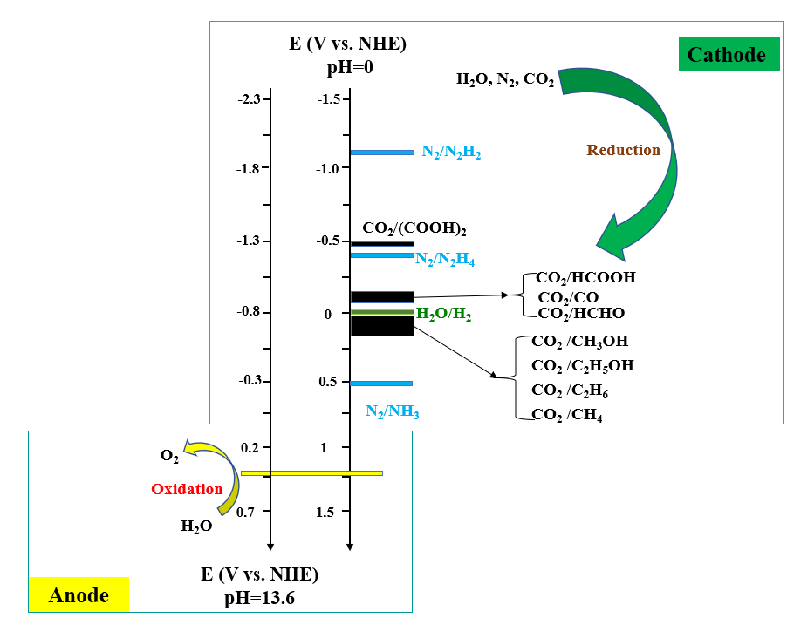
(Photo)cathode
J= -100 mA/cm²
Electrochemical potentials of possible HER, CO₂ RR and NRR in aqueous solution
for the production of different solar fuels.
Notes:
0.71, 1.44, 2.05and 1.73 mA/cm²,

Slide 14
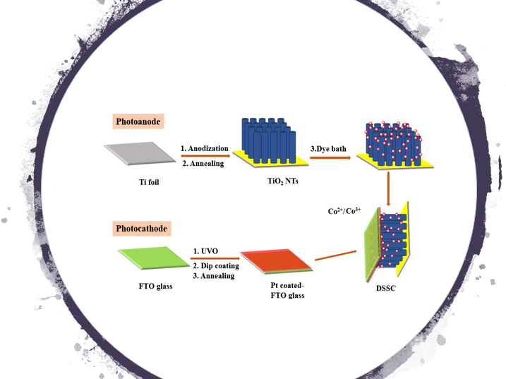
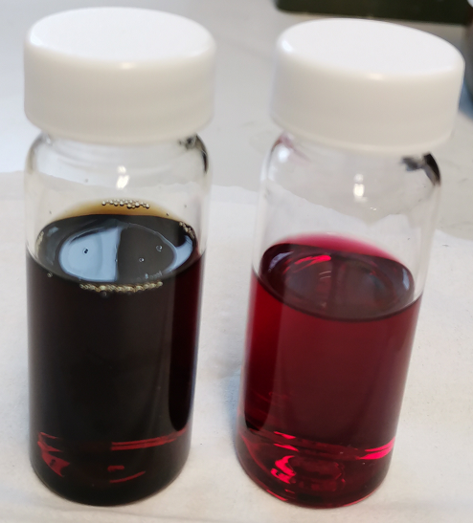
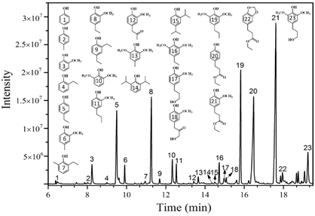
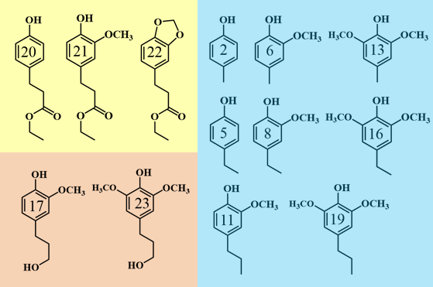
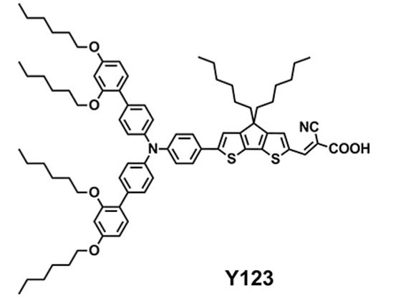
Dye sensitized solar cell
Y123
Lignin depolymerized products

Slide 15
3
Conclusions

Slide 16
Conclusions
1
Anodic TNT array is promising for the design of flexible and efficient (photo)electrode in electrochemical cells.
2
Black TiO₂ offers a platform for solar energy storage and electricity storage systems.
3
Electrochemical reduction method, i.e. TAR, provides an operational control and time-saving pathway for preparation of black TNT.
4
Multi-length scale effect shows importance on PEC water splitting cell .

Slide 17
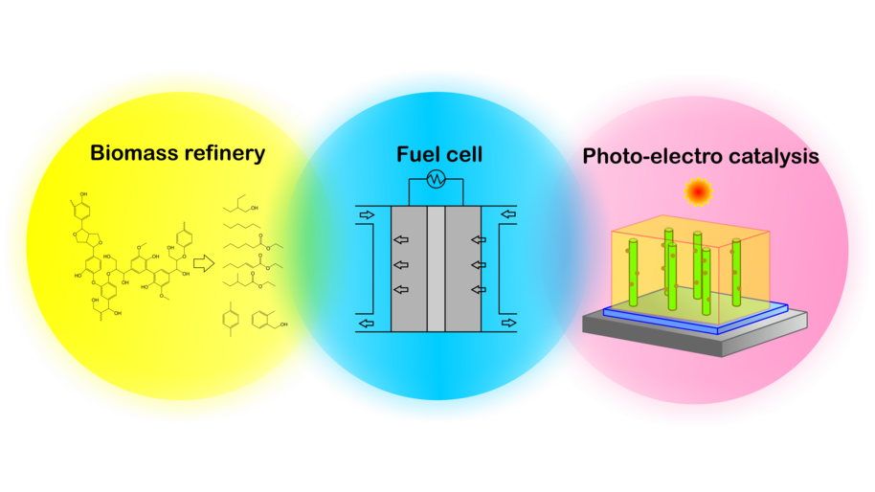
Prof. Yongdan Li
Aalto University
Email : yongdan.li@aalto.fi
Link: https://people.aalto.fi/yongdan.li
Group link: https://www.aalto.fi/en/
department-of-chemical-and-metallurgical-engineering/industrial-chemistry

Slide 18
Prof. Peter D. Lund
Aalto University
Email : peter.lund@aalto.fi
Link: https://people.aalto.fi/peter.lund#contact
Group link: https://physics.aalto.fi/en/groups/newergy/

Slide 19
Thanks!
The China Scholarship Council (CSC), No. 201706250038
The Start-up Package of T10108 Professorship offered by Aalto University to Y. Li
Aalto University School of Science Project T30404
The Academy of Finland Flagship Program, Photonics Research and Innovation (PREIN), No. 320167

