Slide 1
Aalto Bachelor’s programme in Science and Technology
2020

Slide 2

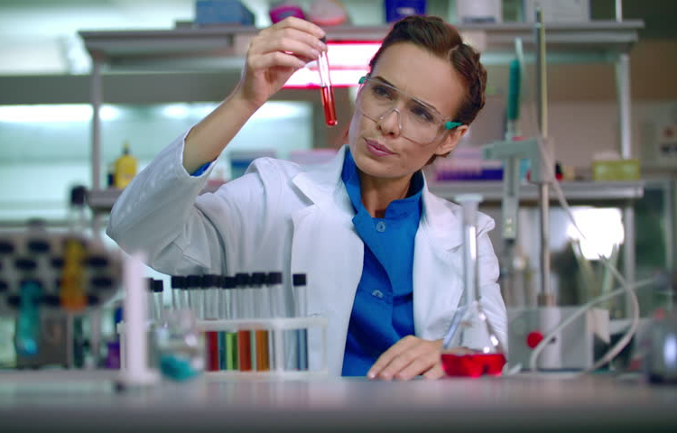
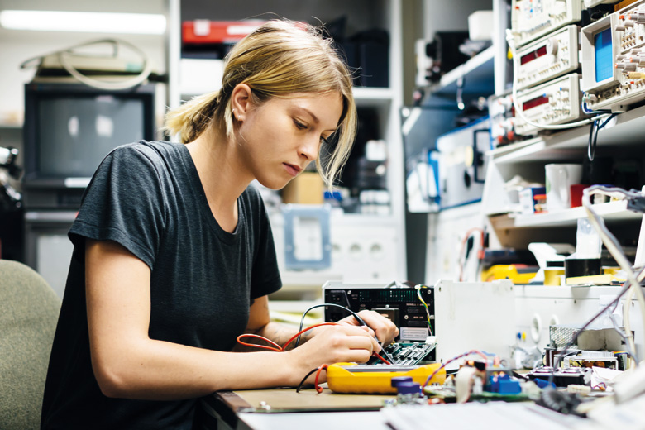
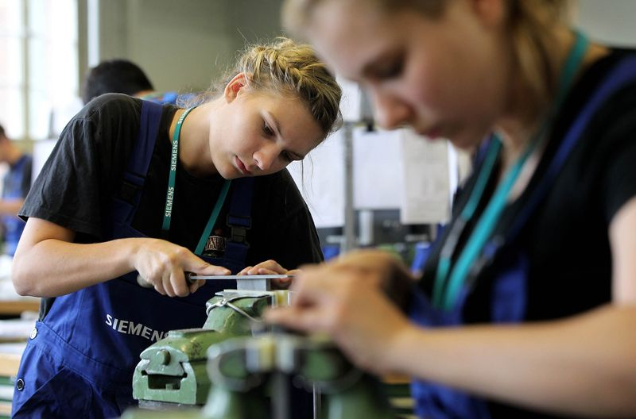

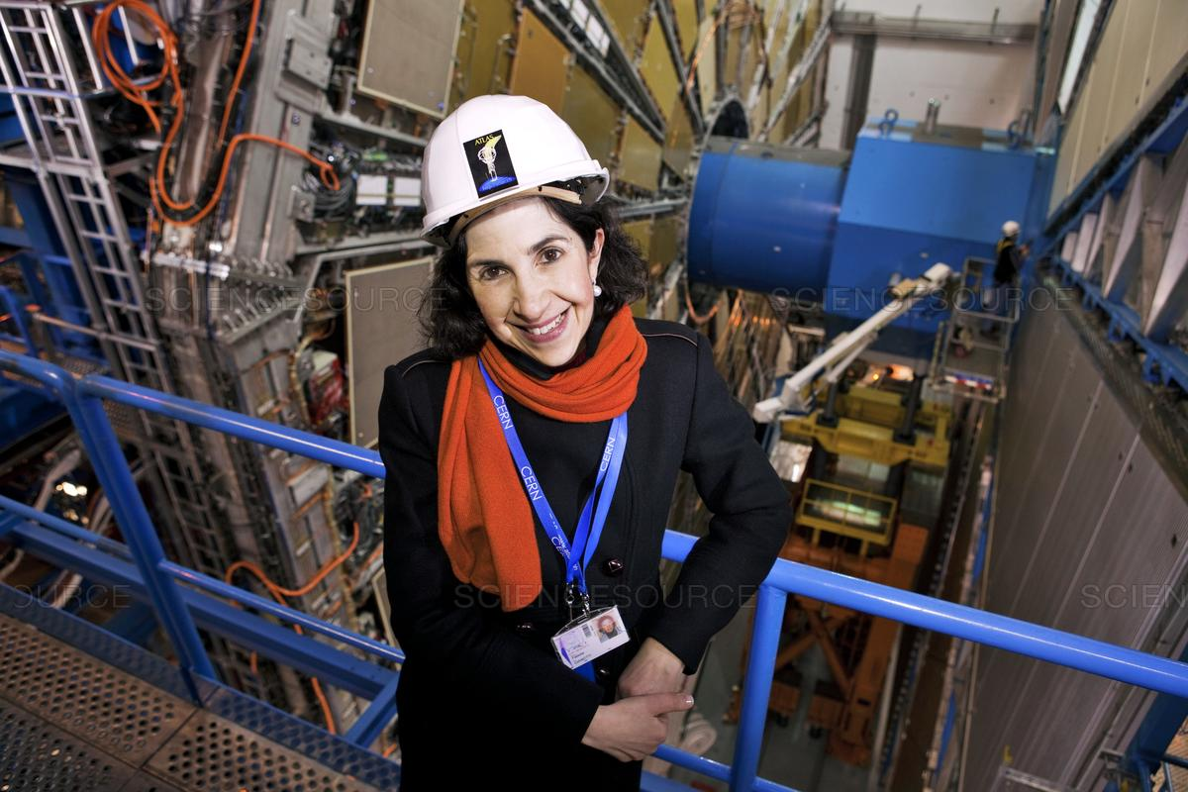
Jobs in science and technology − perception
civil engineer
chemical engineer
electrical engineer
mechanical engineer
computer scientist
physicist

Slide 3

Jobs in science and technology − reality
computer scientist
quantum engineer
civil engineer
mechanical engineer
chemical engineer
electrical engineer
physicist
statistician
mathematician
political scientist
sociologist
historian
economist
business analyst
linguist

Slide 4
Aalto English-language BSc programme in science and technology
The nature of science and technology jobs is changing
Emphasis on mathematics and computational skills
Importance of multidisciplinarity
Example: An engineer wants to simulate the combustion process inside an engine. The task involves fluid dynamics, chemistry, heat transfer, mathematics, programming, and high performance computing.

Slide 5
Aalto English-language BSc programme in science and technology
Five majors:
Chemical Engineering
Computational Engineering
Data Science
Digital Systems and Design
Quantum Technology
Common structure, common courses of mathematics and computation, different specialization paths

Slide 6
Aalto English-language BSc programme in science and technology
Common structure of the programme:
Basic studies 65cr
Math 25cr
Computation 25cr
General studies 15cr
Major 65cr
Including BSc thesis
Minor 20-25cr
Electives 25-30cr

Slide 7
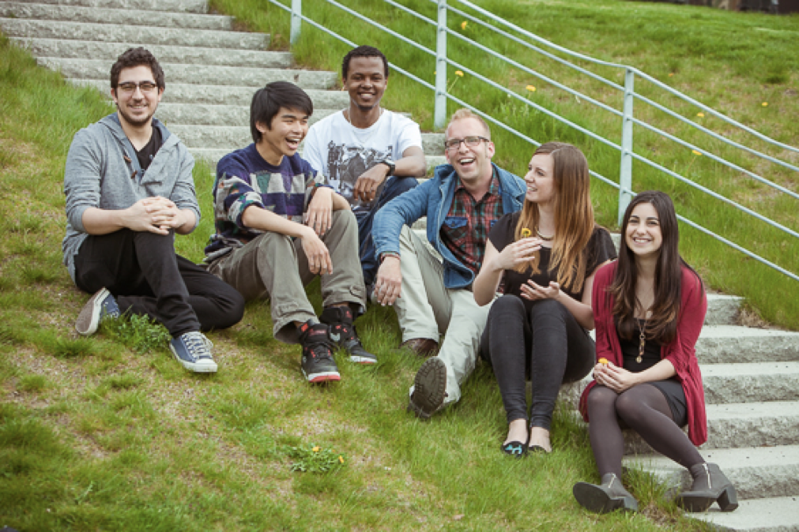
Programme in English
Meet other students from around the world
Interact with international professors
Prepare better for the global job market

Slide 8
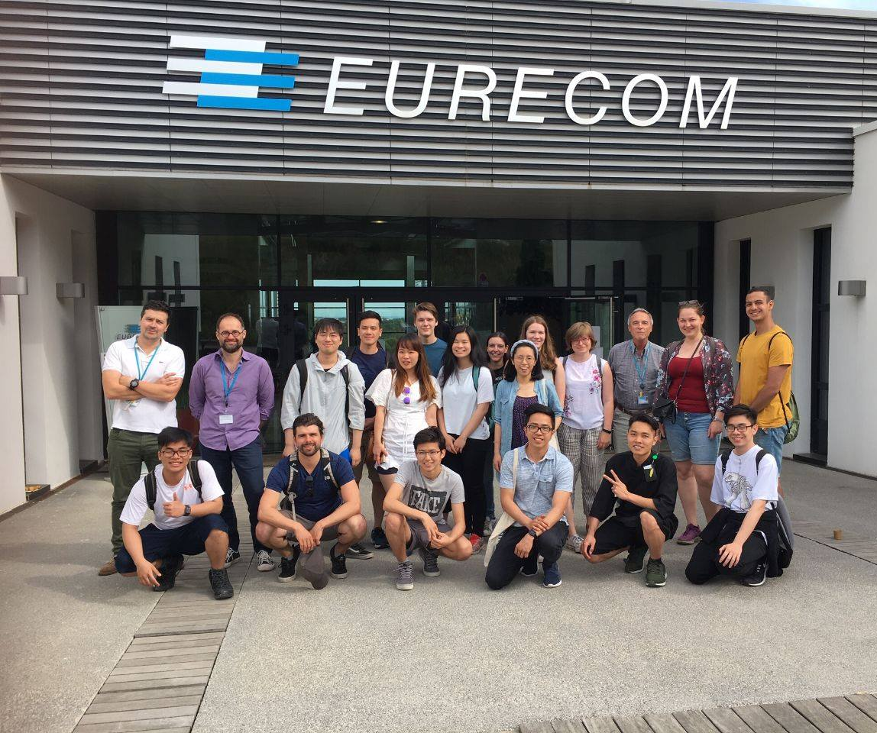
What our students are saying
New programme, first intake in 2018
217 students from 34 different nationalities all around the world
35% Finnish
According to First year feedback 2020
Very high satisfaction to Aalto as a study place
High satisfaction to course contents
Good support for studies from teachers and administrative staff
79% would recommend their study option to other students

Slide 9
The 5 majors

Slide 10
Chemical Engineering
Strong basis from math and programming is combined with chemistry, biochemistry, life sciences and materials technology.
IT is more and more present in all fields of technology and science.
This major gives you a unique competitive edge over those being in the field for longer time. You can really combine cutting edge computational tools to applications that really matter!
Why to choose
this major?
Content of
the studies
Highlights
Notes:
Video is a simulation of the combustion process inside an engine. Good way to highlight the multidisciplinary nature of the field: fluid dynamics, chemistry, heat transfer, mathematics, programming, and high performance computing.

Slide 11
Chemical Engineering
Why to choose
this major?
Content of
the studies
Math, Computer science, Chemistry, Biochemistry, Material science, Design and much more!
Highlights

Slide 12
Chemical Engineering
After having basic knowledge in chemistry, biochemistry and material sciences, both theoretically and in the laboratories, you will continue your studies with a strong connection to design and entrepreneurship.
After BSc, you can choose from a set of MSc majors, giving you opportunities both to work at high impact research or in industry that has a practical impact to well-being for all of us.
Why to choose
this major?
Content of
the studies
Highlights

Slide 13

Computational Engineering
We use computers, mathematics and algorithms to simulate how new technologies will behave in reality.
Why to choose
this major?
Content of
the studies
Highlights
Notes:
Video is a simulation of the combustion process inside an engine. Good way to highlight the multidisciplinary nature of the field: fluid dynamics, chemistry, heat transfer, mathematics, programming, and high performance computing.

Slide 14
Computational Engineering
Physics and Engineering
mechanics of materials, fluid dynamics, thermodynamics, heat transfer
Applied mathematics
linear algebra, differential & integral calculus
Computation
programming principles and algorithms,
learn to use the most popular engineering software
Why to choose
this major?
Content of
the studies
Highlights

Slide 15
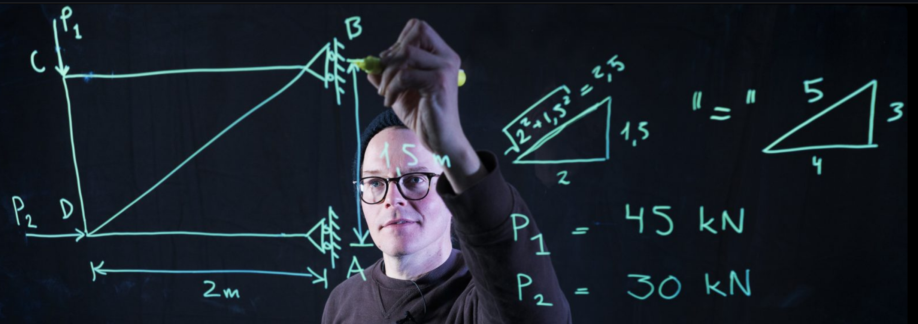
Computational Engineering
Why to choose
this major?
Content of
the studies
Pursue a career in a wide range of fields:
energy, construction, manufacturing, mechanical systems, bioengineering and more!
Highlights
The majority of Aalto Engineers are employed as soon as they graduate!

Slide 16
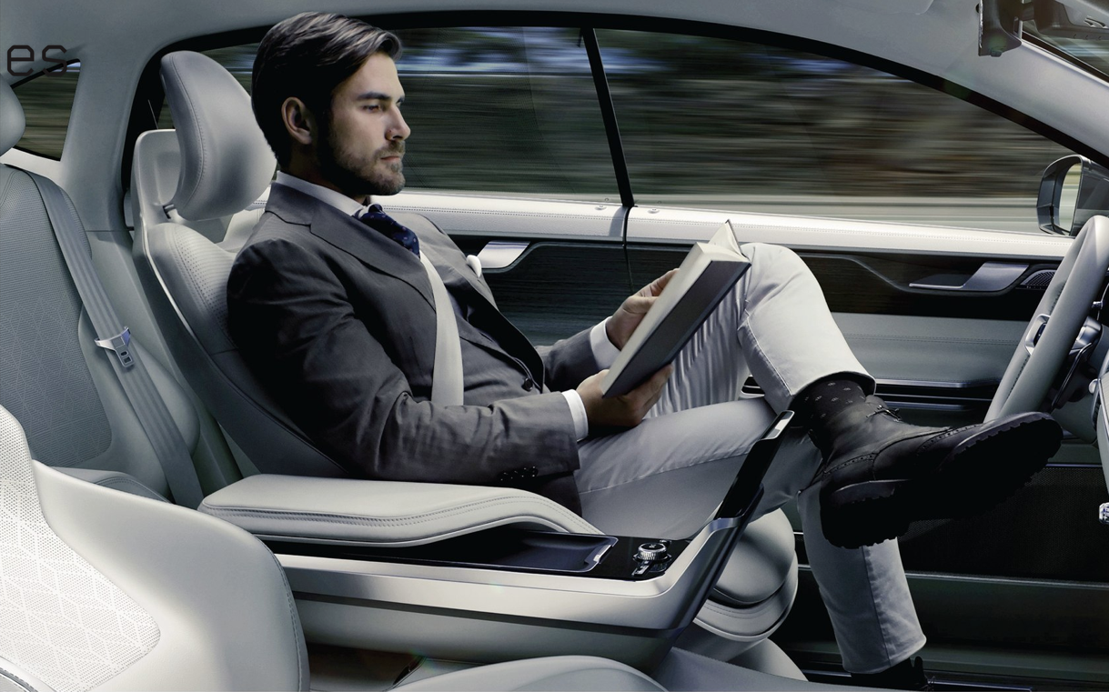

Data Science
Why to choose
this major?
Content of
the studies
Highlights

Slide 17

Data Science
Why to choose
this major?
Computation
programming, algorithms, databases, AI,
machine learning, data mining
Mathematics
matrix analysis, linear algebra, optimization
Statistics
probability and statistics, statistical inference
Content of
the studies
Highlights

Slide 18

Data Science
Why to choose
this major?
Content of
the studies
strong tradition in Aalto in
data science
machine learning
artificial intelligence
world-class research
Highlights

Slide 19

Data Science
Why to choose
this major?
Content of
the studies
strong tradition in Aalto in
data science
machine learning
artificial intelligence
world-class research
Highlights

Slide 20
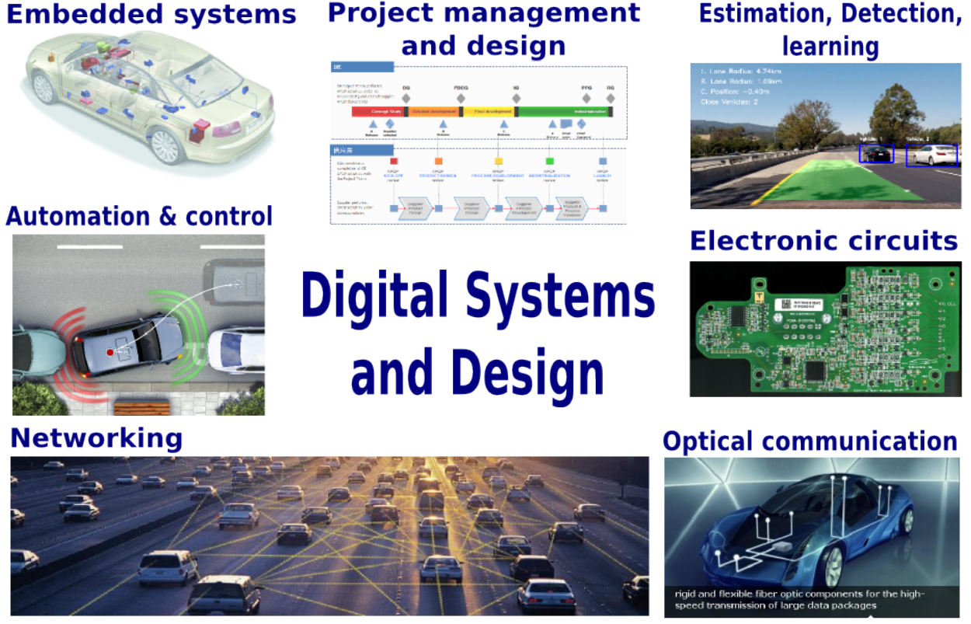
Digital Systems and Design
Why to choose this major?
Why to choose this major?
Content of the studies
Content of the studies
Content of the studies
Highlights
Highlights

Slide 21
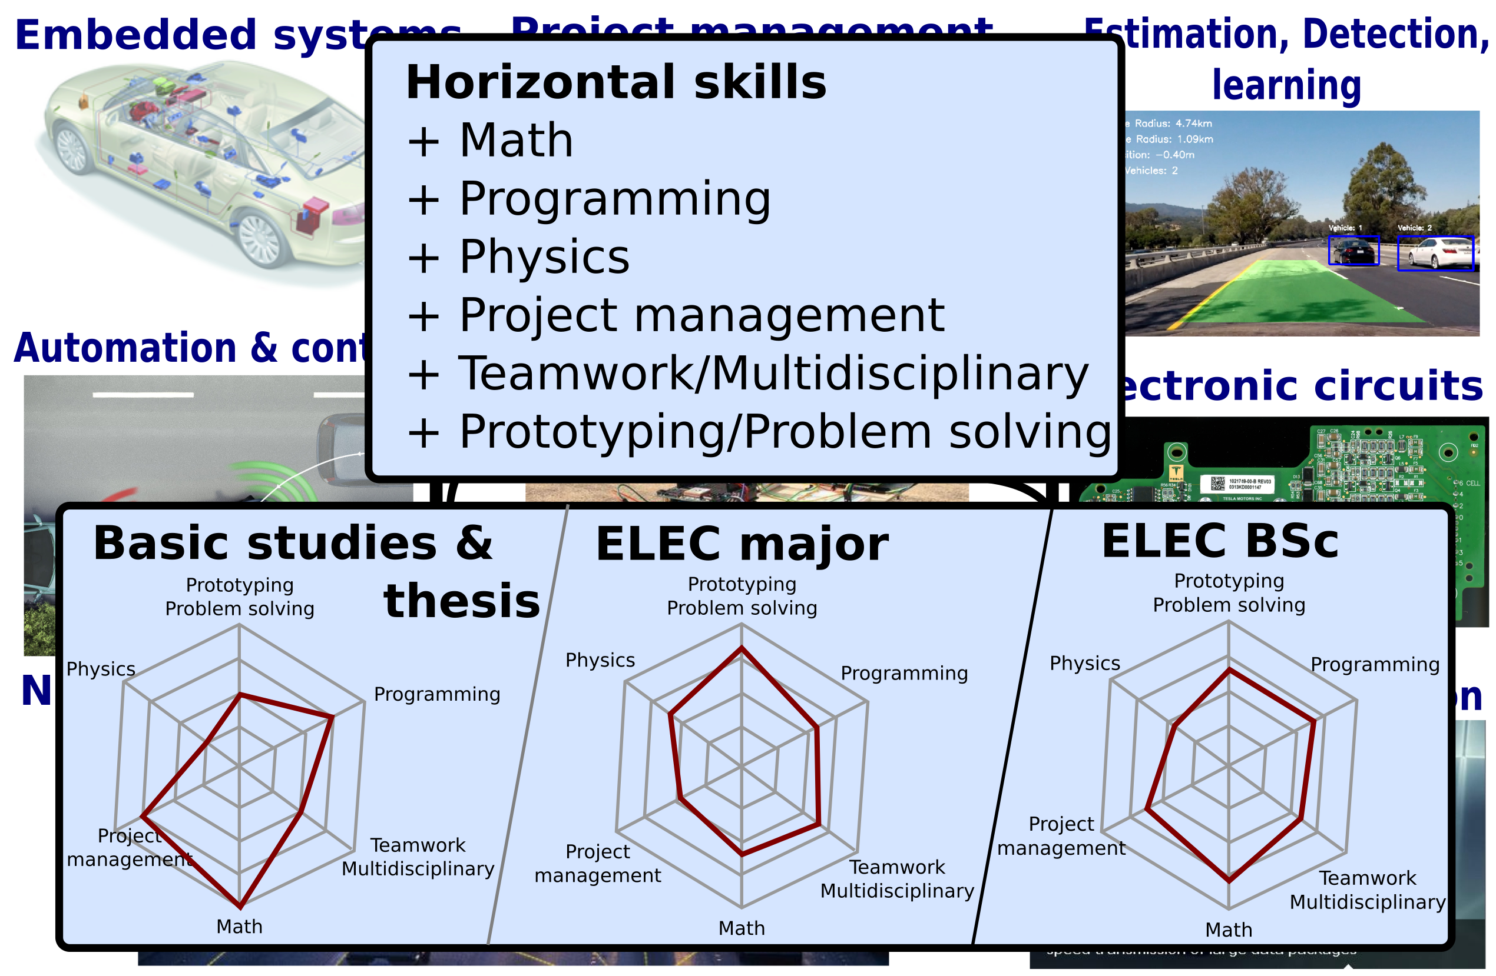
Digital Systems and Design
Why to choose this major?
Why to choose this major?
Content of the studies
Content of the studies
Content of the studies
Highlights
Highlights

Slide 22

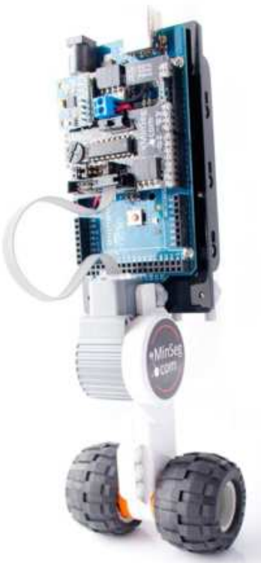
Digital Systems and Design
Design in Engineering Competences
Unique among comparable programs
Industry-relevant programming skills
Python, C++, C, Matlab
Hands-on experiences
MyDaQ/Arduino
Industry internship periods
ELEC-C7430 Industrial training
Why to choose this major?
Why to choose this major?
Content of the studies
Content of the studies
Content of the studies
Highlights
Highlights

Slide 23
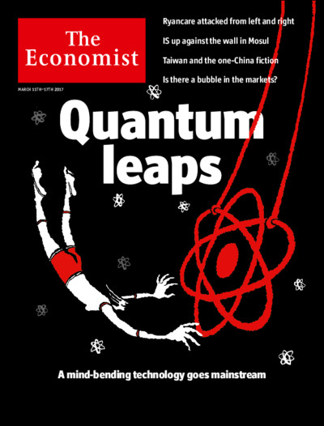
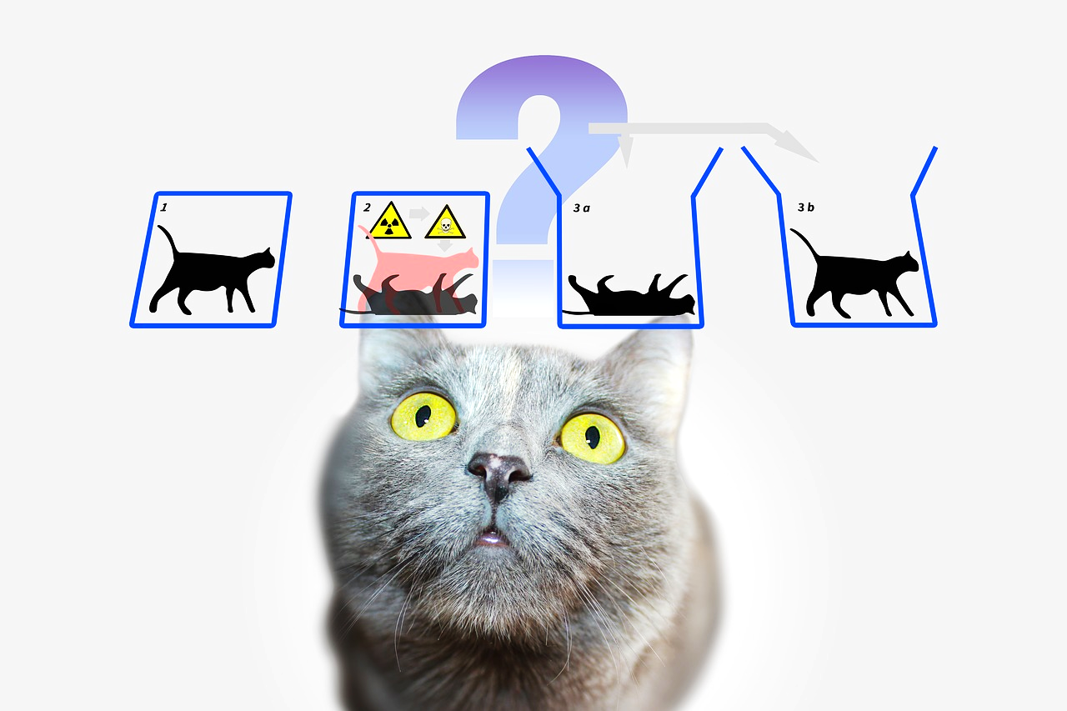
Quantum Technology
Are you fascinated by quantum physics?
Do you want to create real-world applications?
Come study Quantum Technology at Aalto University!
Future quantum technologies:
Quantum computers
Quantum communication
Quantum sensing
Quantum simulation
Become a quantum engineer!
Why to choose
this major?
Content of
the studies
Highlights

Slide 24
Quantum Technology
During the BSc degree, you will:
learn the fundamentals of quantum physics and understand its applications in real-world technologies
acquire mathematical & physical skills to understand the quantum world from a technological perspective
perform experiments on quantum systems and generate roadmaps to future applications
develop computer algorithms exploiting quantum mechanical principles
f
Why to choose
this major?
Content of
the studies
Highlights

Slide 25

Quantum Technology
Why to choose
this major?
Content of
the studies
Broad career prospects in industry and academia
Research and development engineer Quantum Device Engineer
Quantum computing scientist Quantum Software Engineer
Technology consultant Analyst (banking and finance)
World-class research on Quantum Technology in Aalto
Highlights

Slide 26
Thank you!

