Slide 1

BONUS Baltimari Closing Conference 26 August 2020 Future of Maritime Risk Assessment From Research to Practice: Best Practices of Academia & Industry
Prof Jens-Uwe Schröder-Hinrichs, Dr. Anish Hebbar, Anas S. Alamoush
World Maritime University, Malmö, Sweden

Slide 2


Science & Society
Vision
The science we need, for the future we want
Goals
generate knowledge
Objectives
5. transform capacity
inform policies
6. transfer knowledge
IMO A.31/19(a)(2) – 23 Sep 19

Slide 3
Science & IMO
Science as driver
Identifying issues
Partnership for goals
UNESCO/ IOC
Contribution
Expertise
Formulating regulations
GESAMP/ Task Team
UN Ocean/ Contact Group
Resources
IMO MEPC 73/18 – 20 Jul 18

Slide 4
Discerning uptake of research: What are the questions?
Which questions are fit for science advice?
What form science advice should take?
How do we distinguish between authoritative and evidence-based science advice from advocacy designed to advance specific viewpoints or interests?
When is science advice necessary?
What are the sources of science advice for maritime administrations?
How are the processes or institutional arrangements for science advice in maritime administrations?
How do we strengthen institutional arrangements?
US National Research Council, 2002

Slide 5
What is the role of maritime risk research in policymaking?
Why discuss research uptake?
Examples of maritime risk research in the Baltic Sea region
HELCOM BRISK (2011) | SAFGOF (2011)
ChemBaltic (2013) | FAROS (2015)
BONUS STORMWINDS (2017) | HELCOM OpenRisk (2018)
Next Generation SmartResponse Web (2016) | HELCOM Seatrack Web (2019)
Maritime risk research
Policymaking

Slide 6
What is the Baltic contribution?
BALTIC CONTRIBUTION TO GLOBAL MARITIME RISK RESEARCH
45% OVER PAST 50 YEARS | No.1 OVER PAST DECADE

Slide 7
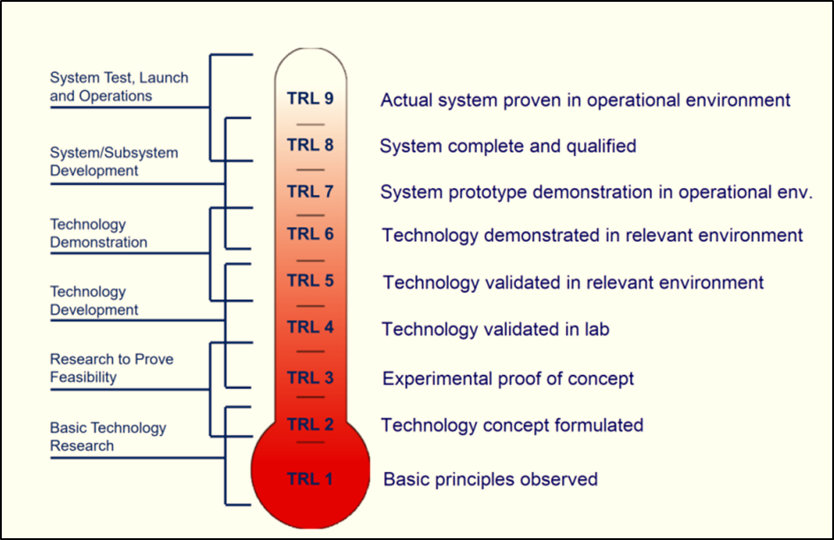
What is the TRL of maritime risk research in the Baltic?
2 Baltic maritime risk research papers – TRL 9
Overall - relatively low
Waterways risk management
Formulation of technology concept - TRL 2
remainder – TRL 1, 3
Decision Support Systems
Proof of concept – TRL 3, 87% - TRL 1-3

Slide 8
Discerning research uptake: What are the key questions ?
Why link policy-makers with (maritime risk) research?
What are the prevailing perceptions?
What are the viewpoints on research uptake?
What are the ways to explain research utilisation?
What are the ways to explain improvement of uptake?

Slide 9
What are the stages in knowledge utilisation?
How do we conceptualise research uptake?
1
RECEPTION
2
COGNITION
3
DISCUSSION
4
REFERENCE
INFLUENCE
5
EFFORT (ADOPTION)
6
Relevant research arrives at the desk of users/ policymakers
Users read and understand the relevant research
Recipients of research discusses the importance of research with peers
Research is preferred by users and, they cite it in their work reports or documents
Users are influenced by research and make efforts to adopt it into decisions/ policies
Research results are input in policy processes and influence decisions
Knott & Wildavsky (1980)

Slide 10
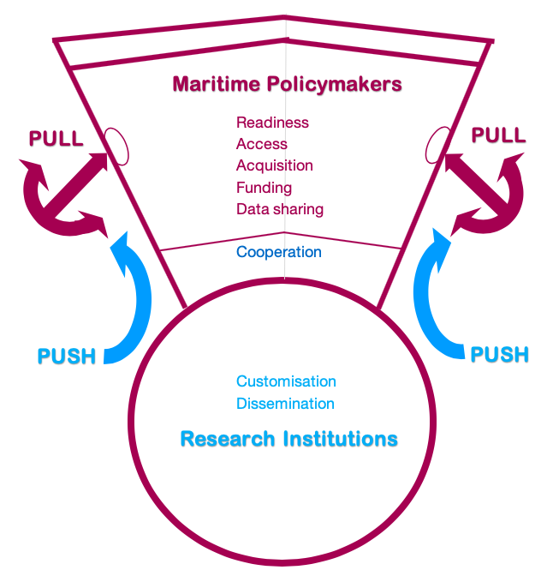
Research uptake: push-pull improvement factors

Slide 11
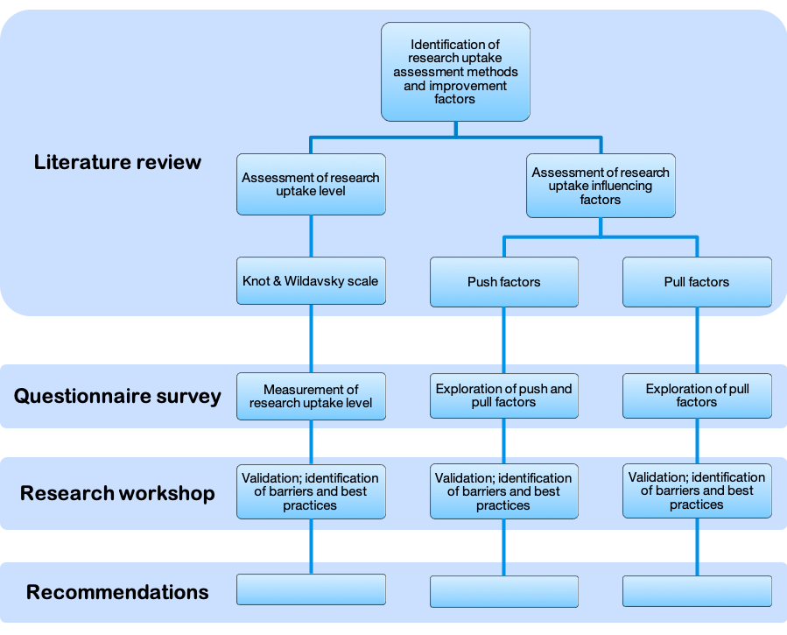
Research Conceptual Framework

Slide 12
Research uptake assessment stages and questions
Uptake Stages | Question
Reception | I receive the maritime risk research relevant to my field
Cognition | I read and understand the relevant maritime risk research
Discussion | I discuss research findings with my peers
Reference | I cite the maritime risk research in my own professional reports
Efforts | I make efforts to adopt maritime risk research in my work decisions
Influence | Research on maritime risk influenced the policies in my administration

Slide 13
Frequency distribution: push factors
Push factors | Don’t Apply Don’t need (0) | Never (1) | Rarely (2) | Sometimes (3) | Usually (4) | Always (5)
Adaptation | 20% | 30% | 30% | 17% | 3% | 0
Dissemination | 20% | 33% | 38% | 3% | 3% | 0
Cooperation | 15% | 11% | 28% | 36% | 10% | 0

Slide 14
Frequency distribution: pull efforts
Pull efforts | Don’t Apply Don’t need (0) | Never (1) | Rarely (2) | Sometimes (3) | Usually (4) | Always (5)
Readiness | 10% | 43% | 30% | 17% | 0 | 0
Access | 23% | 38% | 18% | 9% | 6% | 6%
Acquisition | 13% | 20% | 36% | 14% | 14% | 3%
Cooperation | 11% | 15% | 22% | 32% | 17% | 3%
Funding | 23% | 10% | 7% | 43% | 10% | 7%
Sharing data | 13% | 3% | 10% | 53% | 21% | 0

Slide 15
Frequency distribution: stages + level of uptake
Uptake Stages | Don’t Apply Don’t need (0) | Never (1) | Rarely (2) | Sometimes (3) | Usually (4) | Always (5) | Index Mean
Reception | 0 | 3% | 24% | 60% | 13% | 0 | 2.6
Cognition | 10% | 7% | 17% | 43% | 23% | 0 | 5.1
Discussion | 7% | 10% | 23% | 43% | 17% | 0 | 6.0
Reference | 17% | 17% | 27% | 30% | 10% | 0 | 9.5
Efforts | 10% | 13% | 23% | 37% | 17% | 0 | 11.3
Influence | 10% | 10% | 30% | 43% | 7% | 0 | 9.20
Uptake level |  |  |  |  |  |  | 41.6%

Slide 16
Stage-wise assessment of average research uptake level

Slide 17
What are the sources of knowledge for policy-makers?

Slide 18
What are the best practices of research uptake?
RESEARCH ENGAGEMENT AND ACQUISITION EFFORTS
PRACTIONER | BEST PRACTICE | OUTCOME
Finnish Transport and Communications Agency (TRAFICOM) | Collaboration with research institutions e.g. Aalto University, Helsinki University | Research areas addressed
Swedish Shipowners Association | Focus on four research areas | Ship digitalization and automation, design and technology, behavioural improvement, and competence in shipping industry
Danish Maritime Authority | Frequent partnership with universities in research projects e.g., with the Centre of Maritime Health and Society at the University of Southern Denmark | Maritime accident issues addressed
Danish Maritime Authority | Frequently acquires research from national and regional universities | Training of ship surveyors; developing regulations for passenger ships

Slide 19
What are the best practices of research uptake?
COOPERATION AND NETWORKING
PRACTIONER | BEST PRACTICE | OUTCOME
Swedish Shipowners Association | Collaboration between the Finnish and Swedish maritime clusters which is supplemented by conferences | Green and smart shipping
Gydnia Maritime Authority | Integral part of national delegation to IMO; member in government committees and boards; cooperation with Polish Register of Shipping and Polish Maritime | Cooperation and networking for research opportunities and training of researchers
HELCOM | Cooperation with stakeholders through policy workshops | Acquisition of required information through surveys

Slide 20
What are the best practices of research uptake?
DISSEMINATION (SCIENCE COMMUNICATION)
PRACTIONER | BEST PRACTICE | OUTCOME
Gydnia Maritime University | Peer to peer meetings, local workshops, and conferences | Science communication
BIMCO | Translation of some project outcomes into other languages | Science communication
HELCOM | Creation of a project platform on the web which hosts various projects e.g., Clean Shipping Platform (CSHIPP) | Science communications, policy papers, and utilization of science in making policy decisions

Slide 21
What are the best practices of research uptake?
FUNDING RESEARCH
PRACTIONER | BEST PRACTICE | OUTCOME
TRAFICOM | Funding research projects (sub-contract) | Timely solutions to issues
Swedish Maritime Authority | Funding research, and contributing to research projects | Examples of projects – AIS, Sea Traffic Management, MONA LIZA, and FAMOS
Danish Maritime Authority | Subcontracting research from Technical University of Denmark, CORE law firm, and FORCE technology institute | Emergent issues in autonomous shipping addressed

Slide 22
What are the key concerns - push factors?
PUSH FACTOR CONCERNS
Research process does not include policy-makers Insufficient efforts for transfer of knowledge Focus on producing research regardless of uptake No feedback on utilization of research Research results do not always meet expectations Research is not customized to policymaker’s needs Overwhelming variety of scientific tools and models Research usually requires longer time than available Research gives solutions, but not how to implement Often, research solutions require further research

Slide 23
What are the key concerns - push efforts?
PULL EFFORTS CONCERNS
Training on research appreciation rarely provided Access to relevant research limited Lack of capacity to read and engage with research Lack of awareness about current research Funding required to raise awareness National priorities may precede research uptake Projects often not linked to scientific issues Hardships in acquiring data from authorities Not always easy to approach experts in field for data Academic research marginally influences decisions

Slide 24
Policy recommendations for enhancing research uptake
Training
Focus
Data
Communication
Funding
Cooperation
Acquisition

Slide 25
Policy recommendations for enhancing research uptake
RECOMMENDATIONS FOR POLICY-MAKERS
 | Provide training to employees, particularly those with shorter experience and in lower management levels, on the value of research, and refining skills to interpret research Dedicate time to provide required data, and allow researchers to conduct experiments, interviews, and surveys so that research is more relevant Share research project results nationally, regionally, and internationally Consider fellowships for PhD programmes and post-doctoral research as incentive for early stage researchers and to address research requirements Willingly participate in academic workshops, conferences and seminars Look at past project results, for example at the EU level

Slide 26
Policy recommendations for enhancing research uptake
RECOMMENDATIONS FOR RESEARCH INSTITUTIONS AND RESEARCHERS
 | Focus on new and emerging maritime challenges and risks e.g., digitalisation, autonomous ships, and cyber risks Present direct and timely solutions to problems Take into account end-users needs and consider implementation aspects, particularly financial and other resources of maritime authorities and industry Consider uptake prior as well as post publishing Closely follow international negotiations at the EU and IMO level and keep track of national maritime policy issues Consider setting aside dedicated funding for communication of research and incentivising science communication

Slide 27
THANK YOU
Any questions?

