Slide 1
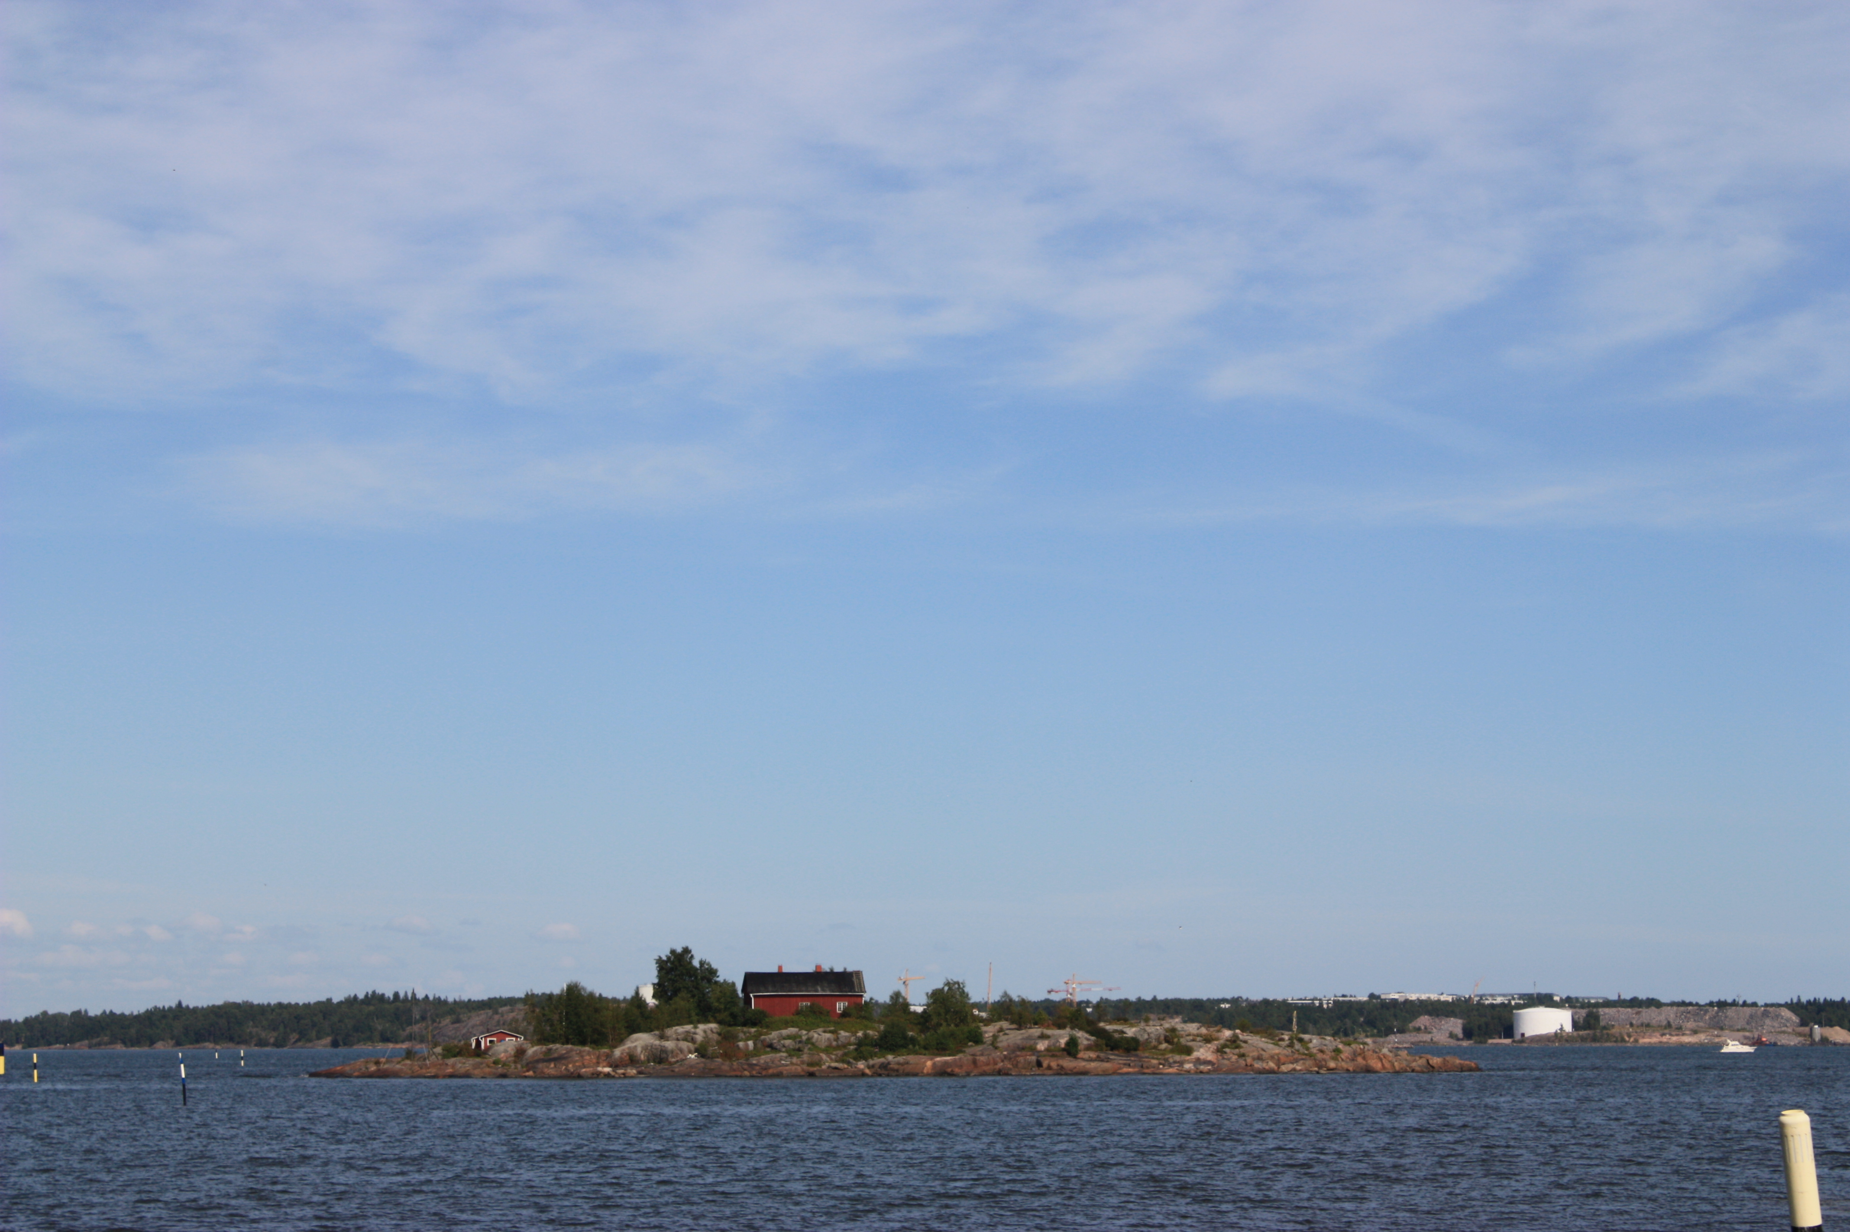



Oil spill response: a comprehensive review
BALTIMARI: Review, Evaluation and Future of Baltic Maritime Risk Management
T., Parviainen¹, Goerlandt, F., Helle, I., Haapasaari, P., Kuikka, S.
¹Doctoral student,
University of Helsinki
BONUS BALTIMARI Closing Conference
Wednesday, 26th August 2020
Notes:
Parviainen, T., Goerlandt, F., Helle, I., Haapasaari, P., Kuikka, S. (2020) Implementing Bayesian Networks for ISO 31000:2018-based Maritime Oil Spill Risk Management: State-of-art, Implementation Benefits and Challenges, and Future Research Directions. Under revision (Journal of Environmental Management).
How Bayesian oil spill risk models for Pollution Preparedness and Prevention can be incorporated in the ISO 31000:2018 risk management framework?

Slide 2

Content
Past: Pollution Preparedness and Response (PPR) models
Present: Bayesian network (BN) models for oil spill risk assessment (OSRA) and management
Future: BNs & ISO 31000:2018 risk management framework
Parviainen, T., Goerlandt, F., Helle, I., Haapasaari, P., Kuikka, S. (2020) Implementing Bayesian Networks for ISO 31000:2018-based Maritime Oil Spill Risk Management: State-of-art, Implementation Benefits and Challenges, and Future Research Directions. Under review (Journal of Environmental Management).

Slide 3
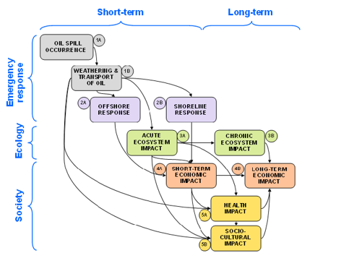
Definitions
Pollution Preparedness and Response (PPR) models =
models addressing the accident occurrence, the response effectiveness, and the ecological, economic, health, and socio-cultural impacts of oil spills.
Figure 1. Framework for classifying oil spill response and short and long-term consequences in PPR context. Adapted from Chang et al. (2014).

Slide 4
Definitions (cont.)
Risk = “uncertainty about and severity of the consequences (or outcomes) of an activity with respect to something that humans value” (Aven and Renn 2009)
Oil spill risks = the uncertainty about the occurrence of an oil spill in the maritime environment, and its related environmental, economic, human-health, and socio-cultural consequences
Uncertainty = often classified as epistemic and stochaistic / ontological uncertainty
Ambiguity = the differing understandings and perceptions of risks, as well as societal values

Slide 5
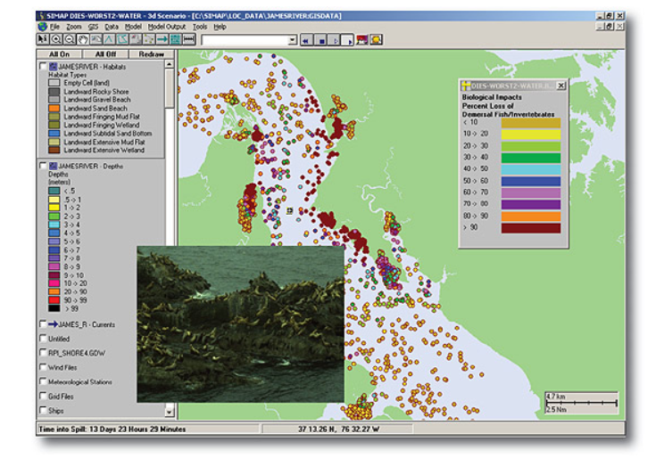
PAST: PPR models
Ex post or ex ante approaches based on modeled simulations to estimate the oil trajectories and the final impacts.
Widely used models for predicting fate and trajectory of spilled oil include, e.g.:
  OSCAR (SINTEF, Norway)
  SIMAP (US EPA), and
  the General National Oceanic and
  Atmospheric Administration Operational
  Modelling Environment (GNOME)
  (Beegle-Krause et al. 2001).

Slide 6
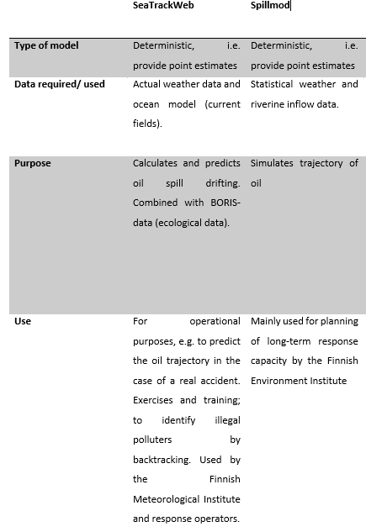
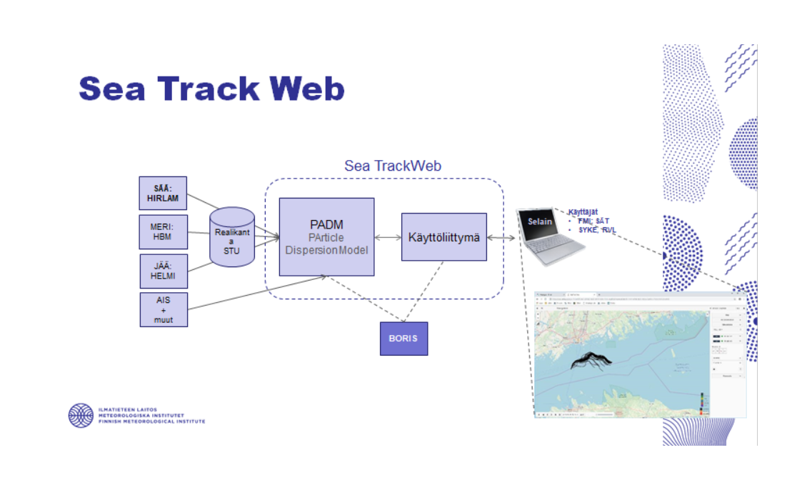
PAST: PPR models
In the Gulf of Finland
(GoF), Baltic Sea:
SeaTrackWeb (STW)
Spillmod

Slide 7
PAST: PPR models
Limited attention has been paid to uncertainty in maritime transport risk analysis and in other maritime modelling contexts
In general, the existing models are deterministic and designed for operational planning or for testing different scenarios
→ In other words, they rarely assess risks per se, i.e. they do not provide information about the uncertainties (probabilities) and consequences of particular scenarios.

Slide 8
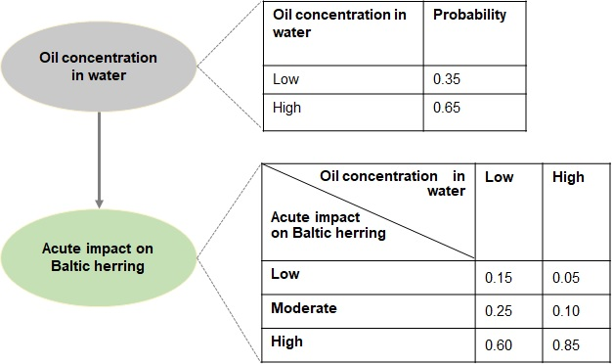
PRESENT: BNs for OSRA
Bayesian networks (BNs) express uncertainty in a probabilistic form
Flexibility in using various knowledge sources – useful when data is scarce
Figure 2. A simplified example of a directed acyclic graph in the context of an oil spill.

Slide 9
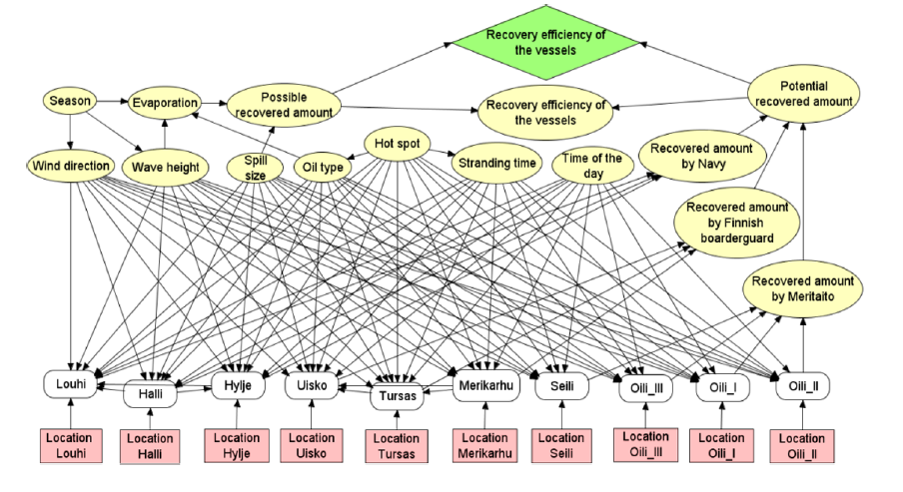
Lehikoinen et al. 2013. Optimizing the Recovery Efficiency of Finnish Oil Combating Vessels in the Gulf of Finland Using Bayesian Networks. Environ. Sci. Technol. 47, 1792-1799.

Slide 10
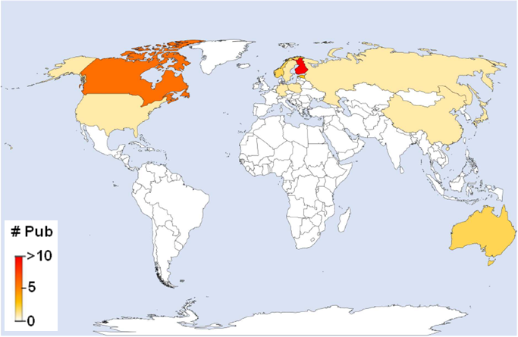
PRESENT: BNs for OSRA
Figure 3. Evolution of OSRA-BN articles for oil spill PPR by publication year and by country, period 2005-2019.
Figure 4. Number of OSRA-BN articles for oil spill PPR by country, period 2005-2019

Slide 11
Figure 5. Framework for classifying oil spill response and short and long-term consequences in PPR context. Adapted from Chang et al. (2014).

Slide 12
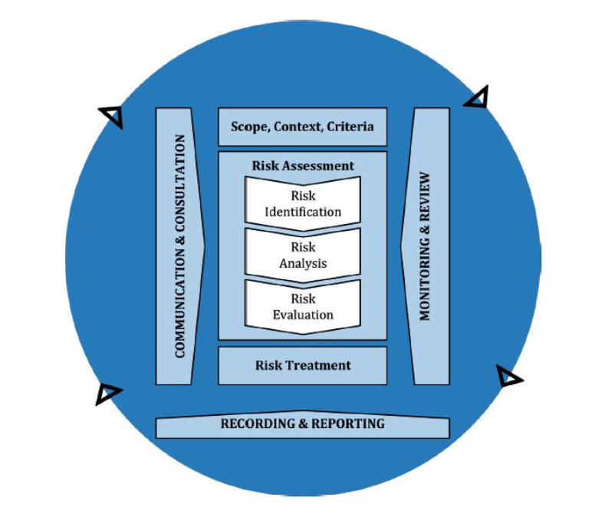
FUTURE: How can BNs contribute to the ISO 31000: 2018 risk management framework?
Figure 6. ISO 31000 Risk Management Process (ISO 2018).

Slide 13
ISO 31000:2018 | BNs provide…
Scope, context, criteria | Context specific risk models for the Baltic Sea (e.g. Lecklin et al. 2011).
Risk assessment (risk identification, analysis, evalution) | Quantifying oil outflows from collision (Goerlandt and Montewka 2014b;Montewka et al. 2015); quantifying the ecological impacts of oil in the Baltic Sea (Helle et al., 2011;Helle et al. 2016;Lecklin et al. 2011) Evaluating response effectiveness (Helle et al. 2011;Lehikoinen et al. 2013b) and cost-benefit (Helle et al. 2015b) or cost-effectiveness of response measures (Montewka et al. 2013).
Risk treatment | BNs inform which treatment to implement as they allow for assessing risks, e.g. the effectiveness of response measures with the use of decision nodes (e.g. Helle et al. 2015;Lehikoinen et al. 2013a).
Recording and reporting | The visual nature of BNs serves as a way of structuring information in a systemic manner
Monitoring and review | BNs can be easily updated as new evidence becomes available; BNs can build on previous models (e.g. the work by Lehikoinen et al. 2013b builds on a previous study by Lecklin (2011)).
Communication and consultation | Visual risk diagrams and causal networks, such as BNs, can support risk communication; BNs can be combined, e.g. with GIS (Jolma et al. 2014); BNs can facilitate stakeholder deliberation (Goerlandt and Reiniers 2017;Parviainen et al. 2019).

Slide 14
FUTURE: How can BNs contribute to the ISO 31000: 2018 risk management framework?
Benefits:
Especially valuable for treating uncertainty
Represent complex systems in graphical fashion
Flexibility in using various knowledge sources (both quantitative and qualitative knowledge)
Support iterative and participatory management based on continous learning processes
Challenges:
Limited capacity to deal with temporal and spatial dynamics
Limitations of expert elicitation
Relatively time-consuming and require extensive expertise

Slide 15
Conclusions
PPR models can provide valuable information for response operators and decision-makers
Limited attention has been paid to uncertainty in maritime transport risk analysis and in other maritime modelling contexts.
Bayesian networks are well suited for evaluating complex systems where uncertainty is high as they express uncertainty in terms of probability distributions.
Most of the existing BNs focus on the environmental impacts of oil spill accidents in the Baltic Sea: only few OSRA-BN models exist for other sea areas. Research on other than the environmental impacts of oil spills remains exploratory. Future research needs: economic & socio-cultural impacts, impacts on shoreline, response effectiveness in iced waters
Bayesian networks offer a flexible modelling approach for risk management as outlined by the ISO 31000:2018 standard/or OSRA & can complement the widely used risk assessment tools

Slide 16



tuuli.parviainen@helsinki.fi
Thank you for listening!

