Slide 1


Slide 2


We embarked
on a mission
Business &
Economics
By merging three leading universities in 2010, Aalto was founded to work as a societally embedded, and innovative research university for a better world
Aalto has a national mission to strengthen Finland’s innovative capacity through first-class research and education
INNOVATION
Art & Design
Science &
Technology

Slide 3
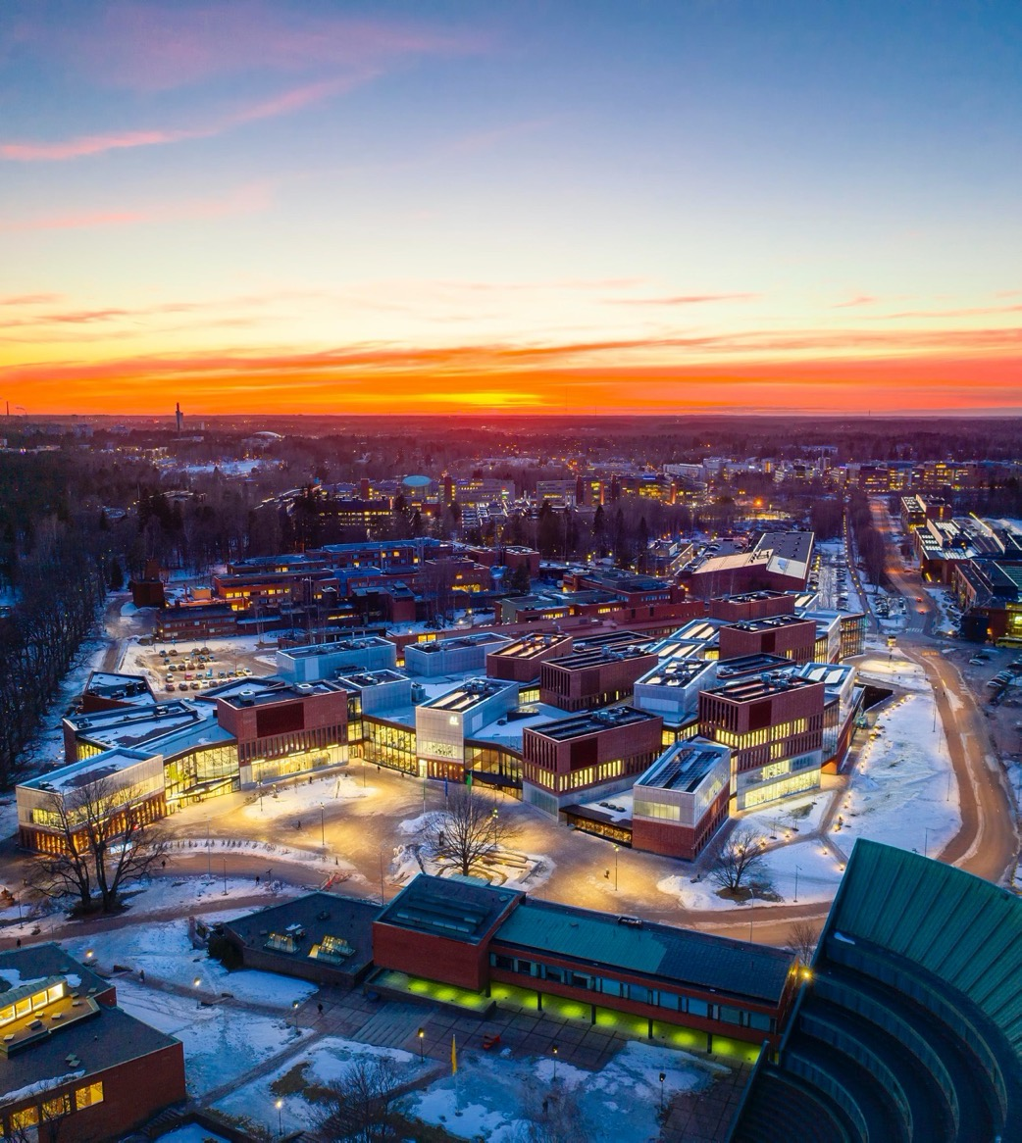
Together, we have come far
We have successfully brought together science, art, technology,
and business to become a
forerunner in our key areas
Our campus has rapidly grown into a world-class collaboration hub
We have transformed into one of Europe’s most international universities

Slide 4
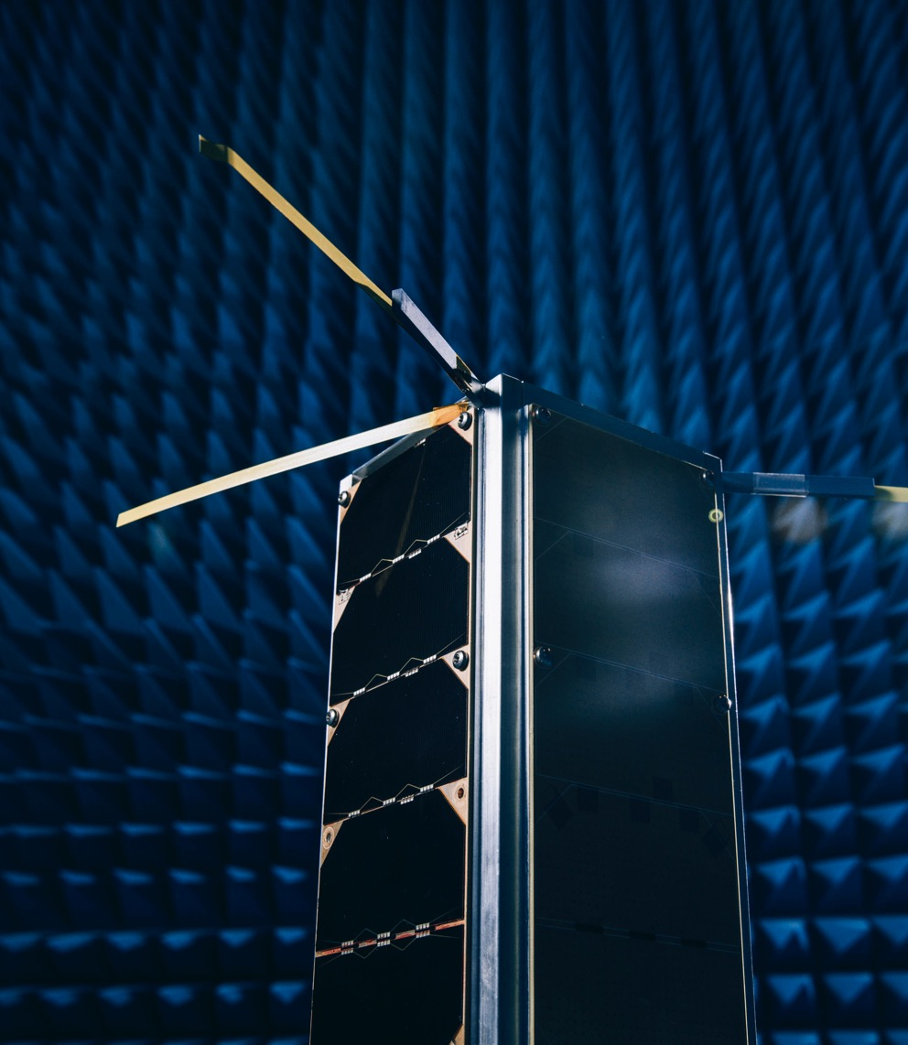
Our current
strengths
Excellence and increasing impact in our chosen key areas in research, art and education
A unique combination of collaborating disciplines
Extensive co-creation with partners
An internationally prominent start-up ecosystem
A courageous, low-hierarchy culture with empowered students

Slide 5

Major trends shaping us
The global sustainability crisis
Technological disruptions and transformation of working life
Global economic centre of gravity shifting towards Asia
The changing landscape of higher education: increasing demand and competition, digitalisation, pressure on funding

Slide 6

Living strategy
We have adopted a living strategy approach tailored for a world in motion
Our purpose, values, and way of working define our long-term direction
We choose development areas and actions that best drive us towards our purpose
As a community, we proactively and continuously re-evaluate our choices

Slide 7
Notes:
CHANGE PHOTO

Slide 8
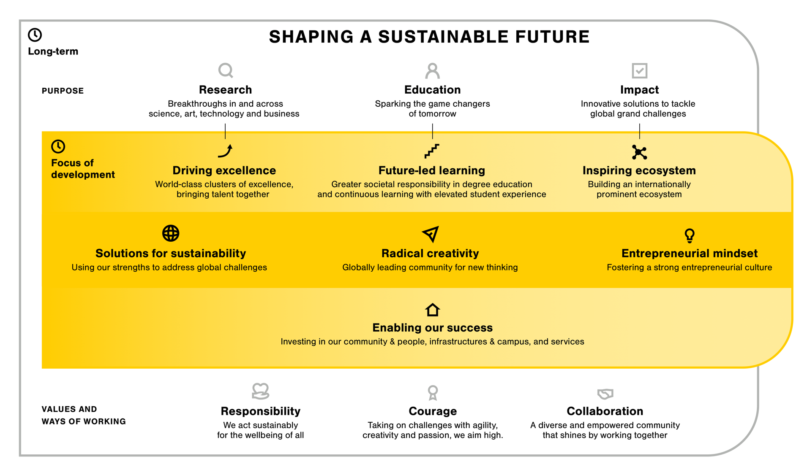

Slide 9
Research
We excel and make breakthroughs in and across science, art, technology and business
Research
Focus of development: Driving excellence
We create world-class clusters of excellence in our key research areas and bring complementary talent together to work on grand challenges.
Actions: Attracting and fostering talent, developing selected research infrastructures, new collaboration across fields

Slide 10
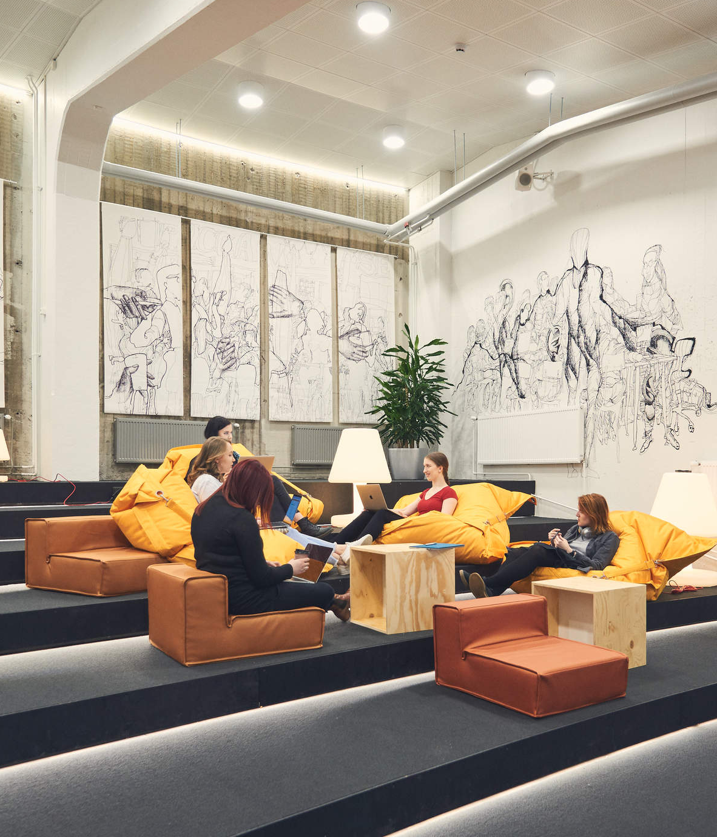
We spark the game changers
of tomorrow
Education
Focus of development: Future-led learning
We take greater societal responsibility in degree education and continuous learning, in and across our key areas. We elevate student experience and quality of learning.
Actions: Renewing educational offering, developing our digital and engaged learning environment, integrating sustainability and multidisciplinary studies into programmes, advancing learning-centricity, focusing on holistic wellbeing
Notes:
PALAUTETAAN EDELLINEN LOGIIKKA

Slide 11

We renew society with research-based knowledge, creativity and entrepreneurial mindset. We generate innovative solutions to tackle global grand challenges.
Impact
Focus of development: Inspiring ecosystem
As a community of faculty, staff, students, alumni and partners, we build our innovation, creative and entrepreneurial ecosystem as a prominent node in global networks. Actions: Cultivating an environment of innovation, developing global and local networks, building a sustainable and thriving campus

Slide 12
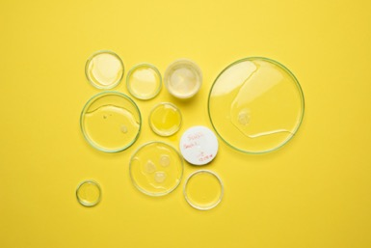
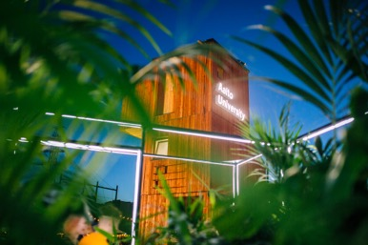
Our three cross-cutting approaches
Focus of development: We help solve grand challenges in and across our key areas. We build an outstanding creative community for new thinking. We foster an inspiring entrepreneurial culture.
Solutions for sustainability
Radical
creativity
Entrepreneurial
mindset
Actions: Connecting our strengths to create solutions for grand challenges, pioneering sustainable solutions in our operations
Actions: Empowering an experimental culture by building the spaces and practices that encourage us to break boundaries and create novel perspectives
Actions: Advancing entrepreneurial capabilities throughout our community, supporting student-driven activities and initiatives
Notes:
.

Slide 13

Enabling our success
Focus of development: We invest in our community & people, infrastructures & campus, and services.
Infrastructures & campus
Services & resources
Community & people
Actions: Developing our culture of inclusion, curiosity, collaboration and wellbeing as our competitive edge.
Actions: Investing in open, state-of-the-art physical & digital infrastructures, and campus environment as long-term assets.
Actions: Building dynamic service solutions and data-driven operations. Strengthening our financial resilience.
Notes:
.

Slide 15
References
A comprehensive, international peer evaluation of Aalto University’s research quality (RAI 2018)
Aalto University is recognised as a globally leading young university (QS top 50 under 50, 2020)
MIT, JRC and EUA have recently portrayed the entrepreneurial and innovation ecosystem evolving around the university as an international role model
Aalto University is recognised as one of Europe's most international universities (THE 2019)
Examples of Aalto University’s distinctive research excellence
Key figures and reports from 2018
An overview of Aalto University’s position in international rankings
Notes:
CHANGE THE PHOTO TO HAVE MORE DIVERSITY?

