Slide 1

AllWell?
The role of teaching in study well-being
October 2019

Slide 2
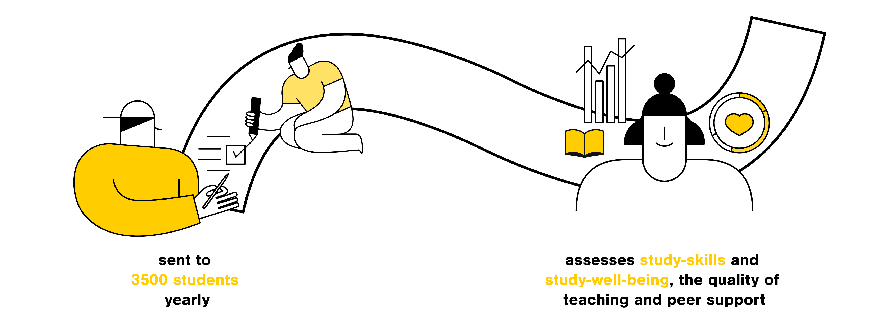
What is AllWell?

Slide 3
What is AllWell?
The AllWell? questionnaire is an annual questionnaire administered to 2nd year Bachelor’s and 1st year Master’s students of Aalto University (about 3500 students yearly)¹.
The questionnaire assesses students’ study-skills and study-well-being, the quality of teaching, as well as peer support through qualitative and quantitative measures, and is used not only to support students in their personal development, but also to develop the quality of teaching at Aalto University.
The study well-being questionnaire uses scales based on the "HowULearn" questionnaire, developed at the University of Helsinki², and applies the „study ability model“³ to structure students’ ability to study.
¹ Response rate: 46% in 2019
² See Parpala & Lindblom-Ylänne, 2012
³ The study ability model (Kunttu, 2005) divides study ability into student's own resources, study skills and motivation, teaching and study environment.

Slide 4
Main findings from the AllWell? questionnaire

Slide 5
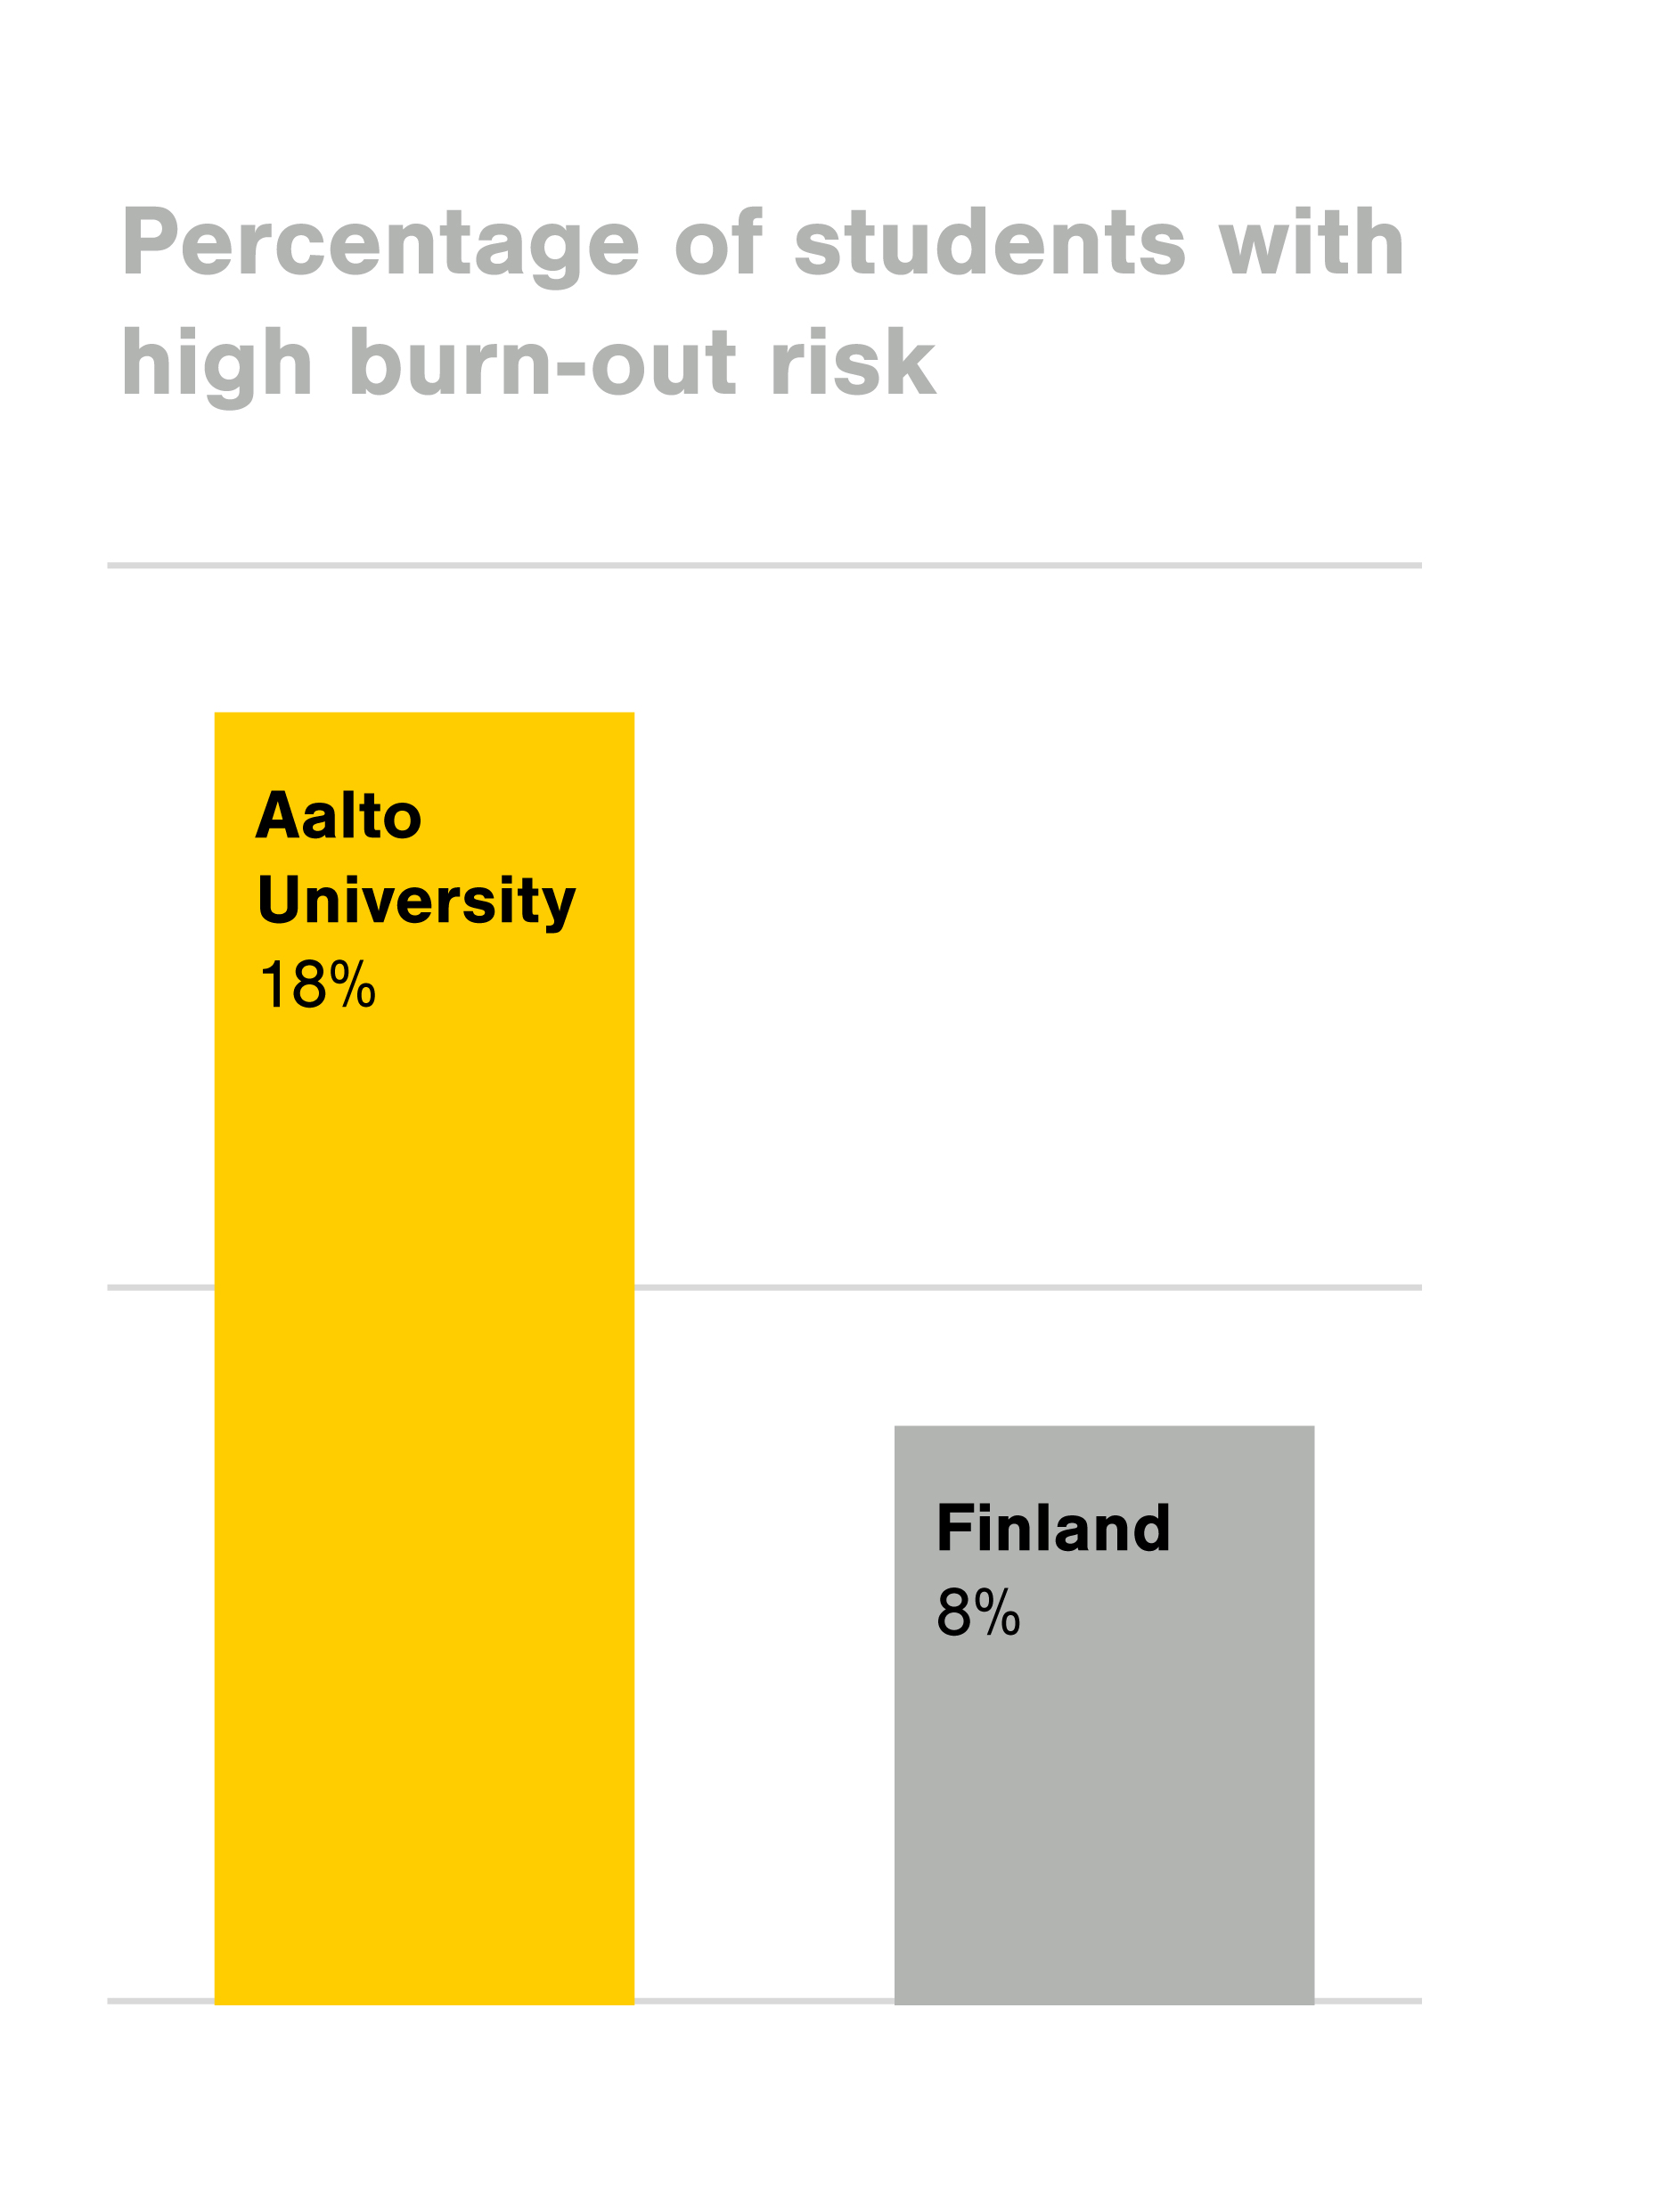
Throughout 2017–2019, around 20% of Aalto University students were at high risk of study-related burn-out¹.
That is more than twice the national average².
¹ Students’ burn-out risk levels consist of three aspects:
study related stress (exhaustion), losing motivation
(cynicism) and experiencing inadequacy.
On the risk scale from 9 to 54, „high risk“ is over 37 points.
² Compare with YTHS2012, Finnish student health care survey results, national level.

Slide 6
Network analyses have shown that students’ burn-out risk is tightly linked to self-criticism, surface approach to learning and self-efficacy.
High Burn-out Risk
High Self-criticism
Students feel inadequate and
are judgemental about themselves and their failures
Surface Approach
Studies seem fragmented and students have difficulties understanding and controlling
the study subjects
Low Self-efficacy
No trust in performance as a student (now and in the future)
or ability to learn when the
subject feels difficult

Slide 7
Teaching can have a positive impact on students’ burn-out risks by lowering surface approach and increasing self-efficacy.
Low Surface Approach
Studies seem coherent and students have no difficulties understanding and controlling the study subjects
High Self-efficacy
Trust in performance as a student (now and in the future) and ability to learn when the subject feels difficult

Slide 8
Why is students’ well-being
so important?

Slide 9
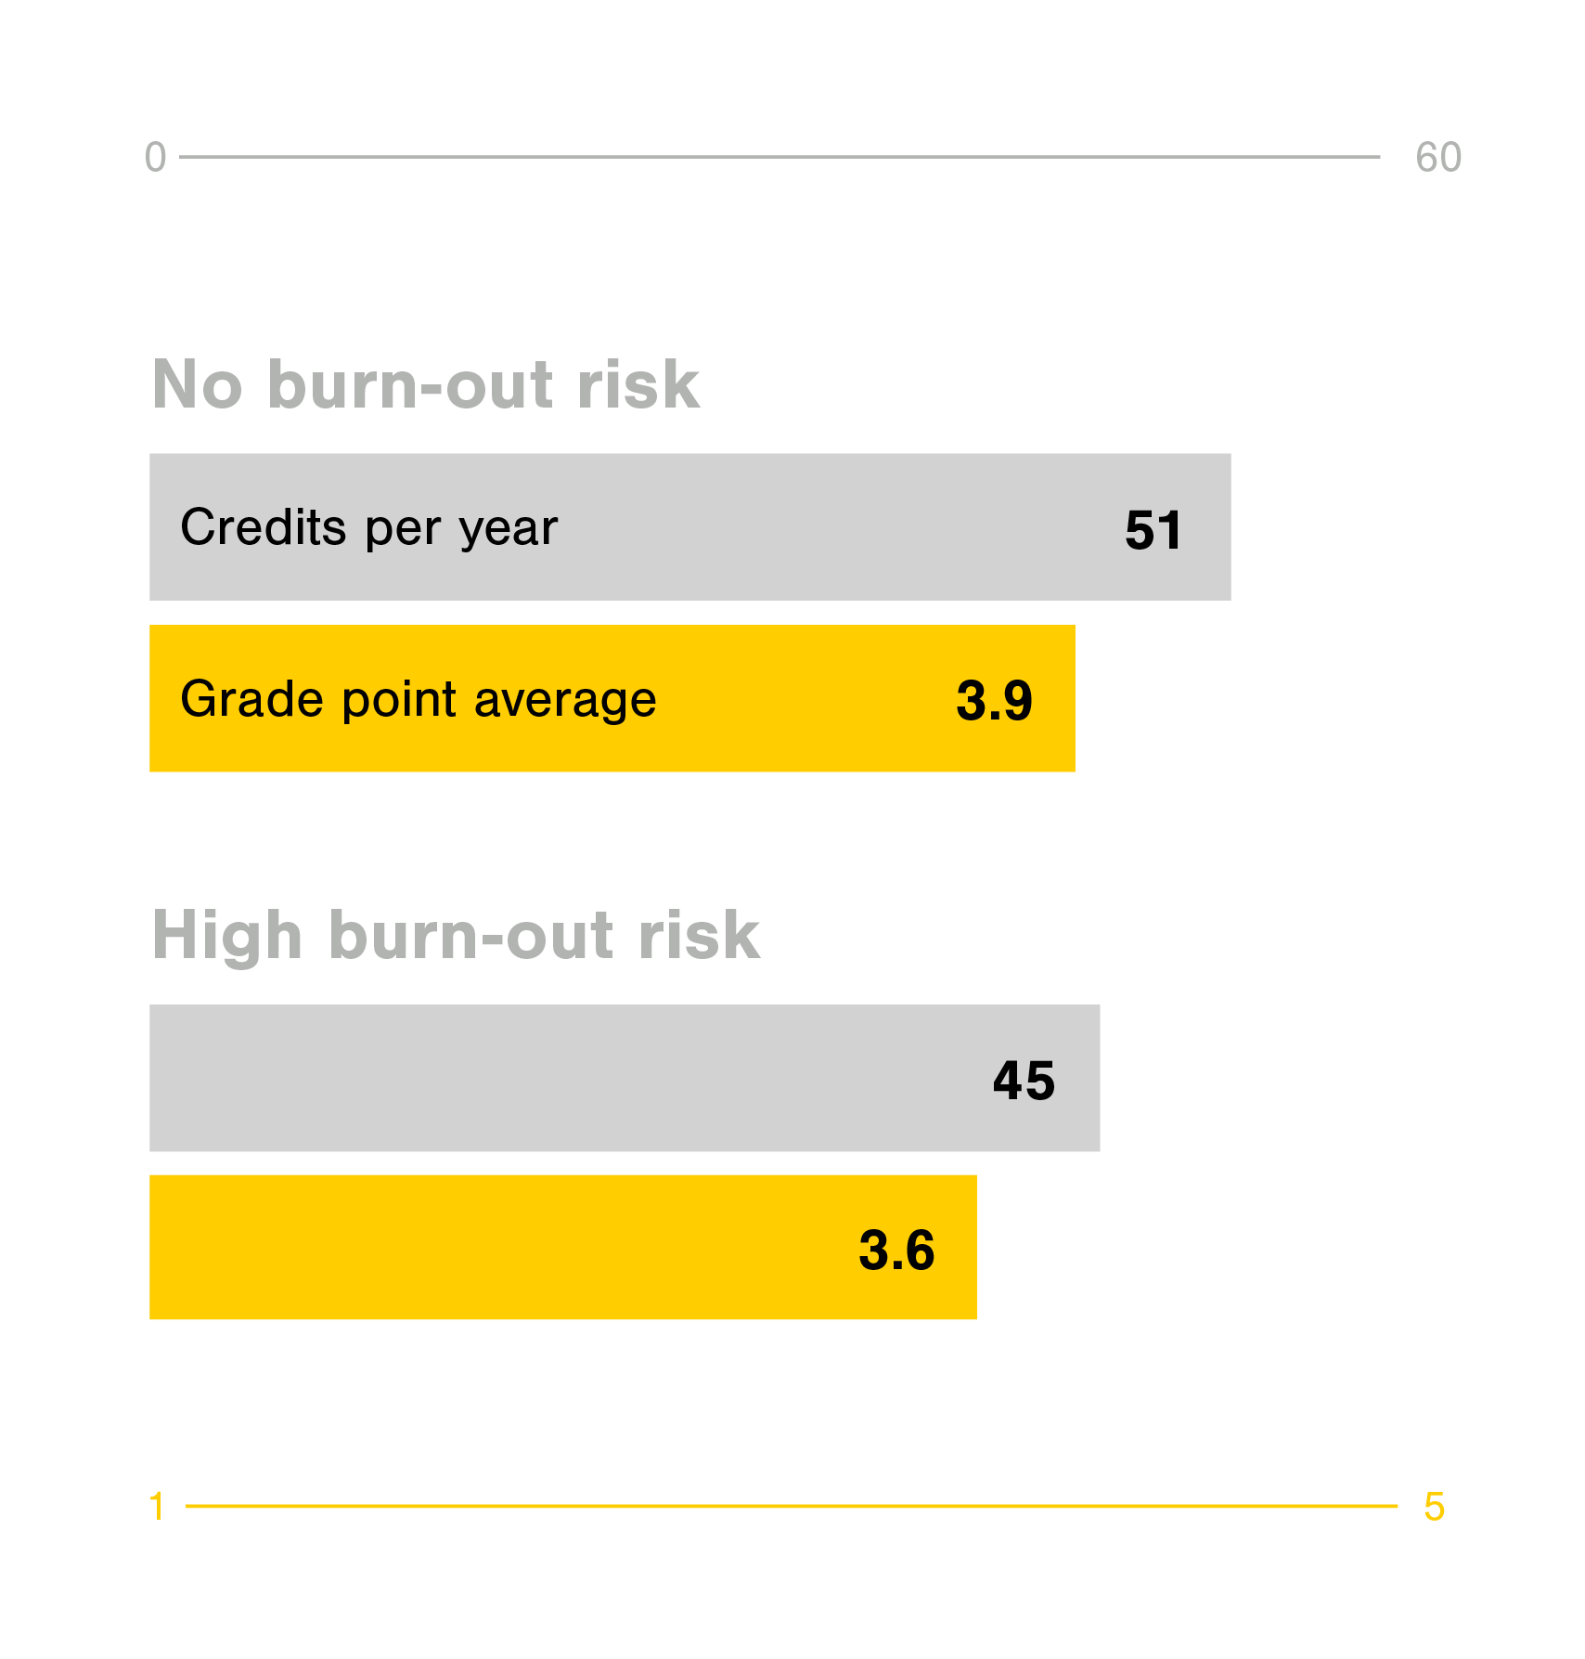
Students’ level of burn-out risk not only affects their well-being, but is also linked to their academic performance¹.
Students with lower burn-out risk levels perform better in regard to both grades and credits.
¹ The effect is probably bi-directional, i.e. low grades lead to high burn-out risk, high burn-out risk leads to low grades.
Data: AllWell? 2017-2019, Bachelor & Master students.

Slide 10
What can we do to improve student well-being?

Slide 11
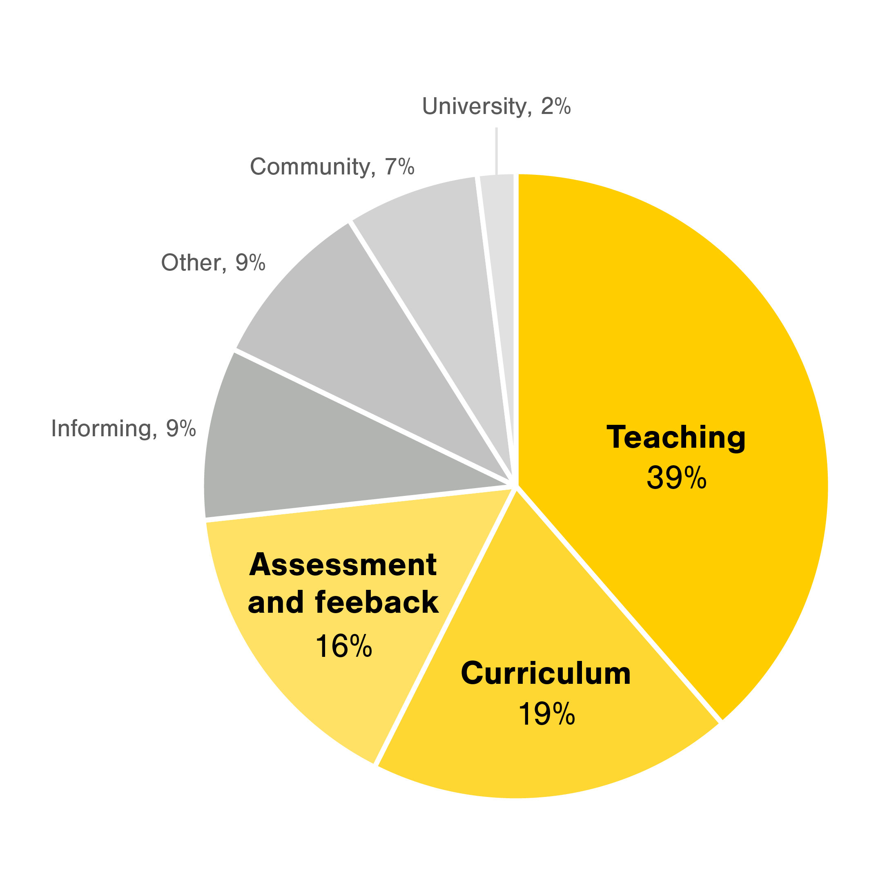
When we asked students what would help to improve their well-being, around 75% of answers pinpointed teaching related issues as a main factor¹.
¹ Results from AllWell?2019, response size 951 students.

Slide 12
What (many of our) students say about ...
Teaching practices, pedagogy, alignment
Assessment and feedback
Curriculum
„More diverse teaching, now really outdated lectures, exercises and exams. [...] I feel that for many courses the main goal is not learning, but rather passing.“
„In my program, course managers should communicate more with each other for two reasons. Firstly, the course content overlaps severely.[...] Secondly, the courses in the same period should be sequenced in terms of workload.“
„[...] In fact, I learned far the most from common courses which have made a lot of tasks / cases from / learning diary during the course and has not been in the exam. The exams just get stressed and they go crazy and then the next day you forget everything. [...] I think the best courses are those with both group and individual assignments.“

Slide 13
How we can improve students’ well-being through teaching?

Slide 14

Based on insights from the AllWell? data and programme-level AllWell? visits, there are three big areas of developmental actions that can help to improve students’ study wellbeing.
Increasing cooperation, communication and co-planning between teachers
Reducing course and curriculum level workload
Focusing on feedback and assessment practices that support learning

Slide 15

With the help of the annual study well-being questionnaire AllWell?, we gain research-based knowledge for planning pedagogical development and teaching curricula.
Read more about how we can improve students’ well-being through teaching:
https://www.aalto.fi/en/services/pedagogical-training-main-page
https://www.aalto.fi/en/services/curriculum-design-course-planning-and-student-well-being-three-things-to-take-into-account
https://www.aalto.fi/en/services/supporting-student-well-being-allwell-counter-feedback

