Slide 1

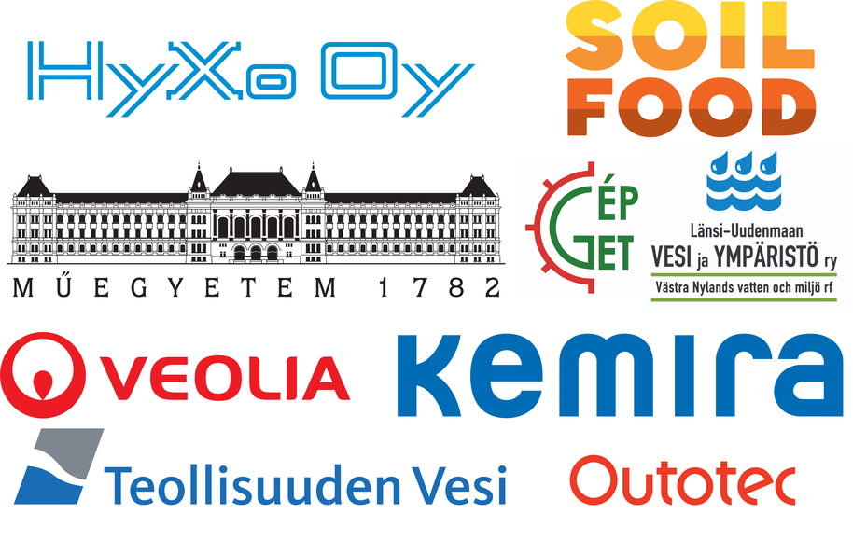
Closing the loop – nitrogen recovery from liquid waste streams Anna Mikola^{1, *}, Juho Uzkurt Kaljunen¹, Anne-Mari Aurola² and Riku Vahala¹ ¹ Aalto University, P.O. Box 15200, FI-00076 AALTO, Espoo, Finland ² Nordkalk Corporation, P.O. Box 21600, Parainen, Finland *Corresponding author: anna.mikola@aalto.fi

Slide 2
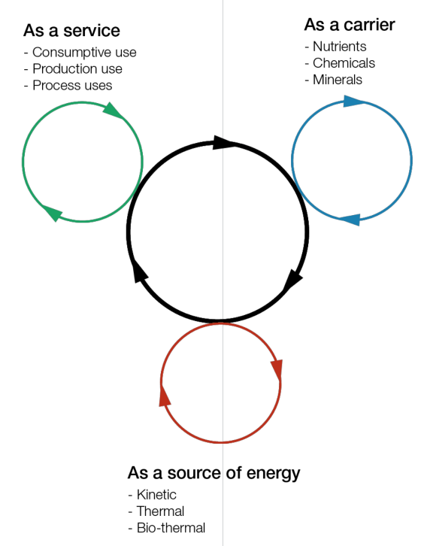
Circular economy for water
From: Water and Circular Economy: A White Paper (2018).

Slide 3
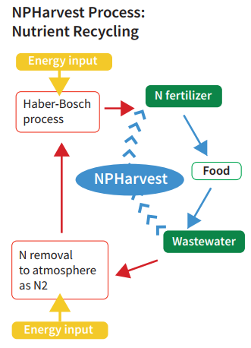
Some facts
Increased agricultural production has led to growing nitrogen fertilizer use as well as pollution of water bodies.
Nitrogen fertilizer production is an energy intensive process.
Removing nitrogen from municipal wastewater accounts for about 50% of the treatment process energy consumption.
Harvesting nitrogen directly from liquid wastes would offer significant energy savings and decrease the load to the water environment.
Notes:
Figure is very simplified description of human induced nitrogen cycle.
Denitrification-nitrification is energy intensive because aeration
Local and global environmental problems: eutrophication, climate change, shift in ecological balances for instance.

Slide 4
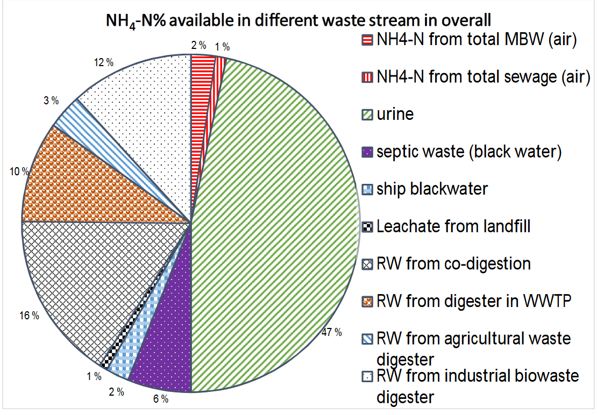
Nitrogen in different liquid waste streams in Finland

Slide 5

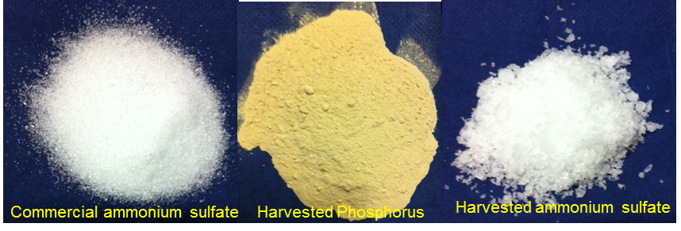
Challenges with the existing nutrient harvesting technologies
High CAPEX and OPEX
Only nitrogen is often harvested, phosphorus not
Struvite process cannot be applied to chemically treated sludge
Lack of demand for end-products
Unsuitable end-products for fertilizer industry

Slide 6
Our approach
The overall objective:
an improved nitrogen stripping-absorption process for different concentrated liquid waste streams such as reject water, urine, landfill leachate and septic waste
optimal end-product quality by combining lime addition and phosphorus recovery from wastewater
resource optimization by using industrial by-products for pH control and for recovery
Technical path
Membrane reactor optimization
Pretreatment and lime product tests
Commercial path
Market potential of different waste streams
End-product value chain studies
Business model development
On-site piloting

Slide 7
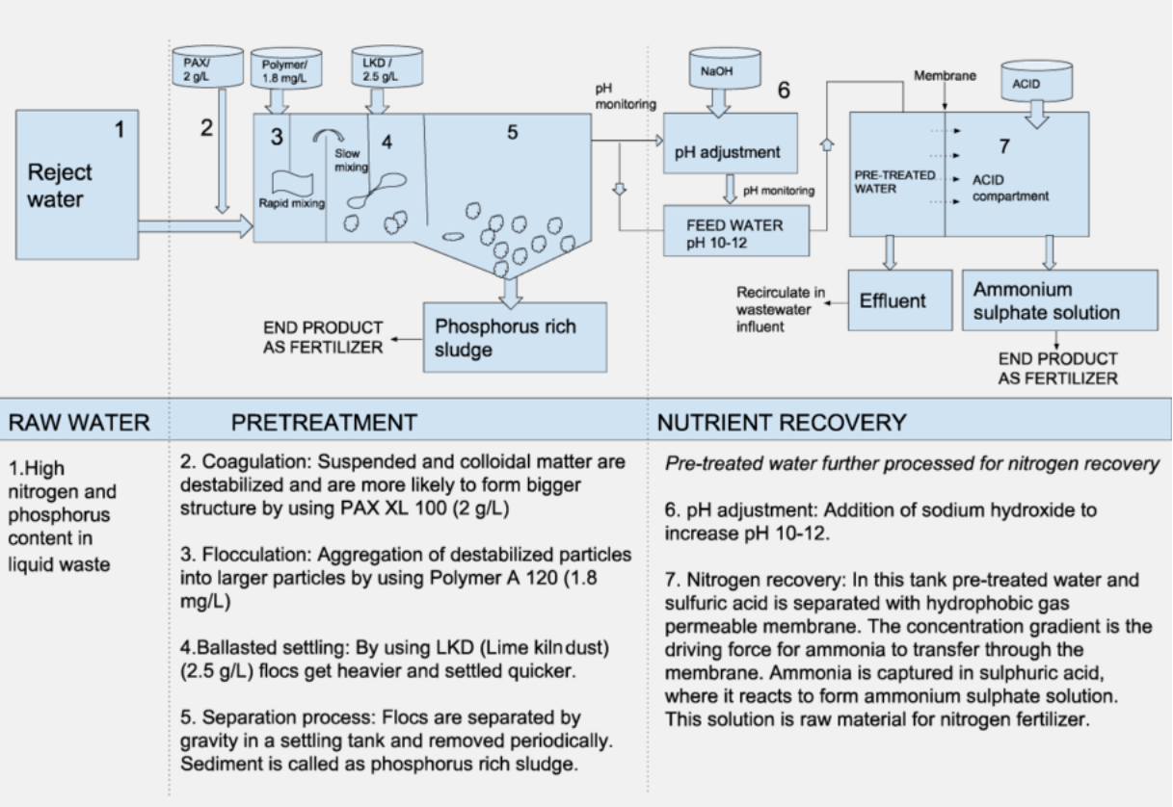
NPHarvest process

Slide 8
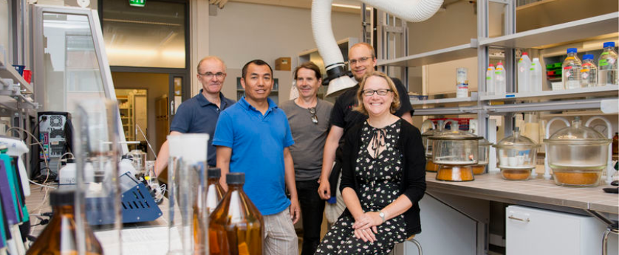
Summary
NPHarvest process has potential to be economically feasible in full-scale applications.
Lime products offer several benefits in combination to a nitrogen recovery process using membrane stripping; currently we are studying the fertilizer value and purity of the end-products.
Pilot studies will be completed by the end of 2019.

Slide 9
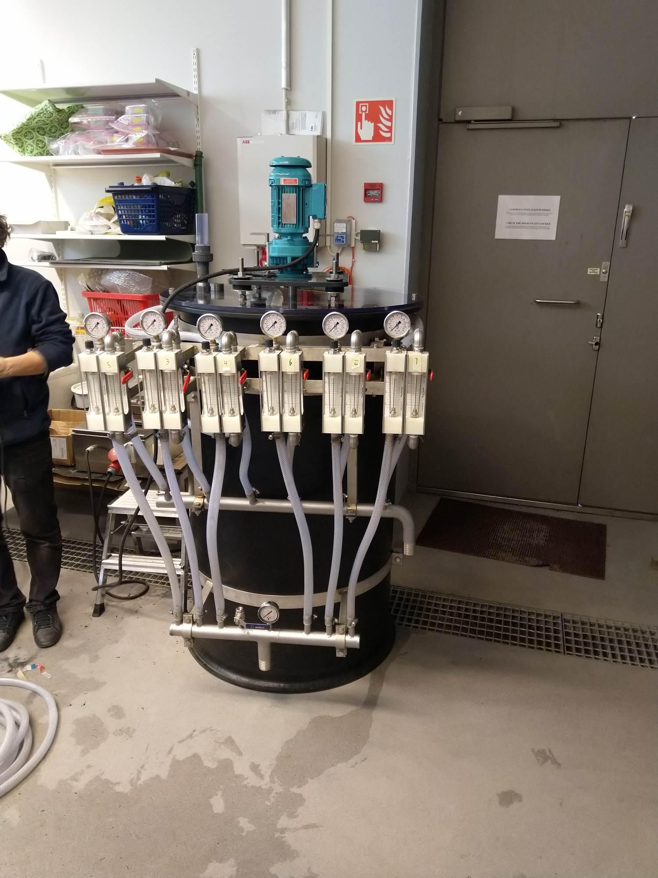
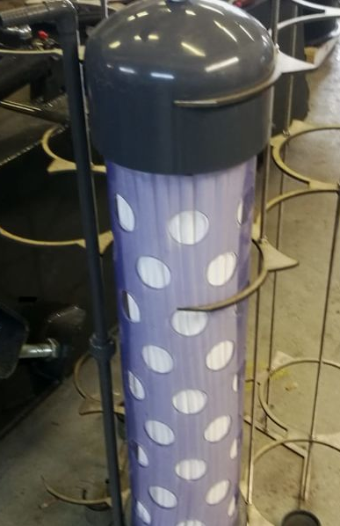
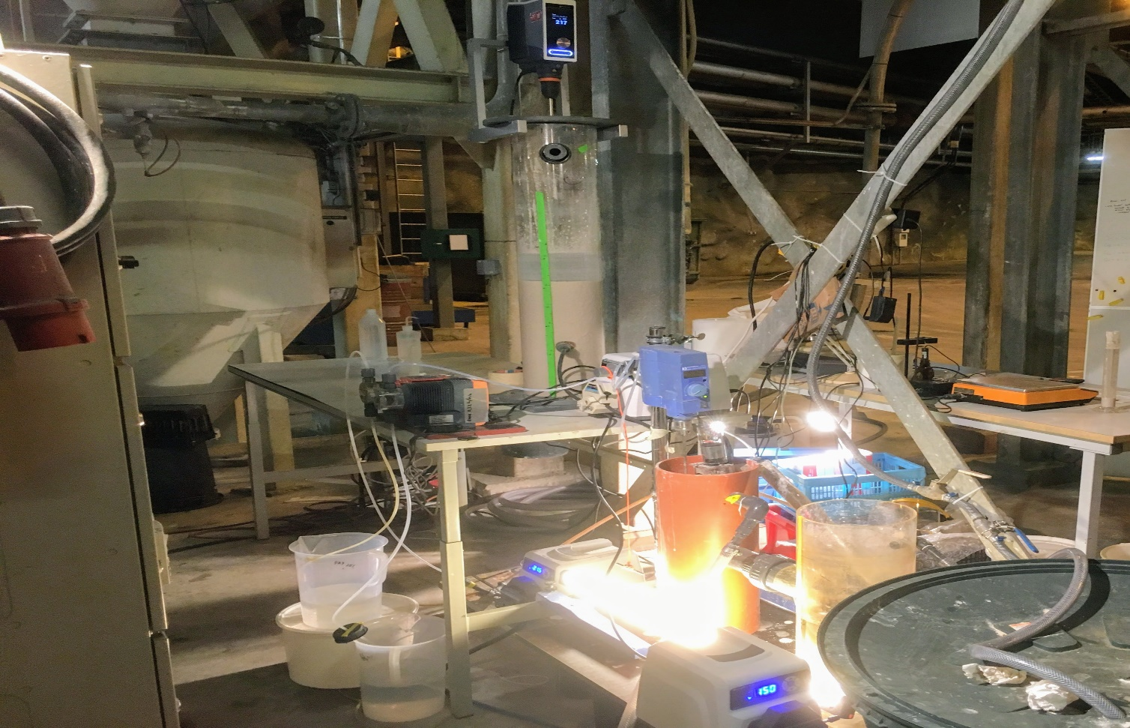
Market studies and technical reports can be found from:
aalto.fi/npharvest

