Slide 1
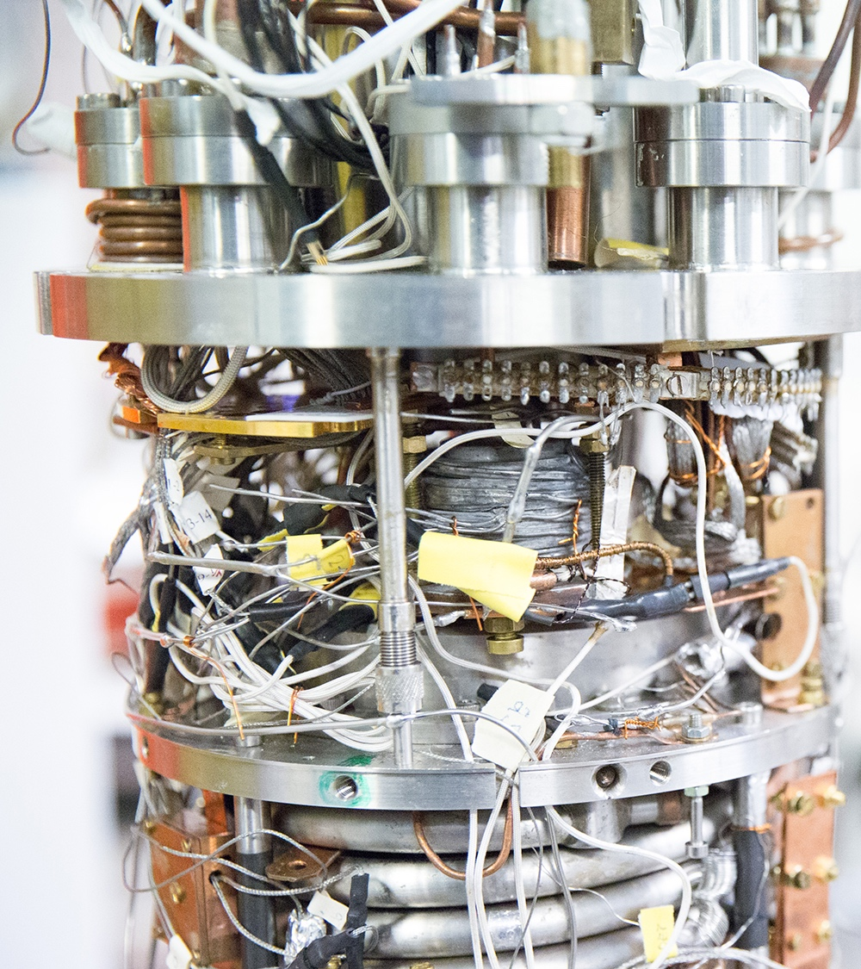
School of Science
Science for tomorrow’s technology, innovations, and businesses

Slide 2
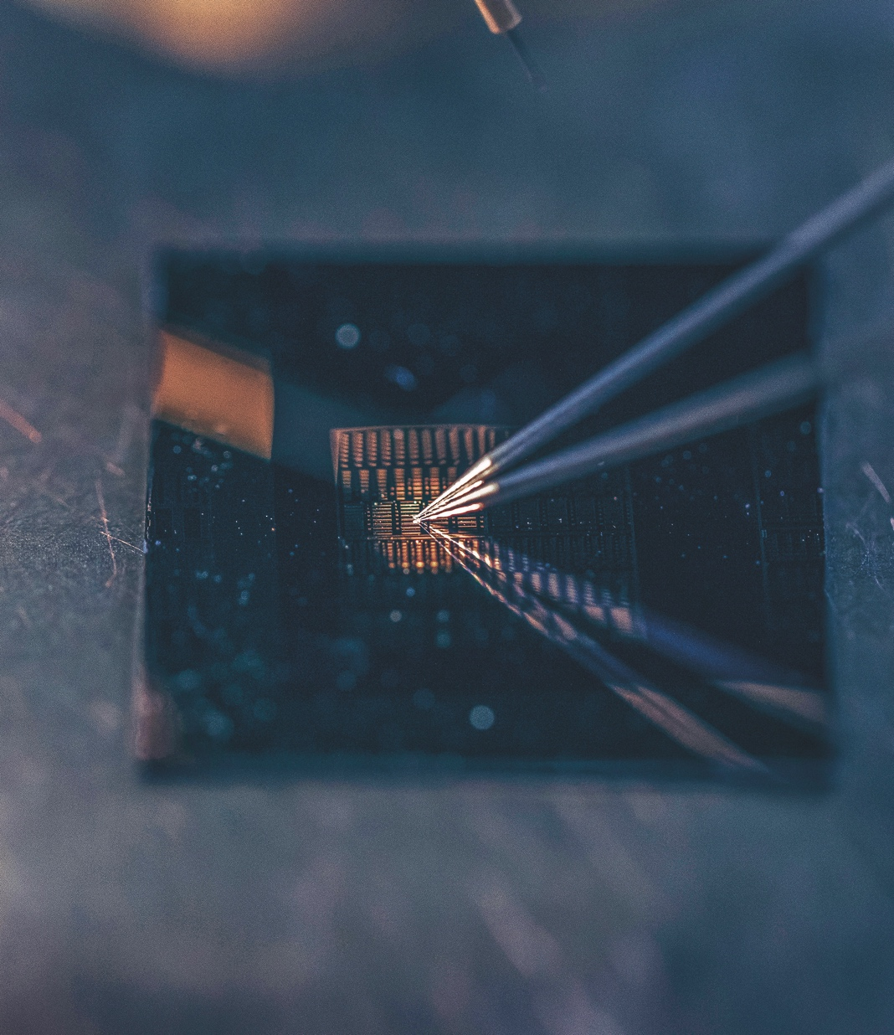
Focus areas
Advanced energy solutions
Condensed matter physics
Creation and transformation
of technology based business
Data science and artificial intelligence
Health technology
Neuroscience
Software engineering

Slide 3
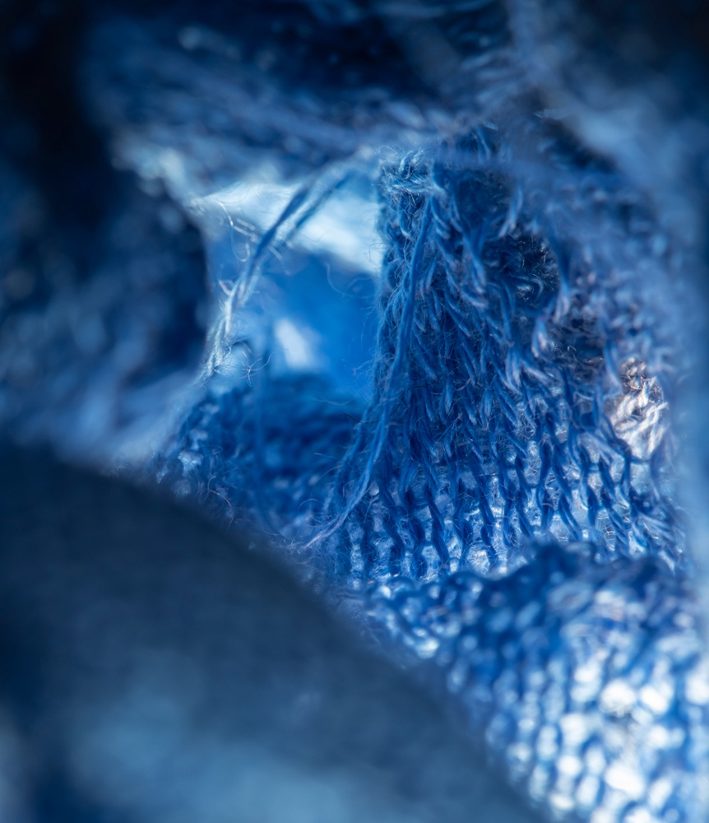
Departments
Applied Physics
Computer Science
Industrial Engineering and Management
Mathematics and Systems Analysis
Neuroscience and Biomedical Engineering

Slide 4

Key figures
3741 degree students
1577 BSc
1324 MSc
104 Lic. Sc.
736 PhD
17% of degree students are
international
2 Bachelor’s programmes (English)
7 Master’s programmes (English)
6 international double-degree programmes
585 degrees in 2018
5 departments
100 professors
Notes:
Bachelor students: 1577
Master students: 1328
Postgraduate/doctoral students: 840

Slide 5
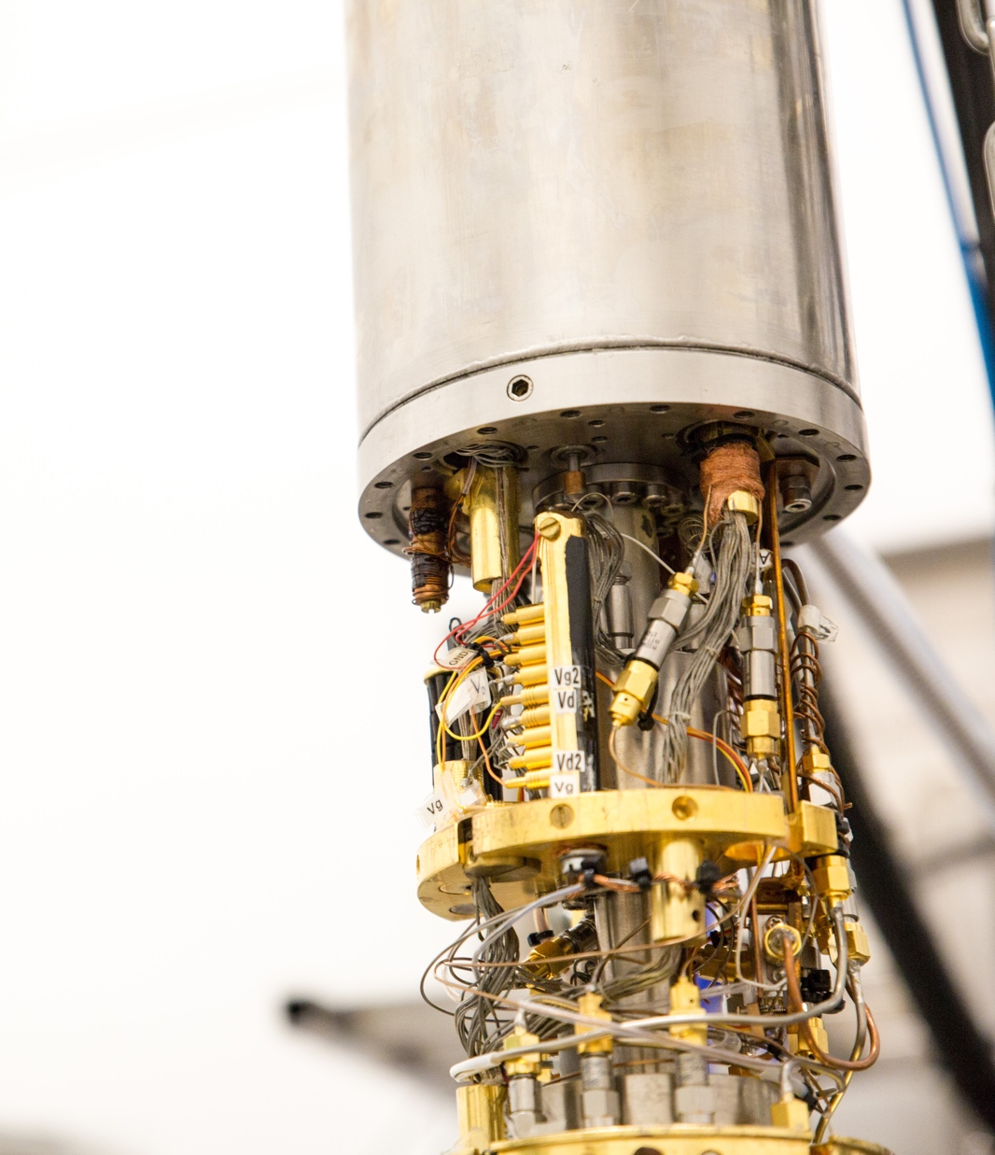
Research
20+ Personal ERC Grants
1 ERC Synergy Grant
    Brain Research
3 EU Flagship memberships
    Graphene Flagship
    Human Brain Project
    Quantum Flagship
3 National Centres of Excellence
    Quantum Technology
    Hybrid Materials
    Artificial Intelligence
Notes:
ERC = European Research Council
National Centres of Excellence :
CoEs are jointly funded by the Academy of Finland, universities, research institutes, the private business sector and many other sources. CoEs carve out new avenues for research, develop creative research environments and train new talented researchers for the Finnish research system and for Finnish business and industry.

Slide 6
Degree programmes
Aalto University Bachelor’s Programmes in Science and Technology:
Data Science
Quantum Technology
Bachelor Programme majors in Finnish:
Computer Science
Engineering Physics
Information Networks
Industrial Engineering and Management
Mathematics and Systems Sciences
Master’s Programmes:
Engineering Physics
Industrial Engineering and Management
Information Networks
Mathematics and Operations Research
Jointly with other Aalto University Schools:
Computer, Communication and Information Sciences
Life Science Technologies
International Design Business Management
Notes:
Aalto Bachelor’s Programme in Science and Technology organised jointly with all four tech schools (Engineering, Chemical Engineering, Electrical Engineering, Science)
International Design Business Management Master’s Programme is university-wide
INTERNATIONAL DOUBLE DEGREE PROGRAMMES
ICT Innovation
(EIT Digital Master School)
Advanced Materials for Innovation and Sustainability AMIS
(EIT Raw Materials)
Security and Cloud Computing, SECCLO
(Erasmus Mundus)
CCIS Security and Cloud Computing
(ITMO University)
Doctoral double degree
(IIT Madras)

Slide 7
International double-degree programmes
ICT Innovation
(EIT Digital Master School)
Advanced Materials for Innovation and Sustainability AMIS (EIT Raw Materials)
Security and Cloud Computing, SECCLO (Erasmus Mundus)
CCIS Security and Cloud Computing (ITMO University)
Doctoral double degree
(IIT Madras)
Notes:
Master’s Programme in ICT Innovation (EIT Digital)
Autonomous Systems (KTH, TU Berlin, U. of Trento, EURECOM, ELTE) - ELEC
Cloud Network & Infrastructures (KTH, TU Berlin, Université Rennes 1, Sorbonne Université, U. of Trento) - ELEC
Data Science (Politecnico di Milano, Univ Polit de Madrid, U. Nice Sophia Antipolis, TU Eindhoven)
Human Computer Interaction and Design (KTH, TU Berlin, U. Twente, U. of Trento, U. Paris-Sud , Univ Polit de Madrid , Politecnico di Milano)
Visual Computing and Communication (KTH, University of Trento)
AMIS - Master’s Programme in Advanced Materials for Innovation and Sustainability (EIT Raw Materials)
Grenoble Institute of Technology France, TU Darmstadt Germany, University of Bordeaux France, University of Liege Belgium
Master’s Programme in Computer, Communication and Information Sciences
Security and Cloud Computing with ITMO University, Russia
SECCLO - Master’s programme in Security and Cloud Computing (Erasmus Mundus)
KTH, NTNU, DTU, University of Tartu, EURECOM
Doctoral Programme in Science
Indian Institute of Technology Madras, Chennai, India

Slide 8
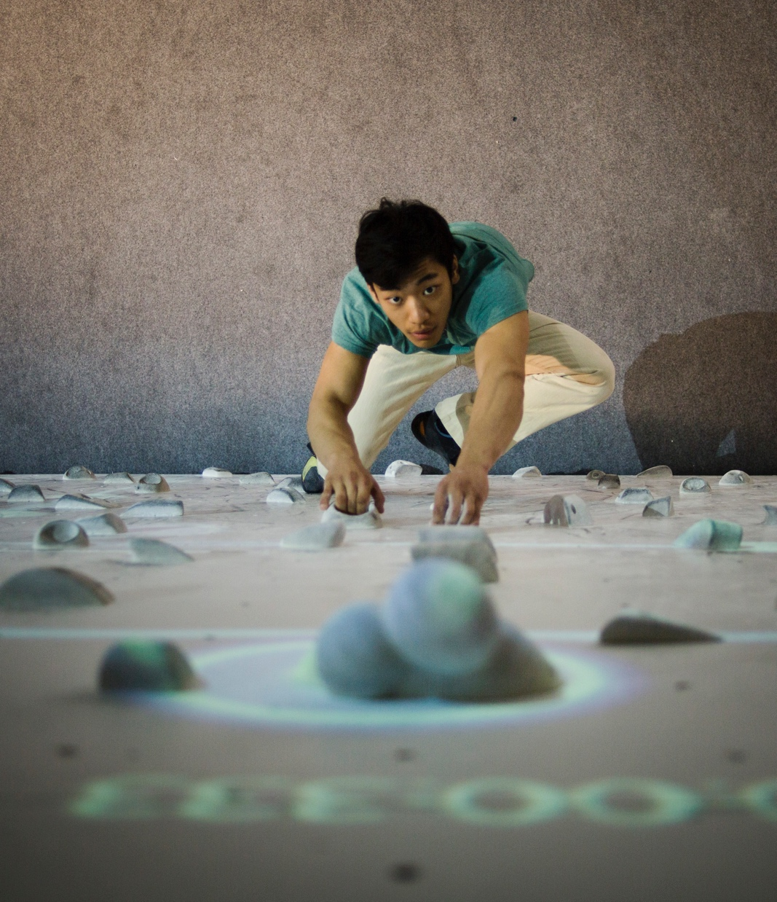
Societal impact
Our research in all fields creates new business, spin-offs and start-ups.
We collaborate with international corporations and the major companies in Finland.

Slide 9
Thank you!

