Slide 1
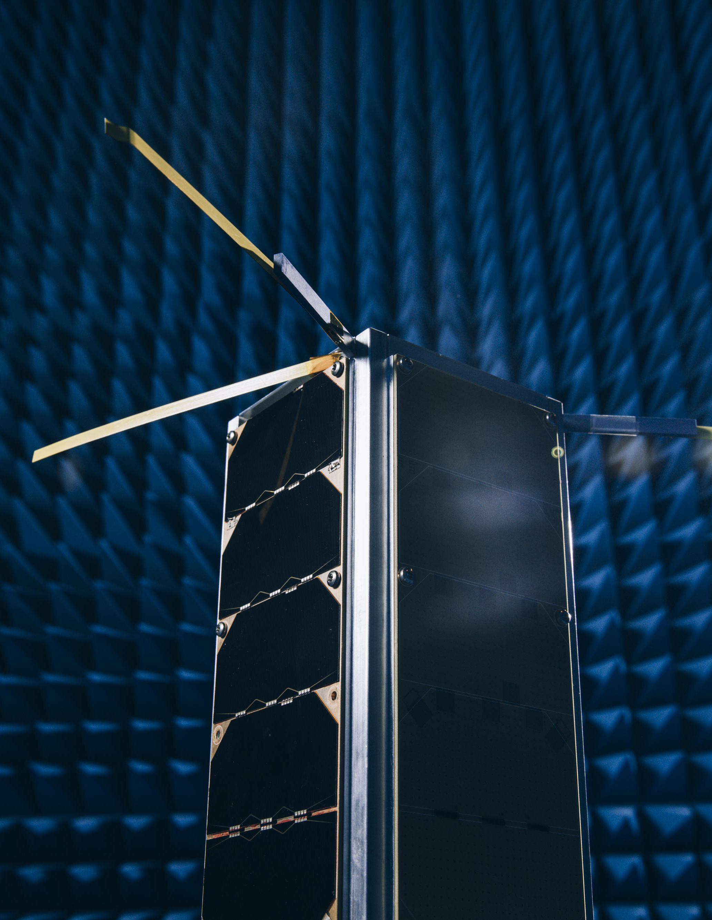
ELEC Midterm Review for Doctoral Researcher
<Thesis Title>
<Your Name>
Supervisor: Prof. XXX YYYYY
Advisor(s): Dr. ZZZ AAAA
Examiner: Prof. SSSS DDDDD
Department of <DEPT>
<Date here>
Notes:
This template was prepared by Prof. Vesa Välimäki and Prof. Simo Särkkä (2025-2026). Date of this version is 23.9.2026.

Slide 2
Outline
▶ My Research
▶ Study Credits
▶ Teaching Experience
▶ Publications
▶ Planned Graduation
About 10-20 slides should be enough for your midterm review presentation

Slide 3
My Research
Working title of my doctoral thesis:
“<Brief But Sufficiently Accurate Title>”
My research focuses on <plain English explanation of what it is that you do>
Start date of my study right and working contract: <if applicable>
<Describe your doctoral research so that also others may understand it>
<When you will go into technical details, be sure to define all terms and acronyms. The external expert may not know the same terms as you.>
<Expected results: Ongoing and future research can be briefly described>

Slide 4
Study Credits
I have completed XX/30 credits <Please remember that you need to have completed 10 credits by the time of your midterm review>
<You may also copy here a screenshot of your study plan and indicate which courses you have completed>
After the Midterm Review, I will have completed YY/30 credits.
I am still missing ZZ credits
List of planned studies to collect 30 credits: <Which courses or other teaching activities will give the remaining credits and when>

Slide 5
Teaching Experience
<You need to have at least one experience of university teaching in interaction with BSc and/or MSc students, e.g., thesis advising. This only applies to those who have a working contract at Aalto University>
<If you have been a teaching assistant or given lectures, please mention the course(s) here>

Slide 6
Publications
<Remember that at least 1 published, submitted, or accepted paper is a requirement at midterm review>
Published and accepted papers <Give standard bibliographical info: all author names in the correct order, paper title, publication forum, pages, month and year or publishing>
Submitted papers
Planned papers <Will you be the 1st author?>
List of planned publications for the doctoral thesis

Slide 7
Planned Graduation
Planned date of submitting the thesis manuscript for pre-examination, e.g. Q1/2029 <Please try to plan that you will graduate in the 4th year of study>
Planned approximate date of doctoral defense, e.g. Q3/2029 <Typically 4-6 months later than the start of the pre-examination>
Planned graduation date <Which DPC meeting? For example, Sep. 2029>

