Slide 1

Professor in Landscape architecture, especially landscape design practices
Aalto University
School of Arts, Design and Architecture

Slide 2
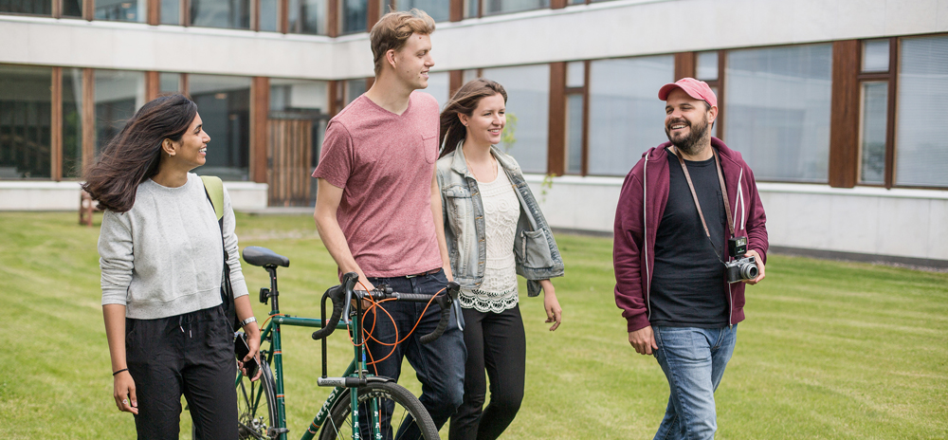
Aalto University
Aalto University is a multidisciplinary community of bold thinkers where science and art meet technology and business.
Aalto University is a university where research, art and education are promoted hand in hand. We are committed to identifying and solving grand societal challenges and building an innovative future.
With high-quality research we aim at creating significant impact on the international scientific community, industry and business, as well as the society at large. Disciplinary excellence is combined with multidisciplinary activities, engaging both students and the local innovation ecosystem.
Aalto has over 13 000 students and six schools with more than 400 professors. We are an international community: more than 45% of our academic personnel have an international background.
Aalto University was founded in 2010 as three leading Finnish universities, Helsinki University of Technology, the Helsinki School of Economics and the University of Art and Design Helsinki, were merged. Our campuses are located in Espoo and Helsinki, Finland.
The University campus in Espoo is developing into a unique, open innovation hub and a center of collaboration that attracts partners from all around the world. It encourages sharing of ideas, inter-disciplinary encounters, creativity, growth and entrepreneurship. The core of the campus will be a vibrant city with versatile services and attractive places to meet.
More info at
aalto.fi

Slide 3
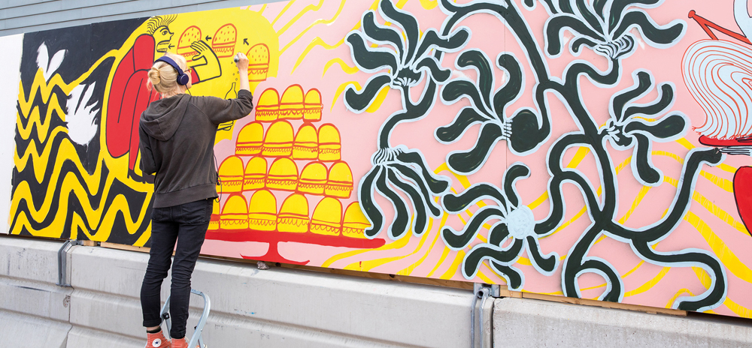
School of Arts, Design and Architecture
Creating better living environments in multi-disciplinary collaboration,
changing the world through artistic means.
Steeped in the deep tradition of Finland’s cultural heritage, the School of Arts, Design and Architecture (Aalto ARTS) educates
towards the future with a focus on fostering a more innovative society.
Our programs prepare students to be global citizens, offering valuable contributions to their communities with a focus on collaborative, compassionate, and unconventional solutions to some of the most pressing challenges of our time.
We have more than 2 700 students and over 300 faculty and staff. 20% of our students are international.
The School has four departments:
Art & Media, Design, Architecture, Film
Cooperation and interaction between the different disciplines represented at the school emphasize a human and user-centered approach in the creation of new environments.
Our research in the field of design and media is world class and on a strong international standing in both art and architecture. Other leading research areas pursued include design, digital media, audiovisual presentation, art research, visual culture and wellbeing construction, as well as community and urban construction.
The school has active links to the surrounding society, business and industry, and the culture sector. We are proud to be ranked at #8 in Art & Design education in the world (QS Ranking 2025).
More info at
arts.aalto.fi

Slide 4
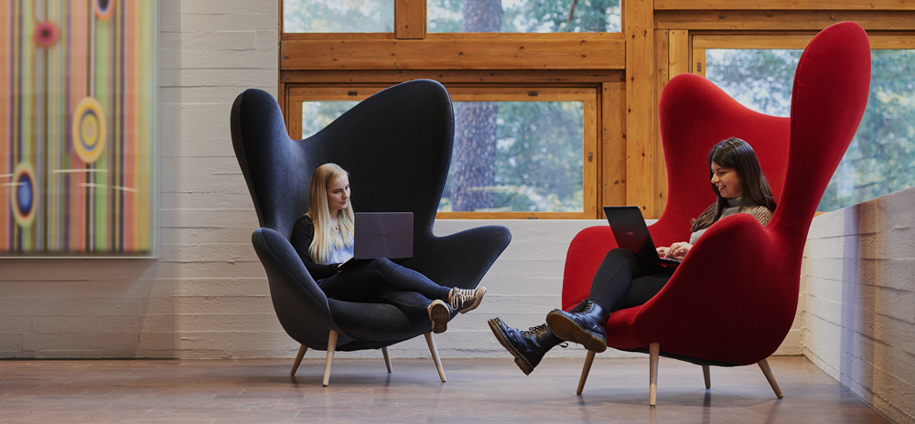
Department of Architecture
An internationally renowned education and research unit
Education
With respect to Finland’s esteemed architectural heritage, we search for new solutions to the challenges of sustainable development. To us, architecture is an art form that requires practical skills and individual artistic development, as well as sustainability knowledge relevant to design and planning. We educate critical thinkers who accept their responsibility to research and design a socially, culturally, and ecologically sustainable built environment. The Department of Architecture offers degree programmes in architecture, landscape architecture and interior architecture. Currently, the BA level courses are taught primarily in Finnish whilst MA and doctoral level studies primarily in English.
Research
The research at the Department of Architecture produces knowledge about architecture, landscape architecture, urban studies and planning, design practice, the role of architecture in society and the future of construction. We also study architectural history and conservation. Furthermore, our focus areas include construction in the social and health sector, construction for a sustainable future, computer-assisted design methods, and humanitarian architecture. Our research profile covers both basic research in architecture and applied research answering the needs of the industry and public sector.
What we offer
We offer you a possibility to work within a well-resourced learning, research and art & design community. The School of Arts, Design and
Architecture has well-equipped infrastructure for research and artistic activities, including a number of top-class workshop premises. We are located on the Aalto University campus in Otaniemi, Espoo, with several other neighboring research institutions and organizations.
About Finland and Helsinki area
Finland has a high standard of living, a world leading education system, and a vibrant commercial and cultural life. It enjoys a robust economy and political stability. It has excellent transport links to the major cities of Europe and beyond. Helsinki is one of Europe’s leading capital cities and a vivid center of scholarship. As a living and working environment, Finland is consistently ranked highly in quality-of-life and competitiveness studies.
Living up to our values
As a community of high ethics, we want to assure the highest international standard in research, education, and teaching. We expect all our community members to respect Aalto values and follow the ethical principles of fair play and integrity in all our activities and the behavior that we expect from each other. The Aalto University Code of Conduct is applicable to all Aalto community members, and it clarifies the values that guide us.
More info at
Dept. of Architecture

Slide 5

Professor in Landscape architecture, especially landscape design practices
Job description
Aalto ARTS has opened a call to find a tenure track or tenured professor in Landscape Architecture with the focus on landscape design and its professional/artistic practices. The position addresses the creation of sustainable, functional, and meaningful landscapes of outstanding design quality, especially at a local and site scale. The post is extremely important for the future standard of artistic practice and practical design expertise in the field of landscape architecture, especially in a context where there is a growing demand for skilled professionals and high-quality design solutions.
The professor of Landscape Architecture is expected to contribute to the artistic foundations of the landscape design discipline and its professional practices. The contributions of the applicant may be emphasized on 1) architectural, conceptual, theoretical, societal reflections of the field and/or 2) on landscape construction, materials, detailing and related sustainability aspects. The applicant is expected to embed landscape design practices into teaching and academic debate in the field. The tasks include teaching/tutoring students in their design projects as well as development and administrative work within the department. The professor is also expected to collaborate with other fields in the department, as well as build networks with other departments of the university and with collaborators beyond Aalto University. We expect you to participate in service to the Aalto University community and to encourage you to cross-disciplinary networking as well as interacting actively with society at large and stakeholders outside the academy.
Requirements
The applicant is expected to have a master’s degree in landscape architecture field and possess professional/artistic merits and competence in landscape design. The evaluation of applicants is based especially on the level of accomplishment and merits gained through artistic work and professional practice. Depending on the profile of the applicant, merits can also include theoretical/conceptual contributions and active professional publishing related to the field and/or experience in practice-oriented or artistic research and/or a doctoral degree in the relevant field. In addition, evaluation includes teaching, academic leadership and other relevant activities in academic and professional communities – this evaluation depends on the level of the tenure track. The successful candidate is expected to be internationally networked and fluent in English. Knowledge of Finnish and/or Swedish is an advantage. Broad knowledge in the field and interaction with other technical and artistic fields are appreciated. Experience and familiarity with the potential and challenges of the northern cultural and environmental context will be considered an advantage. Please find more information on our tenure-track criteria here.
Additional information
The call is open for Assistant and Associate professor levels of the Aalto University tenure track system . The position will begin 1 April, 20027 or as agreed. The professorship is full-time.
More info in the job call

Slide 6
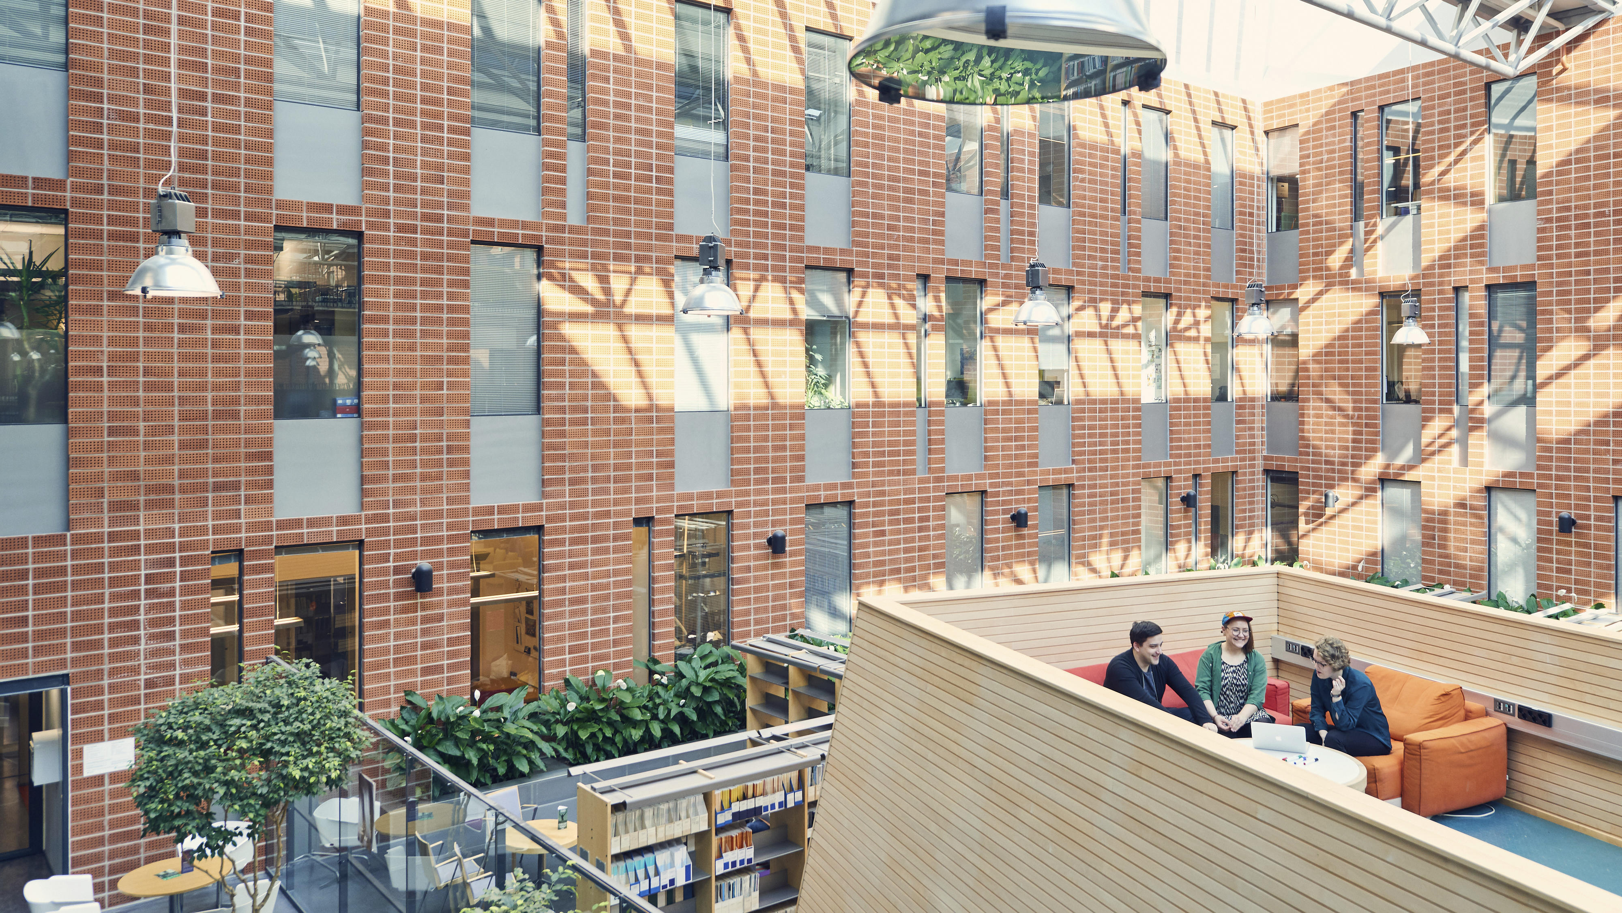
Applying to the position
Professor in Landscape architecture, especially landscape design practices
How to apply?
Please submit the following materials in English and in PDF format through our recruitment system Workday. Please note that the maximum size per document there is 5 MB.
An application letter addressed to the Dean of the Aalto University School of Arts, Design and Architecture, including a statement describing your vision of development of the field and its future orientations in practice and teaching and potentially research (max. 3 pages),
A curriculum vitae, based on the template TENK guidelines, and adapted to professional / artistic careers
A professional/artistic/research portfolio including 1) a comprehensive list of all professional/artistic projects and scientific/professional publications and 2) selected 5-8 most important work samples, major part of them professional/artistic projects. The professional/artistic projects are presented with figures and written reflection and contextualization of the work, and a detailed description of the project team and your specific role in it. The scientific/professional publications are presented as summaries and links to the original publication. Portfolio in total, max 30 pages and maximum size 30 MB. If the document is larger than 5MB, please upload it as a single PDF file to our portfolio uploading service.
Teaching portfolio, compiled according to Aalto guidelines and adapted to the level of the tenure track
We kindly ask you to submit your application materials into our recruitment system Workday no later than midnight on 13 February 2026 at 23:59 (UTC +2).
After the application period closes, the departmental committee will draw a shortlist of candidates who will be invited to a site visit at the Department of Architecture in August 2026. During the site visit they will be interviewed and asked to deliver a teaching demonstration. In addition, the shortlisted applications will be reviewed by external experts.
Aalto University reserves the right for justified reasons to leave the position open or to extend the application period.
Enquiries
For additional information, please contact chair of the departmental committee, Professor Ranja Hautamäki, ranja.hautamaki(at)aalto.fi
In questions related to the recruitment process, please contact HR specialist Satu Pöyhönen: satu.poyhonen(at)aalto.fi
Please note that between 19 Dec 2025 and 7 Jan 2026 there may be delay in responses due to the winter vacation periods in Finland.
Apply here!

Slide 7

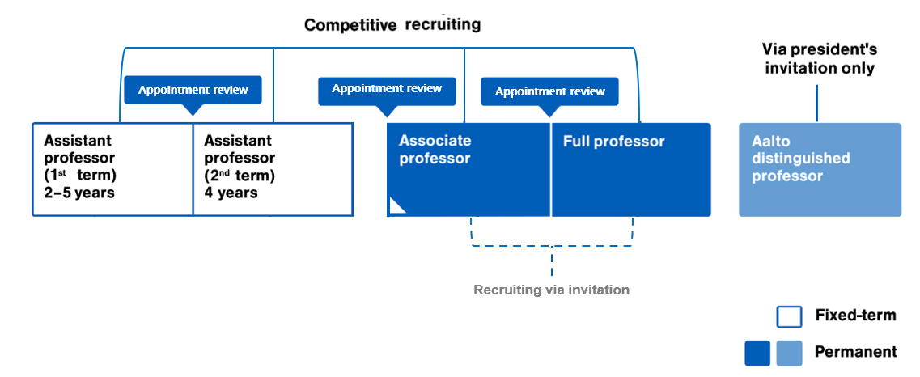
Tenure Track Career
Aalto University’s tenure track career system offers a well-supported and clear career path.
Clear and transparent criteria and processes for recruitment, evaluation, and promotion.
Compensation of success – Adequate salary and compensation to motivate towards Aalto’s vision and objectives.
Equal opportunity to succeed – Motivation and cooperation increase as people in tenure track compete only with themselves, not against one another.
More info at
aalto.fi/tenuretrack

Slide 8
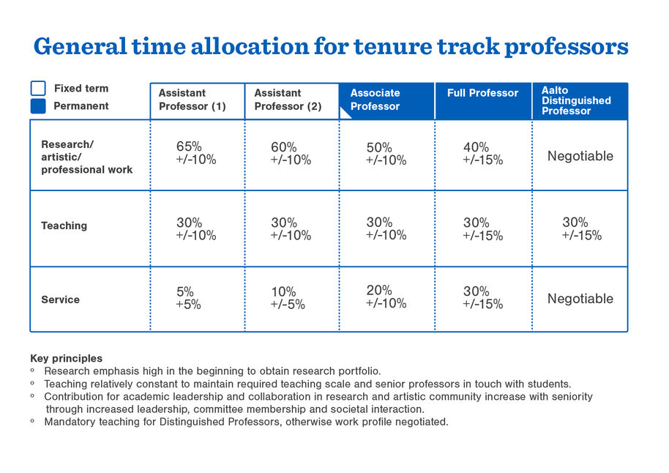
Time allocation for tenure track professor
More info at
aalto.fi/tenuretrack

Slide 9
Working at Aalto University
Why join us?
Established in 2010 as a merger of three leading Finnish Universities, we are both challenger of the old, and traditional with strong history and legacy.
Our unique combination of fields in art and design, technology and business enable multi-disciplinarity and finding clever solutions for the world’s most wicked problems in the interfaces of these fields.
We aim for societal impact, educating game changers to drive sustainability.
We enjoy working at our evolving collaborative campus close to the heart of Helsinki, with good connections, great architecture and amazing nature.
We are international and diverse: more than 40 % of our faculty comes from outside of Finland. Our working environment is multi-cultural, widely English-speaking and its easy to settle in, despite of wherever you come from.
We have strong academic standing and reputation in our key fields – Aalto University is among top 10 of New Universities in the world (QS ranking) and the School of Arts, Design and Architecture is ranked #8 in Art & Design education in the world (QS Ranking 2025).
Our well-functioning and fair Tenure Track career system enables building a successful academic career, providing support for fulfilling your professional ambitions.
Culture that inspires and includes everyone. It’s the people that create Aalto, now and in the future. We want to be an open community where equality and inclusion enable curiosity, innovation, collaboration and wellbeing. We constantly keep learning to find the most impactful ways to empower – and invest in – our people.

Slide 10
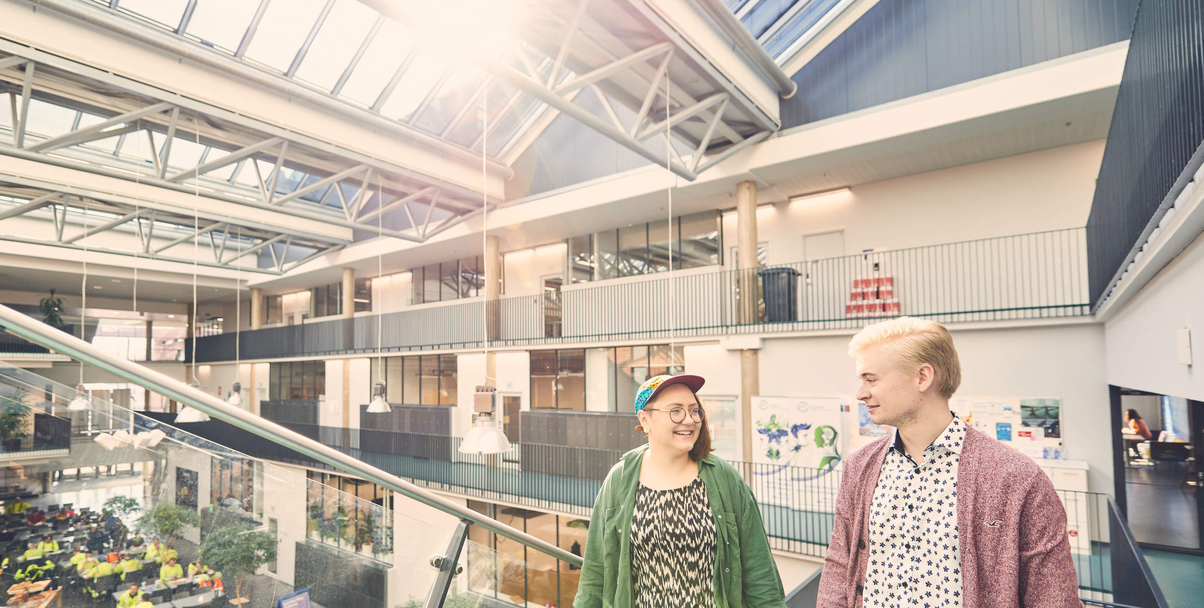

What do we offer?
Meaningful and inspiring environment
We are proud of our purpose to shape a sustainable future. We spark the game changers of tomorrow, and renew society with research-based knowledge, creativity and an entrepreneurial mindset.
Culture that inspires and includes everyone
All our work is guided by the values of the university: responsibility, courage, and collaboration. It’s the people that create Aalto, now and in the future. We want to be an open community where equality and inclusion enable curiosity, innovation, collaboration and wellbeing.
Collaboration reimagined
At Aalto University, a unique combination of science, art, tech, and business brings talent together. We have over 12 000 students and 4 000 employees joining forces to shape a sustainable future. Together with the surrounding companies, startups and technology parks at the Otaniemi campus, we are committed to driving ground-breaking research, educating the game changers of tomorrow, and renewing society.
Vibrant campus at a central location
The vibrant Otaniemi campus, only 10 km away from Helsinki city centre, is the home of a bold and curious community, where science and art meet technology, business and innovation. More about working at Aalto
Visit Aalto University virtually on our virtual campus tour

Slide 11
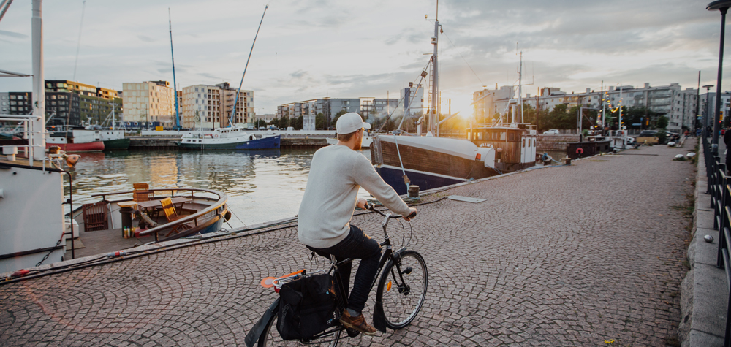
Living in Finland
Finland is famous for being the Happiest Country in the World, and having the world's best education system, world class academic freedom, cleanest air, high trust, and a low hierarchy – themes also important to Aalto.
We are humble people but dare to say we have one of the most advanced education systems in the world.
The Nordic values of equality and co-operation are rooted deeply into our society. We are one of the world’s top countries in press freedom and consider the many voices in our society a strength.
With high investments in R&D, a strong innovation culture, open data and advanced state of digitalization, we are a nation of innovation and entrepreneurship.
Gender equality, flexibility and low hierarchy are at the core of our Nordic working environment. Professional ambitions can be combined with a fulfilling personal life.
We are one of the world’s most reliable and stable nations with low levels of corruption and high level of safety. We are proud to provide exceptionally high standards of social security and healthcare, financed by the state.
Having four distinct seasons, clean air and thousands of lakes, we are some nature-loving people and take good care of our unique environment. We enjoy our midnight sun in the summer and northern lights in the winter.
Finnish language is known to be a bit on the complicated side, but don’t worry, we Finns are fluent in English, and have an international mindset.
We have wide and reliable transport networks, with Helsinki airport serving over 100 direct destinations. The comprehensive public transport makes it easy to commute. Our campus is situated within a 10 minute metro ride from the heart of Helsinki.
Want to live in the best country in the world?
More about Helsinki More about Espoo More about Finland

Slide 12

Recruitment process
December – February 13
Application period
Expert reviews
April 2026
August 2026
Site visit in Aalto
Decision
Fall 2026
Spring 2027
Welcome new Professor!

Slide 13
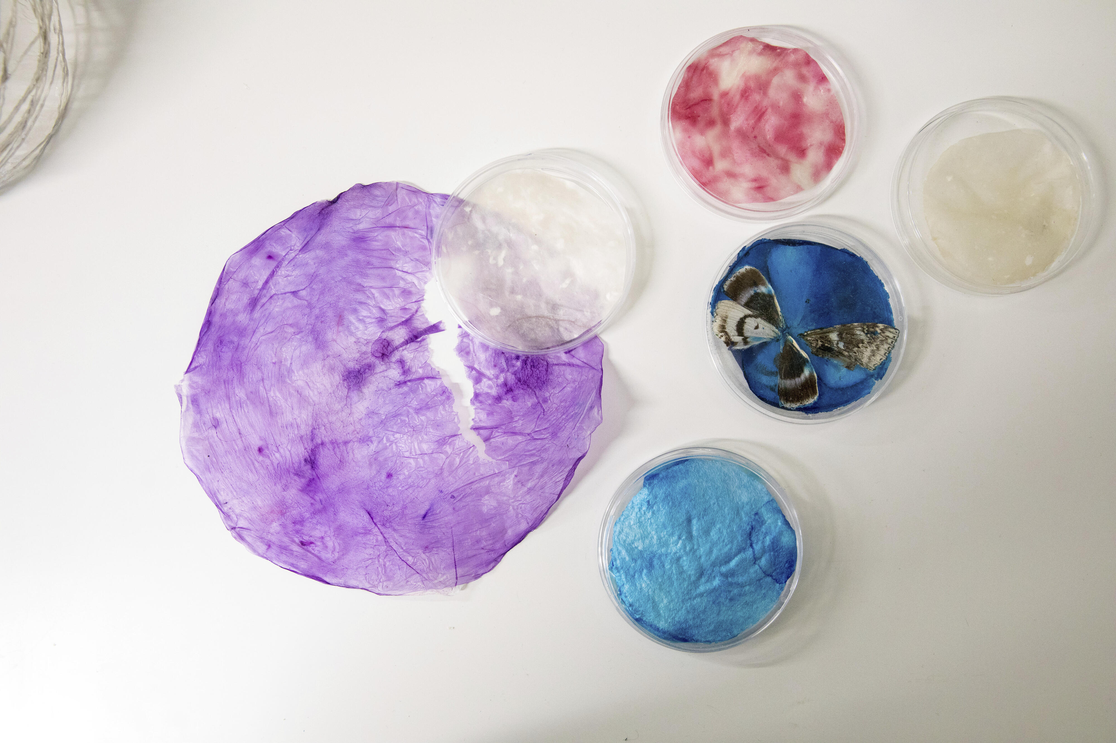
We want you to be part of our community – join us in shaping the sustainable future!
Ranja Hautamäki
Professor, Chair of the Departmental Committee ranja.hautamaki(at)aalto.fi
+358 50 523 2207
Satu Pöyhönen
HR Specialist, Secretary of the Departmental Committee
satu.poyhonen(at)aalto.fi +358 50 575 3888

Slide 14
Aalto University –
a community of
game changers
aalto.fi

