Slide 1

Quantum reservoir computing
From basics to photonic schemes
Johannes Nokkala
Turku Collegium of Science, Medicine and Technology
Summer School on New Directions in Quantum and Quantum Reservoir Computing, Quantum Devices and Related Technologies
21.8.2025

Slide 2
?
Predict dynamics
Unknown EOM, must generalize from data
Say, position data

Slide 3

Since 2000s
Fast & robust
Open system (reservoir)
?
?
Drive!
Response
$$\sum{w_{i}}$$
Predict dynamics
Unknown EOM, must generalize from data

Slide 4

Open system (reservoir)
?
?
$$\sum{w_{i}}$$
Predict dynamics
Unknown EOM, must generalize from data
Impossible from current position alone: coming or going? Need memory!

Slide 5

Open system (reservoir)
?
$$\sum{w_{i}}$$
”1”, ”0”, ”0”,…
Speech recognition

Slide 6
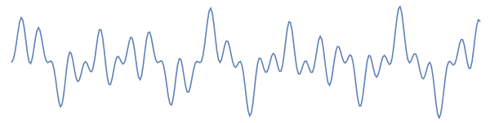
Open system (reservoir)
?
$$\sum{w_{i}}$$
Chaotic time series forecasting

Slide 7
Bucket of water
$$\sum{w_{i}}$$
Chaotic time series forecasting
Chrisantha Fernando & Sampsa Sojakka. European conference on artificial life (2003).
https://creativecommons.org/licenses/by/4.0/

Slide 8
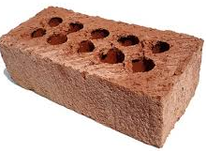
Concrete block
$$\sum{w_{i}}$$
Chaotic time series forecasting
Przyczyna, Dawid, et al. Materials 14.7 (2021): 1724.
https://creativecommons.org/licenses/by/4.0/

Slide 9
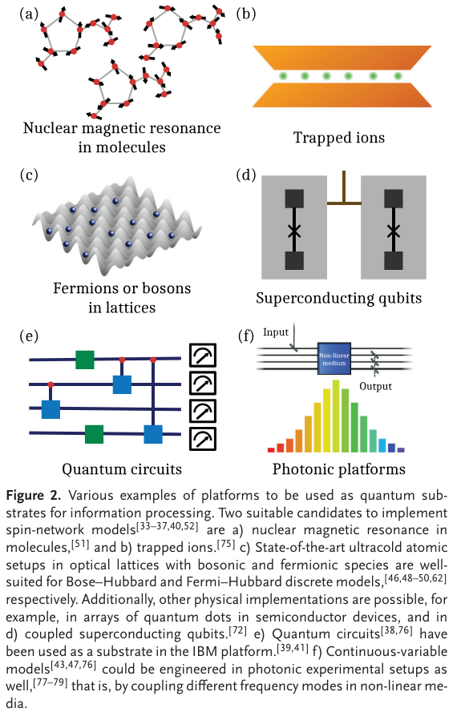
NMR in molecules
$$\sum{w_{i}}$$
Chaotic time series forecasting
Mujal, Pere, et al. Advanced Quantum Technologies 4.8 (2021): 2100027.
https://creativecommons.org/licenses/by/4.0/

Slide 10
Trapped ions
$$\sum{w_{i}}$$
Chaotic time series forecasting
Mujal, Pere, et al. Advanced Quantum Technologies 4.8 (2021): 2100027.
https://creativecommons.org/licenses/by/4.0/

Slide 11
SC qubits
$$\sum{w_{i}}$$
Chaotic time series forecasting
Mujal, Pere, et al. Advanced Quantum Technologies 4.8 (2021): 2100027.
https://creativecommons.org/licenses/by/4.0/

Slide 12
Photonic platforms
$$\sum{w_{i}}$$
Chaotic time series forecasting
Mujal, Pere, et al. Advanced Quantum Technologies 4.8 (2021): 2100027.
https://creativecommons.org/licenses/by/4.0/

Slide 13
Plan for the talk
What is QRC? What’s it for?
Why QRC instead of Q or C alternatives?
Examples & challenges

Slide 14
What QRC? What is it for?

Slide 15
Q inside
$$\sum{w_{i}}$$
Harness Q dynamics by driving with the signal of interest and post-processing the response

Slide 16
Can be custom hardware, need not be universal for QC
Q Communication
Q Simulation
Q Sensing
Q Computing
QML
QRC

Slide 17
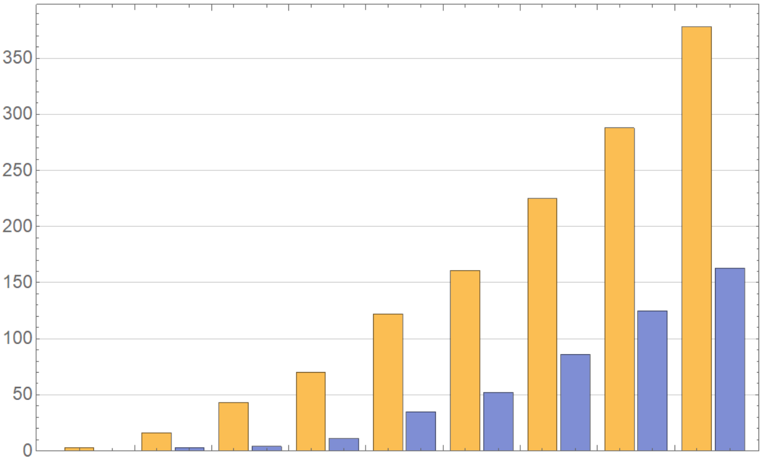

Rough proxies of interest
Citations to seminal paper
$≲$ talk about it
$≲$ work done
”QRC” in title
Stage 1: can it be done on paper?
Stage 2: can it be done in a lab?
2017
2018
2019
2020
2021
2022
2023
2024
2025

Slide 18

Making a QRC
Anything goes..? Actually no
$$\sum{w_{i}}$$
Q
inside
Input mechanism (preprocessing + injection)
Training
Readout mechanism
NL input transformations ubiquitous
Govia, Luke CG, et al.
Neuromorphic Computing and Engineering 2.1 (2022): 014008.
https://creativecommons.org/licenses/by/4.0/

Slide 19

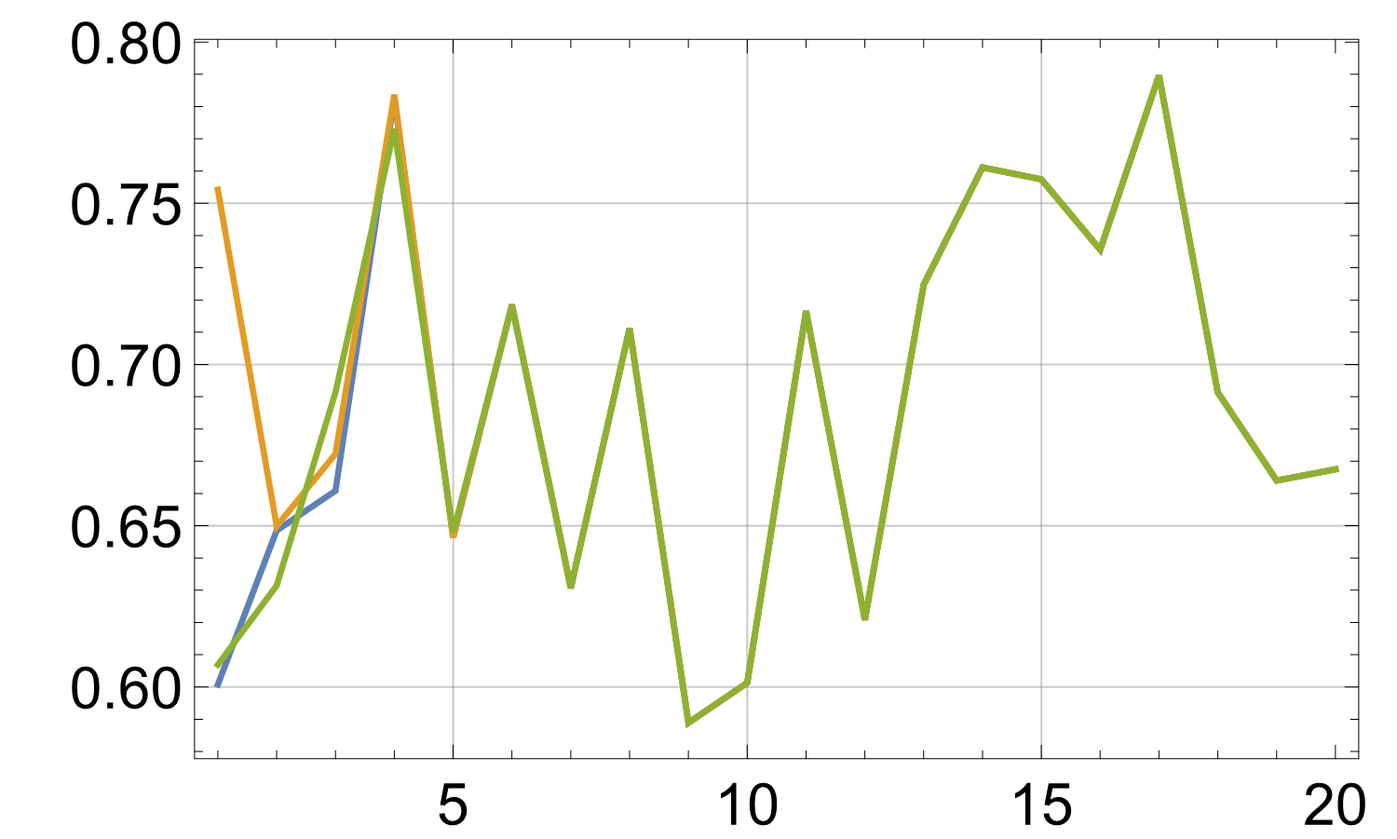
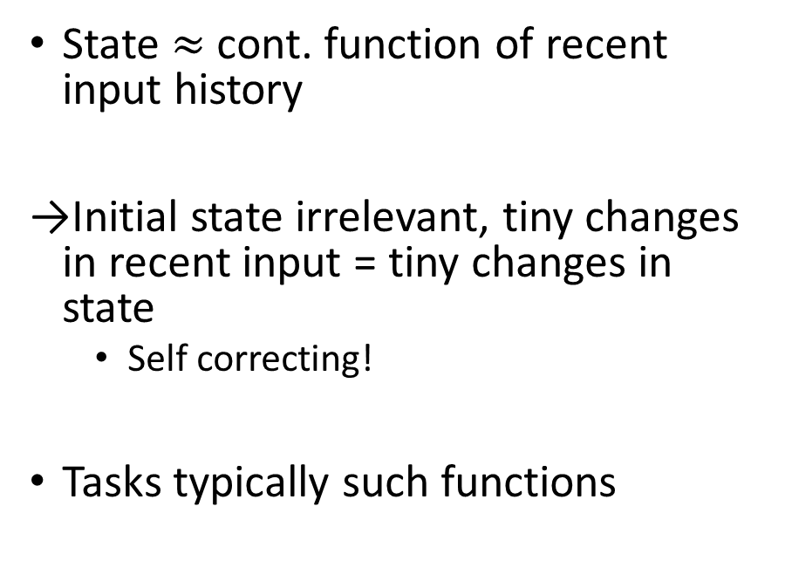
Need fading memory!
State $≈$ cont. function of recent input history
Initial state irrelevant, tiny changes in recent input = tiny changes in state
  Self correcting!
Tasks typically such functions
State
More inputs →
(Same signal)

Slide 20
Fading memory? OQS!
Necessary, not sufficient
  U dynamics reversible
Some mechanisms
  Partial state reset
  Continuous dissipation
  Beam splitter
$$\sum{w_{i}}$$
reservoir,
OQS

Slide 21



Chaotic
Sensitive to initial conditions
Fading memory
Insensitive to input
Sensitive to output extraction

Slide 22
Ideally suited for?
”1”, ”0”, ”0”,…
Time series processing! FM transformations
But also, e.g., procedural generation (see poster by H. Pettugani)

Slide 23
Why QRC?
Comparison with some Q and C alternatives

Slide 24
How good can it be?
$$\sum{w_{i}}$$
reservoir,
OQS

Slide 25


Compare with Q alternatives
Any task QRC can solve a QNN can solve too
1st advantage of QRC: engineering freedom
  Don’t need QC
  Don’t need specific gates
  Don’t need qubits!
Variational QNNs
Input encoding
Quantum dynamics
Measurements
C. post-processing
SC qubits
Compute loss function, find updated parameters
$$θ_{i}$$
$$θ_{i}$$
Ansatz
Parameterized circuit
Iterative optimization

Slide 26
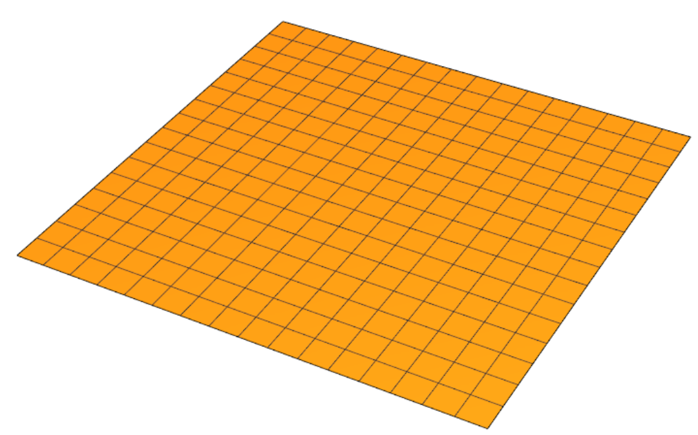
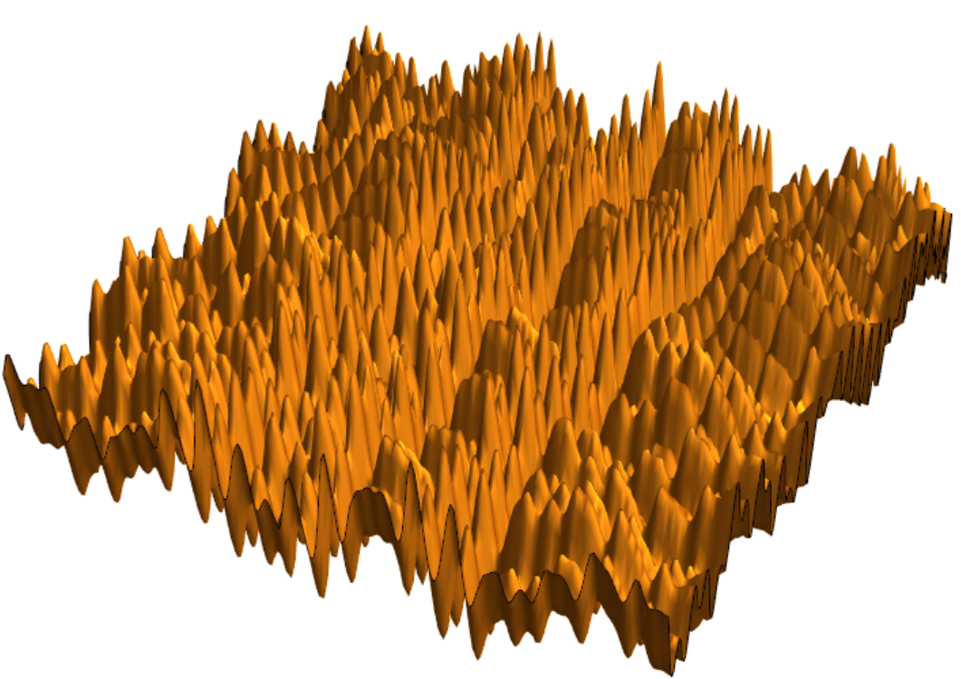
Compare with Q alternatives
2nd advantage of QRC: trainability
QNN loss landscapes awful
QRC? Gather data once, compute pseudoinverse
Target
Orth. projection
High d subspace
spanned by comp nodes
"Barren plateaus in quantum neural network training landscapes." Nature communications 9.1 (2018): 4812.
"Quantum variational algorithms are swamped with traps." Nature Communications 13.1 (2022): 7760.

Slide 27
QRC multitasking
Training = C post-processing of measurement results
Train for different task = different post-processing of same results!
$$\sum{w_{i}}$$
Q
inside
training

Slide 28
Compare with Q alternatives
Let’s be optimistic
Let’s be optimistic
Measurements
QRC
QNN
QRC
QNN
QRC
QNN
QRC
QNN
QRC
QNN
Resolving small gradients expensive
This is only one step
Bad loss landscape = many steps
This is only one task, let’s do 100
QRC multitasking
It’s hard to overstate how enormous the training advantage is!

Slide 29
Compare with C alternatives
100
C neurons
quality
Few qubits
expressivity
different tasks
  The chief motivation since the beginning
  sporadic appearances of others
  This alone enough?
  Not yet, C approaches scalable to millions+ neurons
  Perhaps never, don’t use QC to send email

Slide 30
 | Classical NN | QNN | QRC
Scalability
Expressivity
Trainability
Status
–
Commercialized
Proof-of-principle
Proof-of-principle

Slide 31
Examples & challenges

Slide 32

Making a Photonic QRC
Reservoir?
Input mechanism?
Readout mechanism?
$$\sum{w_{i}}$$
reservoir,
OQS

Slide 33
Simple reservoir: modes in fiber loop
For simplicity: lossless
García-Beni, Jorge, et al.
Physical Review Applied 20.1
(2023): 014051.

Slide 34
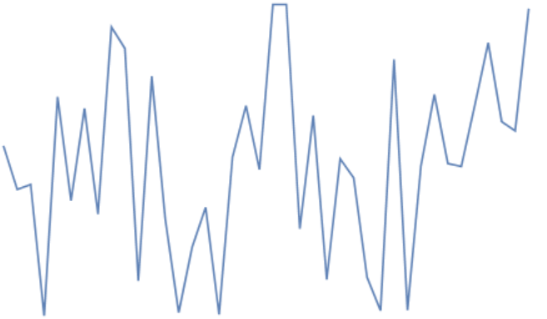


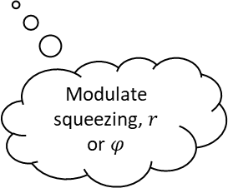


Simple I/O mechanism: must be open!
$$R$$
HD
$$σ_{x}$$
Modulate squeezing, $r$ or $φ$
García-Beni, Jorge, et al.
Physical Review Applied 20.1
(2023): 014051.

Slide 35
Just one mode?
$$R$$
HD
$$σ_{x}$$
FM for any R, but…
1-by-1 ”matrix”
García-Beni, Jorge, et al.
Physical Review Applied 20.1
(2023): 014051.

Slide 36


Simple training
$$R$$
HD
$$\sum{w_{i}}$$
Bias
(Degree 0 term)
$$σ_{x}$$
Fixed!
$$f\left(t\right)=w_{1}F\left[s_{t},s_{t−1},s_{t−2},…\right]+w_{0}$$
At least nonlinear
García-Beni, Jorge, et al.
Physical Review Applied 20.1
(2023): 014051.

Slide 37

Many modes
$$R$$
HD
$$σ_{x}$$
Proportional to identity matrix!
To multimode: identical squeezed states
García-Beni, Jorge, et al.
Physical Review Applied 20.1
(2023): 014051.

Slide 38
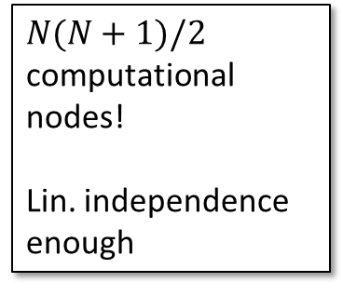
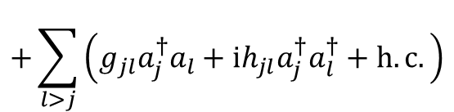
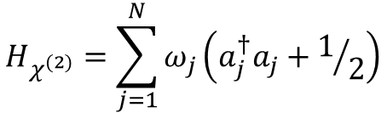


Many modes
$$H_{χ^{(2)}}=\sum_{j=1}^{N}{ω_{j}\left(a_{j}^{†}a_{j}+1/2\right)}$$
$$+\sum_{l>j}{\left(g_{jl}a_{j}^{†}a_{l}+ih_{jl}a_{j}^{†}a_{l}^{†}+h.c.\right)}$$
Random OK!
$$χ^{\left(2\right)}$$
$$R$$
HD
$$χ^{\left(2\right)}$$
Dense symmetric matrix!
$$σ_{x}$$
$N(N+1)/2$ computational nodes!
Lin. independence enough
To multimode: identical squeezed states
García-Beni, Jorge, et al.
Physical Review Applied 20.1
(2023): 014051.

Slide 39
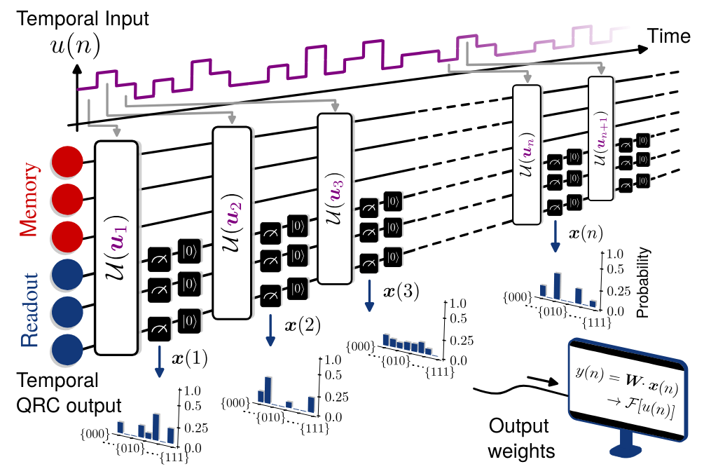
Qubit example: IBM platforms
Mid circuit measurements & reset, separation of memory & readout qubits
Fading memory that tolerates readout & erases even decoherence!
  Hu, Fangjun, et al.
  arXiv preprint arXiv:2312.16165 (2023)
  https://creativecommons.org/licenses/by/4.0/

Slide 40

HD
Qubit QRC | Photonic QRC
Tends to be QC platform esp. experimental demos | Analog quantum optical device
Relevant scales need QEC? | Try to stick with error mitigation
Dilution refridgerator | Room temp
Gates for C hard regime relatively easy | Gates for C hard regime very difficult
Rapid scaling of expressivity | Gaussian case gives only polynomial scaling

Slide 41
Three stages
We are here
Stage 2
It works also in the lab
Stage 1
It works on paper

Slide 42
Three stages
Stage 2
It works also in the lab
Stage 1
It works on paper

Slide 43

Three stages
Substantial advantage in a task of practical interest
Stage 3
It’s even useful
Stage 2
It works also in the lab
Stage 1
It works on paper
C hard dynamics..
..harnessed properly

Slide 44
Schemes optimal in near term?
Can now be destructive
Recent trend: C feedback
  Helps with decoherence, output extraction
Scalability??
  noisy qubits??
  Photonic side: GBS (others) + CV & de-Gaussification (me)
Q
inside
Q
inside
Q
inside
"Quantum optical reservoir computing powered by boson sampling." Optica Quantum 3.3 (2025): 238-245.
"Large-scale quantum reservoir computing using a Gaussian Boson Sampler." arXiv preprint arXiv:2505.13695 (2025).

Slide 45
The problem with ML tasks
Conventional algorithm | ML
Solution correct/incorrect | Varies from high to low quality
How to solve known | How to solve unknown, model + data = approximation
Built from elementary operations, by design | Broken down to elementary operations, out of necessity (hardware acceleration?)
Computational complexity proofs | Heuristic arguments

Slide 46
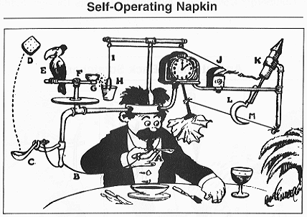
The problem with tasks from C literature
C hard dynamics for C doable tasks overly complicated?
quality
expressivity
Now bad at standard C tasks
different tasks
C hard tasks?
No guarantee of practicality
By Rube Goldberg - Originally published in Collier's, September 26 1931, Public Domain

Slide 47
Alternative: tasks without C counterpart
State preparation
Gate synthesis
Entangler 
Uncorrelated states → entangled states
Nokkala, Johannes. Scientific Reports 13.1 (2023): 7694.

Slide 48

QRC: potential for near term QML tech
Engineering freedom, training advantage, multitasking
Field is moving to experimental demonstrations & expanding to Q tasks
Important challenge: reach C hard regime, harness it for a substantial advantage in a task of practical interest

