Slide 1

Welcome to Aalto University

Slide 2
Given name Family name Major

Slide 3
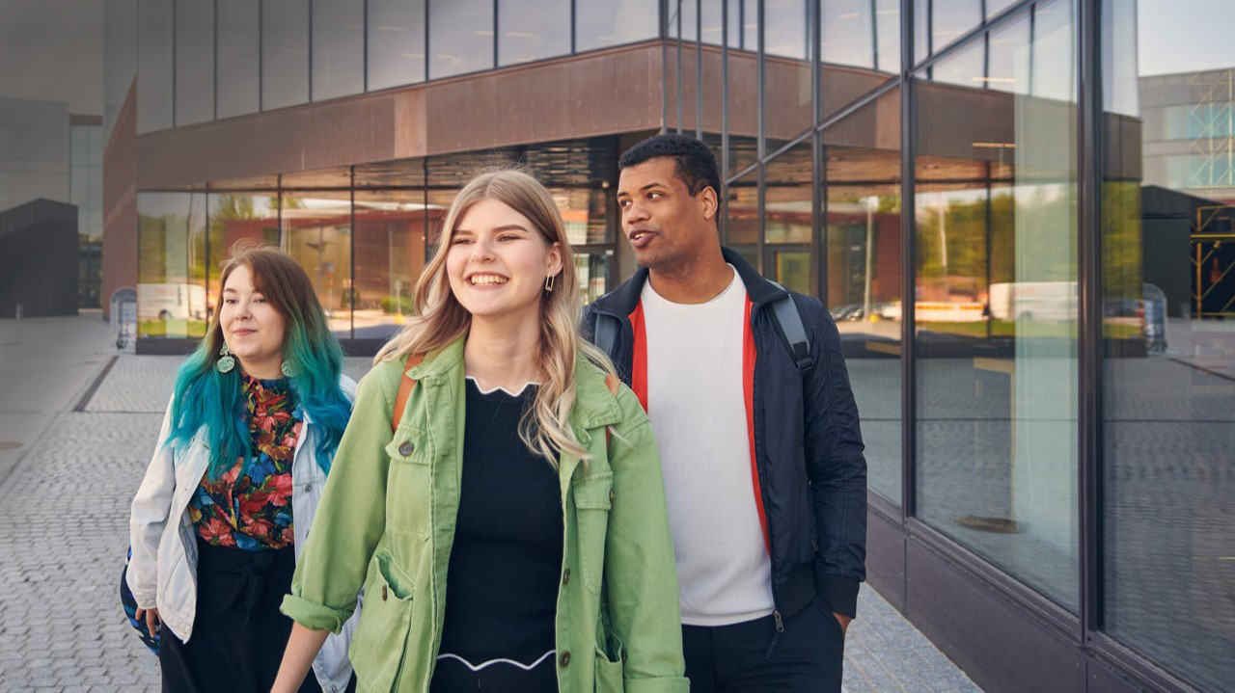
At Aalto University, science and art meet technology and business.
Notes:
Aalto’s three fields of education are art and design, economics and business administration, and technology.
Six schools: School of Arts, Design and Architecture, School of Business, and four schools of technology: School of Chemical Engineering, School of Electrical Engineering, School of Engineering and School of Science.

Slide 4
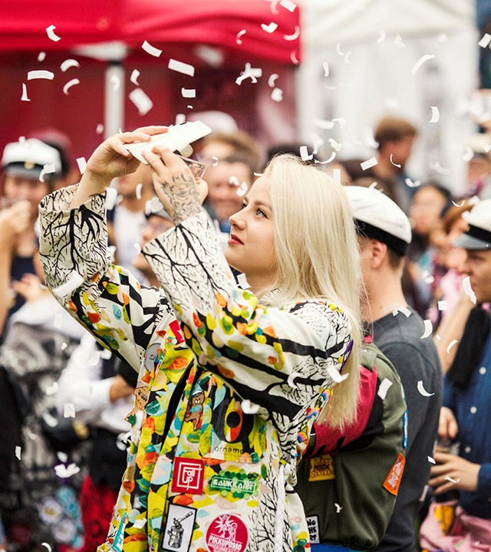
Studying at Aalto University is characterised by…
Community spirit The strong team spirit and a sense of pulling together among our students is evident on lectures and in leisure time activities.
Multidisciplinarity You can combine business, art, and technology in your degree to make it best meet your needs.
Applied methods During their studies, our students collaborate actively with actors and companies in the field.
Expertise-building Our students develop into valued experts, innovative entrepreneurs and responsible leaders of the future.
Notes:
Different schools and majors have their own student associations or guilds that advocate for students and offer a variety of leisure time opportunities.
Art and design, economics and business administration, and technology: Its unique combination of different fields on a single campus makes Aalto University stand out among Finnish universities.
An Aalto University degree is a highly valued asset in the job market, and our graduates find jobs that match their degrees.

Slide 5

We encourage our students to...
embrace radical creativity, courage and cooperation
be curious and determined
build a sustainable future
develop novel solutions to the grand global challenges
Notes:
Photo: The Sun-Powered Textiles project designed and developed a textile collection suitable solar energy harvesting. The jacket in the picture is equipped with a temperature and humidity sensor powered by the solar cells integrated into the textile.
Radical creativity means, among other things, taking brand new approaches to global grand challenges. In practice, this means having the courage to think in a new way and break boundaries.
Our operations are based on high-quality research, education, social impact and shared values: responsibility, courage and collaboration.
We solve global challenges by combining science, technology, art and business.

Slide 6
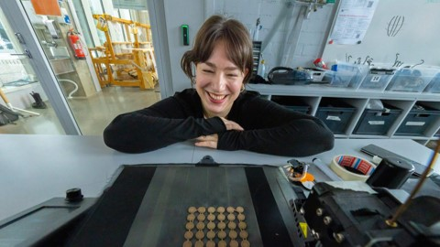
Why did I choose Aalto?
INSERT YOUR PHOTO HERE
Who am I and what am I studying?
How did I end up choosing Aalto and the programme and field I am now in?
What is it like to study at Aalto?
What are my plans for the future?
Notes:
Presenter:
Talk about your experiences here:
how and why you chose Aalto University
your studies at Aalto
your future plans
Think about your answers to the below questions beforehand and use this list of questions as a guideline when you reply. You can pick the most relevant topics; you don’t have to go through all the questions.
What field interested you? What was your favourite subject in high school?
How did you hear about Aalto?
What made you choose Aalto? Why was Aalto the right choice for you?
How did you apply to Aalto University? (certificate-based admission, entrance examination, preparing for entrance examination/advance assignments)
Where are you from? How have you integrated into the Aalto student community?
What is the best part about studying? What have been the highlights for you personally so far? What do you still want to achieve in your studies?
Do you work alongside studies?
What are your plans for the future?
Is there anything else you would like to share about studying at Aalto?

Slide 7
My timetable at Aalto
PUT YOUR OWN TIMETABLE HERE
Monday | Tuesday | Wednesday | Thursday | Friday
 | MS-A0105 Differentiaali- ja integraalilaskenta 1, luento | MS-A0105 Differentiaali- ja integraalilaskenta 1, luento
CS-A1111 Ohjelmoinnin peruskurssi, harkka |  |  | PHYS-A3121 Thermodynamiikka, harjoitus
PHYS-A3121 Thermodynamiikka, labra | PHYS-A3121 Thermodynamiikka, luento | Ryhmätyö |  | LC-5410 Tekniikan alan ruotsi
 |  | Tee labraselostus | YTHS-hammaslääkäri klo 14
 | Unisport: BodyPump klo 18 |  | Kavereiden kanssa etänä klo 19 | Unisport: jooga klo 17
Notes:
Presenter:
Empty this sample timetable and fill in your own timetable. You can fill in your calendar for this week or for a typical study week. Add lectures, exercises, preparation time for examinations, student organisation activities, work (if any), gym classes, appointments with FSHS etc. Also mention the campus you are studying on (Otaniemi, Mikkeli) and the university spaces you are using (hub, Learning Centre, library, group work spaces, cafeterias). The point is to give the audience a realistic idea of how students use time and show that studying and student life is about more than just attending lectures.
Talk about your experiences here:
What are you studying? (What study modules have you completed and what are you going to complete?)
How are you studying: does your everyday involve lectures, exercises, exams, etc.?
What types of projects have you been involved in?
When discussing the timetable in the field of arts, you should mention:
very few exams, more practical work, projects evaluated through critiques
Most courses require class attendance.
Especially during bachelor's degree studies, it is typical to have an entire day (from 9 to 5 pm) of classes for the same course.

Slide 8
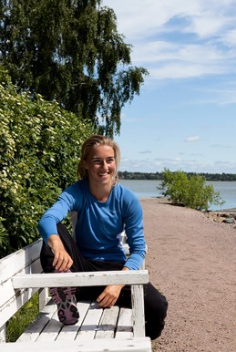
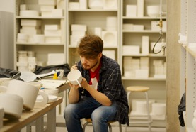

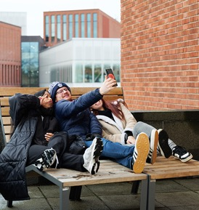
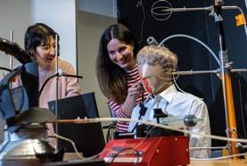
Photos of my time at Aalto
REPLACE THESE WITH YOUR PHOTOS
Notes:
Presenter:
Replace the images with your photos.
Feel free to share experiences of your studies + projects + your exchange studies + hobbies + subject organisation activities

Slide 9
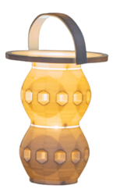
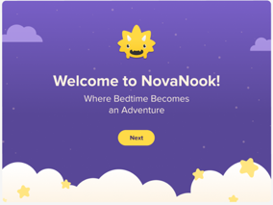

Photos of my projects
REPLACE THESE WITH YOUR PHOTOS
Henna Kyrö
Lighthouse 2022
PLA 3D Print
Henna Kyrö
Panda SuomiSip Chocolates 2023
Fine print, Rhino, Keyshot
Henna Kyrö
NovaNook – Bibliotherapy app for children with nightmares and fears 2024
Notes:
Presenter:
Replace the images with your photos. The images may depict any of your study projects and from any field (technology, business, art)! If you do not have any images to share, you can delete this page.
Feel free to talk about any student projects you have been involved in.

Slide 10
Economics and business administration

Slide 11
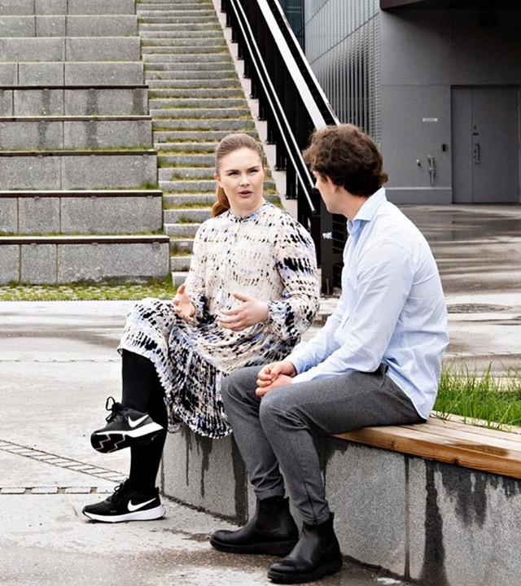
School of Business
The most prestigious business school in Finland
Our degrees are highly valued in the labour market
High-quality teaching and rigorous research
Objective: advancing sustainable business​​
An inspiring student community where everyone is heard
Follow us on Instagram to see what’s going on in our student life: @aaltobiz
Notes:
Our degrees are highly valued and open up a wide variety of opportunities for developing society from a business perspective.
You can complement your business studies with studies in the fields of technology, art and design.​
Our social media channels offer interesting contents and inspiring stories about studying, student life and our alumni.​
You can follow our student life especially on the BIZ Instagram account, which is often features takeovers by students of different programmes who post about the current affairs of the school.
Studying economics and business administration is...
Independent and flexible. The courses consist of lectures, group work and in some cases, math exercise clinics and final exams. Everyone can study in their own way.​
Solution-oriented. The courses deal with and solve real-life global challenges of the corporate world and society.
Characterised by community spirit. The student association for the Aalto students of business, KY, advocates for students and organises a wide range of leisure activities. The strong team spirit and a sense of pulling together among our students is evident also in leisure time activities.
Expertise-building. You get the tools needed for working in specialist and managerial positions. A degree from the School of Business is a highly valued asset in the job market, and our graduates find employment easily in their field of study.

Slide 12

Bachelor’s-level study options in economics and business administration
Bachelor’s Programme in Business (kauppatieteiden kandidaattiohjelma taught in Finnish) has the following majors:
Management (johtaminen)
Accounting (laskentatoimi)
Information and Service Management (tieto- ja palvelujohtaminen)
Marketing (markkinointi)
Finance (rahoitus)
Economics (taloustiede)
Business Law (yritysjuridiikka)
Bachelor’s programmes taught in English
Economics
International Business, Mikkeli unit
Notes:
Major: Selected at the end of the first year
Built around a common core curriculum in the first year. After that, you get to focus on different specialisation areas and deepen your knowledge of the major of your choice.​

Slide 13
Art and design

Slide 14
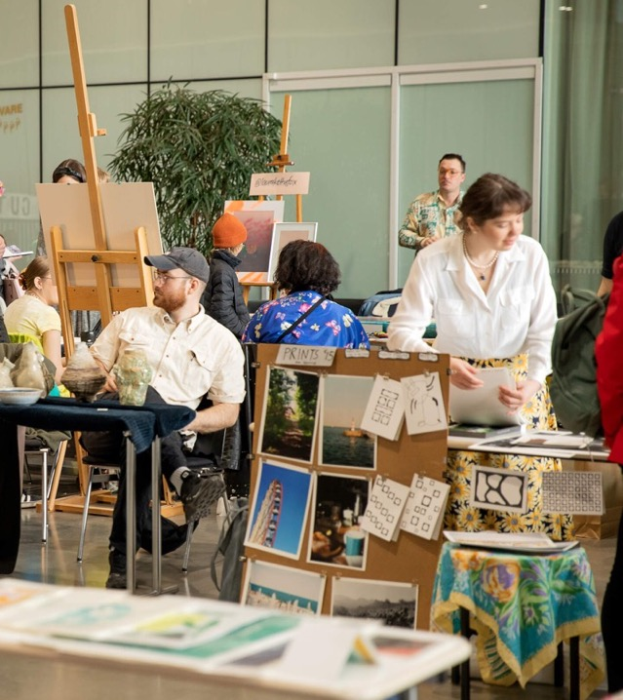
School of Arts, Design and Architecture
The leading school of art and design in Finland and in the Nordic countries.
Imaginative and unconventional approaches to complex social issues
Solutions for sustainability
Cutting-edge workshop spaces and equipment
Follow us on Instagram to see what’s going on in our student life: @aaltoarts
Notes:
The leading school in design, fashion, games, digital media, architecture, film, art education, and art in Finland and in the Nordic countries.
The school was ranked eighth in the QS World University Rankings 2024 (in the field of art and design).
We train our students to be world citizens who create imaginative, collaborative and unconventional approaches to complex social challenges.
95% of our graduates are employed or working as entrepreneurs five years after graduation (source: the 2023 career tracking survey conducted among master’s graduates of 2018).
Studying art and design is characterised by…
Community-driven development Small group sizes give room for community spirit, peer learning and receiving personal feedback. Instead of examinations, evaluation is done through critiques, which are shared feedback sessions.
Practice-oriented approaches Projects are hands-on exercises and require class attendance. Work spaces vary from classrooms to workshops and studios.
Applied methods . During their studies, our students collaborate actively with stakeholders and companies in the field.
Multidisciplinarity. You can combine business, art, and technology in your degree to make it best meet your needs.

Slide 15
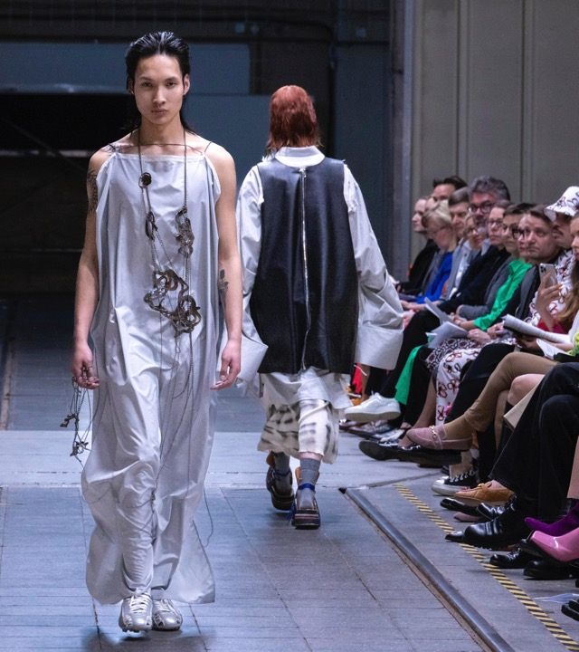
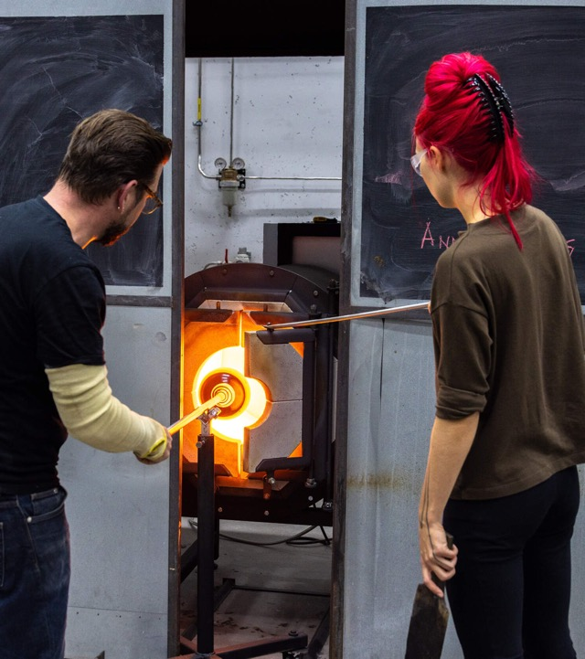
Bachelor’s-level study options in the field of art and design
Programmes offered in Finnish and Swedish:
Documentary Film
Screenwriting
Production Design
Film and Television Producing
Film Editing
Directing
Cinematography
Film Sound Design
Art Education
Fashion
Design
Costume Design: Performing Arts and Film (next application round in 2026)
Interior Architecture
Visual Communication Design
English-taught programme:
Bachelor’s Programme in Design and Media
Notes:
The programmes in architecture and landscape architecture lead to a degree in technology, even though they are offered by the School of Arts, Design and Architecture.

Slide 16
Field of technology

Slide 17
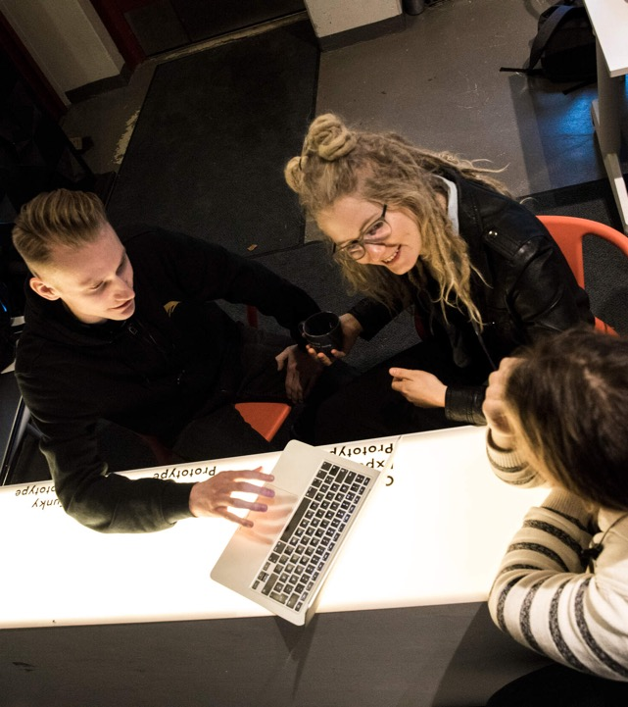
Field of technology
Finland's largest educational offering in the field of technology
Our degrees are highly valued in the labour market.
You can customise your degree with your choice of minors.
A common characteristic is the will to make society better functioning, more ethical and sustainable.
Future challenges create a growing need for experts in technology.
Notes:
Studying technology equips you for a variety of future job descriptions. You can contribute to developing solutions to battle climate change, promote well-being through technology and design more sustainable cities, environments and devices.
Studying technology gives you a broad-based knowledge in topical and emerging fields such as machine learning, robotics, industrial automation, wellbeing technology, bioproducts, environmental and energy technology as well as mobile technology.
Those with an Aalto degree in technology find jobs relevant to their field of study easily. Many students gain relevant work experience during their studies.
Learn more about student life and read students’ stories:
School of Engineering: @aalto.eng
School of Chemical Engineering: @aaltochem
School of Electrical Engineering: @aaltoelec
School of Science: https://www.aalto.fi/en/study-at-aalto/get-to-know-the-school-of-science
Studying technology is characterised by:
Flexibility and variety. The methods used on the courses vary from independently studied lectures and math exercise clinics to more collaborative laboratory exercises and group work.
Cutting-edge infrastructure. Students have access to top-of-the-line workshops, laboratories and learning environments.
Community spirit. Guilds in the field of technology give you a chance to build networks and integrate into the Aalto community and of course, have something fun to do on your leisure time.
Expertise-building. Our education gives you the tools to work in demanding expert and managerial duties in industry, research and as an entrepreneur.

Slide 18
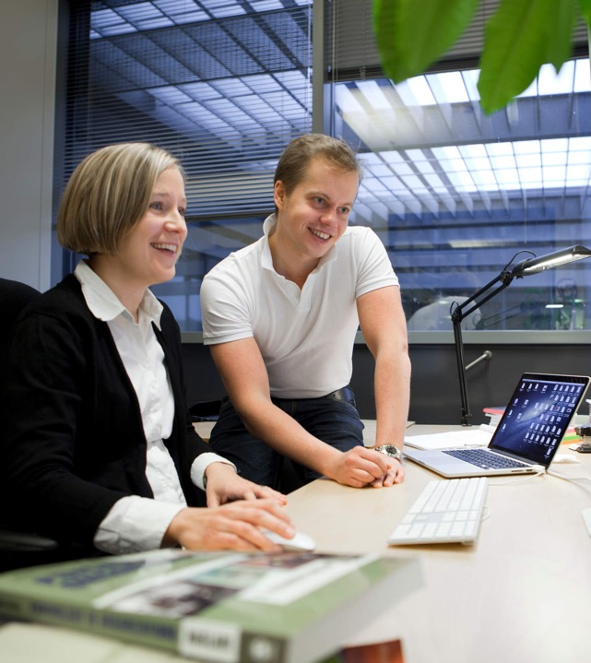
Bachelor’s-level study options in the field of technology
Programmes offered in Finnish and Swedish:
Automaatio ja robotiikka
Bioinformaatioteknologia
Elektroniikka ja sähköfysiikka
Energia- ja konetekniikka
Informaatioteknologia
Informaatioverkostot
Kemian tekniikka
Kestävät yhdyskunnat
Kiinteistötalous ja geoinformatiikka
Rakennustekniikka
Sähköenergiatekniikka
Teknillinen fysiikka ja matematiikka
Teknillinen psykologia
Tietotekniikka
Tuotantotalous
Arkkitehtuuri (ARTS)
Maisema-arkkitehtuuri (ARTS)
Study options in English:
Chemical Engineering
Computational Engineering
Computer Engineering
Data Science
Digital Systems and Design
Quantum Technology
Notes:
Built around a common core curriculum in the first year. After that, you get to focus on different specialisation areas and deepen your knowledge of the major of your choice.​
The study options of architecture offered at the School of Arts, Design and Architecture are part of the field of technology at Aalto.

Slide 19
Studying at Aalto

Slide 20

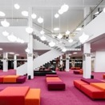

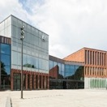

The Aalto campus
Three fields of study on the same campus
Our multidisciplinary student community gives you a chance to meet people from different fields and educational backgrounds.
Learning spaces
The campus has an airy library, student hubs for independent work, laboratories, studios and workshops.
Student union spaces for students
Affordable student housing, guild rooms, formal venues, sports facilities, saunas and much more!
Good services
A shopping centre, restaurants, cafés, gyms, a shop for study supplies, grocery shops, a metro station, a light rail line and extensive bus connections.
A combination of city life and nature
Our green campus is located right next to a nature preserve by the sea. The vibrant campus and its fast connections to the Helsinki city centre give you an opportunity to enjoy fast-paced city life, too.
Notes:
Most of the teaching is given on the Otaniemi campus in Espoo. One programme is taught in the city of Mikkeli in Eastern Finland.
The Otaniemi campus is a meeting point for members of the Aalto community: The greatest asset of Aalto are its people. Studying here gives you valuable contacts and networks.
The campus infrastructure: The Aalto University infrastructure gives you great conditions for cutting-edge research and learning.

Slide 21

International opportunities
Exchange studies
Ca. 130 partner universities worldwide
Gain international experience and language skills
Credits for exchange studies included in the degree
International double degrees
Several master's programmes in different fields
International work placements and projects
Notes:
Presenter:
Here you can talk about your experiences:
Have you been or are you planning to go on a student exchange? Where were you placed as an exchange student and how was it?
Exchange studies
Exchange studies last for 3–6 months. The studies you complete during the exchange will count towards your Aalto degree.
We have ca. 130 partner universities around the world, in, e.g. Australia, Brazil, Canada, Chile, France, Germany, Hongkong, Italy, Ireland, Japan, Mexico, Singapore, Switzerland and the USA.
Internationalisation
Aalto has a large network of international partners, and it collaborates with more than 400 universities.
Aalto offers you a variety of international opportunities, which can take the form of a student exchange or work placement, as well as project work.
Double degrees
In double degree programmes, you study the first year in one university and the second year in another.
This means you get two degree certificates in one package for the equivalent work of a single degree, as well as international experience and possibly extra financial support.
There are several master’s programmes organised in collaboration with international partners, which allow you to earn a degree from both Aalto and another European top university.

Slide 22
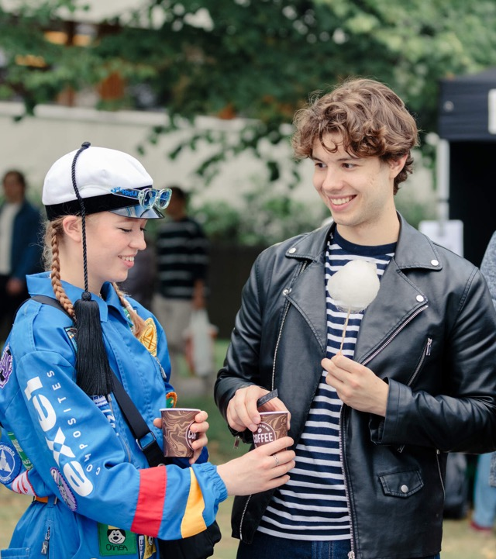
Student life
Aalto University student union AYY
More than 200 student associations – hobbies, events and parties for each day of the year
There is something for everyone: sports, music, theatre, dance, food, games.
Taking up positions of trust in associations is an opportunity to develop your networks and working life skills
Business visits for student organisations
Notes:
Presenter:
Here you can share your experiences of student organisations and student life outside lectures.
What activities have you been involved in? (student union/student associations/guilds)
What have been the highlights for you?
How does involvement in student organisations support your social life?
How does involvement in student organisations benefit you professionally: have you gained related work experience or taken part in a company visit?
AYY and student organisations
AYY represents about 14 000 Aalto University students of arts, business and technology.
AYY offers, e.g. student advocacy services, events, student housing for its members, and the right to use the Finnish Student Health Service (FSHS) and UniSport services.
Get involved in the various student associations of AYY and you’ll have an event for every day of the year! For more information see: https://www.ayy.fi/en
Student organisations by field of study: KY = Aalto University Business Students TOKYO, Students of Art, Design and Architecture in Aalto University, and the Teekkari Section.
Subject associations and guilds by major: there is a subject association for each major. Through the association, you get to meet others studying the same major also in your leisure time.
Services and discounts for students:
Student advocacy: The Aalto University student union AYY advocates for student rights in matters related to education and student life (well-being, health, housing and sports).
Housing: AYY has about 2 500 apartments that are rented out to the members of the student union at affordable prices. Most of them are located in Otaniemi. Read more: https://www.aalto.fi/en/services/housing-for-students
Health care: The Finnish Student Health Service (FSHS) offers general health, mental health, and oral health services to university students. They have a service point in Otaniemi.
Sports services: UniSport has sports centres on six campuses in Espoo and Helsinki. One of them is in Otaniemi. It offers a wide range of different sports as well as facilities for many types of individual and group sports. If you are an active sports person, it pays to purchase the UniSport training card, which is very affordable for students. Read more: https://www.unisport.fi/en
Student discounts: You get discounts at cafeterias, in public transport, gyms, shops, museums and much more.

Slide 23
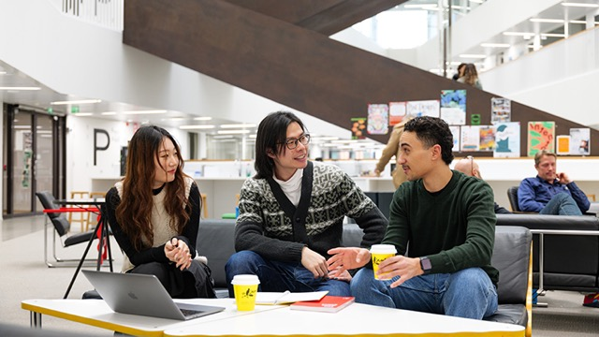

Information about studying at Aalto
Experiences of Aalto students and staff
Aalto.fi
‘Student life at Aalto’
Notes:
Using the search function of aalto.fi pages and the keywords ‘Student life at Aalto’ you can easily find the page.

Slide 24

Career opportunities
Bright career prospects
Collaboration with industry
Work placements, summer jobs
Aalto community
Startup culture
Recruitment events and career services
Notes:
Presenter:
Here you can talk about your own experiences and plans for the future:
What are your plans for the future? What would you like to do after your time at Aalto?
What kind of job would you like to have? What type of career would you like to have?
Do you want to work in Finland or maybe elsewhere?
How does studying at Aalto help you in achieving these goals? (studies, networks, multidisciplinarity)
Bright career prospects
An Aalto degree gives you the best possible conditions to find work that fits your skills and allows you to create products, services and innovations for the future.
You will get to key positions where you can make great changes in society and solve global challenges.
Collaboration with industry
You get to be a part of interesting hands-on projects that involve representatives from the business world. Summer jobs, work placements, industry visits and thesis projects are a good way to build networks.
Work placements
Work experience gathered in Finland or abroad is a key part of your studies.
Work experience improves your chances of building the career you want after graduation.
The majority of programmes offer you a chance to incorporate a work placement (practical training, internship) into the degree.
Aalto supports work placements both with financial aid and grants.
Aalto community
During your student years, you make contacts and form networks that help you along in your career long after your graduation.
Startup culture
You get to be a part of real student-led startup activities. Around 70 to 100 companies are established at Aalto University each year.
Aalto is the origin of, for instance Startup Sauna, Aalto Entrepreneur Society (AaltoES), as well as the internationally recognised events Slush and Summer of Startups.
Recruitment events and career services
Aalto Talent Expo and Summer Job Day connects students and employers
Aalto University's career and recruitment services (Career Design Lab) help students to acquire professional skills, provides channels for job search and organises recruitment fairs.
The Career Design Lab offers services and tools for your career needs both during your studies and after them.

Slide 25
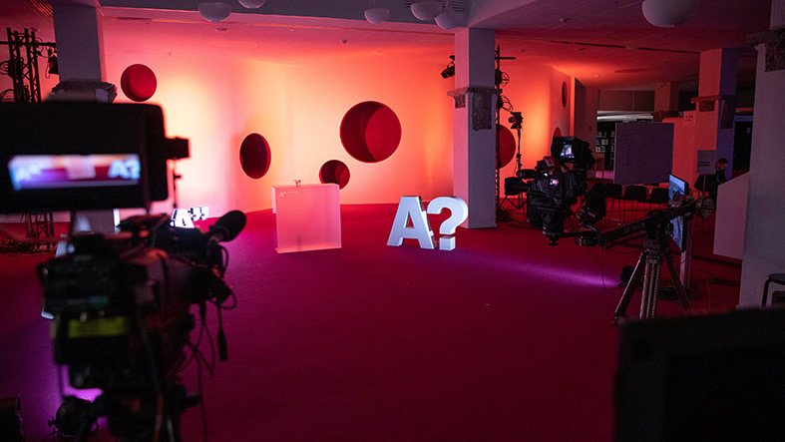
Employment of graduates with an Aalto master’s degree
95-99%
92%
are employed or working as entrepreneurs.
feel that employers
appreciate their
degree.
91%
are satisfied with their degree in relation to their career.
Notes:
91% of the alumni who completed a master's degree at Aalto University five years ago were satisfied with their degree from the perspective of their career.
84% of the respondents are able to use the knowledge and skills they have learned in their current work and 92% would recommend their degree to others.
92% of Aalto University graduates agreed with the survey claim that employers value their degree.
Our graduates’ employment rate in all fields is between 95% and 99%.*
*A career tracking survey (2023) for graduates of 2018 (https://www.aalto.fi/en/collaboration/aalto-university-graduates-in-working-life)

Slide 26
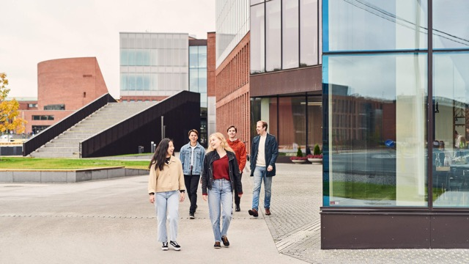
Information on career opportunities and employment
Aalto.fi
‘Aalto University graduates in working life’
Notes:
Using the search function on the aalto.fi pages and the search terms 'Aalto University graduates in working life', you can easily find the page.
For more information on employment rates per school see (links on the above website):
- https://www.aalto.fi/en/school-of-business/school-of-business-graduates-in-working-life
- https://www.aalto.fi/en/school-of-arts-design-and-architecture/school-of-arts-design-and-architecture-graduates-in-working-life
- https://www.aalto.fi/en/school-of-science/school-of-science-graduates-in-working-life
- https://www.aalto.fi/en/school-of-chemical-engineering/school-of-chemical-engineering-graduates-in-working-life
- https://www.aalto.fi/en/school-of-electrical-engineering/school-of-electrical-engineering-graduates-in-working-life
- https://www.aalto.fi/en/school-of-engineering/school-of-engineering-graduates-in-working-life

Slide 27
Applying to Aalto

Slide 28
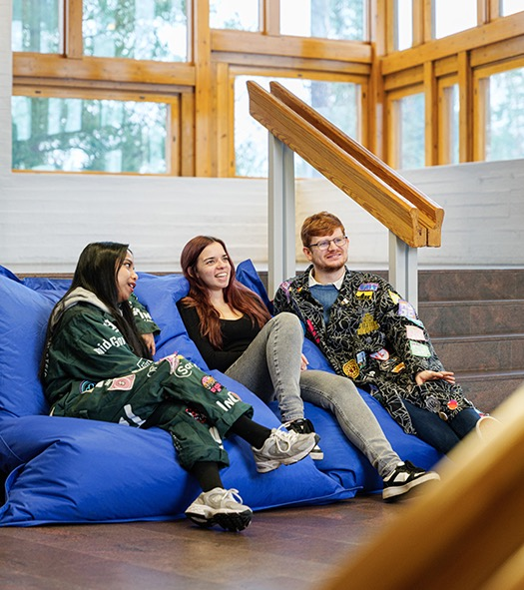
Degrees
Bachelor’s degree 180 ECTS (3 years)
Bachelor of Science (Economics and Business Administration) Bachelor of Arts (Art and Design) Bachelor of Science (Technology)
Master’s degree 120 ECTS (2 years)
Master of Science (Architecture) Master of Science (Technology) Master of Science (Economics and Business Administration) Master of Science (Landscape Architecture) Master of Arts (Art and Design)
Doctoral degree (4 years)
Doctor of Science (Economics and Business Administration) Doctor of Arts (Art and Design) Doctor of Science (Technology)
Notes:
Bachelor’s degree studies
The bachelor’s degree includes a minor: you can choose a minor offered at Aalto or at another university. The degree also includes elective studies.
Studies for the bachelor’s and master’s degree combined, 300 ECTS (5 years)
1 ECTS credit corresponds to a workload of approximately 27 hours.
Studies towards the master’s degree
Once you have completed your bachelor's degree studies at Aalto, you have the right to continue to a certain master’s programme or certain programmes defined by the school.
There is also an admissions process to master’s programmes for those who wish to apply to a study option different to the one they would automatically be admitted to based on their bachelor’s degree.
Master’s programmes are open for application to those with a bachelor’s degree from either a university or a university of applied sciences (AMK).
Students with a bachelor’s degree from Aalto can apply to a variety of master’s programmes.
Depending on the programme, admissions criteria may include prior academic performance, motivation letter, portfolio and interviews. No entrance examinations.
Doctoral studies
The doctoral programmes of the six Aalto University schools
Full-time doctoral studies (4 years), part-time doctoral studies (4–8 years)

Slide 29
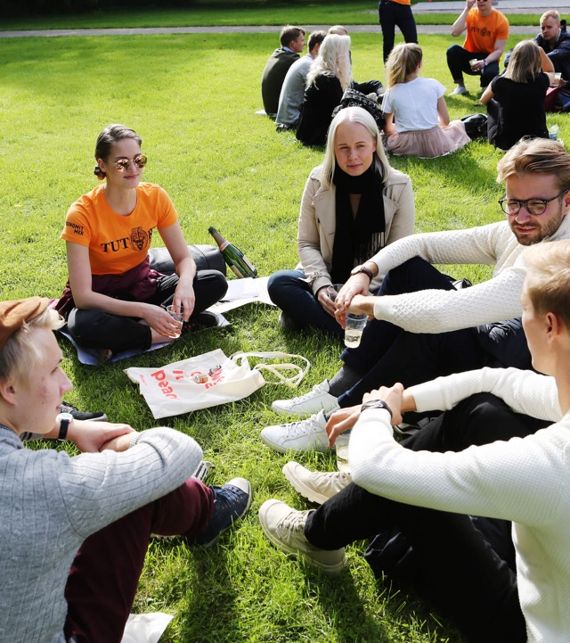
Application periods in 2025
Bachelor’s programmes taught in English (a separate application for Aalto) 8–23 January 2025
Bachelor's programmes taught in Finnish and Swedish (the second national joint application) 11–25 March 2025
All applications are submitted through the Studyinfo online service.
Notes:
In addition:
Applying to Aalto University master’s programmes 28 November – 27 December 2024
Autumn joint application procedure:
1–11 September 2025
The autumn joint application procedure is an option only for those who have completed Open University studies at Aalto University through the Open University route for technology students (not available in English).

Slide 30
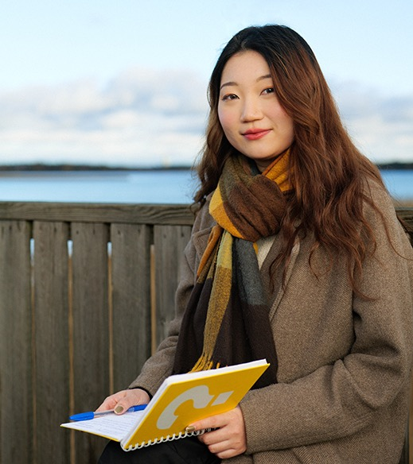
Upper secondary school (high school) studies and student admissions
The score of your Finnish matriculation examination is important, particularly in the certificate-based admission process for the fields of economics and business administration and technology.
Mathematics
Mother tongue
Physics and chemistry
Language, advanced
Other subjects
In the field of arts, the advance assignments and entrance examinations play a bigger role.
Studying and practising arts train you in the skills that are evaluated in the entrance examinations.
Notes:
Economics and business administration
The minimum requirement for certificate-based admission is a passed matriculation examination test in mathematics at the basic or advanced level. Advanced mathematics may be useful but it is not necessary.
The applicant can get points for five subjects: mother tongue, mathematics (basic or advanced , with the advanced syllabus giving more points), the top-scoring language and the two other top-scoring subjects thereafter. (Note: new scoring system in certificate-based admission from 2026 onwards, read more at https://yliopistovalinnat.fi/en.)
Field of technology
Study options for MSc (Tech.) Certificate-based admissionstake into account the applicant’s grade in three subjects: mother tongue (if Finnish or Swedish), advanced mathematics and EITHER physics OR chemistry, depending on which one has the better score. The minimum requirement for certificate-based admission is a passed matriculation examination test in mathematics at the advanced level. In addition, a minimum grade requirement is set for the matriculation examination grade in one of the following: advanced mathematics, physics or chemistry (for more information (in Finnish and Swedish), see dia.fi).
Architecture and landscape architecture: In the combined-score admissions, points are given for mother tongue and mathematics (basic or advanced syllabus) as well as the three top-scoring subjects thereafter. Final admission decisions are based either on the combined score of the entrance examination and final secondary education grades or on the entrance examination score only. (Read more at dia.fi.)
Information Networks: In certificate-based admission, five subjects are considered: mother tongue, advanced mathematics, a foreign language at the advanced level, and the two other top-scoring subjects. In addition,a minimum grade requirement is set for the matriculation examination grade in advanced mathematics and mother tongue (for more information, see https://opintopolku.fi/konfo/en/).
The minimum requirements may change annually. Therefore, you should always check the instructions for each study option on the DIA website (dia.fi).
New scoring system in certificate-based admission from 2026 onwards, read more at https://yliopistovalinnat.fi/en.
Art and design
Most of the study options do not give points for final secondary education grades. The study options of Art Education, Design, and Visual Communications Design do give points for the matriculation examination.
Their final admission decisions are based either on the combined score of the entrance examination and final secondary education grades or on the entrance examination score only. (see more at https://opintopolku.fi/konfo/en/)
Art Education: Points are given for the mother tongue grade for all applicants who have completed either the Finnish matriculation examination or the IB, EB, RP or DIA (Deutsches Internationales Abitur) certificate. Those with a Finnish upper-secondary-level diploma for fine arts or media may be rewarded extra points.
Design: Points are given for the mother tongue and mathematics grades and the two top-scoring subjects for all applicants who have completed either the Finnish matriculation examination or the IB, EB, RP/DIA (Deutsches Internationales Abitur).
Visual Communication Design: Points are given for the mother tongue and the advanced foreign language grade for all applicants who have completed either the Finnish matriculation examination or the IB, EB, or RP/DIA (Deutsches Internationales Abitur). In addition, points are given for the two top-scoring subjects. One of these may be a Finnish upper-secondary-level diploma in media or fine arts.

Slide 31
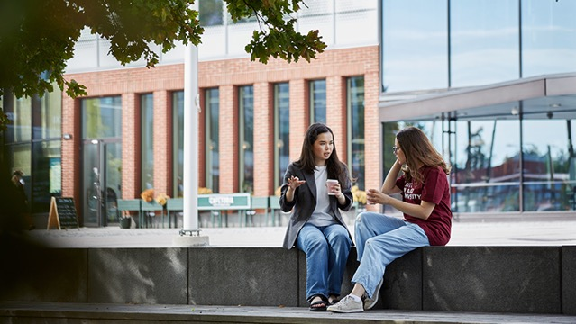
Information on applying in 2025
dia.fi
kauppatieteet.fi
https://opintopolku.fi/konfo/en/
aalto.fi
https://yliopistovalinnat.fi/en
Aalto.fi
‘Applying to bachelor’s programmes’
Notes:
Using the search function of the aalto.fi pages and the keywords ‘Applying to bachelor’s programmes’, you can find the page easily.
Applying to bachelor’s programmes
https://www.aalto.fi/en/admission-services/applying-to-bachelors-programmes
This page lists all the Aalto bachelor’s-level study options and contains links to the descriptions, admissions criteria, as well as application instructions for all the study options.
Field of technology
dia.fi joint admissions for engineering and architecture (in Finnish and Swedish)
opintopolku.fi same as above + Information Networks and the study options for the bachelor’s programmes taught in English
Aalto.fi bachelor’s-level study options and master’s programmes taught in English
Economics and business administration
Kauppatieteet.fi joint admissions for the field of economics and business administration
https://opintopolku.fi/konfo/en/ the Finnish-taught bachelor’s-level study option and English-taught bachelor’s-level study options
aalto.fi bachelor’s-level study options and master’s programmes taught in English
Art and design
Studyinfo (opintopolku.fi/konfo/en) bachelor’s-level study options and bachelor’s programmes taught in Finnish, Swedish and English
Aalto.fi bachelor’s-level study options and master’s programmes taught in English
First-time applicants
Applicants who have not accepted an offer of admission after the year 2014 and have not completed a university degree
A fixed number of available student places is reserved for first-time applicants.
Open University routes
Students who have completed Open University studies may be admitted to pursue bachelor’s and master’s degrees at Aalto University in separately defined study options without an entrance examination and regardless of educational background, provided they meet the requirements set for the given Open University route.
For more information on the Open University route for business students, see: https://www.aalto.fi/en/aalto-university-open-university/open-university-route-to-a-degree-in-economics-and-business (The option is only available in Finnish)
For more information on the Open University route for technology students, see: https://www.aalto.fi/fi/aalto-yliopiston-avoin-yliopisto/avoimen-vaylan-opinnoilla-tekniikan-tutkinto-opiskelijaksi (The option is only available in Finnish or Swedish)
Separate smaller admission groups (for the fields of economics and business administration, and technology):
Admission based on competitive performance:see the Studyinfo service, where you can find this information under the relevant admission criteria, for instance under performance in MAOL or Talousguru competitions.
In the field of economics and business administration, you can also apply on the basis of your SAT or ACT score or special merits.
Demonstrating language proficiency
Applicants to the Aalto University study options in technology and arts and design taught in Finnish or Swedish are required to have sufficient proficiency in one of the two languages. Studies in the field of economics and business administration require sufficient proficiency in Finnish.
For more information on demonstrating Finnish or Swedish proficiency: https://www.aalto.fi/en/study-at-aalto/language-requirements-finnish-and-swedish
Applicants to the English-language bachelor’s programme in art and design must demonstrate sufficient English proficiency .

Slide 32
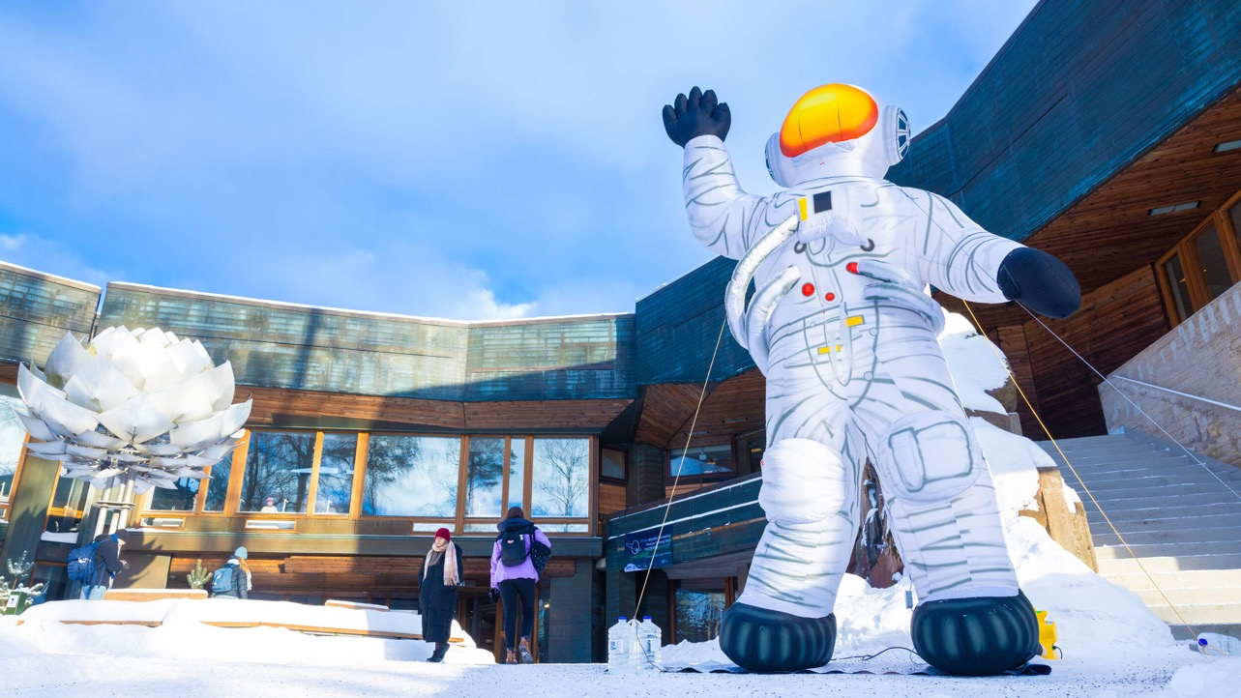
Ask us anything
You can also ask questions online.
Chat with Aalto students:
https://www.aalto.fi/en/study-at-aalto/chat-with-aalto-students
Contact our Admission Services:
admissions@aalto.fi

Slide 33
See you at Aalto University!

