Slide 1





Recent works on non-aqueous redox flow battery
Yihan Zhen, Yongdan Li
Department of Chemical and Metallurgical Engineering
School of Chemical Engineering
Aalto University, Finland
School of Chemical Engineering and Technology
Tianjin University, China
Email: yongdan.li@aalto.fi; ydli@tju.edu.cn
1

Slide 2
Content
Background
Our recent work on active materials
Our recent work on membranes
Summary

Slide 3



Background
Fossil fuel power
Wind and solar energy
Low efficiency
High efficiency Environmental protection
Environmental pollution
Notes:
renewable energy had another record-breaking year in 2019, as installed power capacity grew more than 200 gigawatts (GW) – its highest increase ever.
Wind and solar energy have become mainstream electricity sources and are increasingly cost-competitive with fossil fuel power plants. Nearly everywhere in the world, producing electricity from new renewables is more cost effective than producing it from new coal-fired power plants.

Slide 4
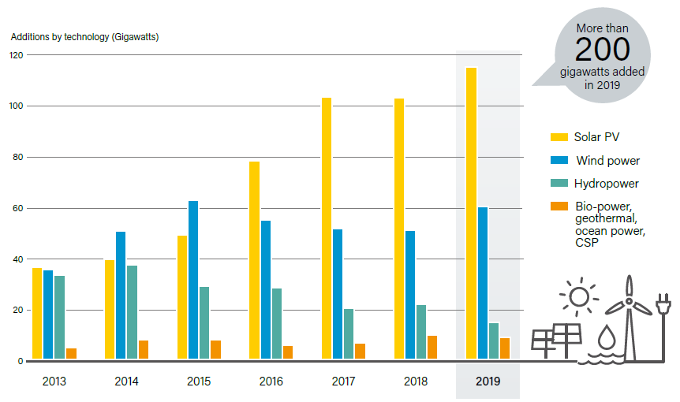
Background
Annual Additions of Renewable Power Capacity
Renewables 2020 global status report
Notes:
More than 200 GW of new renewable power generating capacity was installed in 2019, raising the global total to 2,588 GW by year’s end.
In 2019, 57% of renewable power capacity additions were of solar PV followed by wind power (around 60 GW for 30%)

Slide 5
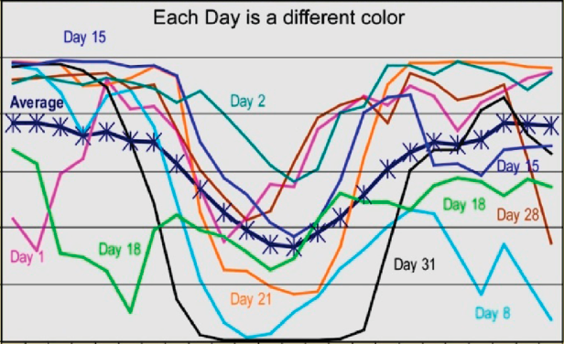
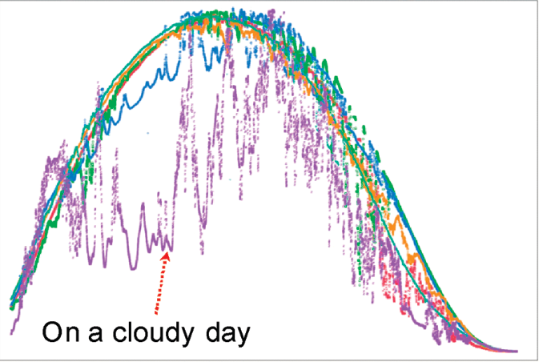
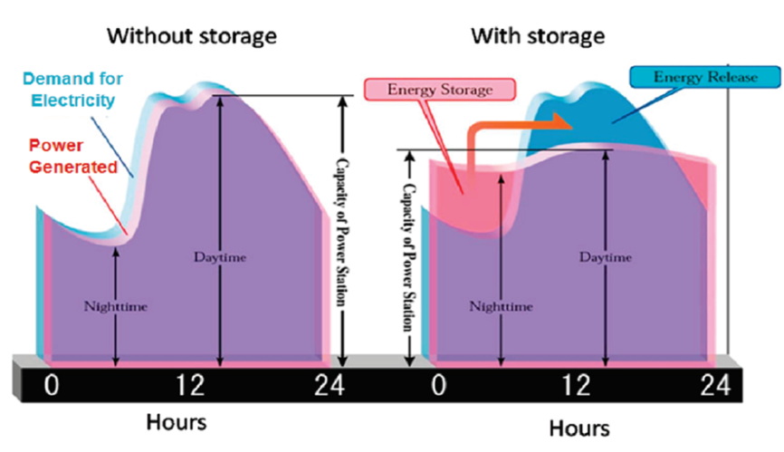
Background
Daily profiles of wind power
PV power over a span of 6 days
Balance of generation and demand
Developing large-scale energy storage technology is greatly desirable.
Chem Rev. 2011, 111, 3577-613.
Notes:
Although the power generation of renewable energy is growing rapidly, it is highly intermittent due to the alternation of day and night and the changing seasons. If it is integrated directly into the grid, it will cause damage to the grid. Therefore, developing large-scale energy storage technology is greatly desirable.

Slide 6
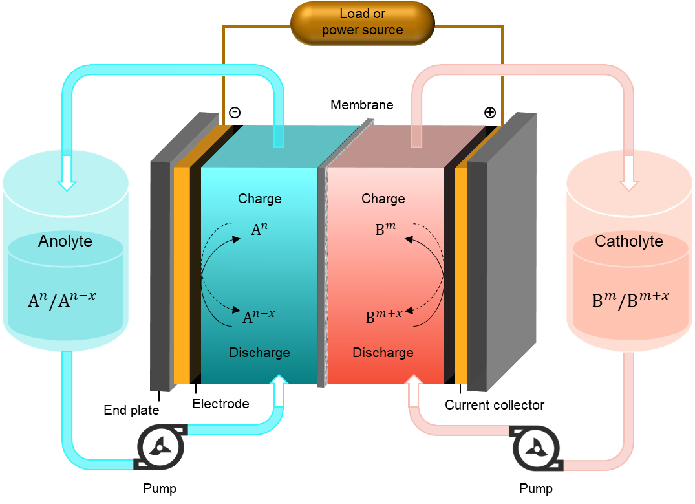
Redox flow battery
Redox flow battery for large-scale energy storage
Long cycle life
Rapid response
Flexible operation
Decoupled power and energy
Independent modular design
Notes:
Among the energy storage technologies, redox flow battery is widely considered to be one of the most promising ones for practical application. It has some unique advantages such as long cycle life, rapid response, flexible operation, decoupled power and energy and independent modular design. For redox flow battery, the energy is stored in the active species dissolved in the liquid electrolyte and circulating between the external tanks and the cell compartments by pumps. The figure shows a typical structure of a redox flow battery.

Slide 7
Redox flow battery
Advantages
Challenges
High ion conductivity
High current density
Long cycling life
Narrow voltage window
Low energy density
Narrow temperature range
Aqueous RFBs
Advantages
Challenges
Wide voltage window
Multi-selective redox couples
Higher energy density
Low electrolyte conductivity
Low current density
Irreversible capacity decay
Non-queous RFBs
Notes:
Based on the solvent, redox flow battery can be divided into aqueous flow battery and non-aqueous flow battery.

Slide 8
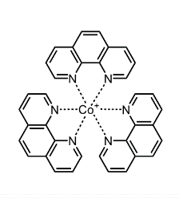
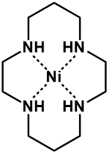
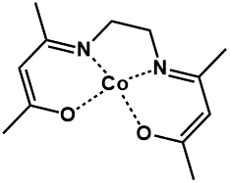
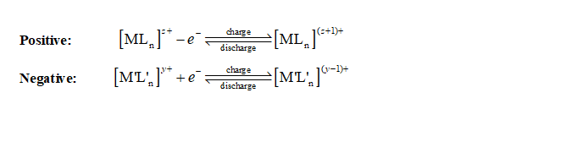
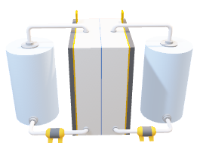
Non-aqueous redox flow battery
Organometallic
NARFBs
Positive:
Negative:
$M/M′$ are transition metal ions, $L/L′$ are ligands, and n is the number of ligands.
Metal-free
NARFBs
The redox reaction is based on the charge-state change of the active sites.
Deep eutectic solvents (DESs)-based NARFBs
Other NARFBs
Redox-targeting-based NARFBs
Lithium NARFBs
Notes:
NARFBs can be divided into organometallic-based NARFB, metal-free based NARFB and other NARFBs. Our work focuses on the first two.
The organometallic species is formed by the combination of the metal center and the ligand.
The metal-free organic materials undergo redox reactions based on the charge-state change of the active sites.

Slide 9





Non-aqueous redox flow battery
Active materials
Low solubility
Side reactions
Irreversible capacity decay
Challenges
Solution: Molecular modification
Potential
Solubility
Stability
Introducing electron-withdrawing groups or electron-donating
groups
Introducing poly(ethylene oxide) (PEO) chain
Extending π-conjugation and the delocalization of charge
Ionic liquid modification
-2.17 V
-2.38 V
0.1 M
1.72 M
Notes:
The active materials of non-aqueous flow batteries are currently facing the following problems: Low solubility, Side reactions and Irreversible capacity decay
The active substance is optimized mainly through molecular modification.

Slide 10
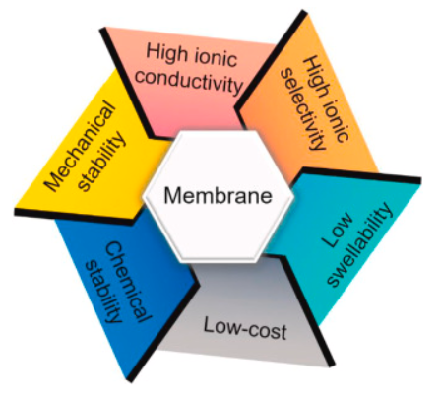
Non-aqueous redox flow battery
Membrane
Porous membrane (PM) Ion exchange membrane (IEM)
Challenges
Serious crossover
Chemical instability
Ion conductivity
Modification
Intrinsic membrane
Surface and pore modification of the porous substrate.
Make intrinsic membrane with organic, inorganic and MOF like nano-domains and continues phases.
J. Power Sources, 2021, 500, 229983
Notes:
functions as preventing the crossover of the positive and negative active species whilst facilitating the transfer of the supporting electrolyte ions

Slide 11
Content
Background
Our recent work on active materials
Organometallic compounds
Organic metal-free compounds
Our recent work on membrane
Summary

Slide 12
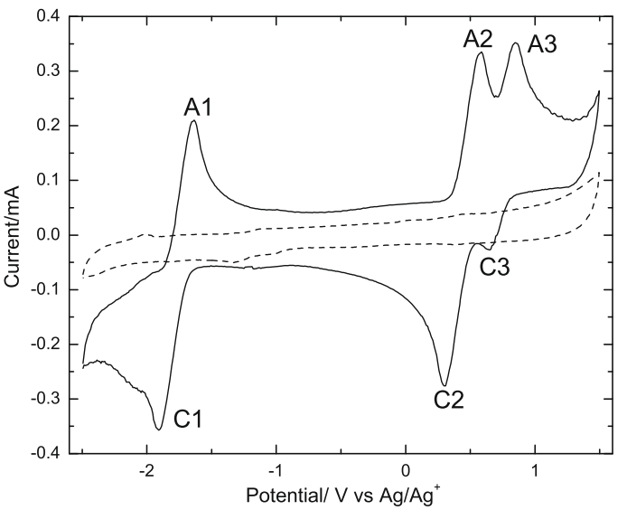
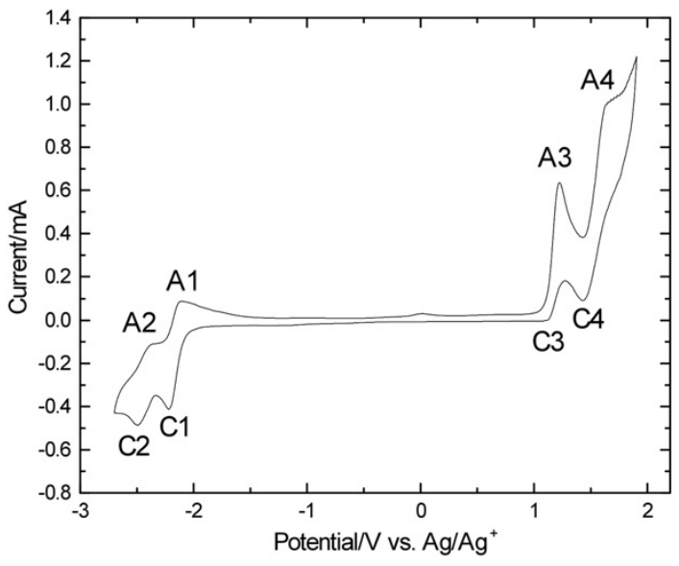
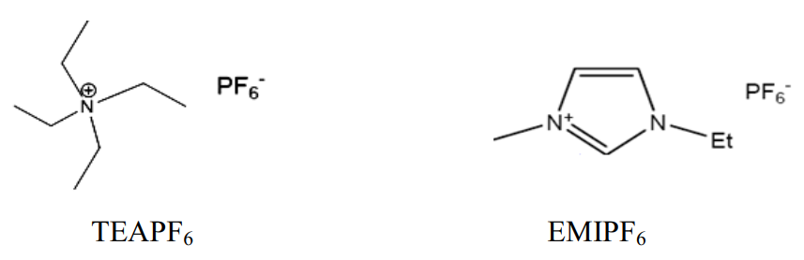
Design symmetric organometallic NARFBs
V(acac)₃ based NARFB
Cr(acac)₃ based NARFB
OCV: 2.2 V
OCV: 3.4 V
Optimization of the supporting electrolyte. (V(acac)₃ based NARFB)
Tetrabutylammonium hexafluorophosphate (TEAPF₆)
1-ethyl-3-methyl imidazolium hexafluorophosphate (EMIPF₆)
Electrochem. Commun., 2009, 11, 2312-2315.
Electrochem. Commun., 2010, 12, 1634-1637.
J. Power Sources, 2012, 203, 201-205.
Notes:
Design symmetric organometallic NARFBs based on acetylacetone (acac) ligands
In 2009, we, in collaboration with Professor Levi Thompson, reported a non-noble metal complex, vanadium acetylacetonate, as the active species in a NARFB So far, most of the ICM research articles used vanadium acetylacetonate as the active material
In 2010, we reported another single-metal RFB employing chromium(III) acetylacetonate as the active species and achieved a high cell voltage of 3.4 V
We were also the earliest group to discuss the effect of the supporting electrolyte on the performance of the NARFBs

Slide 13
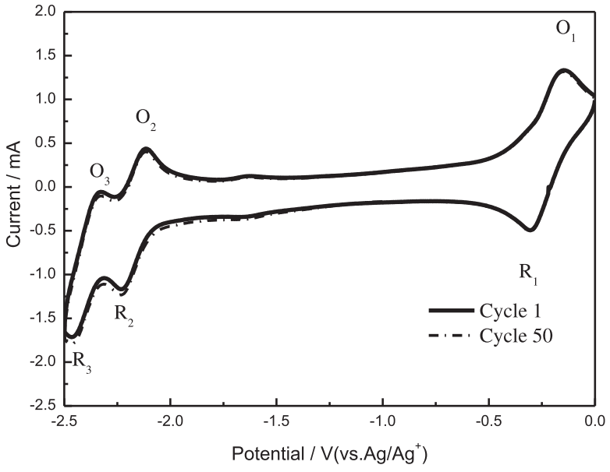
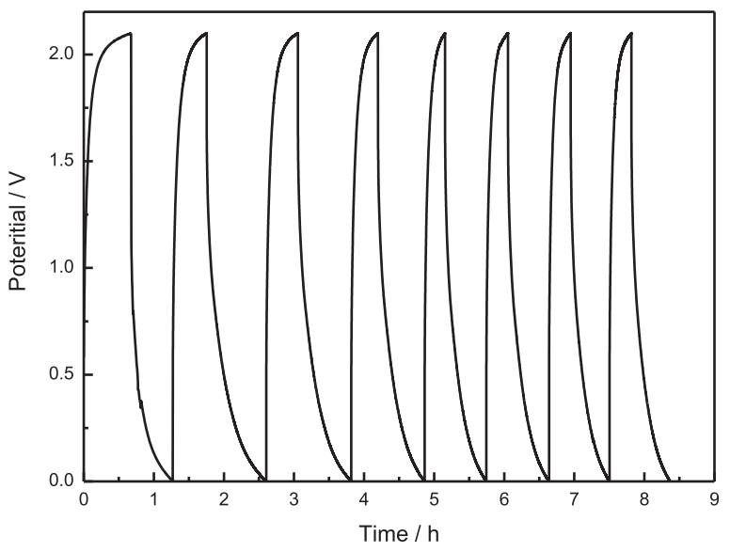
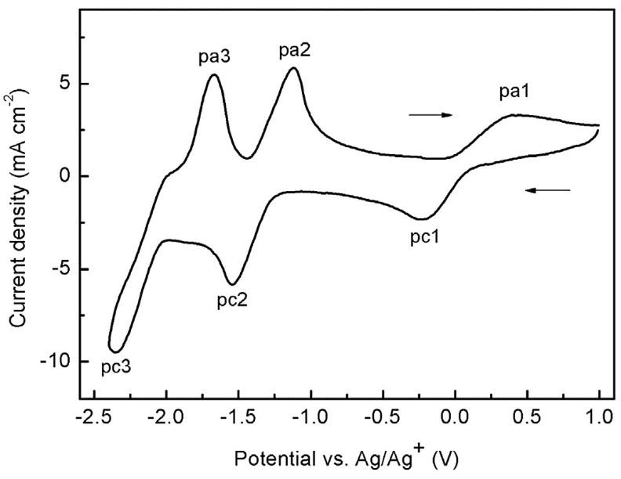
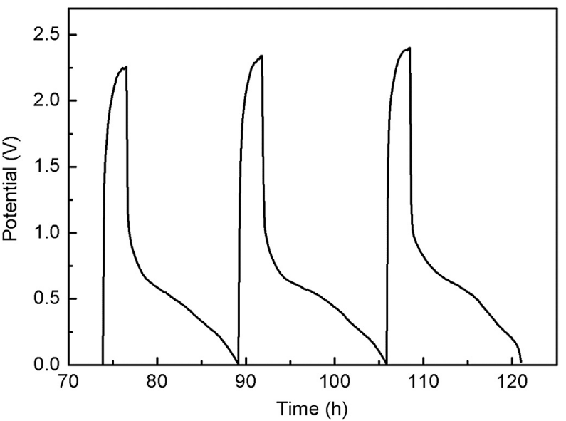
Design all-cobalt based NARFBs
Ligand: bis(acetylacetone)ethylenediamine (acacen)
Co(acacen) based NARFB
OCV：2.0 V
CE: 90.24%
Ligand: Phenanthroline (phen)
[Co(phen)₃](PF₆)₂ based NARFB
OCV：1.45 V
J. Power Sources. 2012, 217 ,199-203.
J. Power Sources, 2015, 279, 205-209.
Notes:
Based on previous research, we chosen cobalt at the metal center, synthesized two Co-based active materials and designed all-cobalt (Co) based NARFBs.
In 2012, we employed bis(acetylacetone)ethylenediamine cobalt(II) as the active species and obtained a high CE of 90.24% at that time

Slide 14
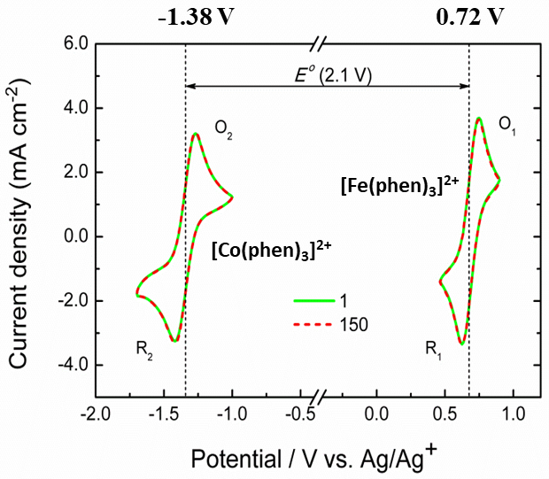
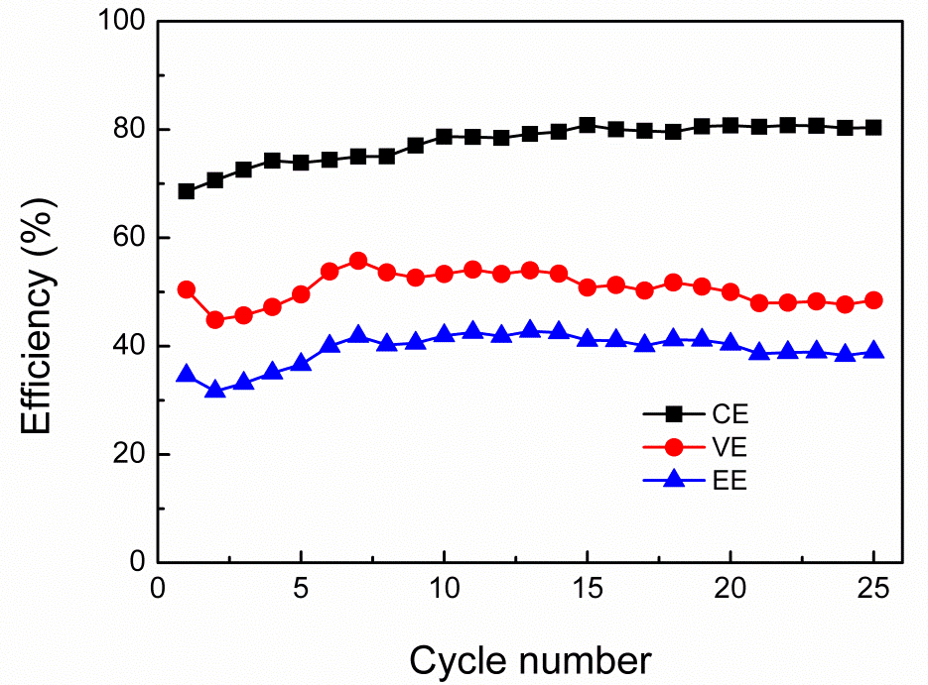
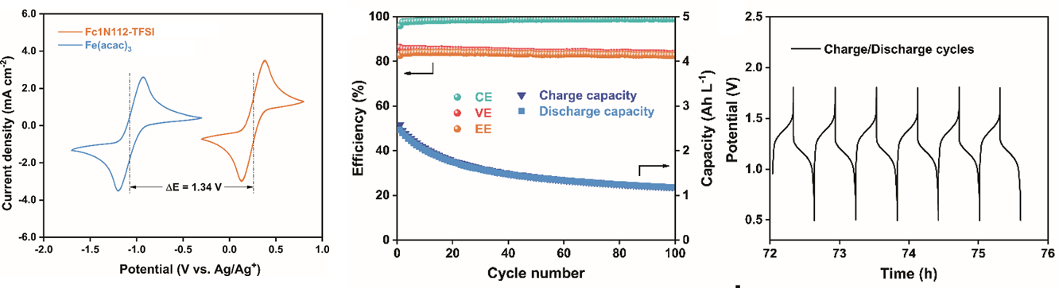
Design Iron based NARFBs
Design Fe/Co and all-iron based NARFBs
Positive: [Fe(phen)₃](PF₆)₂
Negative: [Co(phen)₃](PF₆)₂
OCV: 2.1 V
CE: 80% over 25 cycles
Positive:
Fc1N112-TFSI
Negative:
Fe(acac)₃
OCV：1.34 V
CE: 98.7% over 100 cycles
J. Power Sources, 2015, 293, 778-783.
J. Power Sources, 2020, 445, 227331.
Notes:
We reported the cobalt and iron complexes as active species afterwards. We designed Fe/Co NARFB with the same ligand (Phenanthroline), and also designed an all-iron metal center based unsymmetric NARFB.

Slide 15
Content
Background
Our recent work on active materials
Organometallic compounds
Organic metal-free compounds
Our recent work on membrane
Summary

Slide 16
Organic metal-free compounds
Organometallic active materials
organic active materials
Challenge
Advantages
Limited resources
Low solubility
Decomposition of the ligand
Scalability
Abundant resources
Potentially low cost
Efficient biodegradability
high solubility
high chemical stability
sufficiently separated redox potentials
Ideal active materials

Slide 17
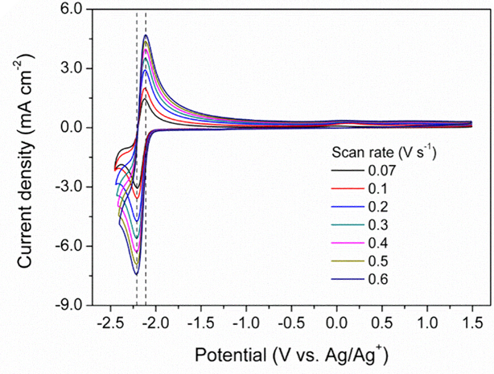
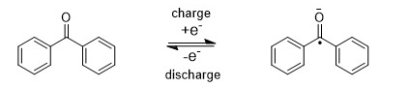
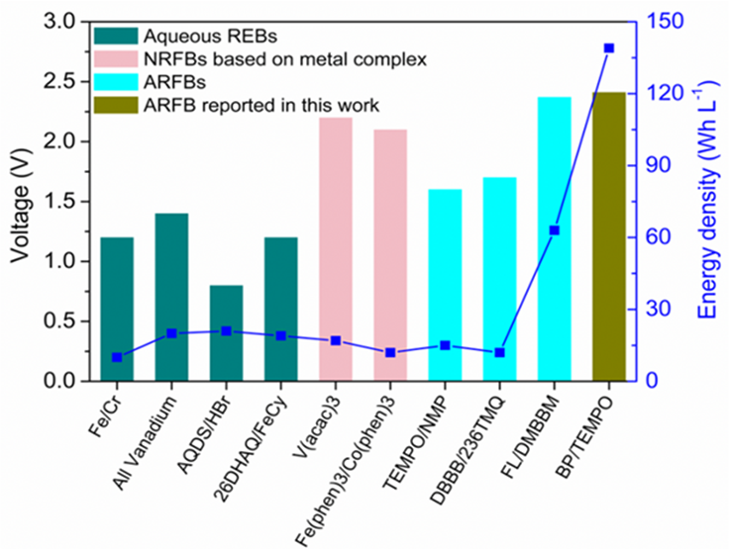
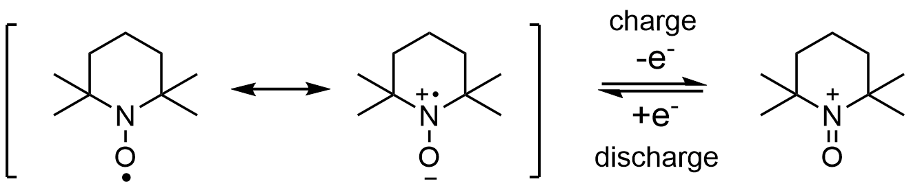
Benzophenone
Benzophenone (BP)
Potential：-2.16 V
Solubility: 4.3 M
Design BP/TEMPO based NARFB
Potential：0.25 V
solubility: 6.1M
OCV: 2.41 V. Theoretical energy density: 139 Wh L⁻¹
Int. J. Hydrogen Energy, 2017, 42, 17488-17494.
Notes:
We greatly improved a promising organic anodic redox-active species, benzophenone, which owns small molecular weight and very minus electrochemical potential -2.16 V
We employ TEMPO as the positive active material. Owing to the high solubility of the active materials and the high open circuit voltage of the battery, this system exhibits a high energy density as 139 Wh L⁻¹

Slide 18
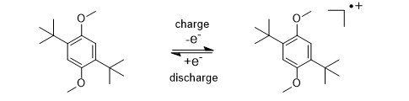
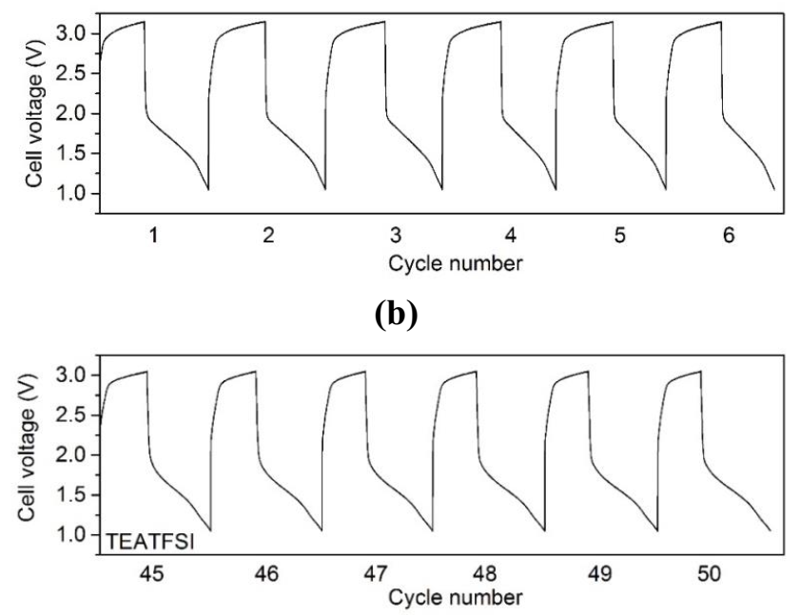
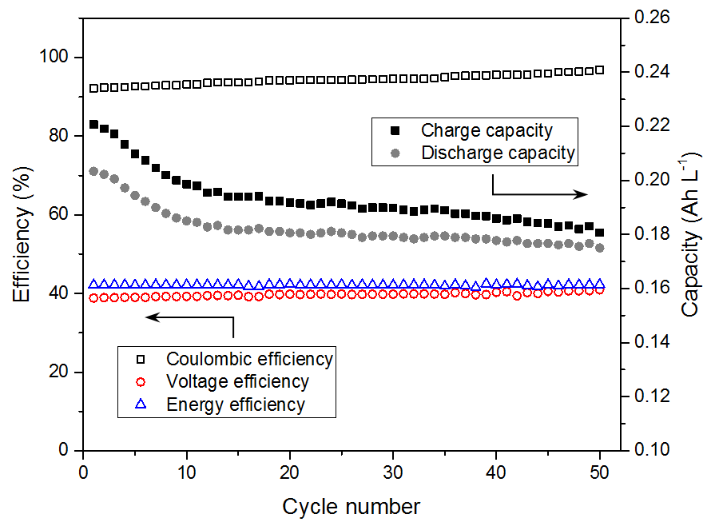
Design BP based NARFB
Negative (BP)
Positive (DBB)
International Journal of Electrochemical Science, 2018, 13, 6676-6683.
Notes:
Based on the above research, we designed a flow battery based on BP and DBB to further improve the battery performance. In addition, we screened the supporting electrolyte and found that when TEATFSI is used as the supporting electrolyte, the battery charge and discharge performance is the best. It shows that TEATFSI has the best compatibility with this system.
Considering that the battery voltage can be further optimized by modifying the active material, we studied the influence of different substituents on the battery voltage and charge and discharge performance. We Introduced the electron-donating functional groups methyl and methoxy groups into the BP structure, the redox potential of BP moves negatively, which effectively increases the open circuit voltage of the battery.

Slide 19
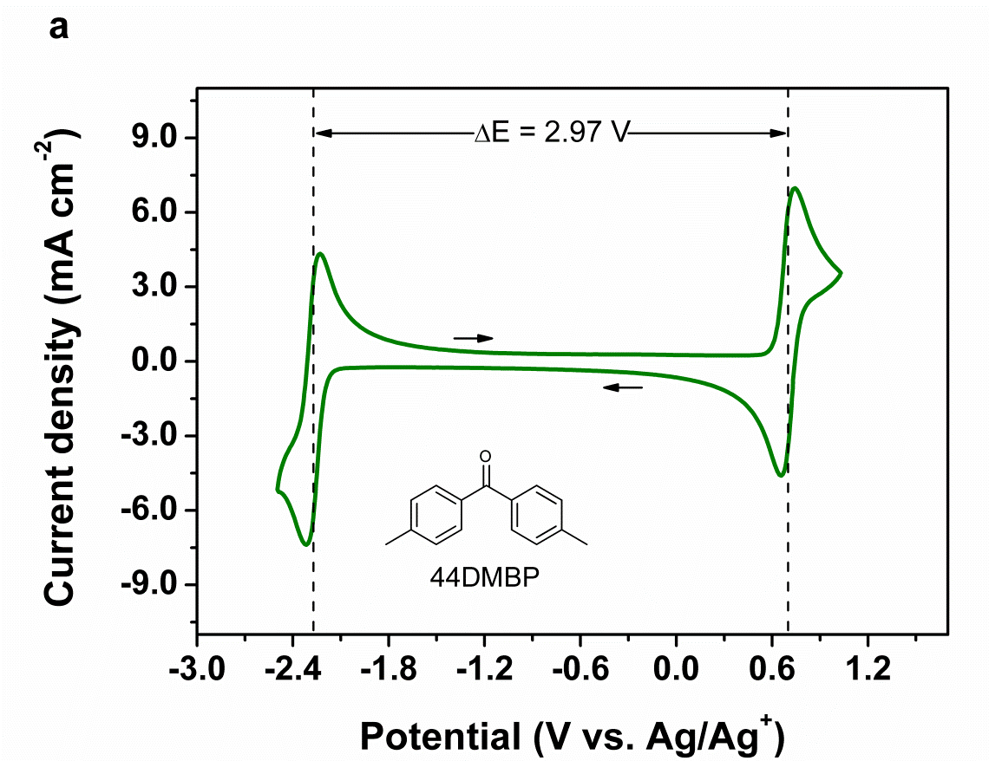
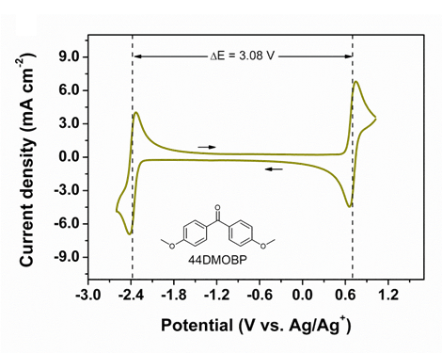
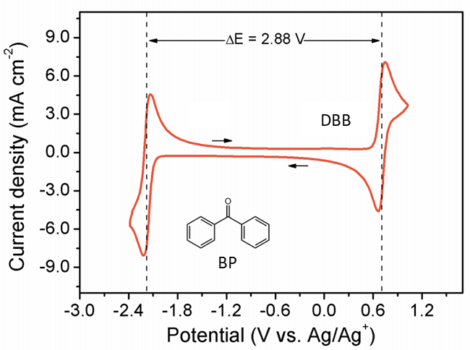
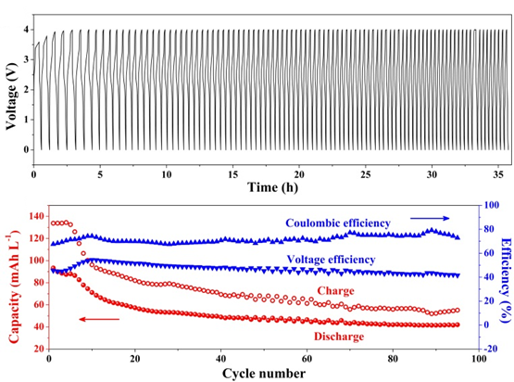
Design BP based NARFB
BP/DBB
DMBP/DBB
DMOBP/DBB
DMOBP/DBB in TEAPF₆/MeCN
CE: 72%, (95 cycles at J of 1 mA cm⁻²)
RSC Adv. 2019, 9, 13128-13132

Slide 20
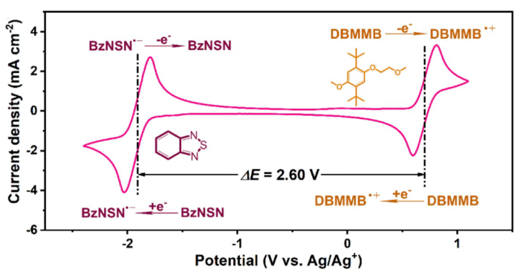
Enhance BzNSN/DBMMB based NARFBs
Positive:
2,5-di-tert-butyl-1-methoxy-4-[2’- methoxyethoxy]benzene (DBMMB)
Negative:
2,1,3-benzothiadiazole (BzNSN)
OCV: 2.6 V
Supporting electrolyte: TEATFSI
Solvent: MeCN
J. Power Sources. 2019, 443, 227283.
Notes:
Considering that the membrane and supporting electrolyte play an important role in the performance of the battery, we tried to improve the performance of the BzNSN/DBMMB based battery by screening the membrane and supporting electrolyte. The TEATFSI and commercial Daramic 250 porous separator were experimentally proved to have good compatibility with the system, and they show high compatibility with the active materials and low area specific resistance, respectively, which contribute to the enhanced performance of the resultant NARFB.
The improved performance of the present NARFB can be attributed to two factors. Such a low resistance renders high efficiency even at high current density
Compared with Li⁺, the weaker ion pairing of TEA⁺ in TEATFSI with BzNSN⋅⁻ has little impact on the stability of radical anions, leading to improved cycling stability

Slide 21
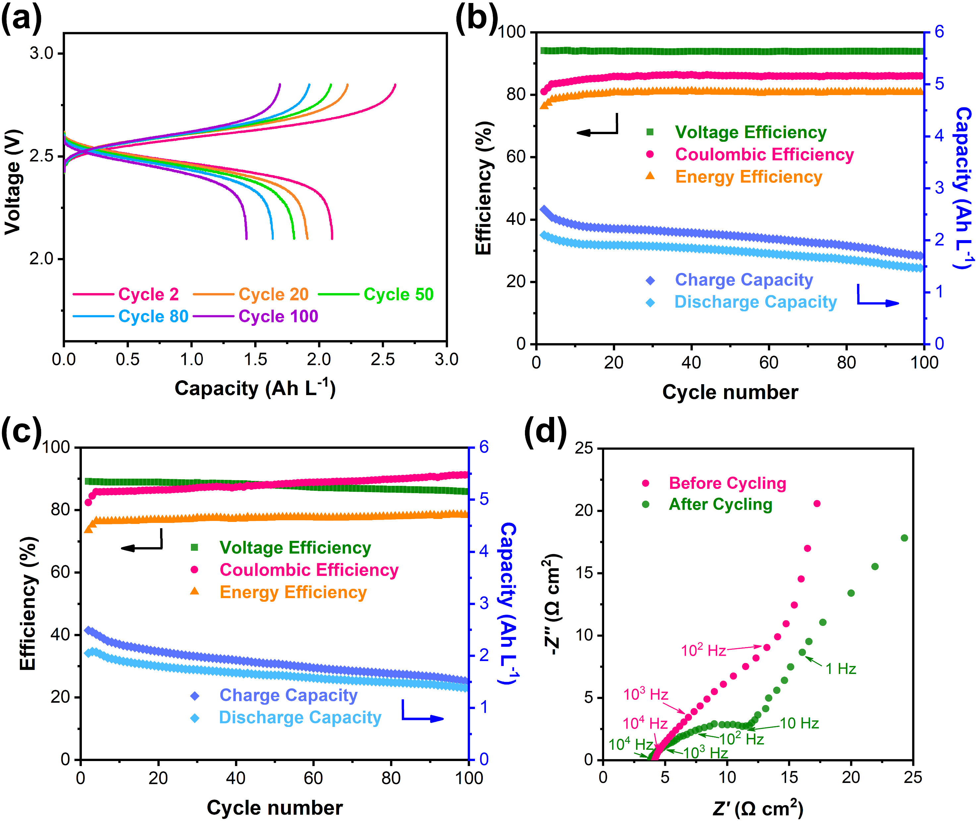
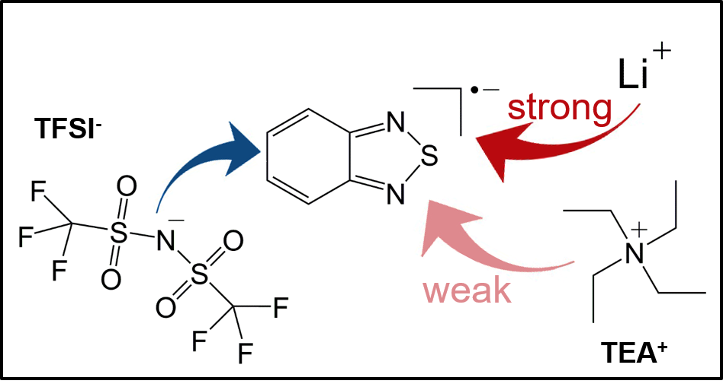
Enhance BzNSN/DBMMB based NARFBs
Membrane: Daramic AA-250
High compatibility with BzNSN/DBMMB system
CE: 89.1%, EE: 78.3% (100 cycles at J of 40 mA cm⁻²)
J. Power Sources. 2019, 443, 227283.
Notes:
Considering that the membrane and supporting electrolyte play an important role in the performance of the battery, we tried to improve the performance of the BzNSN/DBMMB based battery by screening the membrane and supporting electrolyte. The TEATFSI and commercial Daramic 250 porous separator were experimentally proved to have good compatibility with the system, and they show high compatibility with the active materials and low area specific resistance, respectively, which contribute to the enhanced performance of the resultant NARFB.
The improved performance of the present NARFB can be attributed to two factors. Such a low resistance renders high efficiency even at high current density
Compared with Li⁺, the weaker ion pairing of TEA⁺ in TEATFSI with BzNSN⋅⁻ has little impact on the stability of radical anions, leading to improved cycling stability

Slide 22
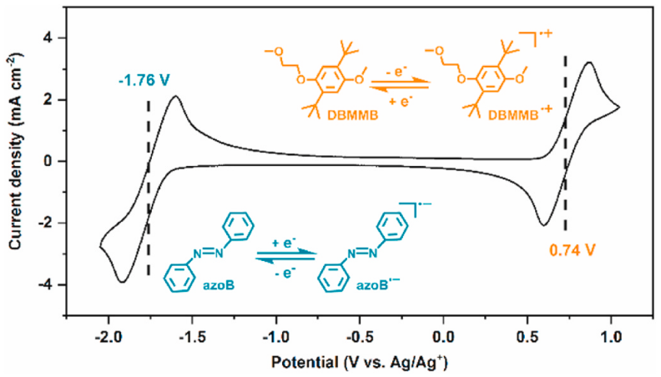
Enhance azoB/DBMMB based NARFBs
Positive: DBMMB
Negative: Azobenzene (azoB)
OCV: 2.2 V
Supporting electrolyte: TEATFSI
Solvent: MeCN
J. Power Sources. 495 (2021) 229819.
Notes:
Considering that the solvent also play an important role in the performance of the battery, we also enhanced the performance of azoB/DBMMB based NARFB by using MeCN as solvent and TEATFSI as supporting electrolyte. Thanks to the high conductivity of the electrolyte system and the excellent kinetic rate of the active materials, the battery shows excellent rate performance and high power density.

Slide 23
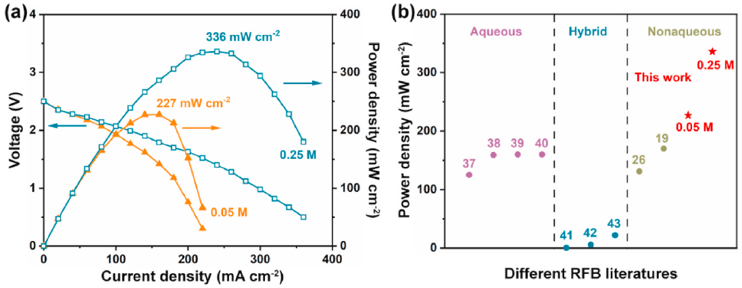
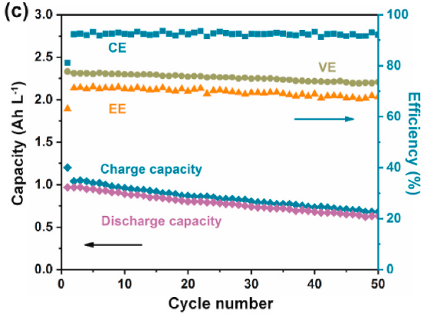
Enhance azoB/DBMMB based NARFBs
High compatibility with azoB/DBMMB system
Power density:
336 mW cm⁻² at J of 240 mA cm⁻²
CE: 92.3%, EE: 69.5%
(50 cycles at J of 80 mA cm⁻²)
J. Power Sources. 495 (2021) 229819.
Notes:
Considering that the solvent also play an important role in the performance of the battery, we also enhanced the performance of azoB/DBMMB based NARFB by using MeCN as solvent and TEATFSI as supporting electrolyte. Thanks to the high conductivity of the electrolyte system and the excellent kinetic rate of the active materials, the battery shows excellent rate performance and high power density.

Slide 24
3-NT/DBMMB based NARFBs
Positive: DBMMB
Negative: nitrobenzene (NB)/2-nitrotoluene (2-NT)/3-nitrotoluene (3-NT)
/4-nitrotoluene (4-NT)
ACS Appl. Mater. Interfaces 2021, 13, 35579–35584
Notes:
To study the substituent effect, methyl group is added at the pro/meta/para position to generate 2-NT/3-NT/4-NT. All of them exhibit high solubility and fast mass- and charge-transfer kinetics. Coupled with DBMMB of high miscibility as the catholyte active material, the resultant NARFBs exhibit high-rate capability, volumetric energy density, and good cycling performance.

Slide 25
3-NT/DBMMB based NARFBs
Capacity Retention:
3-NT (83.6%)>NB (66.1%) >4-NT (44.0%)
CE: 93.7%, EE: 71.8%
(0.1M, 50 cycles at J of 60 mA cm⁻²)
ACS Appl. Mater. Interfaces 2021, 13, 35579–35584
Notes:
To assess the robustness, three ionic BROMs were subjected to cycling test in flow cells with Daramic-250 as the porous separator. there is an enormously rapid capacity decay when 2-NT is utilized as the anode material. In sharp contrast, the utilization of 3-NT leads to obvious improvement in cycling stability, 83.6% capacity retention after 50 cycles compared with 66.1% for NB and 44.0% for 4-NT. The 2-NT•- radical anion shows a higher value than NB•- and thus is more prone to nucleophilic reactions whereas 3-NT•- is the opposite. The major decayed species can be isolated and identified to be azo-dimer by 1H NMR and GC-MS analysis.

Slide 26
Design symmetric NARFBs
Design Ferrocene/anthraquinone based bi-redox molecule （FcMeAAQ）
Synthsis route：
Electrode reaction：
J. Power Sources. 480 (2020) 229132.
Notes:
The crossover of anolyte and catholyte during cycling places a serious obstacle for the performance of nonaqueous redox flow batteries (NARFBs). Employing symmetric RFB is an effective strategy to alleviate this issue. A new bi-redox material, 1-(ferrocenylmethyl-amino)-anthraquinone (FcMeAAQ) composed of ferrocene and anthraquinone two moieties, is designed for symmetrical NARFB. Both experimental and density functional theory calculational results show the relatively good stability of FcMeAAQ

Slide 27
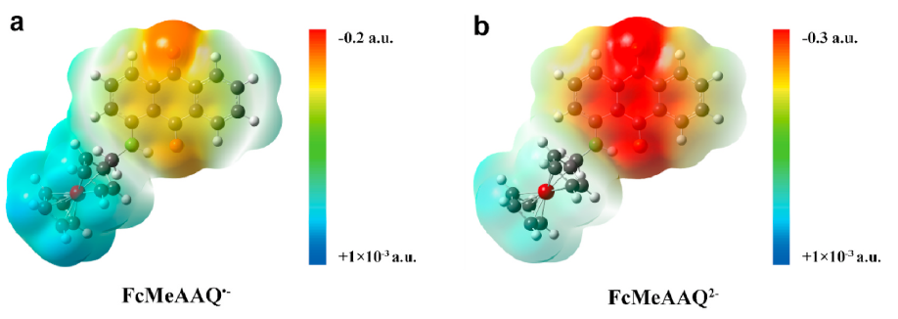
Design symmetric NARFBs
CV of electrolyte
one-electron redox reaction
two-electron redox reaction
One-electron redox reaction OCV: 1.42 V
Two-electron redox reaction OCV: 2.06 V
Good stability of FcMeAAQ when one-electron redox reaction is involved.
J. Power Sources. 480 (2020) 229132.
Notes:
The crossover of anolyte and catholyte during cycling places a serious obstacle for the performance of nonaqueous redox flow batteries (NARFBs). Employing symmetric RFB is an effective strategy to alleviate this issue. A new bi-redox material, 1-(ferrocenylmethyl-amino)-anthraquinone (FcMeAAQ) composed of ferrocene and anthraquinone two moieties, is designed for symmetrical NARFB.

Slide 28
Design symmetric NARFBs
CE: 90.8%, EE: 81.8% (100 cycles at J of 2 mA cm⁻²)
J. Power Sources. 480 (2020) 229132.

Slide 29
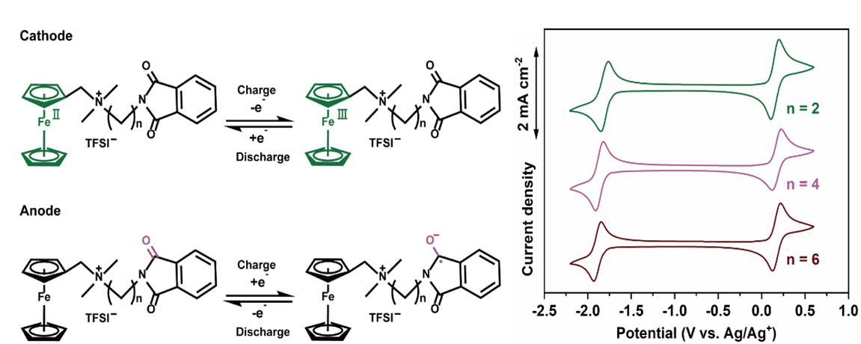
Design symmetric NARFBs
Design Ferrocene/Phthalimide Ionic bi-redox molecule
Synthsis route：
Electrode reaction：
ACS Appl. Energy Mater. 2021, doi: 10.1021/acsaem.1c01362
Notes:
A series of ionic BROMs based on ferrocene (Fc) and phthalimide (Ph) moieties with fast mass and charge-transfer kinetic are synthesized, which show high solubility and ionic conductivity. The assembled symmetric NARFB shows an open circuit voltage of 2.04 V, cycling capacity retention of 99.8% per cycle and energy efficiency of 77.0% over 50 cycles at 20 mA cm-2. Furthermore, the battery yields a peak power density of 110 mW cm-2 at 90 mA cm-2, which outperforms most NARFBs. This work demonstrates a promising molecular engineering strategy to improve the cycling stability of BROMs and to enable the high-current operation of symmetric NARFB.

Slide 30

Design symmetric NARFBs
Design Ferrocene/Phthalimide Ionic bi-redox molecule
Power density:
110 mW cm⁻² at J of 90 mA cm⁻²
CE: 94.6%, EE: 77.0%
(50 cycles at J of 20 mA cm⁻²)
ACS Appl. Energy Mater. 2021, doi: 10.1021/acsaem.1c01362
Notes:
A series of ionic BROMs based on ferrocene (Fc) and phthalimide (Ph) moieties with fast mass and charge-transfer kinetic are synthesized, which show high solubility and ionic conductivity. The assembled symmetric NARFB shows an open circuit voltage of 2.04 V, cycling capacity retention of 99.8% per cycle and energy efficiency of 77.0% over 50 cycles at 20 mA cm-2. Furthermore, the battery yields a peak power density of 110 mW cm-2 at 90 mA cm-2, which outperforms most NARFBs. This work demonstrates a promising molecular engineering strategy to improve the cycling stability of BROMs and to enable the high-current operation of symmetric NARFB.

Slide 31
Content
Background
Our recent work on active materials
Our recent work on membrane
2D materials modified membrane
Summary

Slide 32
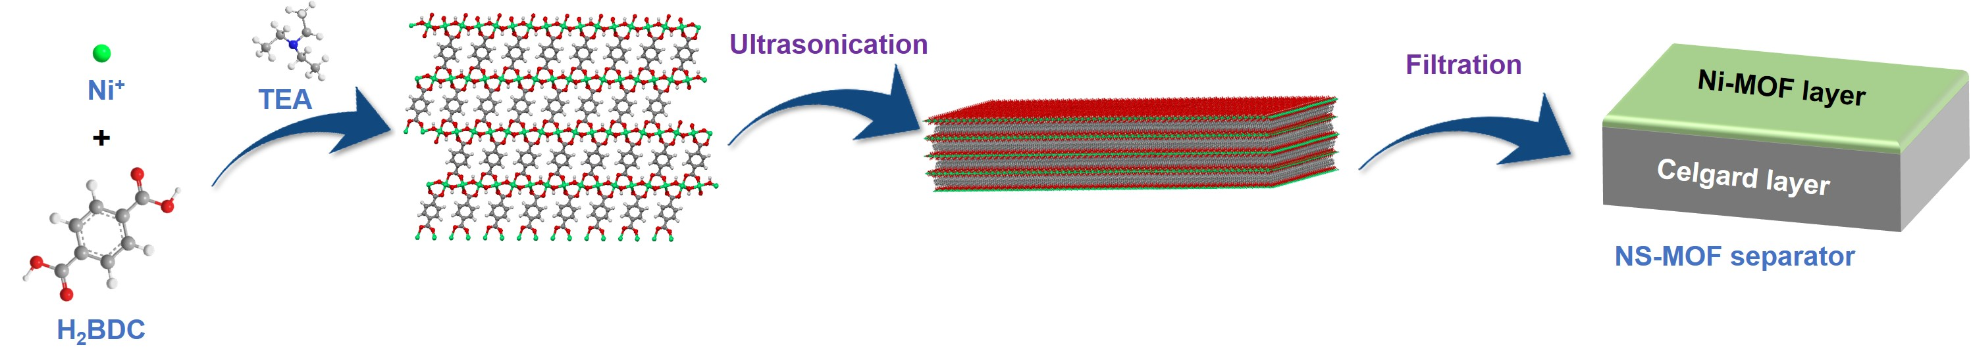
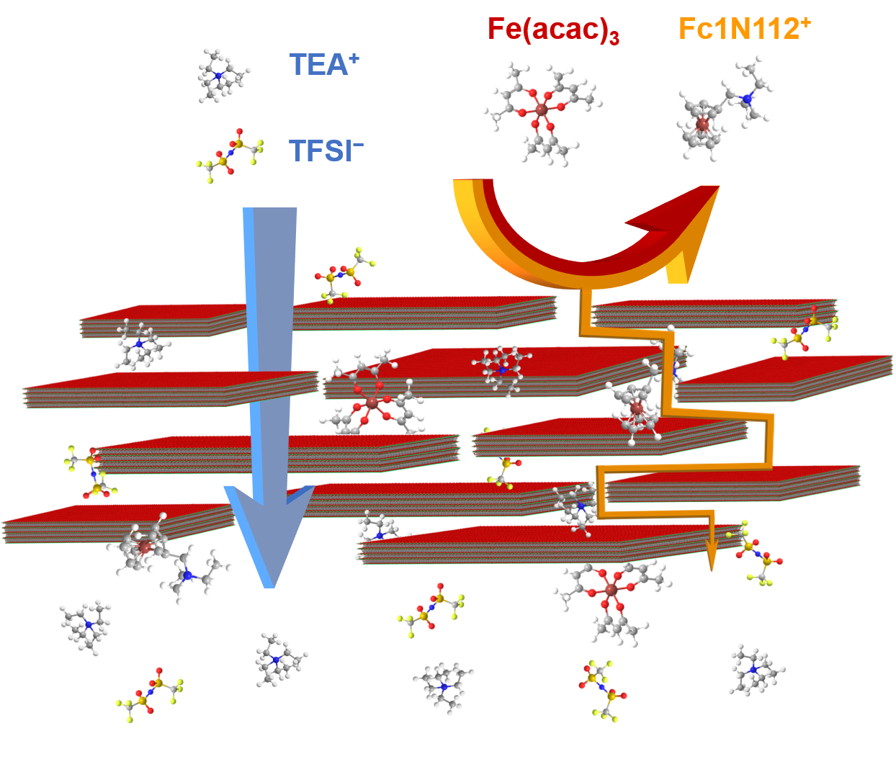
2D MOF modified membrane
Fabrication route：
Most active species are blocked by the MOF layer.
Supporting electrolyte ion can pass through the interlayer spaces formed by the nanosheets assembling and the intracrystalline MOF pores
J. Membr. Sci. 2020, 612, 118463.
Notes:
Metal-organic frameworks (MOFs), self-assembled by inorganic metal center and organic ligands, possess regular structural micropores and high porosity, which have been widely applied in gas storage and separation. Compared to the 0D nanoparticles, two-dimensional (2D) MOF nanosheets are expected to afford faster ion transfer and provide higher ion conductivity due to their ultrathin thickness and high surface area. The 2D MOF nanosheets can be self-assembled layer-by-layer to form highly integrated selective composite film. The guest species are able to permeate through the 2D layered MOF membranes and realize the molecular sieving via either pores within MOF nanosheets or interlayer passages among nanosheets.

Slide 33
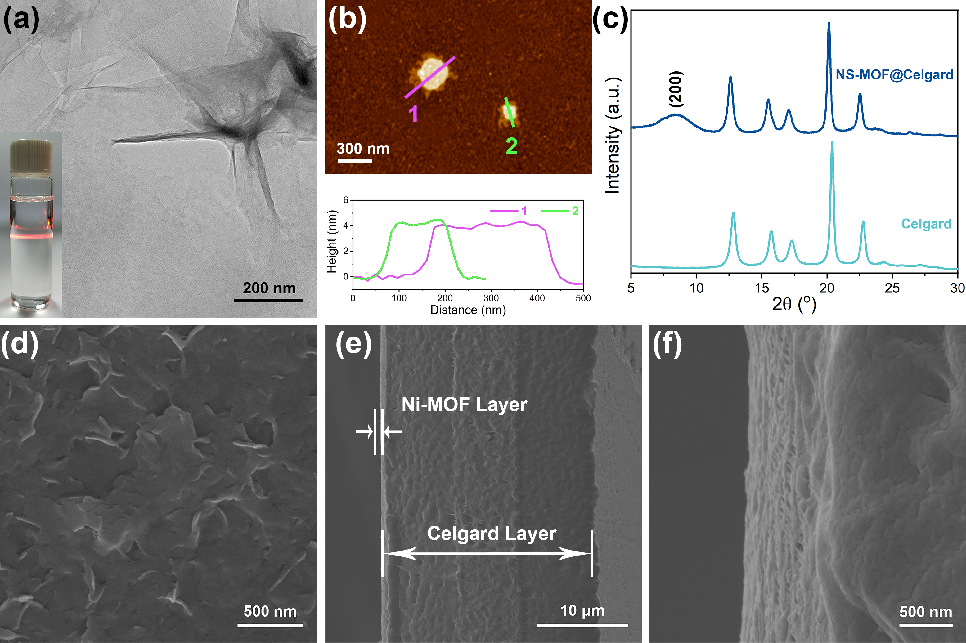
2D MOF modified membrane
Characterizations
The thickness of most nanosheets is ca. 4 nm.
Almost no cracks around the surface and lamellar microstructure.
Notes:
The thickness of most nanosheets is ~4 nm as revealed by the AFM image. The diffraction peak at 8.4 o is assigned to the (200) of Ni-MOF. The MOF layer is closely assembled by the 2D nanosheets, without cracks at the surface as evidenced by the SEM results. Lamellar microstructure is observed in the cross-section SEM images (Fig. 2e and f) and the thickness of the Ni-MOF nanosheet assembled layer is ~500 nm.

Slide 34
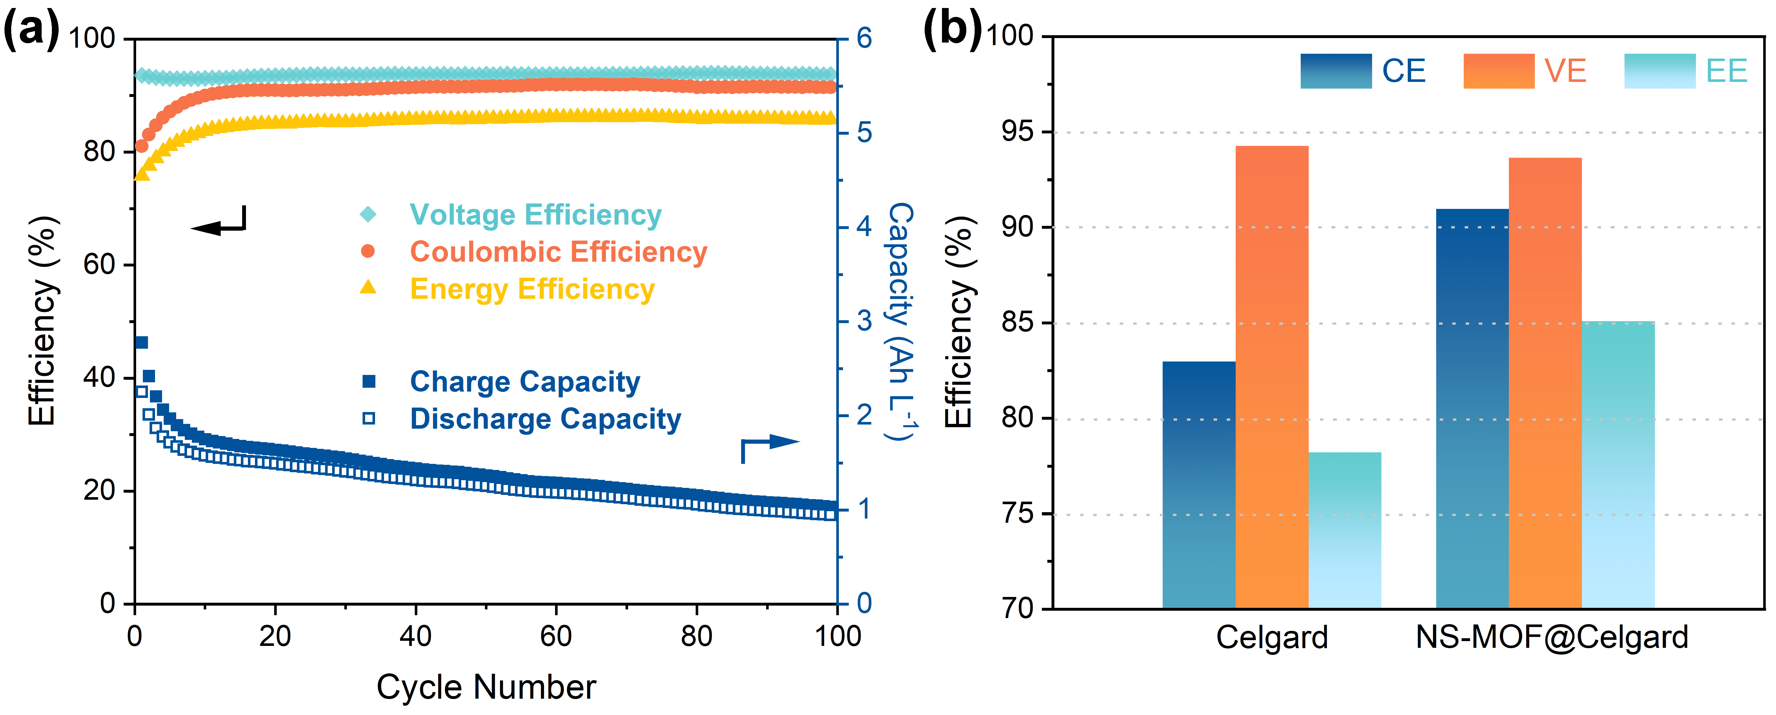
2D MOF modified membrane
Battery performance
(c)
(d)
The flow cell assembled with NS-MOF@Celgard separator delivers high CE (91.0%), EE (85.1%) and discharge capacity (1.30 Ah L⁻¹) compared with the pristine Celgard separator (82.9%, 78.2%) without expense of VE.
Notes:
To evaluate the long-term cycling performance, flow cells were tested at j = 4 mA cm−2 for 100 cycles. The NARFB with the NS-MOF@Celgard separator shows more stable cycling performance and higher capacity retention than the cells with the Celgard separator. CE improves significantly, indicating that crossover is mitigated, which is in consistent with the penetration results. The flow cell assembled with NS-MOF@Celgard separator delivers high CE (91.0%), EE (85.1%) and discharge capacity (1.30 Ah L−1) compared with the pristine Celgard separator (82.9%, 78.2%) without expense of VE at j = 4 mA cm−2. This work provides a facile yet efficient strategy to alleviating the crossover effect in NARFB.

Slide 35
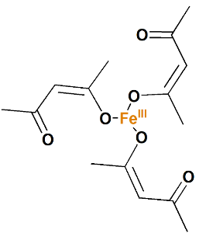
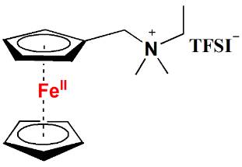
2D vermiculite modified membrane
Li-vermiculite
Vermiculite layer
TEA⁺
Characteristics of vermiculite
Ion exchange capacity
Adjustable layer spacing
Excellent chemical stability
Low cost
Interlaminar channels improve screening performance
Surface charge accelerates electrolyte diffusion
J. Power Sources 2021, 500, 229987.
Notes:
Vermiculite is a kind of clay layered silicate mineral, which is composed of silicon-based tetrahedral sheet and magnesium based octahedral sheet in the ratio of 2:1. Therefore, it presents the characteristics of sandwich structure. It has the characteristics of low price and good chemical stability. Due to the weak interlayer force, the nanosheets can be peeled out by simple physical or chemical methods. In addition, in the process of vermiculite formation, trivalent aluminum ions will replace part of the Si ions in the SiO2 tetrahedron and produce negative charges, which leads to the electronegativity of vermiculite. In order to achieve the electrical neutrality of vermiculite, some cations are often adsorbed in the interlayer. Therefore, vermiculite has excellent ion exchange capacity. In addition, the interlayer spacing can be adjusted by exchanging different kinds of cations. When vermiculite is loaded on the commercial membrane, molecules of different sizes can be screened through the layered pores stacked on the nanosheets, which helps to prevent cross over of active materials. The surface charge of vermiculite nanosheets is helpful to the diffusion of electrolyte ions.

Slide 36
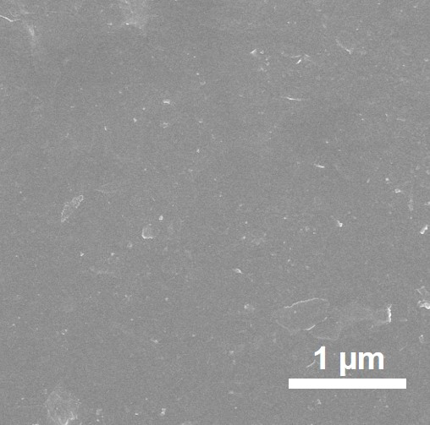
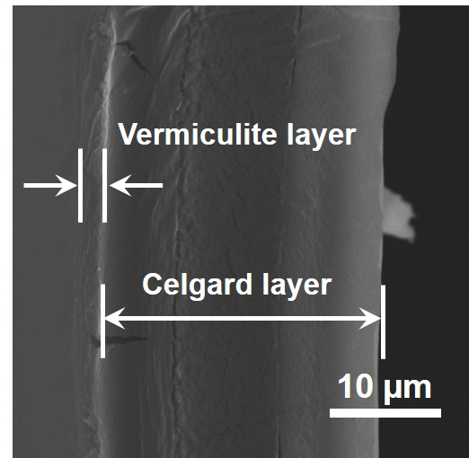
2D vermiculite modified membrane
Exfoliated vermiculite nanosheets: 350 nm
The surface of the modified membrane
The cross section of the modified membrane: 1 micron
Notes:
The length of the nanosheets is about 350 nm and the thickness is about 2 nm. A layer of vermiculite nanosheets was assembled on the surface of Celagard commercial membrane by filtration method. It can be found from figure a that the surface of the modified membrane is flat without obvious holes. It can be seen from the cross section of the modified film that the thickness of the assembled layer is about 1 micron. The smaller the thickness of the nanosheets can reduce the increase of the internal resistance. A layer of vermiculite nanoflakes on the surface can significantly improve the selectivity of the membrane. .The high selectivity of the modified membrane is mainly due to the 1.4 nm interlayer pores in the vermiculite layer. Compared with 30 nm mesoporous of Celgard, the interlayer pore of vermiculite has better barrier effect on active materials.

Slide 37
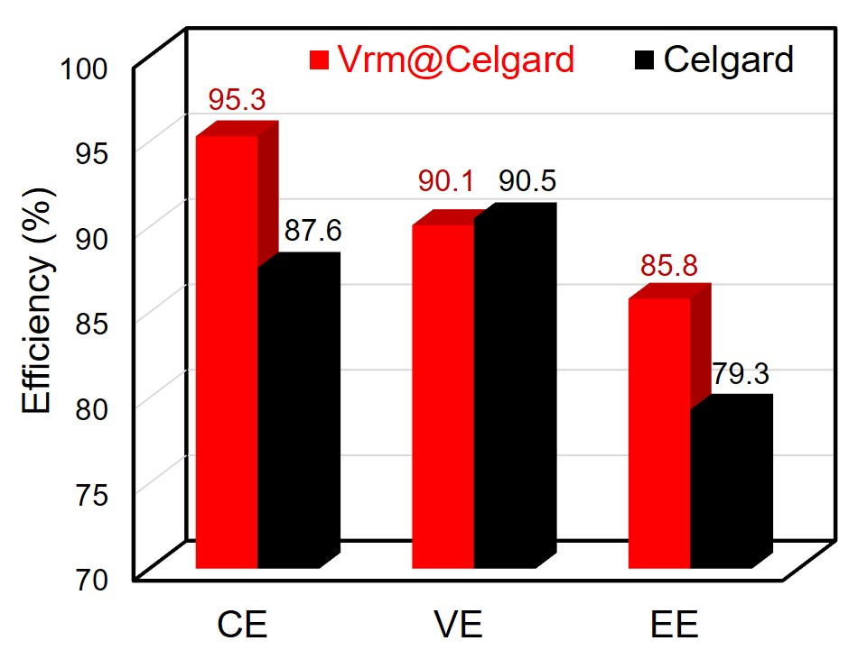
2D vermiculite modified membrane
Battery performance
The vermiculite nanosheets are effective in preventing cross effects and improve CE without significant expense of VE.
Notes:
in the battery test, the membrane modified by vermiculite nanosheets showed better electrochemical performance.
Compared with Celgard, after 100 cycles, the average coulombic efficiency of the modified membrane increased from 87.6% to 95.3%, increased by about 8%, and CE reached 99.0% after 100 cycles. Although an additional layer of vermiculite nanosheets was added to the surface of commercial membrane, the modified membrane had no significant negative effect on VE (90.1% vs 90.5%). Considering the significant increase of CE, EE also increased significantly (85.8% vs 79.3%). In addition, a hundred cycles Vrm@Celgard The average discharge capacity of Celgard (0.104 AHL − 1) is 11.8% higher than that of Celgard (0.093 AHL − 1). This shows that the vermiculite nanosheets are effective in preventing cross effects.

Slide 38
Content
Background
Our recent work on active materials
Our recent work on membrane
Summary

Slide 39
Summary
The potential and solubility of the active materials can be improved by molecular modification
Designing bi-redox materials can mitigate the crossover of the electrolyte.
Modifying membrane by 2D materials can enhance the ion selectivity of the membranes without expense of resistance.

Slide 40
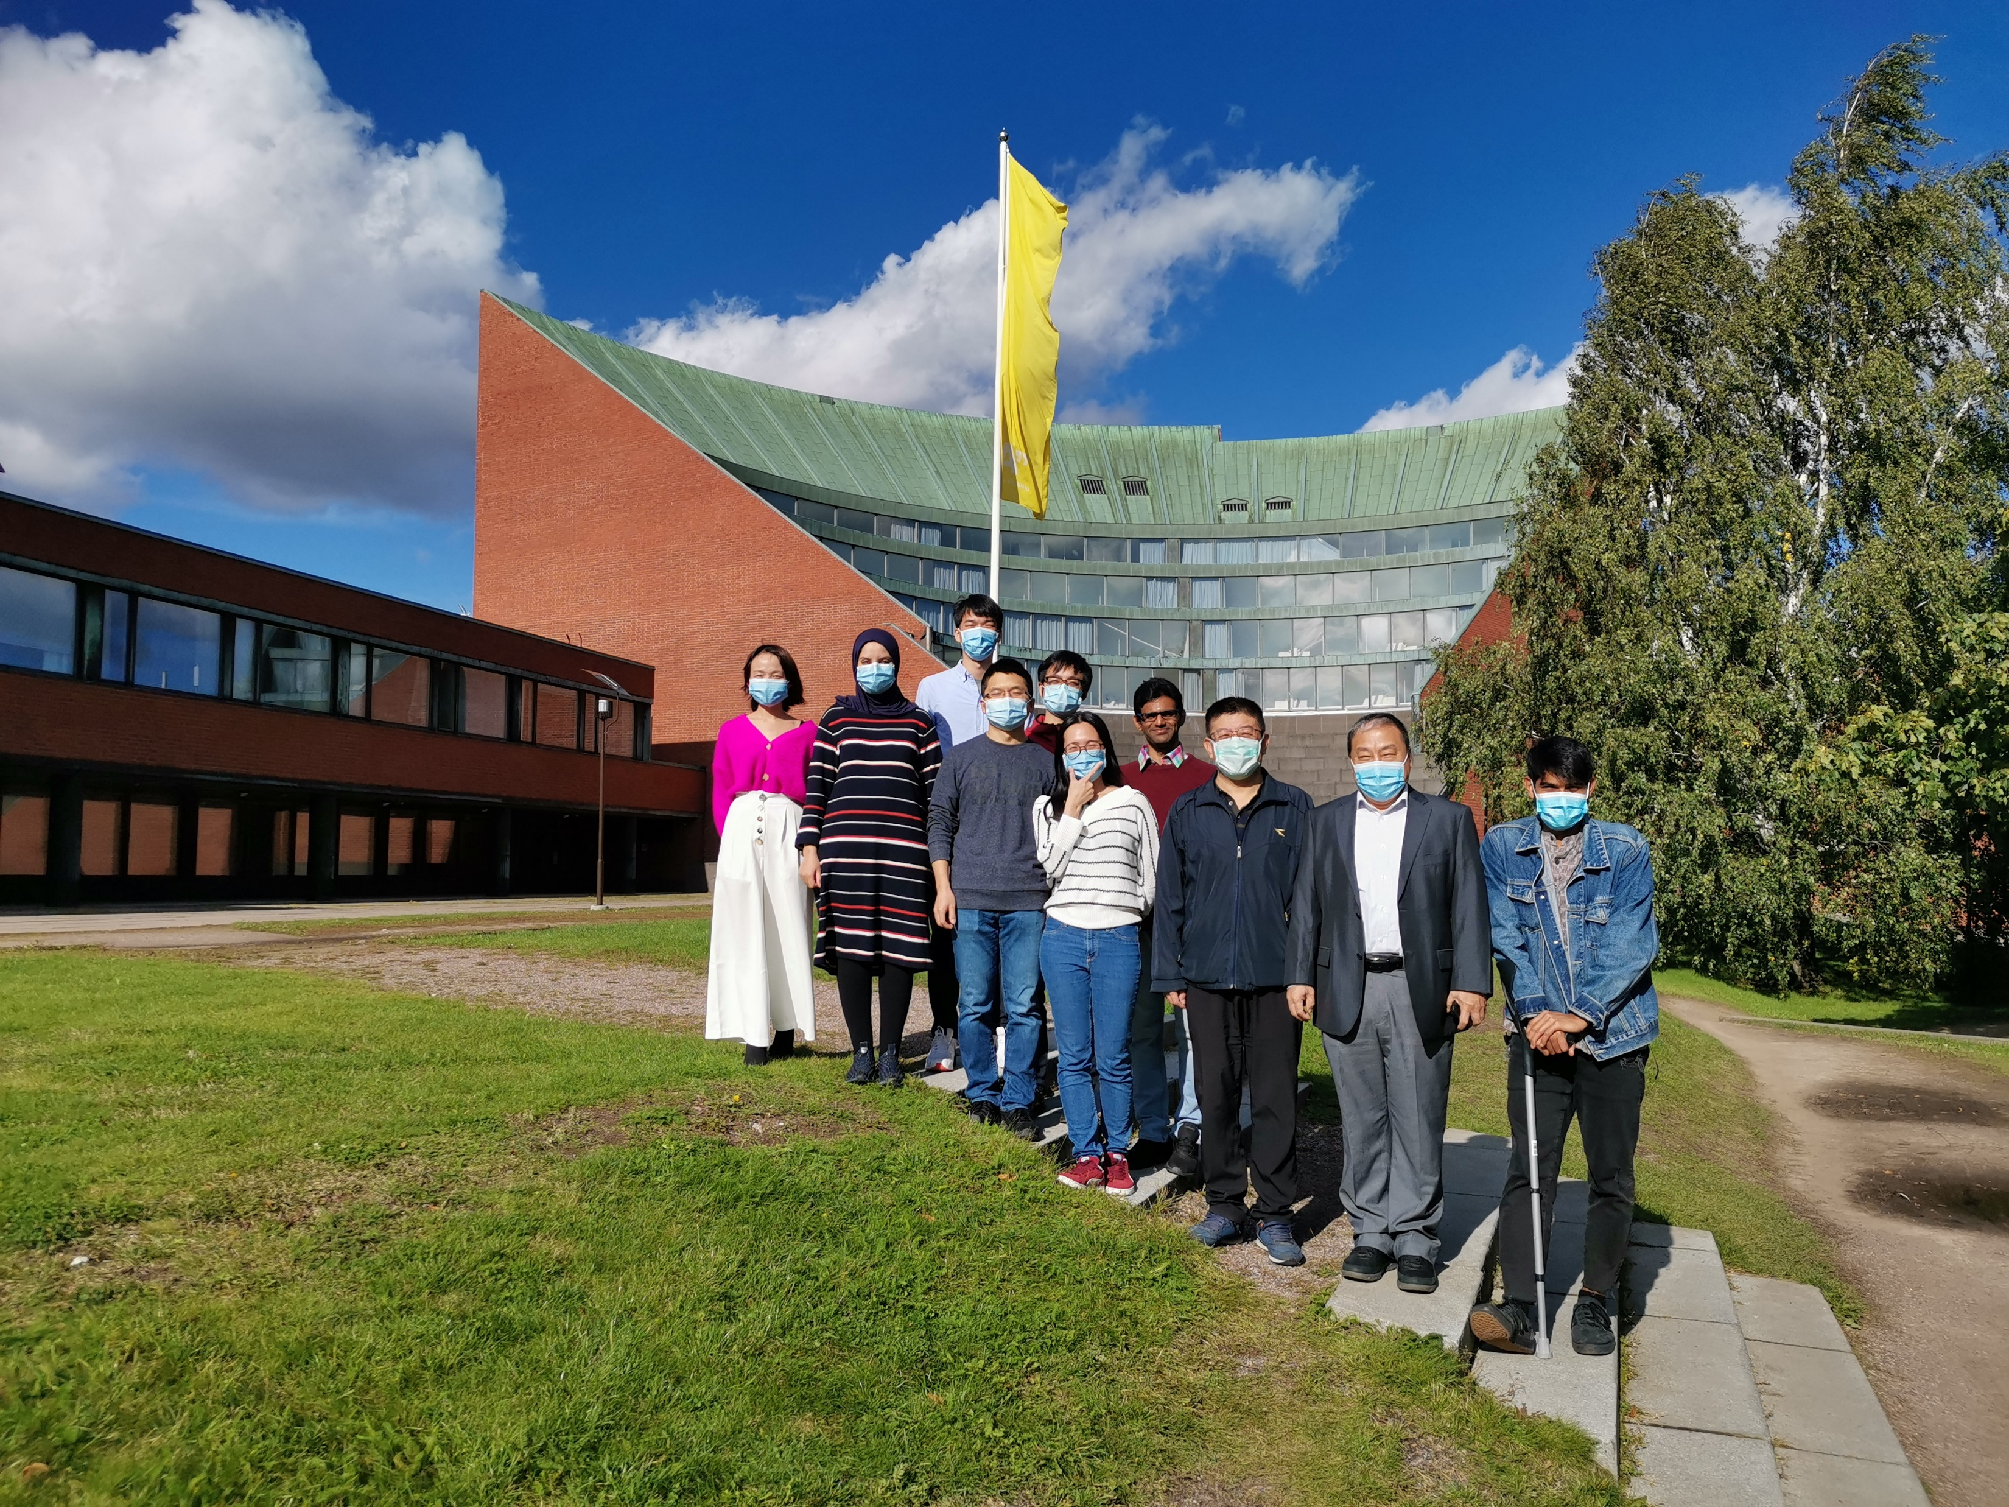
Thanks for your attention!

